Slide 2
Table of Contents
Introduction to the course.
Off-Grid Fundamentals.
Off-Grid components.
Off-Grid design/Sizing and component connections.

Slide 3
Introduction to the course
1.All fundamentals of off grid system.
-What is a stand alone system?
-How does it work?
-Applications in the real world
2.Introduction to the Off-grid world.
-Solar energy production curve.
-Energy consumption curve.
-Battery Charge and discharge current.
-Peak sun hour.
-Power & units
3.Component of Off-grid system.
-Inverter
-Battery
-PV Modules

Slide 4
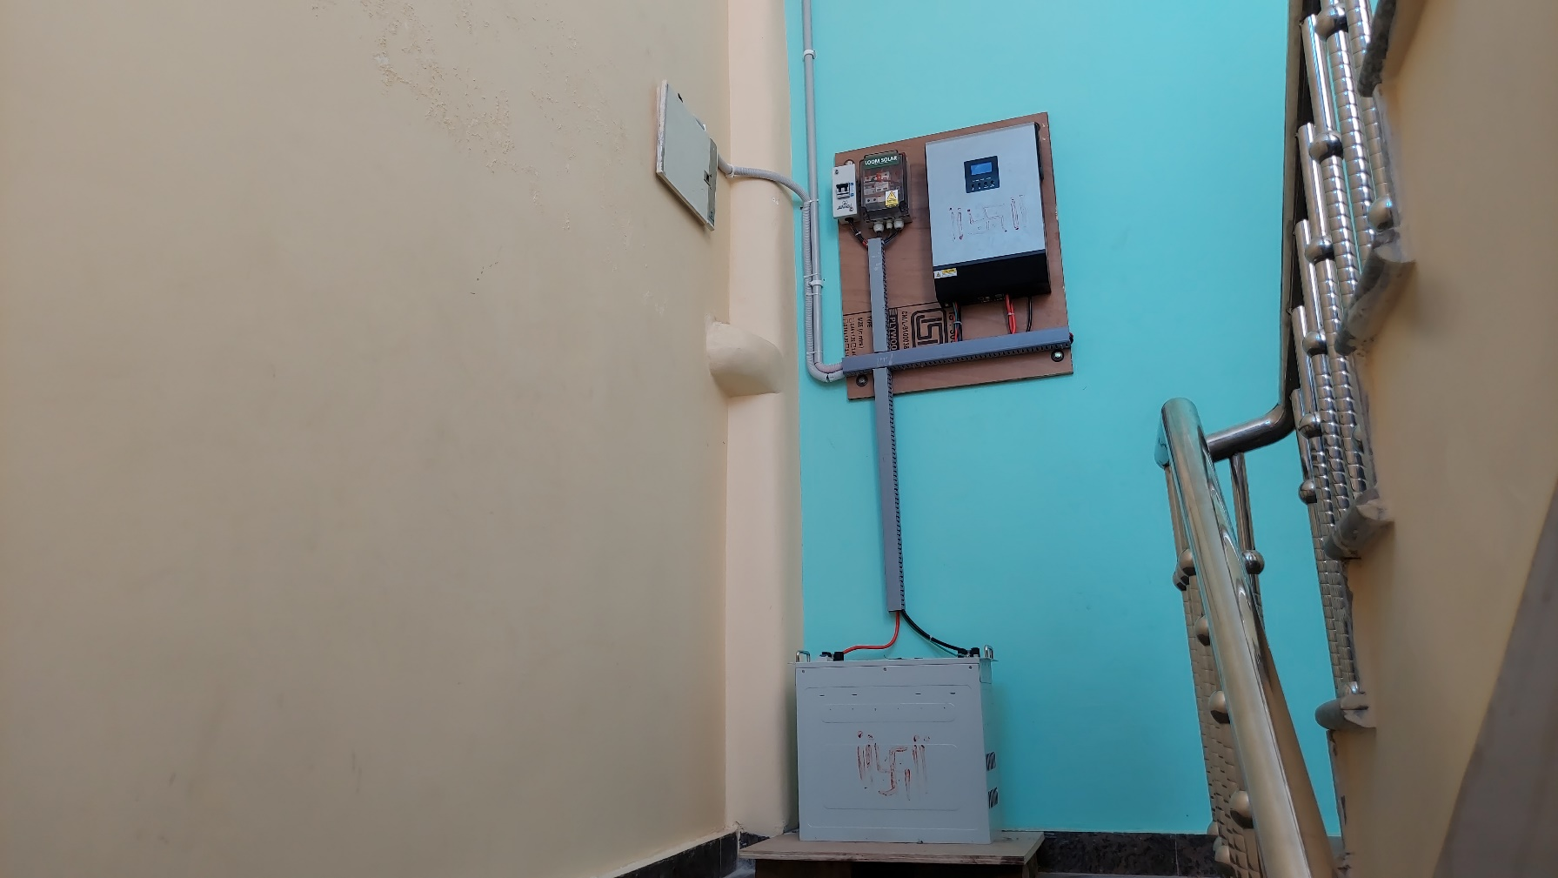
Off-Grid Fundamentals
What is Off-grid solar system?
-Those are solar system which is not connected to grid or completely independent from grid.
-Also called stand alone solar system.
-Energy can be consume at the same time or stored in the battery

Slide 5
Off-Grid Fundamentals
How does it work?
Inverter
For power conversion (DC/AC)
PV Module
For energy production
To Load
Battery
For power storage

Slide 6
Applications in the real world
Agriculture
Water pumps for irrigation
Industrial
Hospitals
Office
Factory
Residential
Power Consumers
EV Charging
Boats

Slide 7
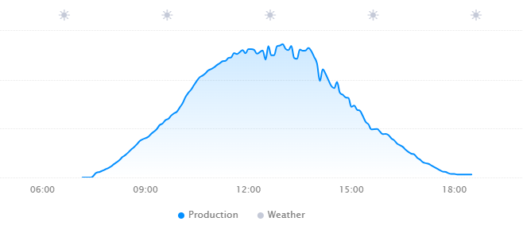
Introduction to the Off-grid world.
Peak Sun Hour: 11AM – 2PM
Power & Unit- 4units per KW

Slide 8
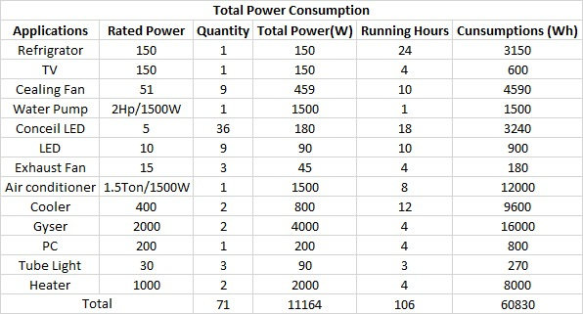
Off-grid design & sizing Energy Audit

Slide 9
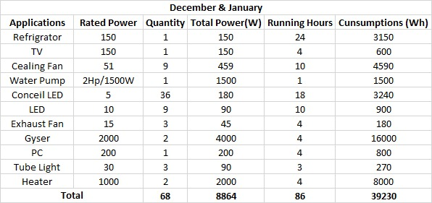
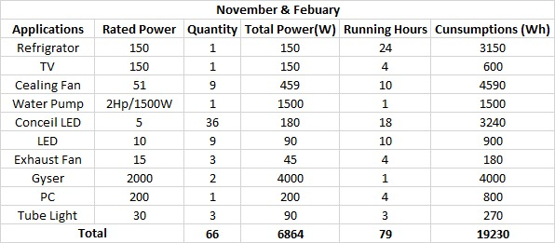
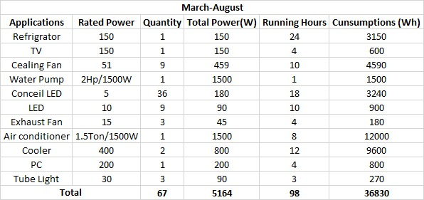
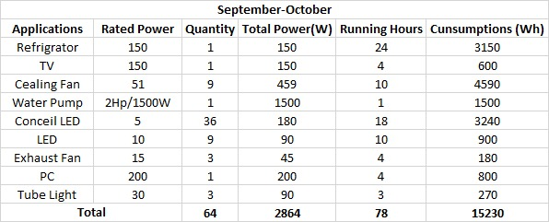

Slide 10
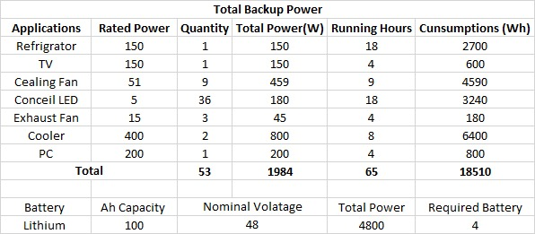
Result of Energy audit
After the calculation we got the peak load 8.8Kw and 40Units consumption in a day. It means we need solar system who can produce 40Units per day.

Slide 11
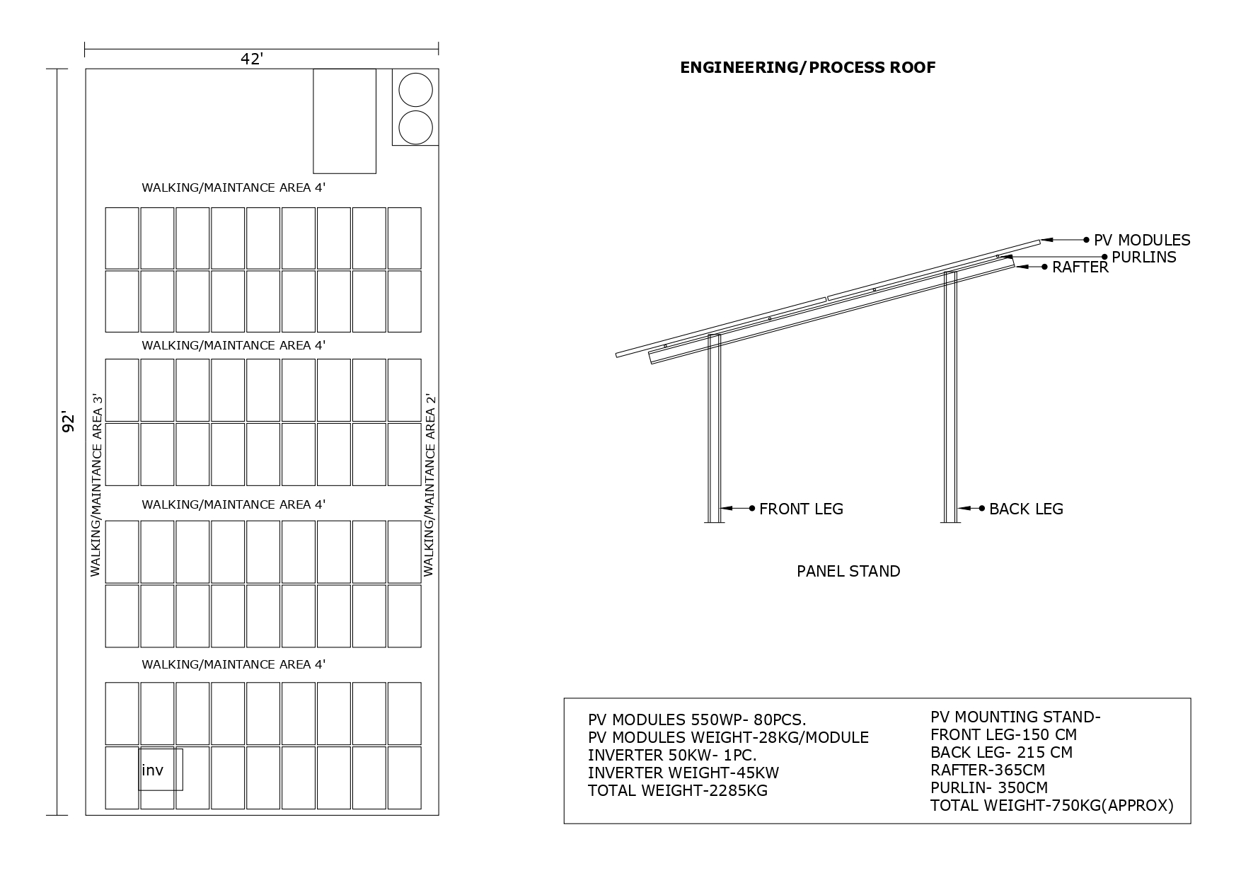
ROOFTOP PLAN
1.Type of roof
2.Rooftop area
3.Paracite wall’s height
4.Obstacle height.
5.Shadow free area
6.Design of structure
7.Height of structure
8.Material of structure
9.Water drainage
10.Strenght of rooftop
11.Total weight of system

Slide 12
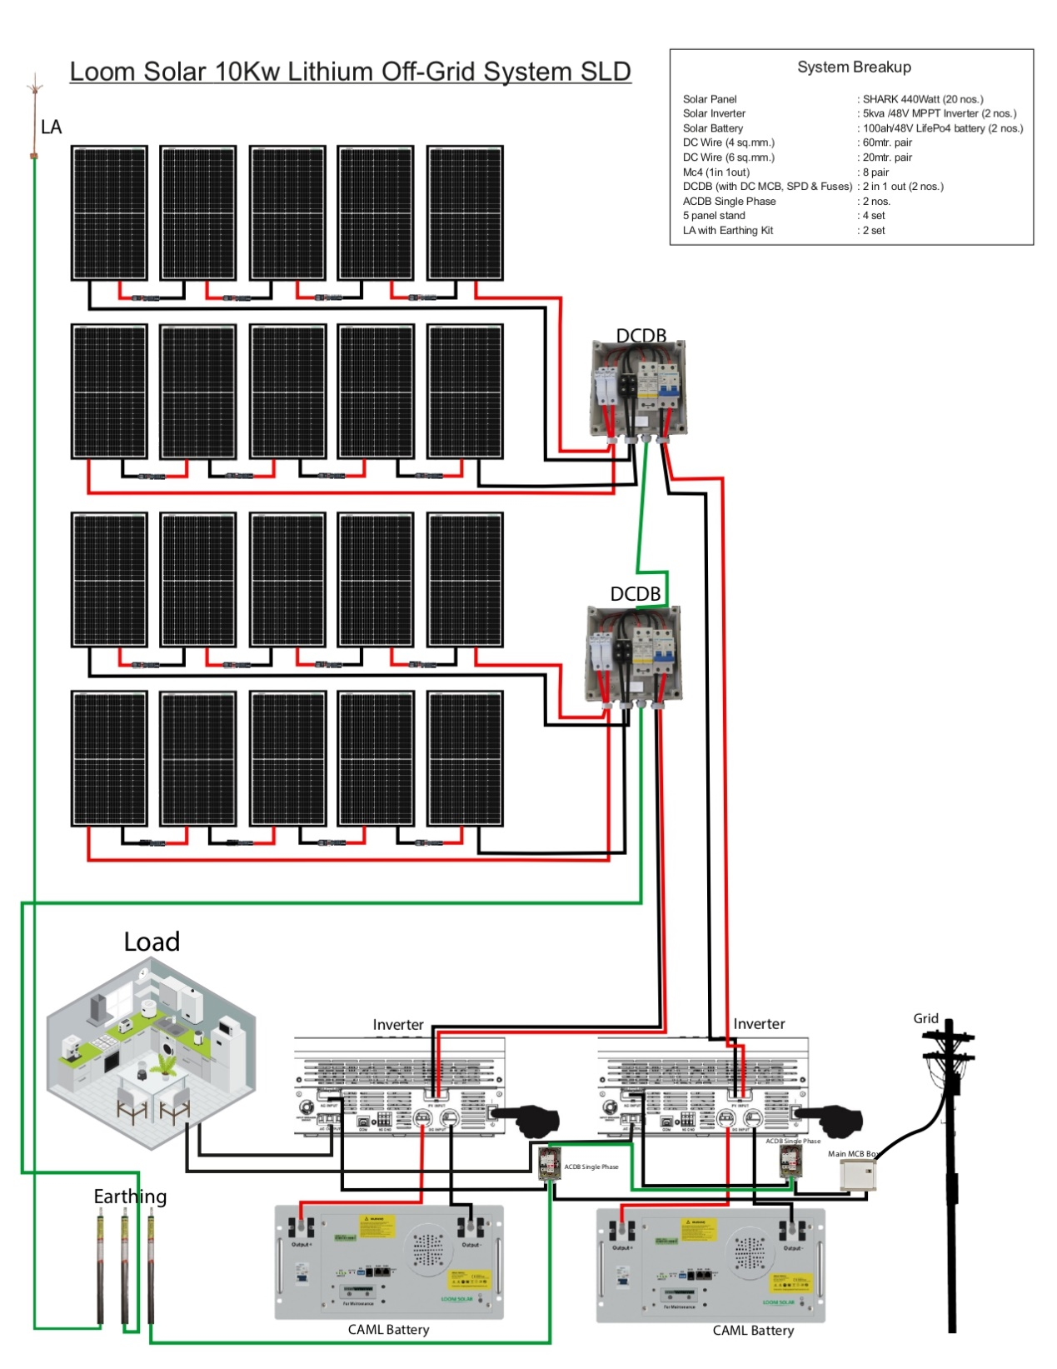
CONNECTION & COMPONENTS
COMPONENTS
1.PV Module Shark450-20Pcs.
2.PV Module mounting stand- 1Set
3.Inverter 5Kw- 2Pcs.
4.Lithium Battery-4Pcs.
5.ACDB 100Amp Single Phase-1Pc.
6.DCDB 2in 1Out- 2Pc.
7.AC Copper Cable 10SQ.MM 2C- According to site.
8.DC Wire 4Sq.MM- According o site.
9.Earthing wire 6Sq.MM 1C- According to site.
10.Earthing wire 16/25 Sq.MM- According to site.
11.LA-1Pc.
12.Earthings -3Pcs.
13.MC4 Connector- According to joints.
14.Changeover Single Phase 63Amp
15.Lugs & Connector- According to requires
16.Bus Bar

Slide 13
Advantages & Disadvantages
Advantages
Energy Independence
Suitable for remote/rural area
Environmentally Friendly
Emergency Power Supply
Low Operating Costs:
Modularity and Scalability
Disadvantages
High Initial Cost
Weather Dependency
Space Requirements
Complex System Design
Backup Generator May Be Necessary

