Slide 1

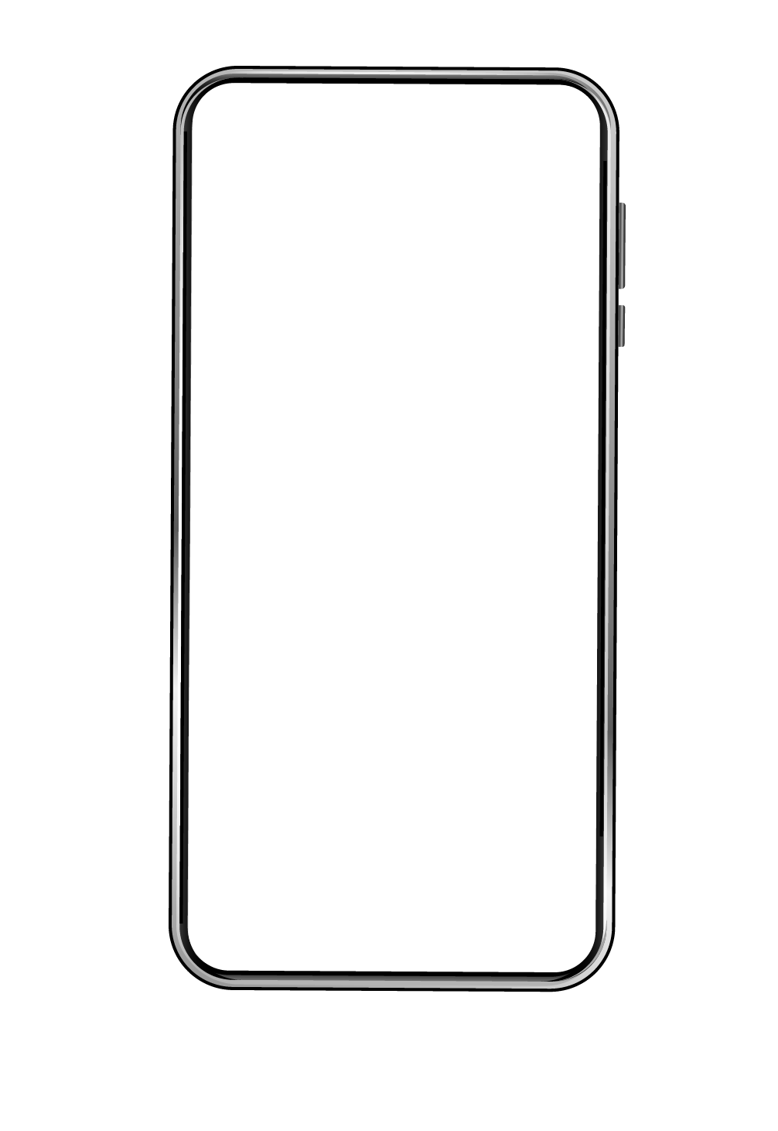
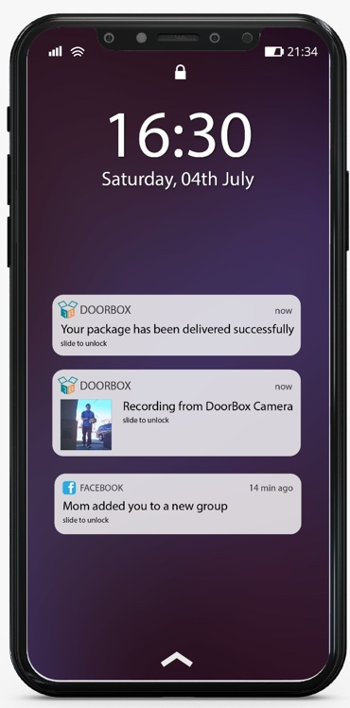
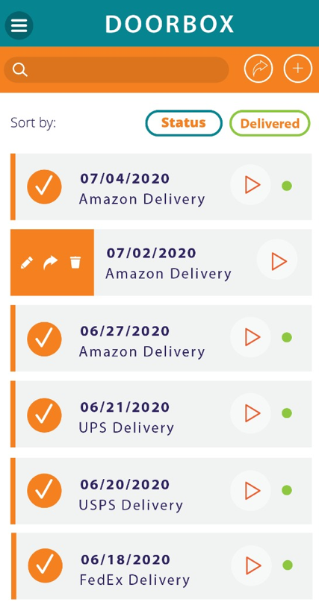
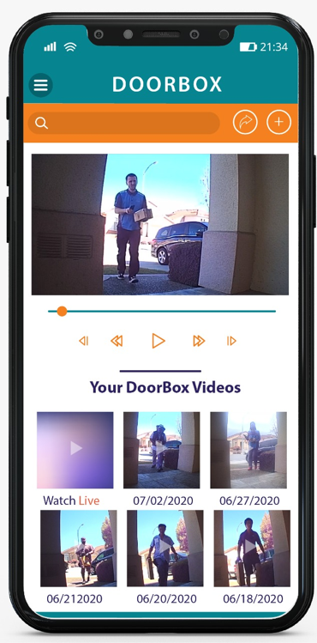

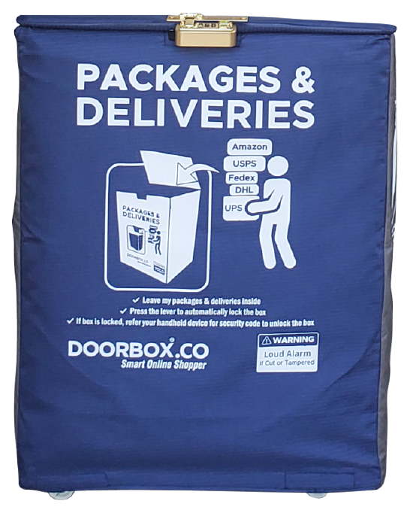


DoorBox – Intelligent Front-Porch Attendent
World’s No.1
XXX
Kumar Sundaresan
Founder & CEO
DoorBox Corporation (USA) &
DoorBox Global LLP (India)
When It Comes To Showing
Maximum Number Of
Actual Successful Deliveries
With Video Proof
www.doorbox.co/youtube
Over 23 years of Experience as an Entrepreneur.
Founded First Software Company In 1997 and It Surpassed $1 Million In Revenue Within 14 Months. Subsequently, Founded Many Profitable Technology Companies.
Architected, Led And Implemented Big Data And Other Emerging Technology Solutions For Several Clients Such As Google, Linked-in, PWC, AT&T, IBM And 25+ Other Blue-chip Clients. Software Algorithm Inventor.
Holder of 11 Granted US & International Patents on DoorBox. More Patents Pending.
B.Tech From Indian Institute of Technology, Madras. M.S. from University of Southern California
Live Notification
Live Monitoring
Delivery Update
Live Notification
App Control
Motion Detection
Alarm Alert
Mobile Alert
SMS Alert
Live Watch
WIFI / Bluetooth
Cloud Storage
Cloud Sharing
GPS Tracking
Temperature
Live Notification
Live Notification
Notes:
Have to work on this

Slide 2
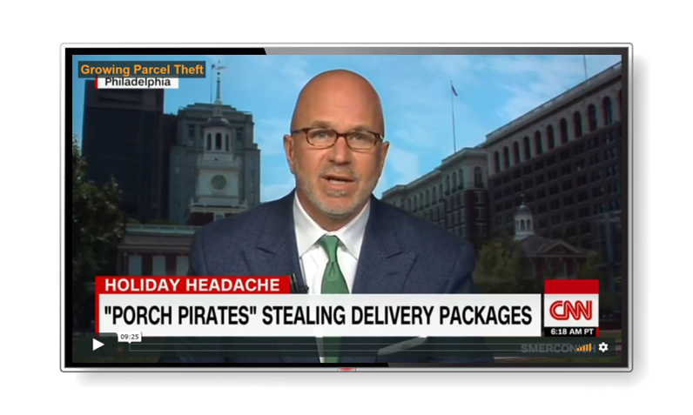
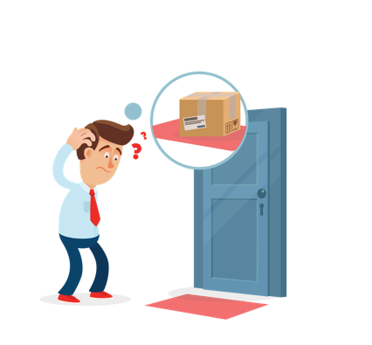
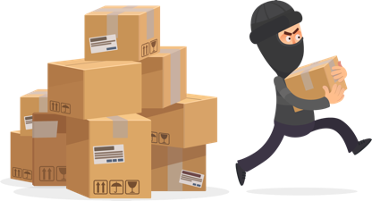


Last Mile Delivery Remains An Unsolved Problem
1.7 Million Packages Are Lost Per Day
in US Alone, adding up to more than $9 Billion In lost goods and services in a year. Amazon alone loses $25 Million everyday.
See The CNBC Video www.doorbox.co/cnbc
90,000 Packages Are Stolen Daily
In New York
See The New York Times Article www.doorbox.co/nyt
Over 128 Million Households Have No Protection For Their Online Deliveries.
Over 150 Million Amazon Prime Members Are Struggling To Solve Package Theft Problem.
Parcel carriers lose close to $89B this year from parcels not delivered in first attempt.
See The New York Times Article
www.doorbox.co/89b

Slide 3
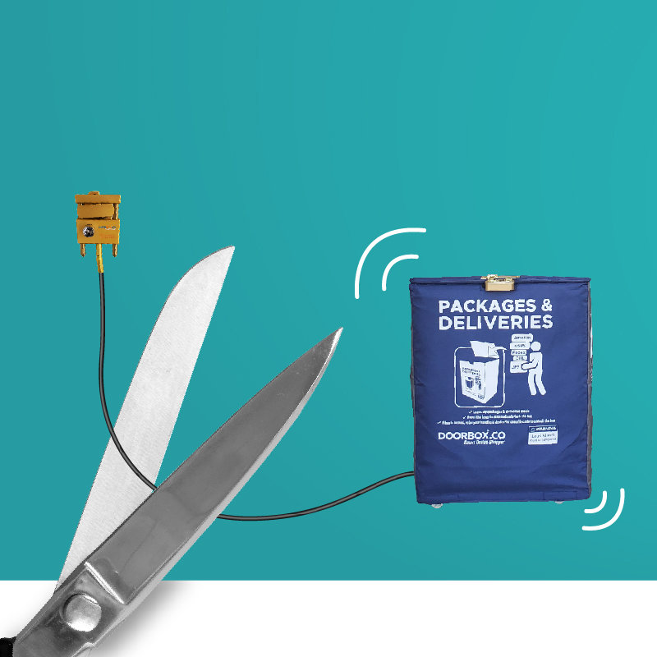
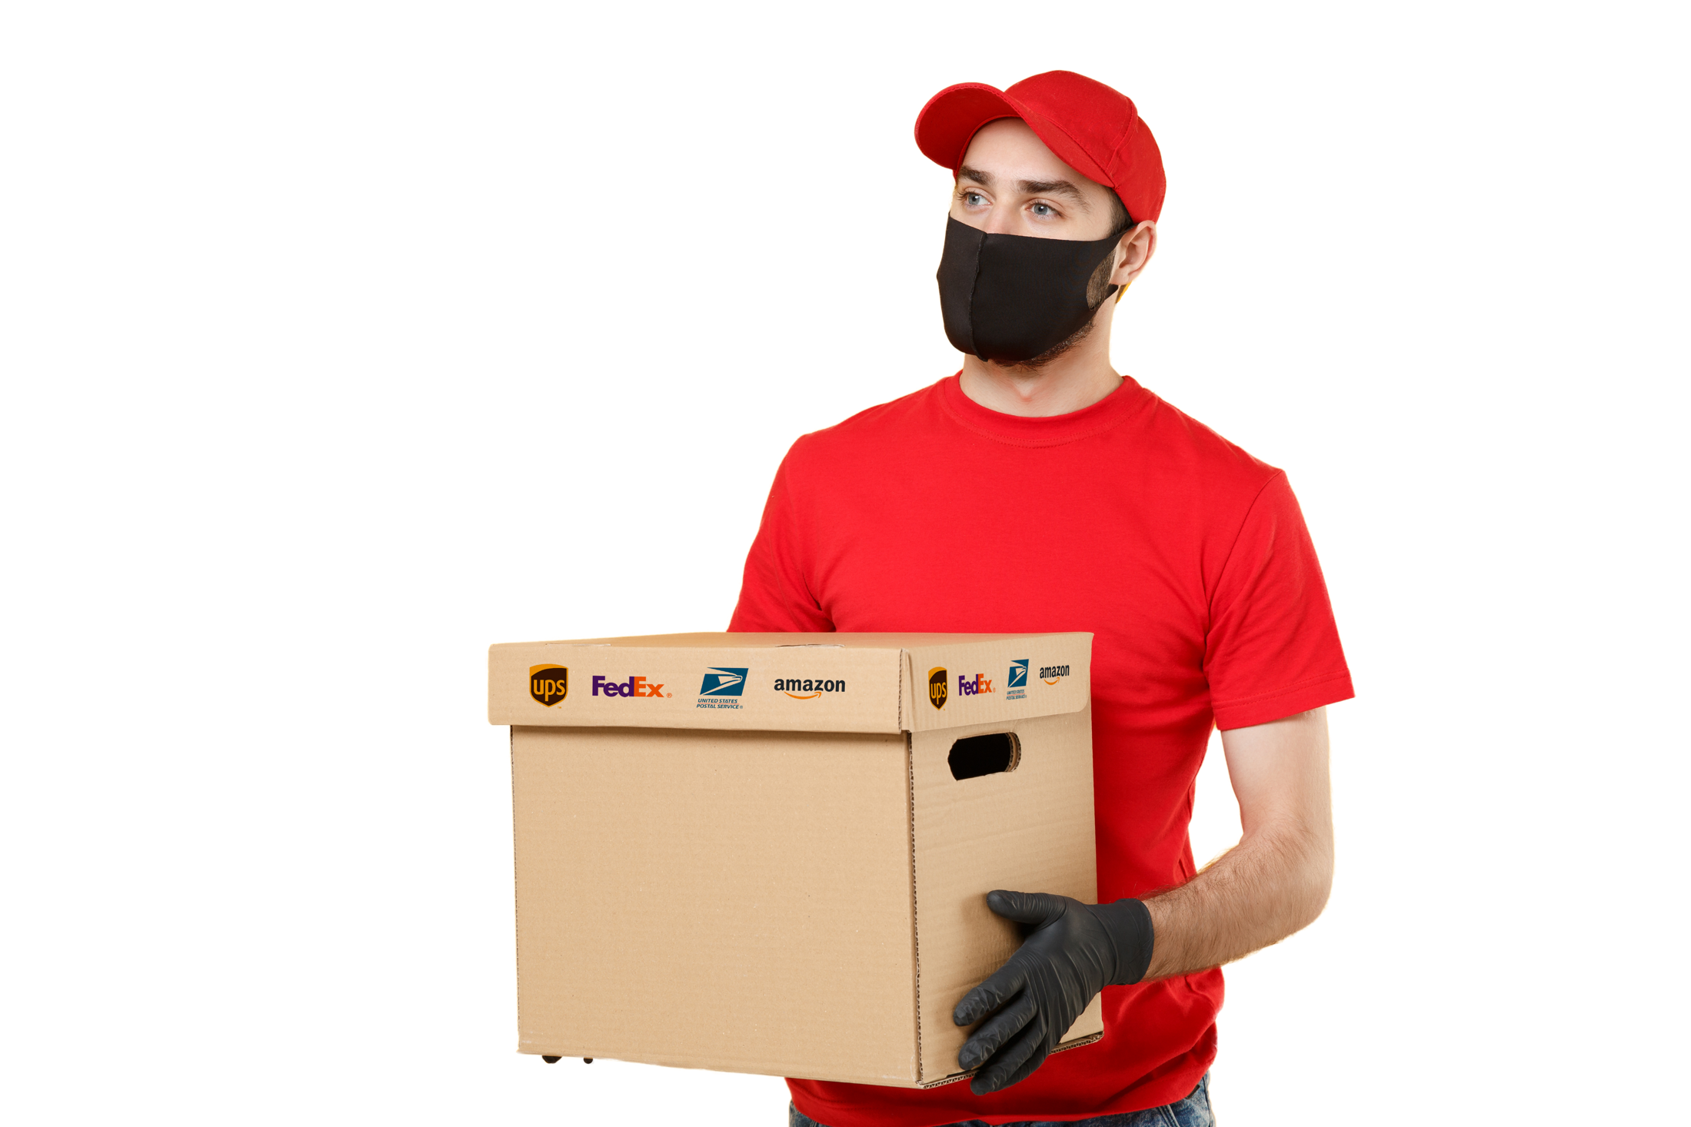
130 Backers
Goal Met Within 4 Days In Kickstarter. 257% Funded
11+
Fully Granted Utility Patents
In USA (2), Canada, Japan, UK, Germany,
France, Netherlands, China, Hong Kong And
India. Many More Pending Worldwide
Anti-Theft Alarm Protection
No. 3
Out of Top 200 In Amazon Best Sellers In “Package Drop Box And Lockers” Within Weeks
World’s No.1
600+
Units Sold On Amazon & Website. Out Of Stock Now –Heavy Backlog
No.1
New Release On Amazon With 5 Star Reviews shortly after launch in Amazon
Shark Tank
Shortlisted for 2020 Season

Slide 4

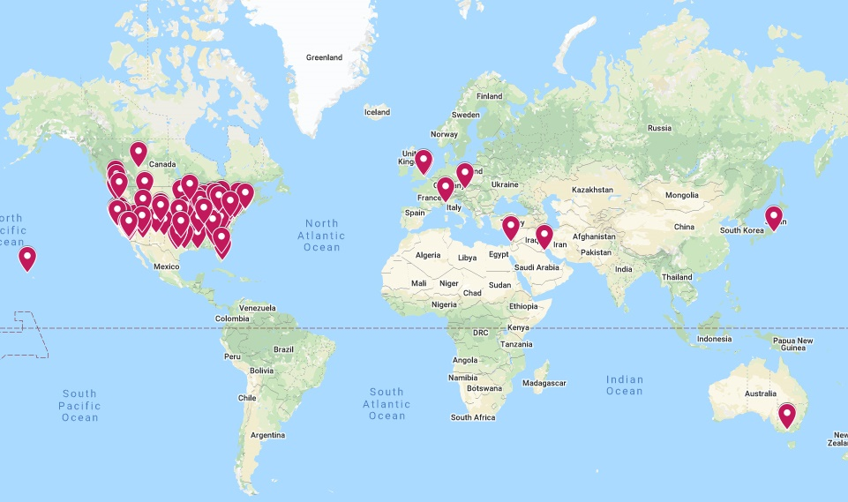
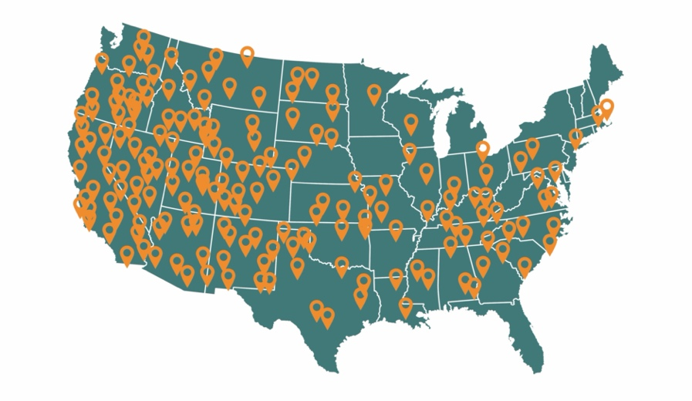
Excellent Traction in US and Worldwide
“I bought this for work - we don’t have 9-5 office staff. The box fits our most important pieces, weather proofing a huge plus!”
Robb Mars, Texas
(Purchased 3 times in 2020)
“Doorbox is a Life Saver!”
Amanda Peterson, Montana
(Purchased 2 times in 2020)
“Wow..What are you waiting for?”
Amy Kafka, Washington
600+
DoorBox’s Sold.
Out of Stock Now.
Heavy Backlog.
33+
5 Star reviews.
Strong Demand
in USA, UK, Japan and
Around the World.

Slide 5
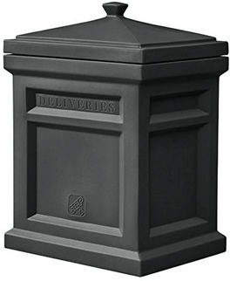
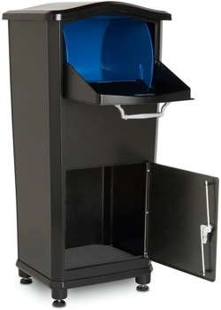

Current Solutions Don’t Work
“Dumb” Boxes – No Lock
Simple, No Assembly.
No Tamper Detection Or Alarm.
Relies On Weight And Camouflage.
Basic locking
Cheap, No Attachments.
Very Shoddy Workmanship.
No Multiple Deliveries.
Cameras with Surveillance Only
Built In With Most Home Alarm Systems.
Non-Actionable – Just Recording.
Can’t Stop Package Theft.
Step2
Amazon Review
Elephantrunk
Amazon Review
“...Fills up with water/leaks..”
“..way too light it blew away..”
“.. Very flimsy. Lid won’t stay on..”
“ Flies away with wind too often.
“ Not worth the money..”
“ Very Shoddy Workmanship – Unusable ”
“.. Super small opening..”
“.. Hard to setup..”
“Locking mechanism is trash. Poor quality metal. Easily Broken..”

Slide 6
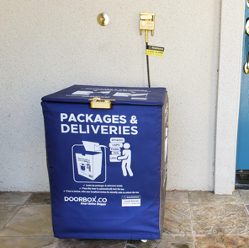
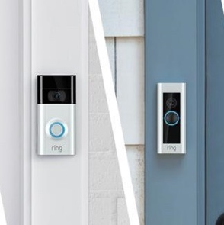
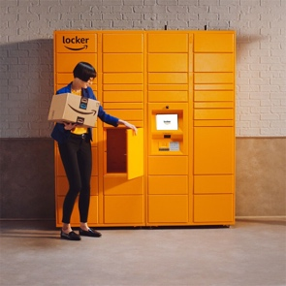
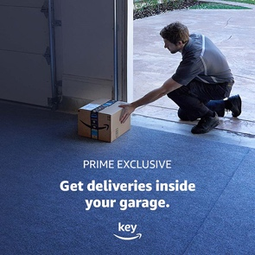
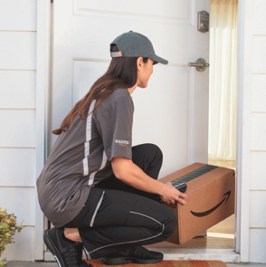
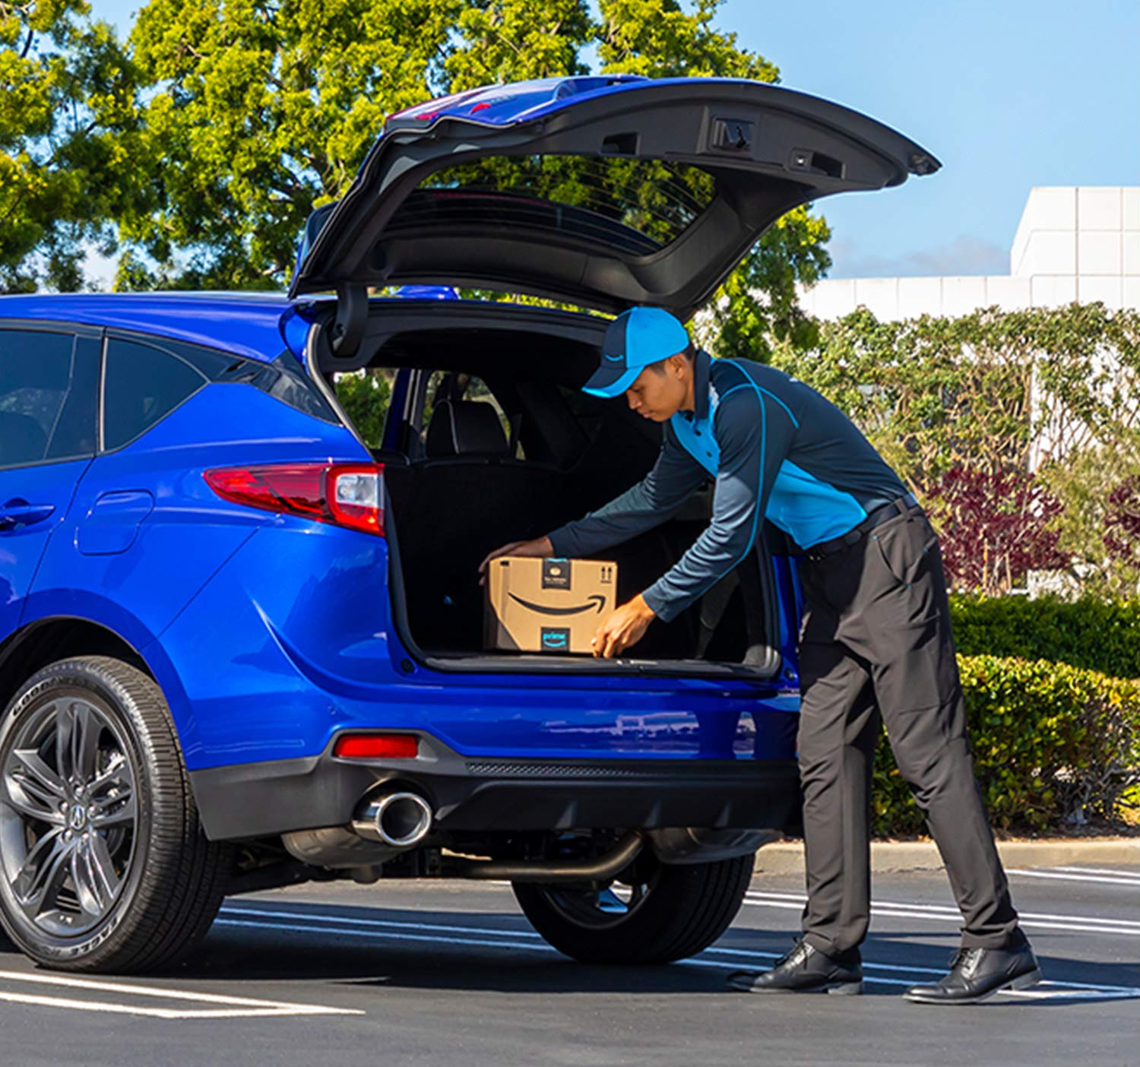




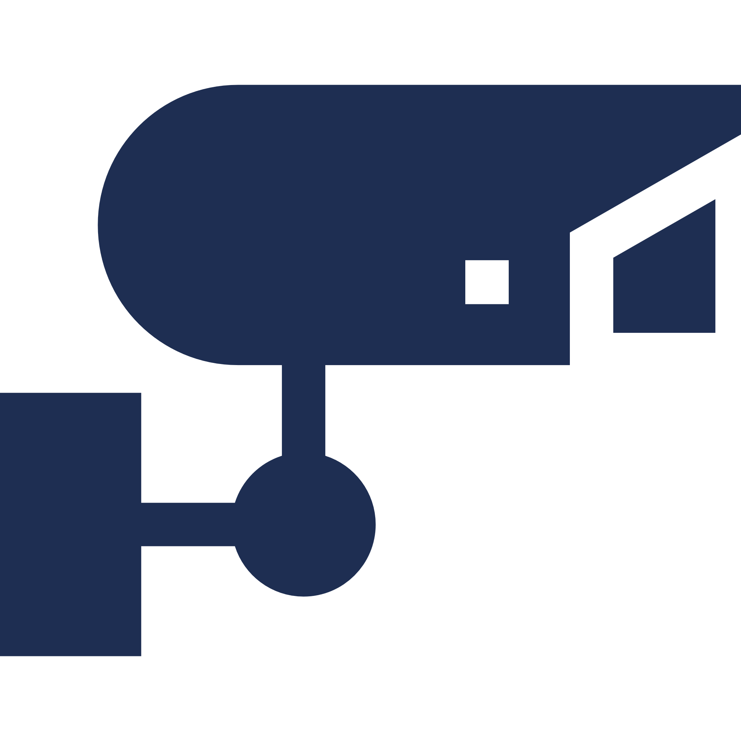








Even Amazon Is Struggling To Solve This Problem
XXX
XXX
XXX
XXX
XXX
XXX
Garage Delivery
Trunk Delivery
Security Camera
No Strangers Are Allowed Inside Your Home
Privacy
Convenience
Family Security
Pet Security
Lower Home Owner Insurance Cost
N/A
N/A
N/A
N/A
N/A
N/A
N/A
N/A
N/A
N/A
N/A
N/A
Strangers Allowed
Higher Insurance Cost
Strangers Allowed
Higher Insurance Cost
N/A
Strangers Allowed
N/A
N/A
N/A
Product Features

Slide 7
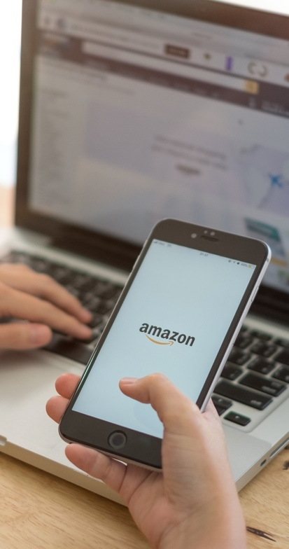

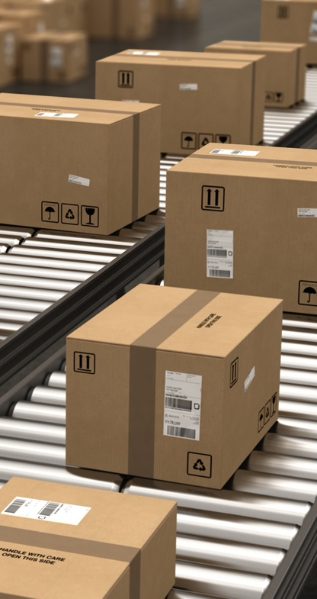
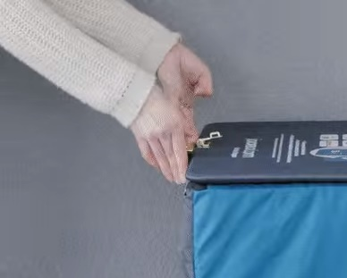
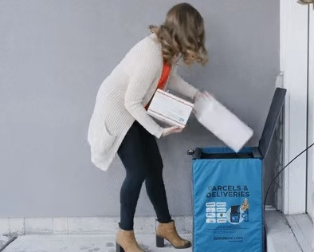
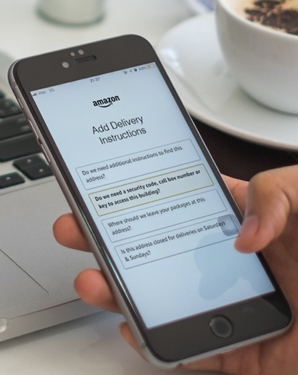
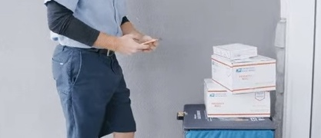
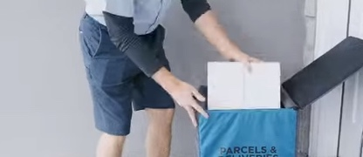
DoorBox – How it works ?
02
04
Customer enters the DoorBox security code (e.g. 234) in the delivery instruction box. This is a one time set up. Amazon Sends This Code Every Time to Delivery Personnel.
Delivery person uses the security code to open the DoorBox and drops in the package securely. For first delivery (84% of deliveries), the DoorBox is already open. Why lock an empty box, right? Most other solutions fail right here.
Customer unlocks and picks up the package happily and Securely.
Customer orders from any online store.
Order is processed and dispatched to the shipping carrier.
01
03
05

Slide 8
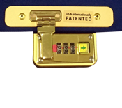
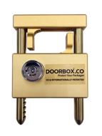
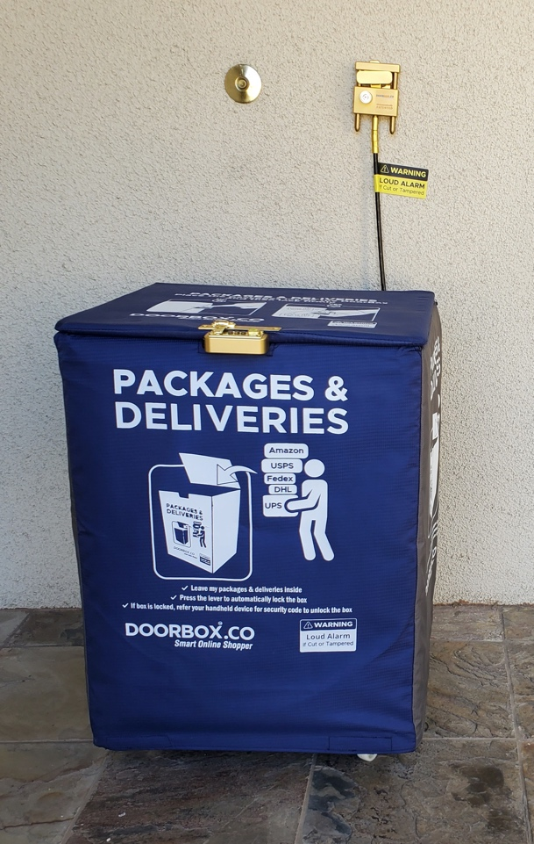
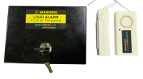
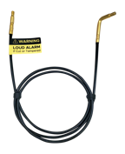
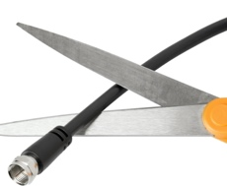

DoorBox Innovation
Secure Combination Lock
Soft-closing lid with secure combination lock to receive multiple deliveries
Lock Assembly
Locking assembly that fits all types of doorknobs, guardrails and posts
Alarm Box
This securely encloses the alarm, wires and the circuitry inside. An option to turn alarm on or off anytime
Proprietary Steel Cable
Alarm-enabled steel cable with conductive wires inside that detects tampering and it can withstand over 800-LBS of force
Secured Conductive wires
Conductive wires around the DoorBox that monitors and detects tampering of DoorBox
Anti Theft Audible Alarm
A 125-decibel audible alarm

Slide 9
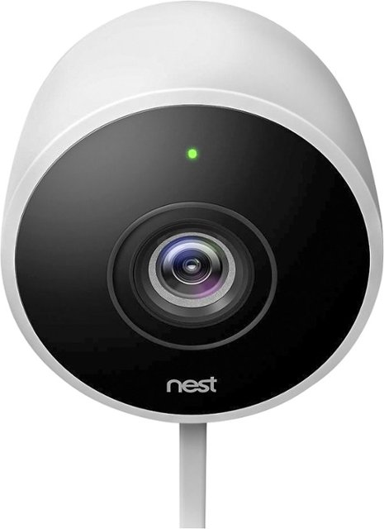
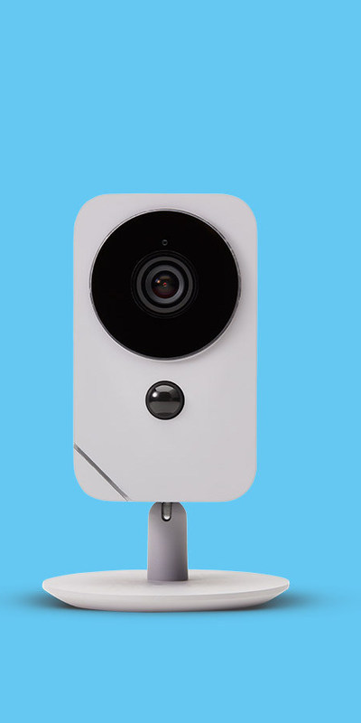
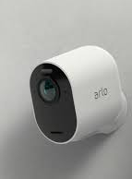
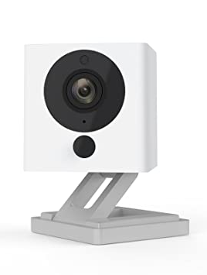
Security Cameras Are Simply Inadequate To Solve Front-Porch Needs.
XXX
XXX
Ring, Nest, Arlo, ADT & Others
View and Interact With People At Front Porch
Prevent Package Theft At Front-Porch
Process Images Using AI At Front-Porch and Trigger Events. Integrate Common Events With Google Nest, Alexa and Open-Source AI.
Open or Close DoorBox Based on Image and Voice Responses
Greet Residents Returning Home & Update Status Upon Arrival
Turn-on Lights When Anyone Approaches in the Night
Keep Food Warm or Cold Depending On Triggered Events
Alert or Call Residents Depending on Extreme Events Instead of Simple Push Notifications. Intelligent Image Processing At Play Here.
Product Features

Slide 10

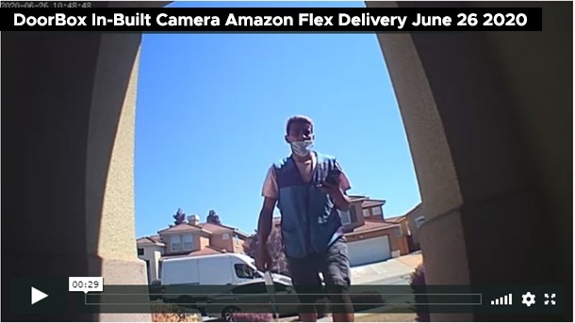


Product Roadmap
01
02
03
Q1 2021
Built-in Camera
Pilot Testing Is Underway.
See Recordings www.doorbox.co/camera
Q2 2021
Integration into
Home Security Systems
Q1 2021
Mobile App Integration

Slide 11











Staying Ahead - Moats
XXX
Patents & Trademarks
11+ Fully Granted Utility Patents in USA (2), Canada, Japan, UK, Germany, France, Netherlands, China, Hong Kong & India. There Are Multiple Additional Patents Pending. Doorbox is a USPTO Registered Trademark and a Brand.
Technology
In Built Camera, Image Processing by AI, Event Processing by IOT, Integration With Home Security and NextDoor and Other Social Apps.
Higher Margin
Great Advantage Over Competitors Because Security is Provided By Electronics (Continuity Wires) and Not Heavy Metal or Large Plastics.
USA (2)
JAPAN
CANADA
GERMANY
UK
INDIA
CHINA
HONG KONG
FRANCE
NETHERLANDS

Slide 12
Unit Economics
XXX
DoorBox – Current Price & Profit per Unit
DoorBox – Future Price & Profit per Unit
Variation
Sales Channel
Price
Commission & Fees
Advertisement
Shipping
Production Cost
Profit
Ultra-Premium
Premium
DoorBox with
In-Built Camera
DoorBox with Camera & API
Amazon | Website
$179.00 | $179.00
$45.50 | $0
$10.00 | $25.00
$0 | $15.00
$70.00 | $70.00
$53.50 | $69.00
Amazon | Website
$159.00 | $159.00
$45.50 | $0
$10.00 | $25.00
$0 | $15.00
$70.00 | $70.00
$33.50 | $49.00
Amazon | Website
$249.00 | $249.00
$50 | $0
$10.00 | $25.00
$0 | $15.00
$80.00 | $80.00
$109.00 | $129.00
Amazon | Website
$299.00 | $299.00
$50 | $0
$10.00 | $25.00
$0 | $15.00
$80.00 | $80.00
$159.00 | $179.00

Slide 13
Projected Sales and Profit Growth
XXX
$400
1800
$350
1500
$300
$250
1200
Units Sold In Thousands
$200
Revenue in USD Million
Gross Profit in USD Million
900
$150
600
$100
300
$50
0
$0
2020-2021
2022
2023
2024
2025
2026
Cumulative Units Sold In Thousands
Cumulative Revenue in USD Million
Cumulative Gross Profit in USD Million

Slide 14

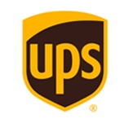







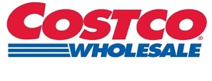








Extraordinary Synergy For Win-Win
XXX
XXX
DoorBox Will Provide Secure Delivery Options, To All E-Tailers. DoorBox Can Keep Groceries Cool With Its Dry Ice Pack Inside.
XXX
DoorBox Could be a Game Changer for These
DoorBox Will Create Extraordinary Efficiencies For Numerous Carriers.

Slide 15

The Ask – Toward Seeing One DoorBox In Every Household
$175,000
Marketing & Establish Partnerships
$575,000
Refill Stock
$1 Million
$250,000
Mobile App & Smart Home Integration

Slide 16






Team
Investors & Advisors
XXX
XXX
Siva Renganathan
Shivakumar
Venkataraman
Investor
Masters in Computer Science.
Apple Corporation and Amazon.
Artificial Intelligence & Machine Learning.
VP – Google Search Ads
IIT - Madras
Univ. of Wisconsin Madison
I
I
XXX
XXX
RAMYA Siva
VENU
VEMULA
Investor
Bachelors in Computer Science.
Yahoo, Mastercard and Apple Corporation.
Big Data and Mobile Applications.
VP & Google Fellow
Google Search Infrastructure
XXX
XXX
Gayatri Sundaresan
Bala
ParthasarAthy
Investor
Co-founder, MoneyTap
Co-founder, Prime Ventures
Co-founder, Snapfish
IIT-Madras, Univ. of California
Bachelors in Computer Science. Faculty For iOS and Android Mobile Apps. Over Two Decades of Software Experience.

Slide 17


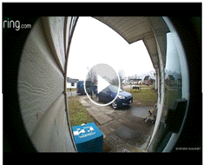


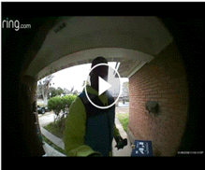
Happy Customers In Amazon and Everywhere Else……
Unlike other similar or high priced solutions this box easily collapses for storage between deliveries.
I am an avid online shopper, so I don’t miss any of these packages either. Over the last week since installation, I feel like its Christmas every day.
This box gives me tremendous peace of mind!! I used the DoorBox, didn’t even leave instructions because they we printed on the box. Success!!
I would highly recommend this box to ensure you get the packages you have paid for and a porch thief does not! I had one small issue with the lock and the customer support was AWESOME!

Slide 18
Appendix

Slide 19
Quick URLs
www.doorbox.co – Home Page Of Our Company
www.doorbox.co/cnbc - CNBC Video of Package Theft in USA
www.doorbox.co/nyt - Newyork Times Article of Package Theft
www.doorbox.co/youtube – Hundred’s of Actual Delivery Videos
www.doorbox.co/camera - Our Doorbox Camera Pilot Testing
www.doorbox.co/amazon - Doorbox Listing in Amazon
www.doorbox.co/walmart - Doorbox Listing in Walmart
www.doorbox.co/kickstarter - Doorbox Kickstarter Listing

