Slide 1
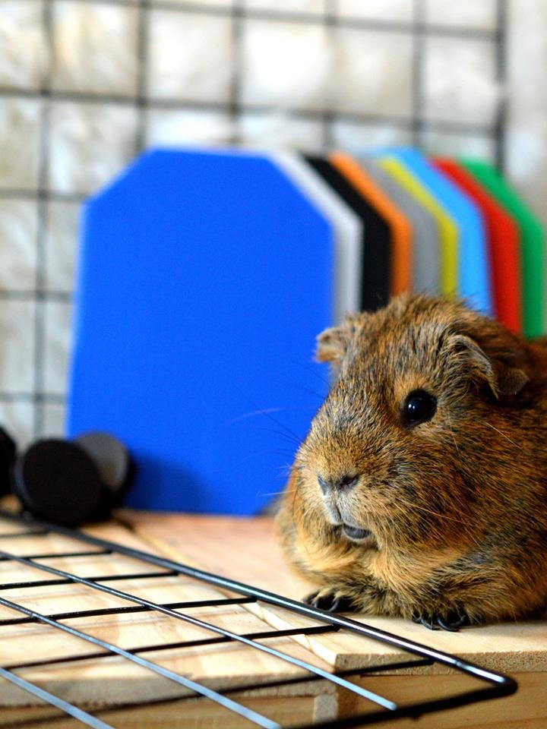
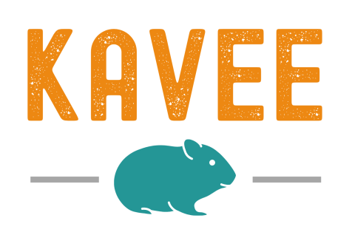
Assembly instructions

Slide 2
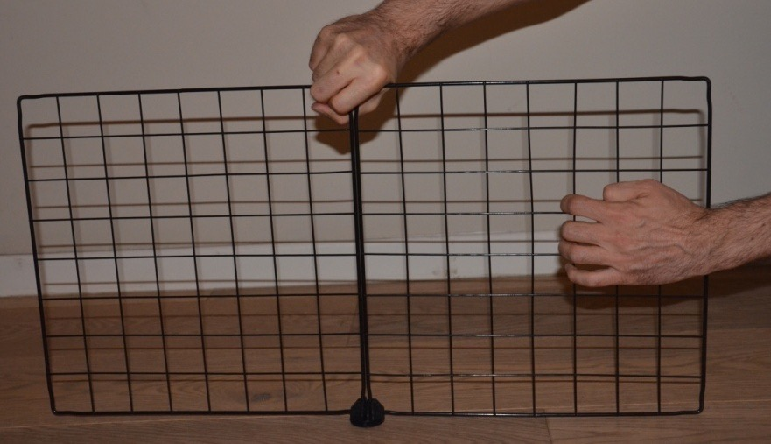
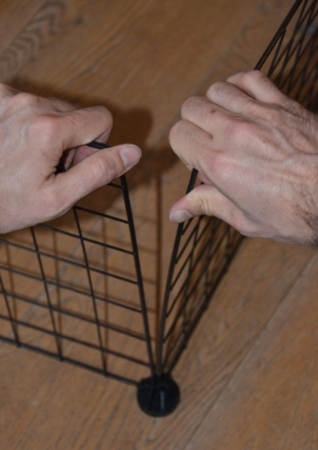
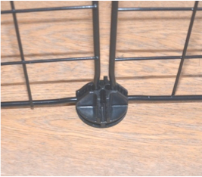
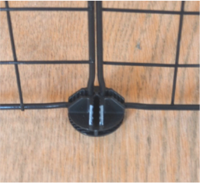
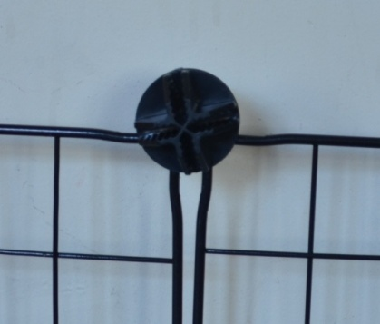
GENERAL GUIDELINES
X
X
Always pull the grids along the axis of the connectors otherwise connectors might break.
Do not pull on the meshing to disassemble a grid and always pull on the frame of the grid. Otherwise you might damage the meshing.
X
✅
Always fully engage the grids inside the connectors to ensure good holding and alignment of the assembly
X
Do not misalign the connectors, otherwise it might cause holding and alignment problem on the assembly
You have questions or comments about our products?
Contact us and we will reply to you within 24h : info@kaveecage.com

Slide 3
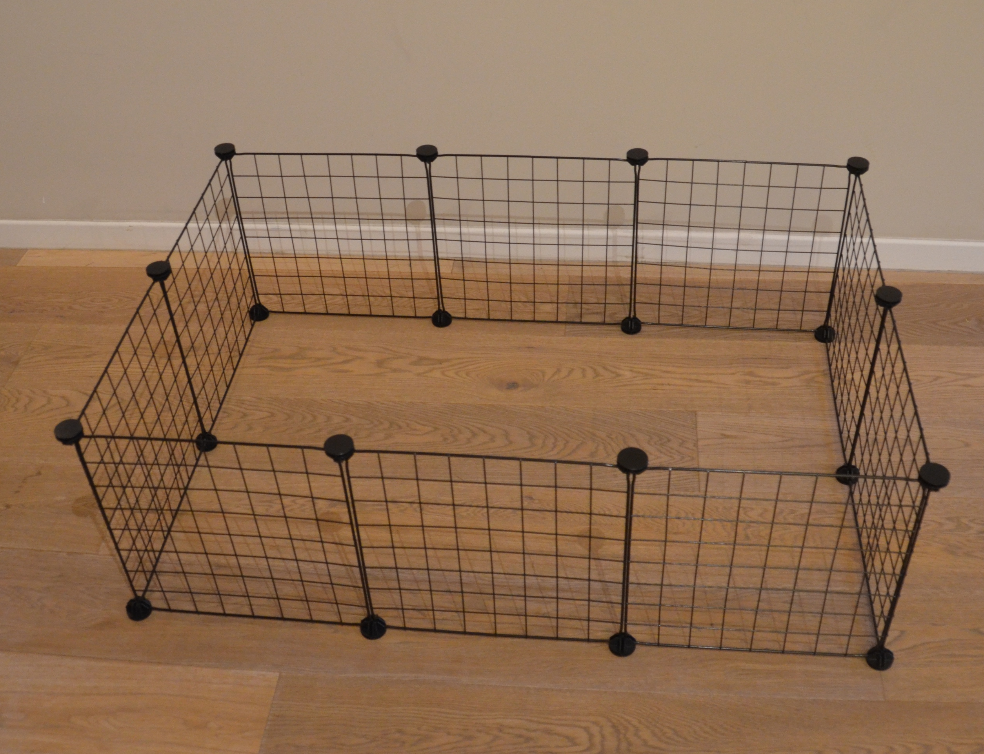
GENERAL GUIDELINES
For simple C&C cages, there is no need to use grids to create a cage bottom.

Slide 4
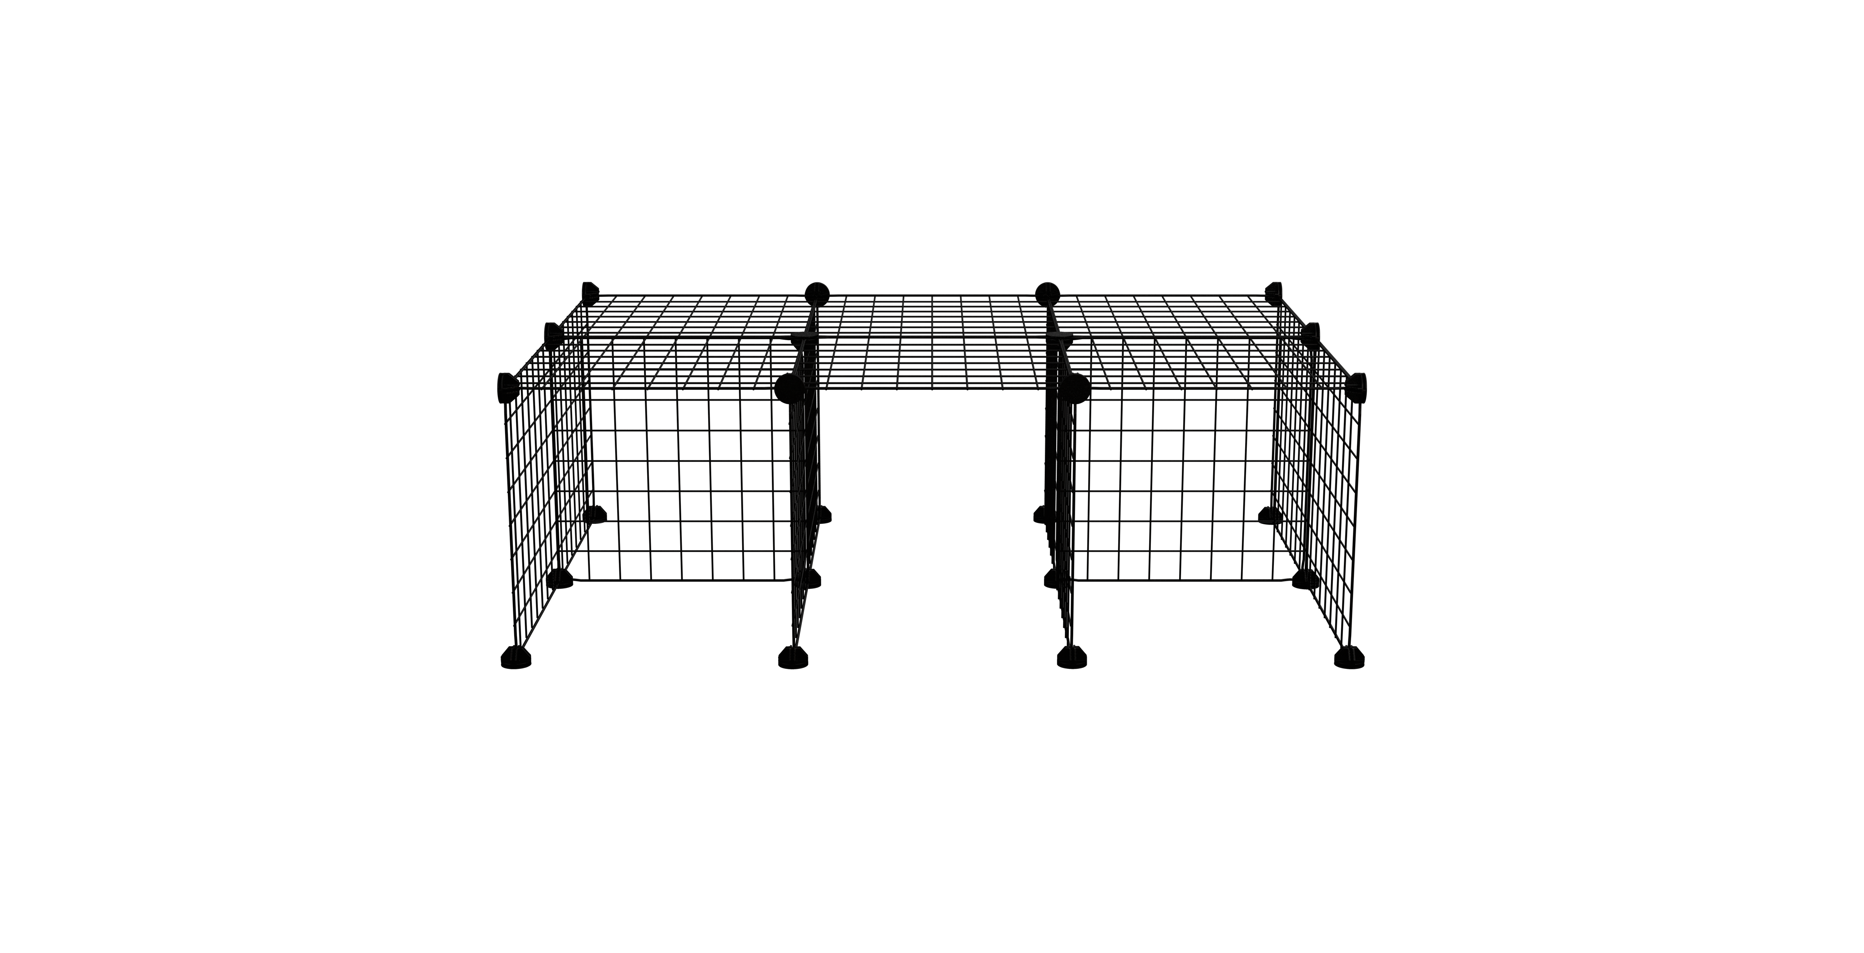
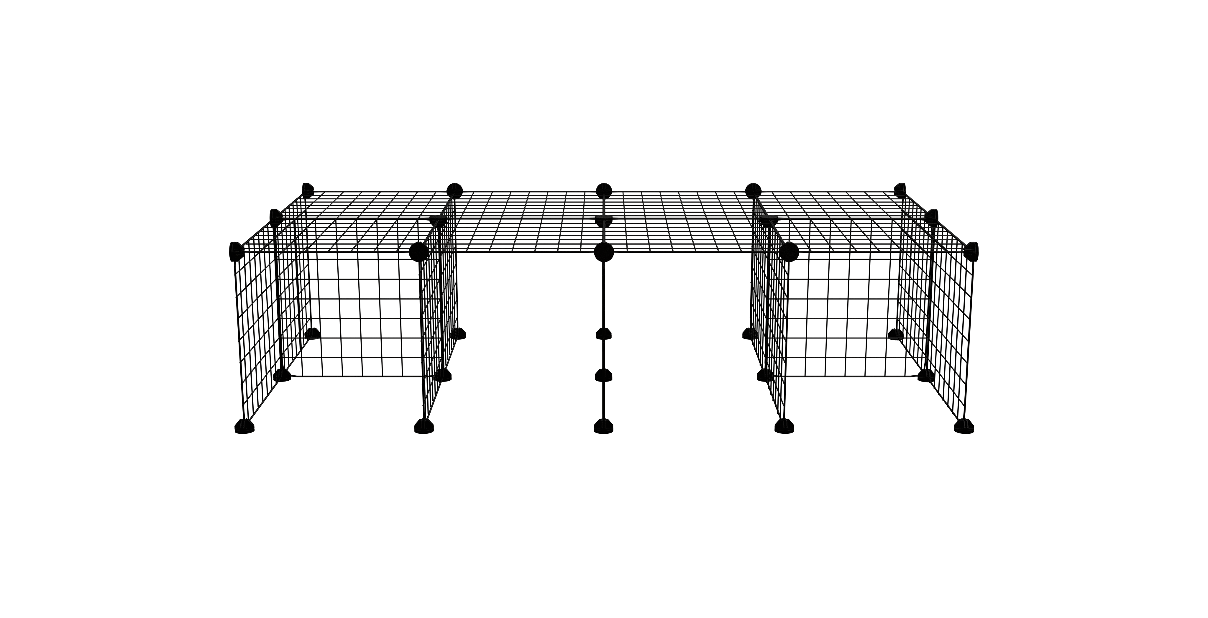
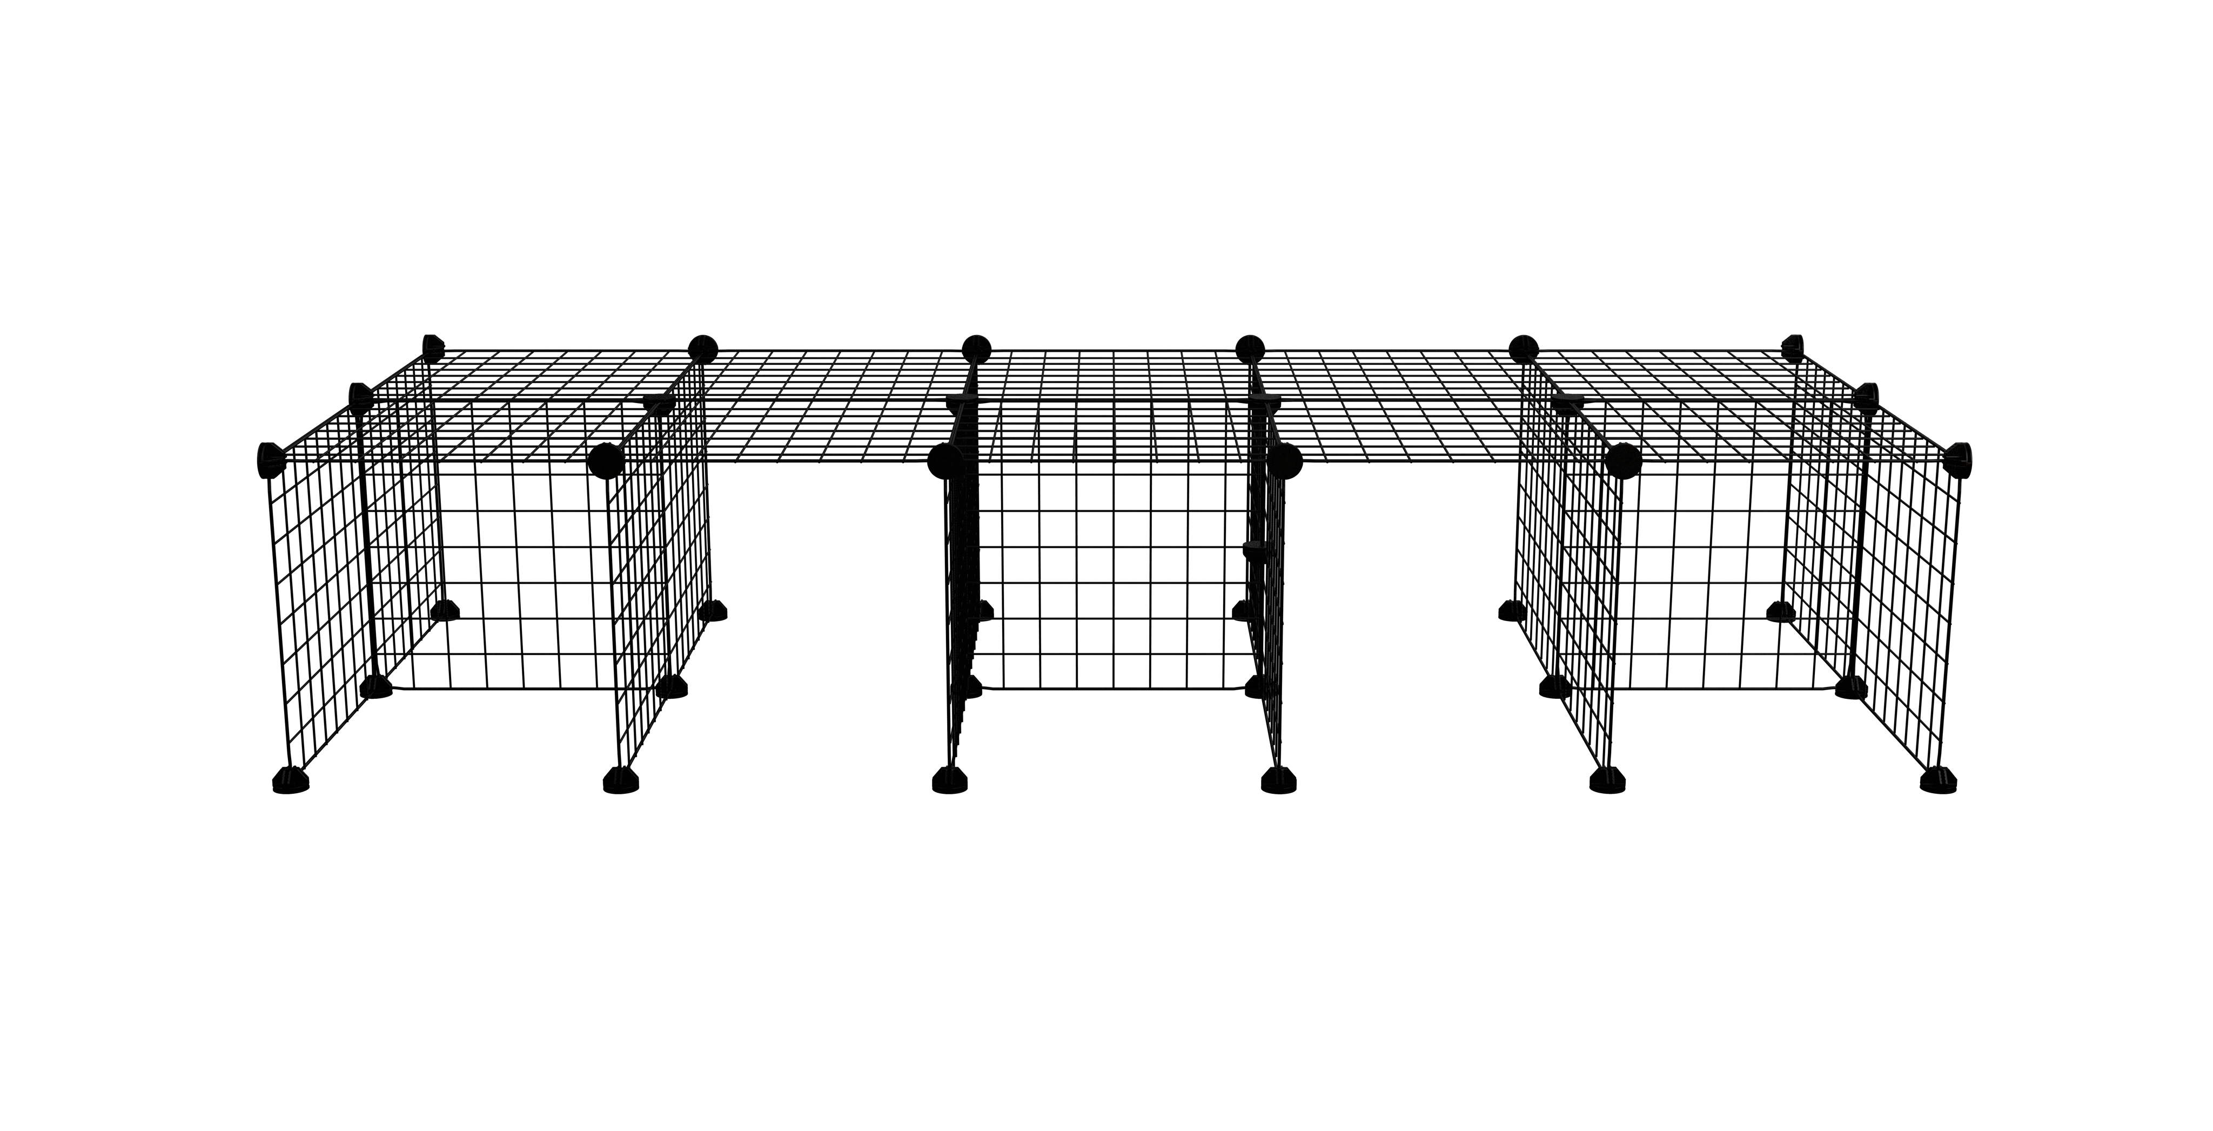
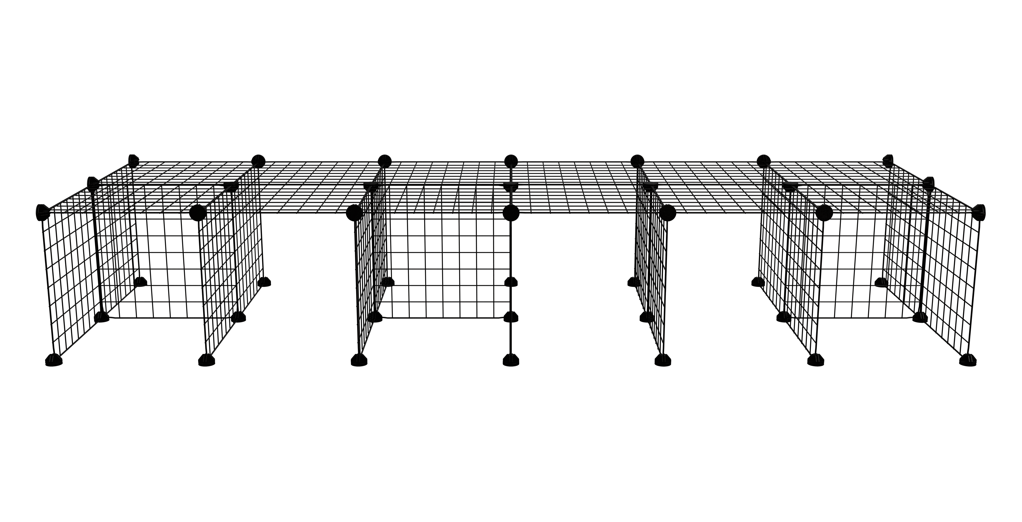
STAND ASSEMBLY
If you have a C&C cage with a stand, start first to build the stand before the cage. Use below pictures and next page to assist you with the assembly.
3X2
4X2
5X2
6X2

Slide 5
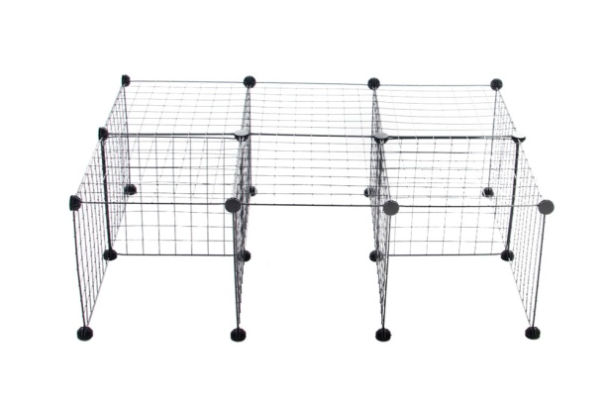
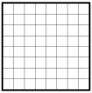
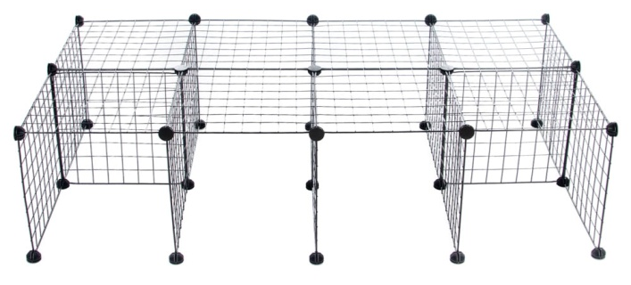
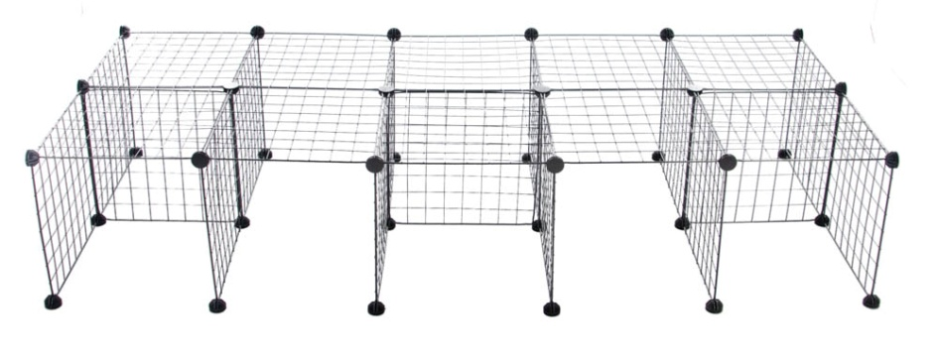
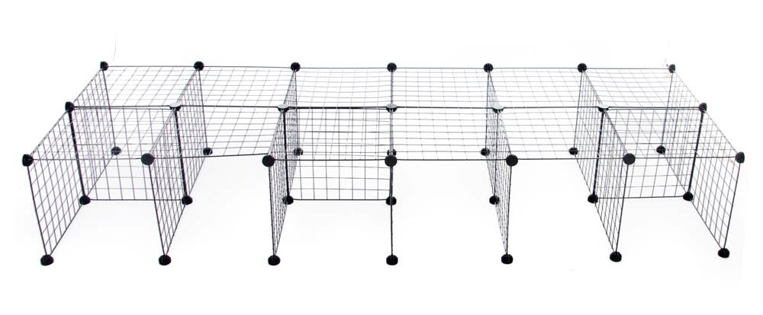
STAND ASSEMBLY
If you have selected a C&C cage with a stand, start first to build the stand before the cage. Use below pictures and the indicated quantity of grids&connectors to assist you with the assembly.
Stand 3x2 :
16 Grids
24 Connectors
Stand 4x2 :
20 Grids
30 Connectors
Stand 5x2 :
25 Grids
36 Connectors
Stand 6x2 :
29 Grids
42 Connectors
One way to easily build the stand is to first build the legs of the stand and then separately the cage bottom. Then you position the legs and you place over the bottom of the cage.
Once the stand is up, you can move to the next step and assemble the grids of the cage on it.

Slide 6
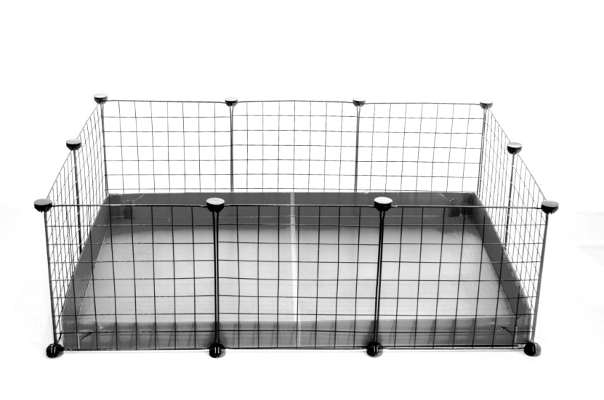
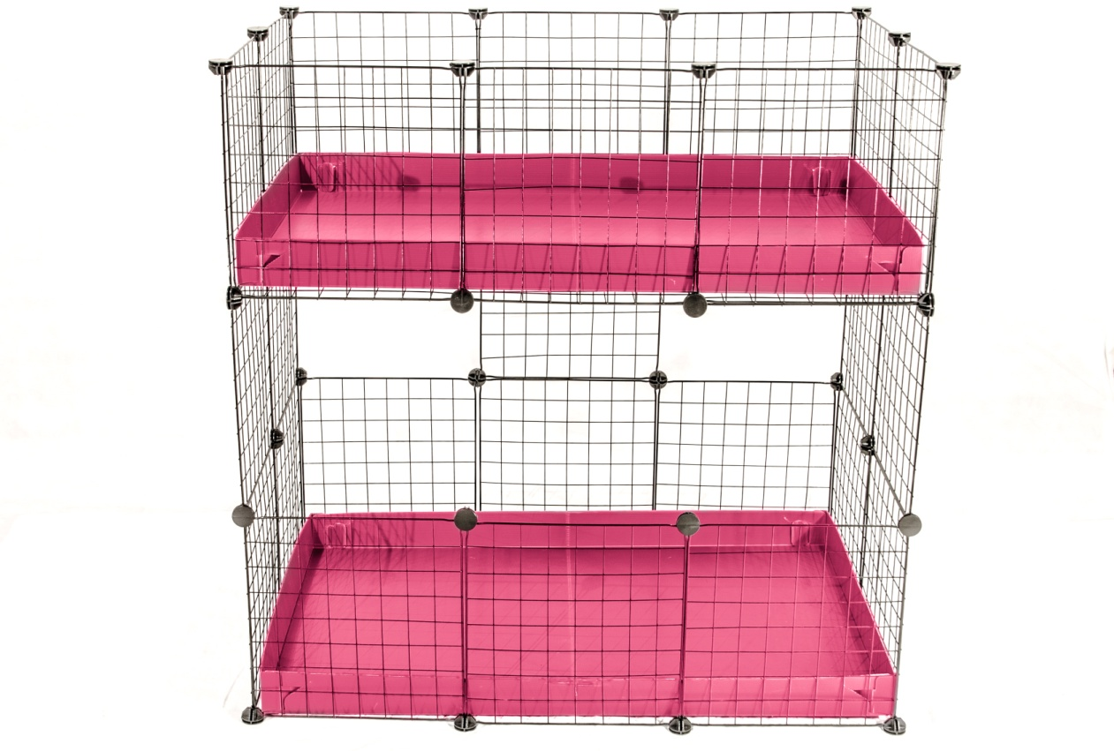
CAGE ASSEMBLY
Assemble the grids and the connectors following the below guideline ( you can zoom on the pictures if required).
Note: Don’t forget to follow the general guidelines
Once it is completed you can move on to the next step and insert the correx base
C&C Simple
C&C 2-Tier
For the 2nd Tier, do not forget to make a bottom with grids.

Slide 7
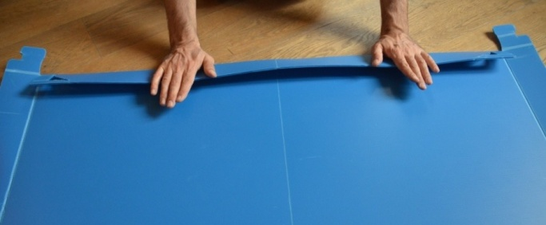
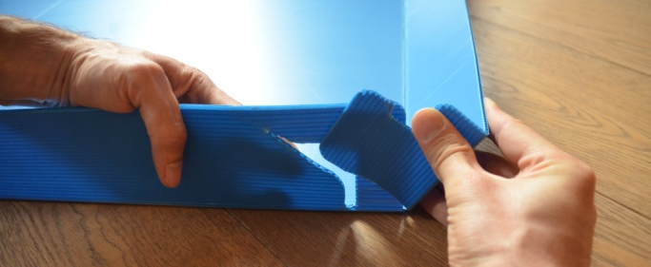
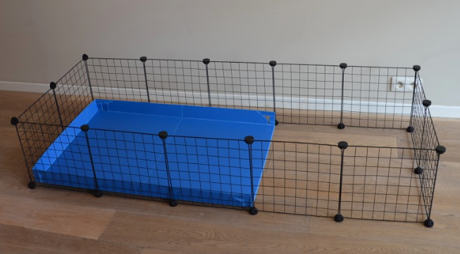
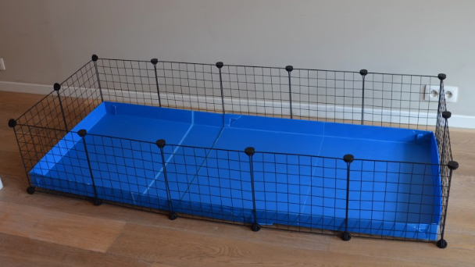
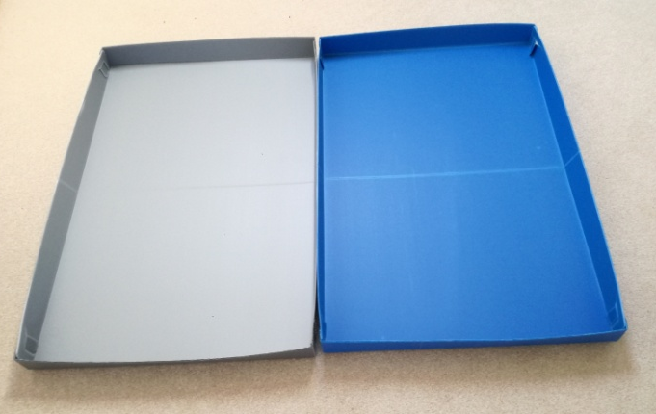
BOTTOM ASSEMBLY
1 - Fold the 4 edges of the correx sheet to help the bottom to get into shape.
2 - Then, assemble the 4 edges by inserting the hook, outside in the pre-cut hole.
Correx sheets combination
For C&C cages 3x3 and 5x2 you will have to combine 2 correx sheets to make the bottom. Let’s take the example of a 5x2 C&C cage:
Junction
Assemble and place the first 3x2 correx sheet, keeping one side with the edge open in flat position
Then prepare the second correx sheet keeping also one side and place it in overlay position
Option : For a cleaner junction, on the second correx sheet, you could also cut out the edge that will remain open and use some tape to attach the two correx sheets.
For C&C cages 4x4 and 6x2, you can also combine the 2 correx sheets as described before or you could simply lay them next to each other. Thanks to our low edge design, the piggies can easily "jump" over the edge, going from one base to another, giving them the opportunity to do a bit of exercise ☺.

Slide 8
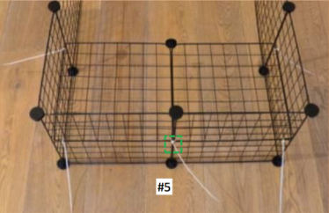
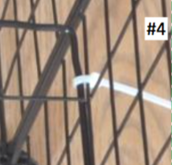
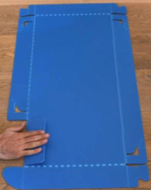
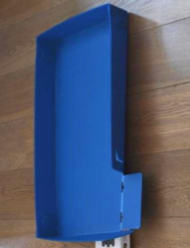
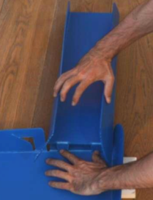
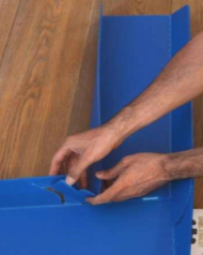
LOFT ASSEMBLY
#1
#5
#5
Mount the loft (2 grids + 1 connector) at half-height with the five cable ties. For the cable ties 1, 2, 4 and 5 proceed as shown on above picture. For the cable tie 3, use below instructions
#2
#4
#3
Loft correx assembly
Turn upside down the correx sheet of the mezzanine and fold the edge where the ramp will fit. Then, flip over the mezzanine and assemble the 3 corners, in the same way as the correx bottom. Then insert the two tabs of the ramp inside the two slits on the mezzanine. Finally, assemble the corner of the ramp with the mezzanine, inside out. The correx loft is ready to be fitted on the grids.

Slide 9
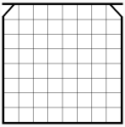
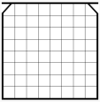
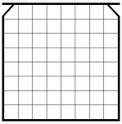
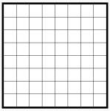
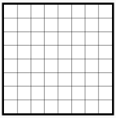
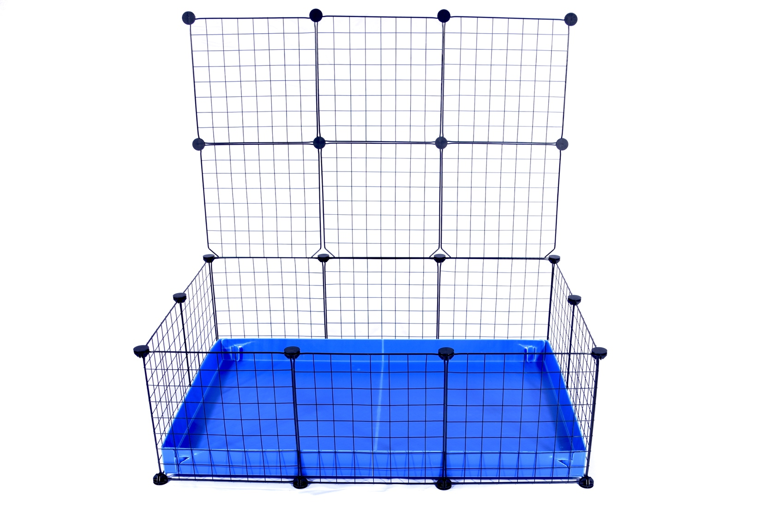
LID ASSEMBLY (1/3)
If you have selected a C&C cage with a lid, use below sketches to help yourself assembling your lid.
Lid 1x2 for Loft :
2 Door-grids
3 Connectors
Lid 3x2 :
3 Door-grids
3 Grids
8 Connectors
Lid 4x2 :
4 Door-grids
4 Grids
10 Connectors
Then, you just need to insert the hinges of the lid in the connectors of your C&C cage.
To prevent connectors breakage, it is recommended to not open the lid more than 180° and to put it against a wall

Slide 10
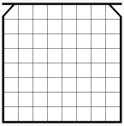
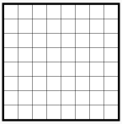
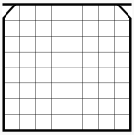
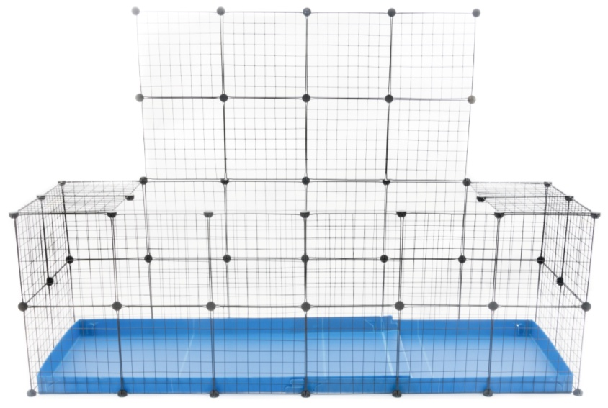
LID ASSEMBLY (2/3)
For the very large C&C cages, the lid is not meant to be bigger than 4x2. This is to keep enough rigidity.
Lid 5x2:
4 Door-grids
F I X E D
6 Grids
11 Connectors
variant
F I X E D
F I X E D
Lid 6x2:
5 Door-grids
F I X E D
7 Grids
16 Connectors
variant
F I X E D
F I X E D

Slide 11
LID ASSEMBLY (3/3)
Likewise for large enclosures, the lid dimensions should not exceed 4x3.
Lid 3x3:
F I X E D
3 Door-grids
6 Grids
10 Connectors
Lid 4x4:
F I X E D
4 Door-grids
12 Grids
18 Connectors
FIXED
FIXED

Slide 12
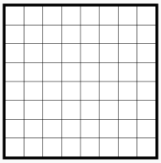
DOOR ASSEMBLY (1/2)
You can create openings using the door-grids which are included in the rabbit cages or also available in set on our webstore.
Single height door - Simple:
Remove the connector
Note: Insert that connector not too strongly, otherwise it will be harder for you to remove it
Gently pull on the door frame while pushing down at the same time on the grid next to it
- How to open and close easily the door of your C&C cage?
https://www.youtube.com/watch?v=HiIugZfUfMs
- Alternative options: Use only one of the 2 connectors to close the door
Or
Single height door - Double:

Slide 13
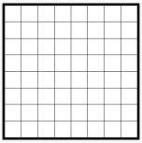
DOOR ASSEMBLY (2/2)
Double height door - Simple
Connector to be fitted sideway
Remove the connector
Gently pull on the bottom door frame while pushing down at the same time on the grid next to it
- How to open and close easily the double door of your C&C cage?
https://www.youtube.com/watch?v=9goLKiephR8
- Alternative option:
You can attach the 2 doors-grids together with a cable tie
Double height door - Double

