Slide 1

INDUSTRY INSIGHTS
Is Global Payroll Set-Up to Impact the Bigger Business Picture?

Slide 2







Introductions
MELANIE PIZZEY
Chief Executive Officer
RUAIRI KELLEHER
Chief Executive Officer
IVAN CHANEY
Senior Director, Global Strategy

Slide 3
Industry Insights: Demographic & Focus Areas

Slide 4




Understanding the Demographic
COUNTRY COVERAGE
ORGANIZATION SIZE
55%
represented organizations of over 2,500 employees
62%
Presence in 11 countries or more
JOB ROLE
REPORTING LINE
75%
Payroll Manager or higher
45%
44%
FINANCE
HR
1%
OTHER

Slide 5

Focus Areas
01
02
Global Payroll Operations & Vendor Relations
Technology
03
04
Payroll Information Access
Employee Experience
Notes:
https://401kspecialistmag.com/panic-attack-worker-financial-stress-costs-employers-500-billion-annually/

Slide 6
Industry Insights: The Findings

Slide 7


Global Payroll Operations
Processing and Analysis
Percentage of those that frequently use excel within payroll processing and data analysis
Over 71%
Notes:
EM

Slide 8
Global Payroll Operations
15+ days before payroll close
11-14 days before payroll close
22.9%
11.7%
PAYROLL CLOSE
What is your current payroll close date for all data inputs and
changes?
Under 6 days before payroll close
7-10 days before payroll close
26.4%
39%

Slide 9


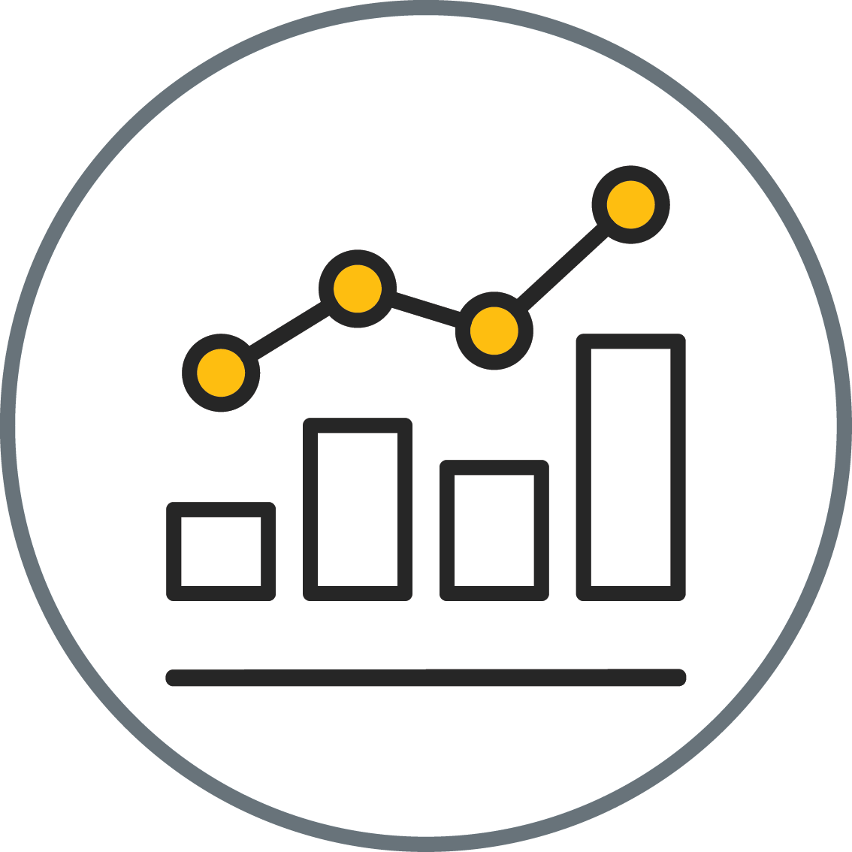
Vendor Relations
57.6%
Over 44%
Percentage of those that are managing anywhere between 5 and 101+ vendors
Do you believe there is a single vendor who can handle all of your
payroll needs globally?
42.4%
NO
YES
Top 3 focus areas for improvement relating to payroll provider services
46%
How important is achieving global payroll delivery through a single
vendor?
40%
VERY IMPORTANT
SOMEWHAT IMPORTANT
14%
1.
Compliance
2.
Accuracy
3.
Reporting Capability
NOT THAT IMPORTANT

Slide 10
Technology
Integration levels between Payroll Software and HCM Systems
Organizations with a cloud-based Human Capital Management (HCM) solution in place
66.7%
49.3%
14.6%
Integration but manual intervention required
Seamless Integration
Organizations with a cloud-based payroll solution in place
33.6%
36.1%
No integration

Slide 11
Payroll Information Access
How do you currently access payroll reports and analytics?
How long does it typically take to produce global payroll related reports?
31%
Real-time dashboard and access to relevant reports
19%
1 week+
More than 1 day
4-8 hours
1-3 hours
Instant access
41%
31%
Service provider delivers as part of the service
12%
31%
Manual consolidation of reports from multiple systems
12%
7%
Service provider delivers when requested
16%

Slide 12
Employee Experience
51.7%
EMPLOYEE SELF-SERVE
How do employees currently update their payroll related information?
24.9%
14.6%
8.8%
Self-service capability
Contact a member of HR/Payroll
Other
Dedicated mailbox for payroll queries
70.2%
ON-DEMAND PAY
Has your organization considered or are you currently using
on-demand pay?
16.1%
9.8%
3.9%
No plans to implement
Unsure
Future plans to implement
Currently in use

Slide 13


Questions?
Over to you…

Slide 14
THANK
YOU

