Slide 1

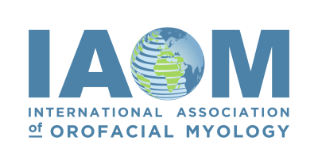

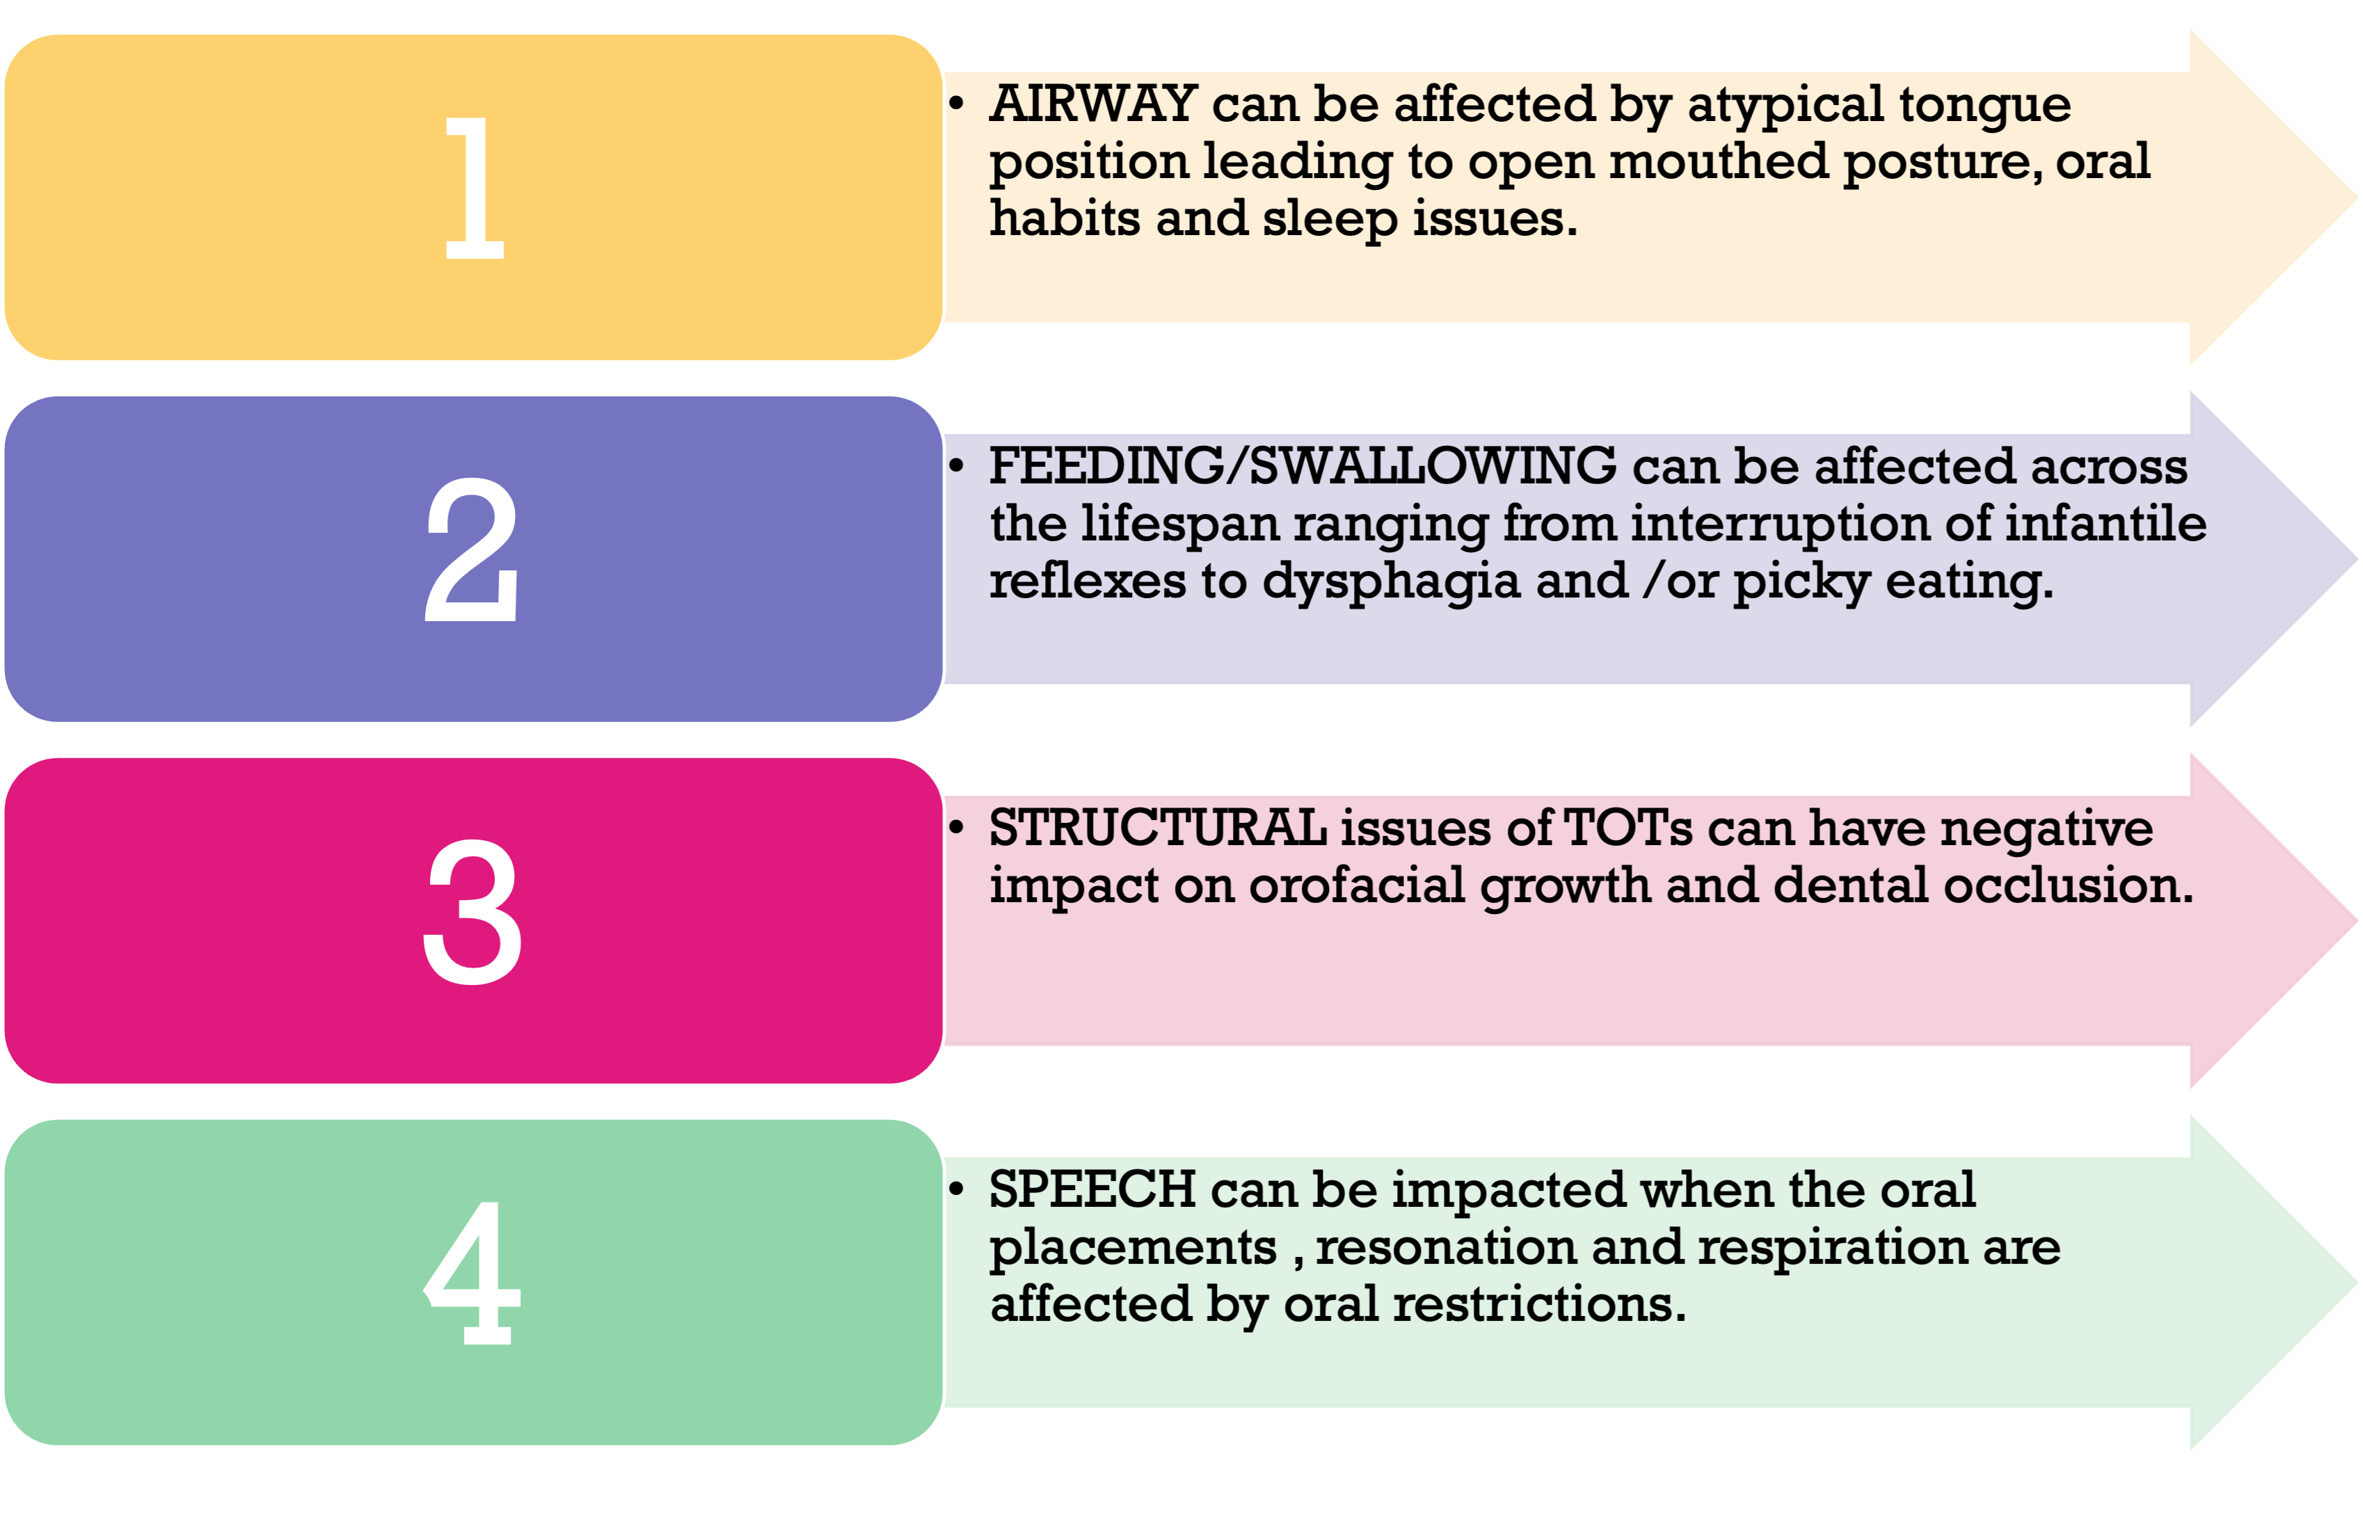
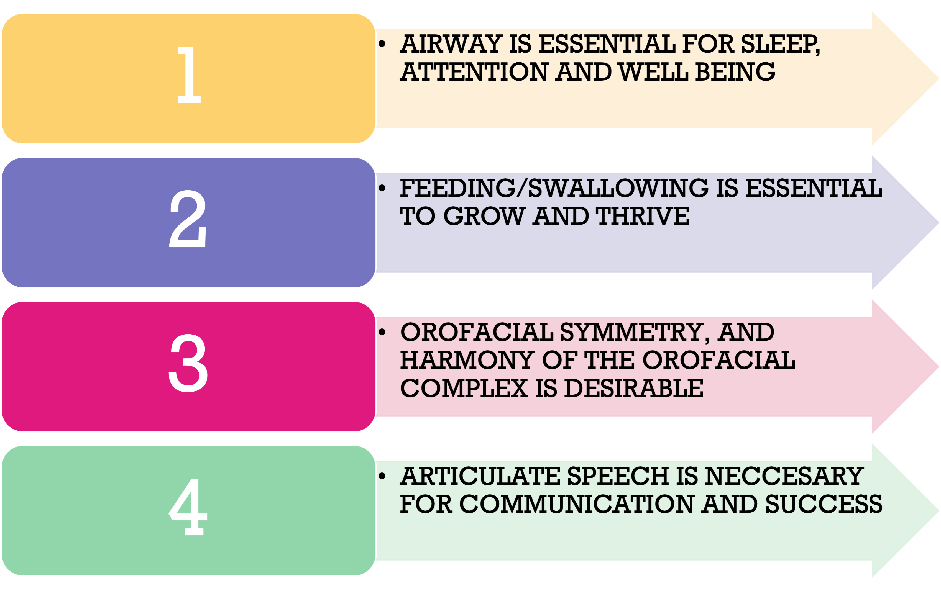
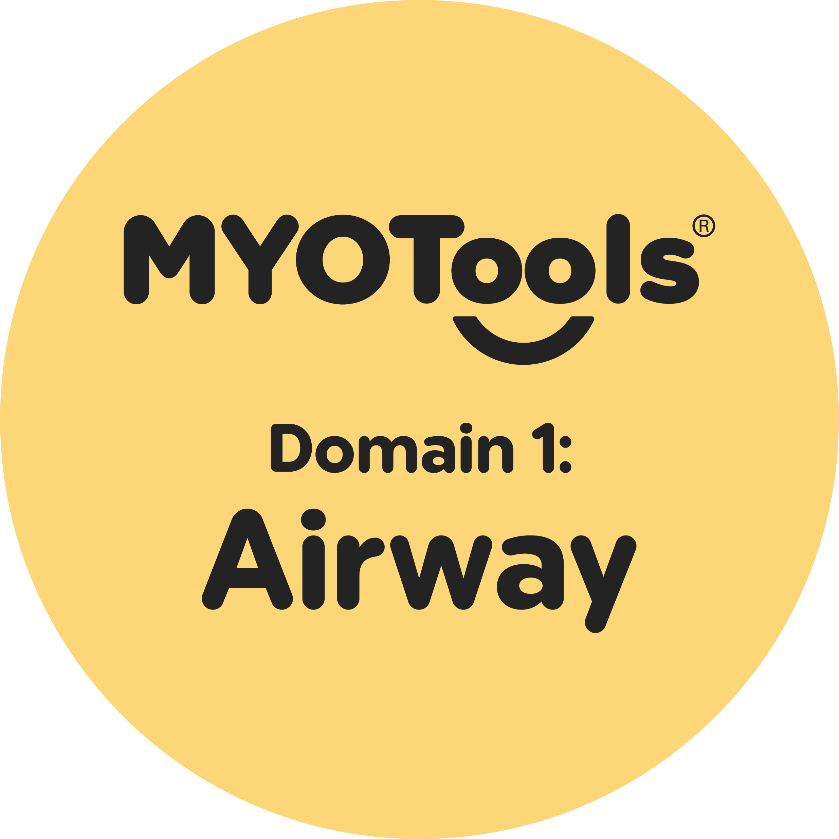
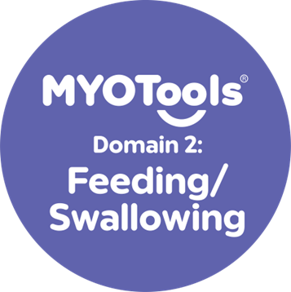

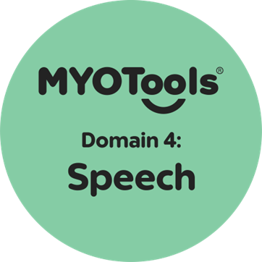
The Impact of Tethered Oral Tissues Across the 4 MYODomains™️
Robyn Merkel-Walsh,MA,CCC-SLP/COM®
ABSTRACT
DISCUSSION
AIRWAY
SPEECH
Board Certified Orofacial Myologists® (COMs®) are professionals who receive specialized training in the assessment and remediation of Orofacial Myofunctional Disorder (OMDs) including tethered oral tissue (TOTs). OMDs are the nexus of structure and function in which atypical movement pattern influence structure, or when structural anomalies impact function Merkel-Walsh, 2020).
TOTs are a congenital condition in which the oral frenula are too tight, too thick, too short and/or in an atypical location (Merkel-Walsh & Overland, 2018). TOTs may impact various areas of function ranging from breastfeeding challenges at birth, to sleep disturbances in adults.
The COM® is skilled to assess and support the functional challenges associated with TOTs and will be an important part of a TOTs care team. Since the impact of TOTs can be diverse, there are multiple members of the patient’s care team that address signs and symptoms of the disorder.
The purpose of this poster is to investigate a spectrum of symptoms that manifest from TOTs across the 4 MYODomains™, the current level of evidence across the three important pillars of clinical data, patient feedback and research. The importance of interprofessional collaboration and roles and responsibilities of licensed /certified professionals will also be explored.
OMDs include “dysfunction of the lips, jaw, tongue, and/or oropharynx that interferes with normal growth, development, or function of other oral structures, the consequence of a sequence of events or lack of intervention at critical periods that result in malocclusion and suboptimal facial development” (D’Onofrio, 2019, p.1). Symptoms can be present at birth or manifest over time. For example, a newborn may be diagnosed with abnormalities of structure such as ankyloglossia, dystonia or micrognathia which cause problematic feeding, swallowing or breathing. In contrast, a baby can be born with ideal orofacial structures but by four years of age, present with a dental malocclusion , tongue thrusting and speech challenges secondary to prolonged sucking habits.
When TOTs are present, signs and symptoms of both structure and function will be evident across the 4 MYODomains™ of airway, feeding/swallowing, structure and speech (Merkel-Walsh, 2024). This includes but is not limited to:
Airway: The anatomy and function of the lungs, larynx, tongue, nasal passages, and sinuses are essential for breathing, focus, attention, sleep, and maintaining proper oral resting posture. These systems directly affect overall health and well-being.
Feeding/Swallowing: Structural deficits or neuromuscular disorders (e.g., dystonia) can impair the swallowing process at various stages. This may lead to difficulties with food intake, bolus preparation and collection, bolus transfer, swallowing and ultimately digestion and/or food intake.
Structure: The orofacial complex consists of hard and soft tissues, muscles, fascia, and nerves that coordinate to support functional movement. Disruptions in this system, due to congenital anomalies, birth trauma, injury, developmental delays, and/or or harmful oral habits, can result in deficiencies, misalignment, asymmetry, and/or dysfunction od breathing, sleep, eating, swallowing or speaking.
Speech: Effective speech production relies on the coordination of the brain, nervous system, lungs, larynx, articulators, and resonators. OMDs can contribute to structural speech sound disorders, manifesting as hypo- or hypernasality, vocal strain, reduced phonatory control, lisping, speech sound distortions, and atypical oral placements for speech.
The tongue plays a vital role in respiration. Tethered oral tissues (TOTs) can negatively impact the airway by altering tongue posture, specifically when the tongue fails to rest against the hard palate. This atypical positioning can disrupt normal breathing patterns and contribute to sleep-disordered breathing. Genioglossus muscle dysfunction is frequently observed in individuals with tongue-tie as well as in those with sleep apnea (Azagra-Calero et al., 2012; Oh et al., 2021). A short lingual frenulum has been identified as a risk factor for sleep-disordered breathing (Villa et al., 2019; Bussi et al., 2022), and studies show that lingual laser frenectomy may improve obstructive sleep apnea syndrome (OSAS) in pediatric patients (Fioravanti, 2021).
When TOTs and airway concerns are present, the interdisciplinary clinical team should prioritize interventions targeting oral resting posture (e.g., orofacial myofunctional therapy), optimizing tongue space (e.g., palatal expansion), improving sleep quality (e.g., OMT, CPAP), and eliminating noxious oral habits (e.g., oral motor therapy/OMT). Otolaryngologists, airway-focused dental professionals, and sleep specialists play essential roles in these cases, working in collaboration with licensed myofunctional therapy providers.
Perhaps the most debated aspect of TOTs is their impact on speech, despite SLPs noting via clinical data and patients reporting faster progress in speech therapy when the condition is treated with frenectomy and oral motor/myofunctional therapy. While some studies show a notable correlation, others find limited statistical support. Marchesan (2004) reported that among subjects with altered lingual frenula, 48.81% of those with posterior ties had difficulty with /r/, /s/, and /z/; 57% of those with short frenula presented with speech issues; and 47.2% with anterior restrictions were similarly affected. Meaux et al. (2016) documented significant post-treatment improvements, including a reduction in fronting from 90% to 10% in one subject, and the elimination of fronting and stopping in another (40% to 0%). Assaf et al. (2021) found that tongue mobility and speech articulation significantly improved following frenuloplasty in children with ankyloglossia. Likewise, Messner & Lalakea (2022) and Ito et al. (2015) reported early improvements in substitution and omission errors following tongue-tie release. In contrast, Salt et al. (2020) found no statistically significant correlation between TOTs and speech disorders; however, they noted that 19% of children who underwent tongue-tie treatment had previously seen a speech-language pathologist due to persistent issues with alveolar and palato-alveolar phonemes (/l/, /s/, /r/, /ʃ/, /z/).
FEEDING/SWALLOWING
LEARNER OBJECTIVES
Observable complications secondary to TOTs include (but are not limited to) poor milk transfer, GERD, picky eating, inefficient mastication, delayed oral transit time, and tongue thrusting, which is supported by both clinical data and emerging literature. While the most robust body of evidence relates to the breastfeeding dyad (Cordray et al., 2023a; Hill, 2023), recent research is beginning to explore the broader feeding implications of TOTs beyond infancy and breastfeeding (Baxter et al., 2020; Cordray et al., 2023b). IBCLCs, speech/physical/occupational therapists, nutritionists and gastroenterologists are critical to the feeding/swallowing team.
SUMMARY
Learner Objectives:
Professionals will state how TOTs may impact the airway and sleep.
Professionals will define how ankyloglossia may impact speech.
Professionals will list 2 structural implications of TOTs.
Professionals will list 2 feeding complications (beyond breastfeeding) that are correlated with TOTs.
In conclusion, TOTs can have impact on all 4 MYODomains™ with mixed levels of evidence. Professionals specializing in orofacial myology should be educated and aware of the interaction of form and function and consider that:
More research is needed in each domain to include calculation of prevalence and correlation between impact of TOTs on other oral structures, feeding beyond the breast and the prevalence of speech sound disorders of non-tethered versus tethered subjects.
THE 4 MYODOMAINS™️
STRUCTURE
Since the tongue plays a critical role in shaping the palate in utero, ankyloglossia is often associated with a high, narrow palatal vault. Tongue-tie has also been implicated in various forms of malocclusion (Dydyk et al., 2023, D’Onofrio, 2019). Kotarska et al. (2024) identified ankyloglossia as a potential contributing factor to maxillary constriction, Class III malocclusion, and mandibular incisor crowding; however, a recent systematic review and meta-analysis by Póvoa-Santos et al. (2024) found no statistically significant correlation despite clinical reports of occlusal abnormalities in patients with tongue-tie. Additional structural anomalies include midline diastema in cases of maxillary labial frenulum restriction and periodontal concerns with labial or buccal TOTs (Merkel-Walsh & Overland, 2018; Baxter et al., 2024). Orthodontists will be a critical part of the OMD team.
REFERENCES
https://cdn.shopify.com/s/files/1/1545/7007/files/TOTsReferences-July_2025_1.pdf?v=1755533589

