Slide 1
BACnet and IoT [Internet of Things]
Albert Putnam
Cimetrics Analytika
BACnet and IoT for Users
Apologies to Toby Considine for not getting over IoT

Slide 2
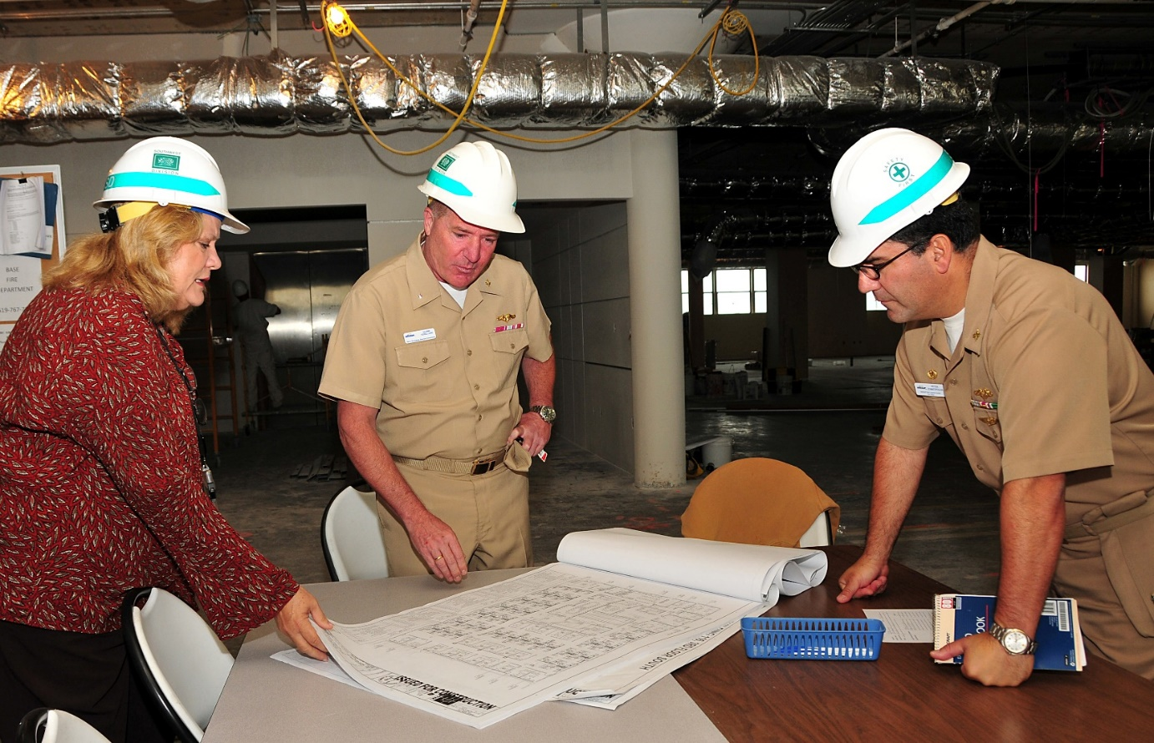
BACnet Users Group
Manufacturers, Contractors, Owners
Facilities Managers
Systems Managers

Slide 3
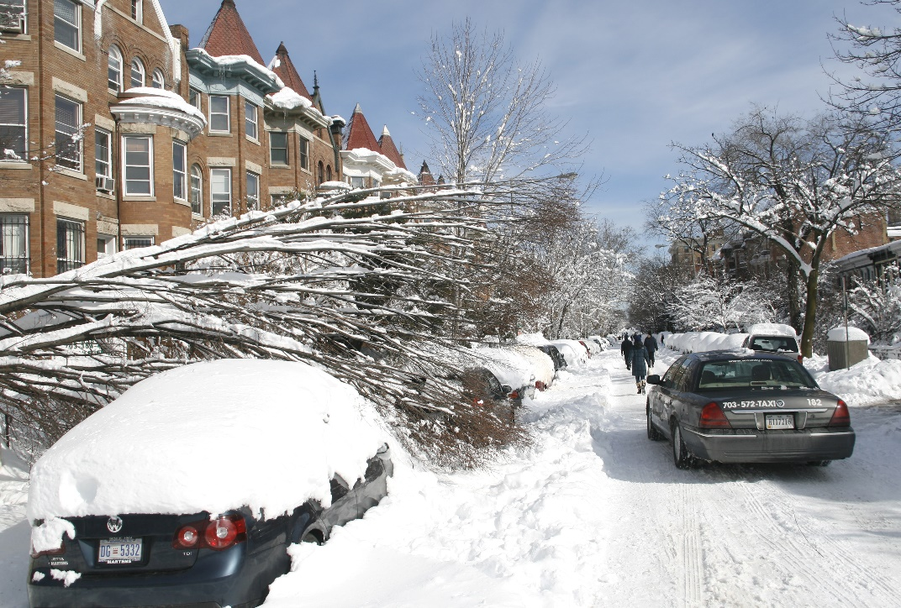
Darkness Despair Disaster

Slide 4
Crave - Stability and Reliability

Slide 5
Secondarily – Optimization and Efficiency
Make the best of what is given
Economically: Maximize ROI
Get the best outputs for inputs
Adjust inputs
Manage transformation

Slide 6
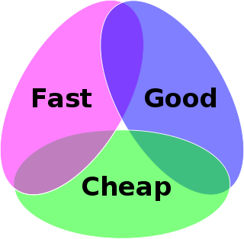
Optimization Triad
Quality
Economy
Speed

Slide 7
Any Offer strives to the following – including the Managed Things Opportunity
Deliver:
Stability, Reliability
Better output for inputs
ROI
Ecosystem of connected or managed things goals.

Slide 8
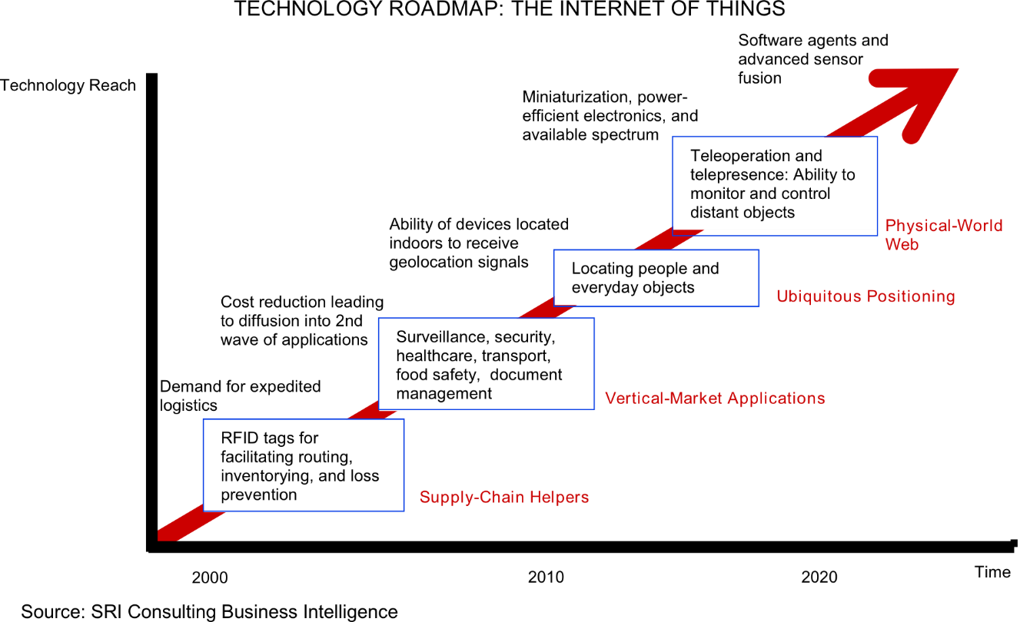
Internet of Things
Inventory Tracking
Smart Connected Devices

Slide 9
IoT Platform Components (Alan Messer, Samsung)
Out of Box User Experience
Privacy
Performance
Semantics
Data
Protocol
Communications
Security
Discovery
Setup
Longterm User Experience
Much focus on
Privacy
Security
Manageability
Quest: Interoperability

Slide 10
Lingua Franca - BACnet
Model
Defaults
Simple
Extensible
Reliability
Optimization
BACnet is ahead

Slide 11
What can BACnet borrow from IoT?
Social and behavioural strategies
Wireless background – WiFi, Bluetooth and others
RFID and location/tracking infrastructure
Energy harvesting and alternative energy sources
Low cost “dumb” sensor applicability – for things not in tight loops
Models of simplicity and “just good enough”

Slide 12
Systems – well understood and modeled
Get data flowing and managed
Get the analysis of the model into production and practice
Analytika Cimetrics

Slide 13
Cimetrics Analytika Offering
Analytika : Platform of production implementation of analysis of well modeled systems (of systems).
Cimetrics : TCP/IP connectivity solutions: BACnet, Modbus, MTconnect, Sunspec, OPC.
Excellent models and defaults to get productive quickly.

