Slide 1



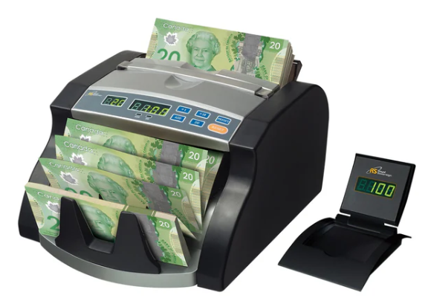


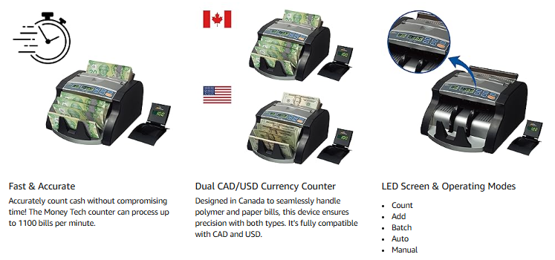

`
Canadian Commercial Bill Counter (CAD/USD)
Model RBC-1200-CA
Counts 1100 bills per minute
Back load hopper holds 130 bills at a time
Convenient automatic start
Retractable handle for easy carrying
Add mode shows cumulative total of all bills counted
Counts bills into batches from 1-999
External display included

Slide 2
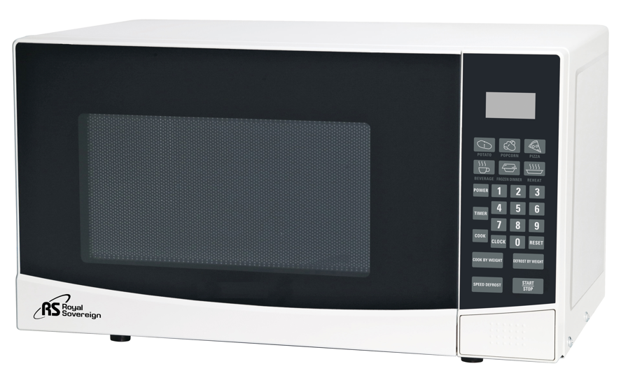
0.7 Cu. ft Countertop Microwave
Model RMW700-20W
Provides speed and convenience when reheating or cooking meals and snacks at home or work. Ideal for home,
hotel rooms, college dorms or small office breakrooms
Microwave power output: 700 watts
Touch pad controls and LED display
Digital clock and timer
6 convenient automatic cooking menus
10 microwave power levels
Speed & weight defrost
Child lock
Push button door
Colour: Stainless Steel with Black Body
Unit Dimensions: 17.8”W x 13.9”D x 10.3”H
Unit Weight: 23.1 lbs.

