Slide 1
Team Dealer Pre-Book Deck
2024

Slide 2
Mouthguards
Must order in Case Pack Quantity Increments of 6 units per style

Slide 3
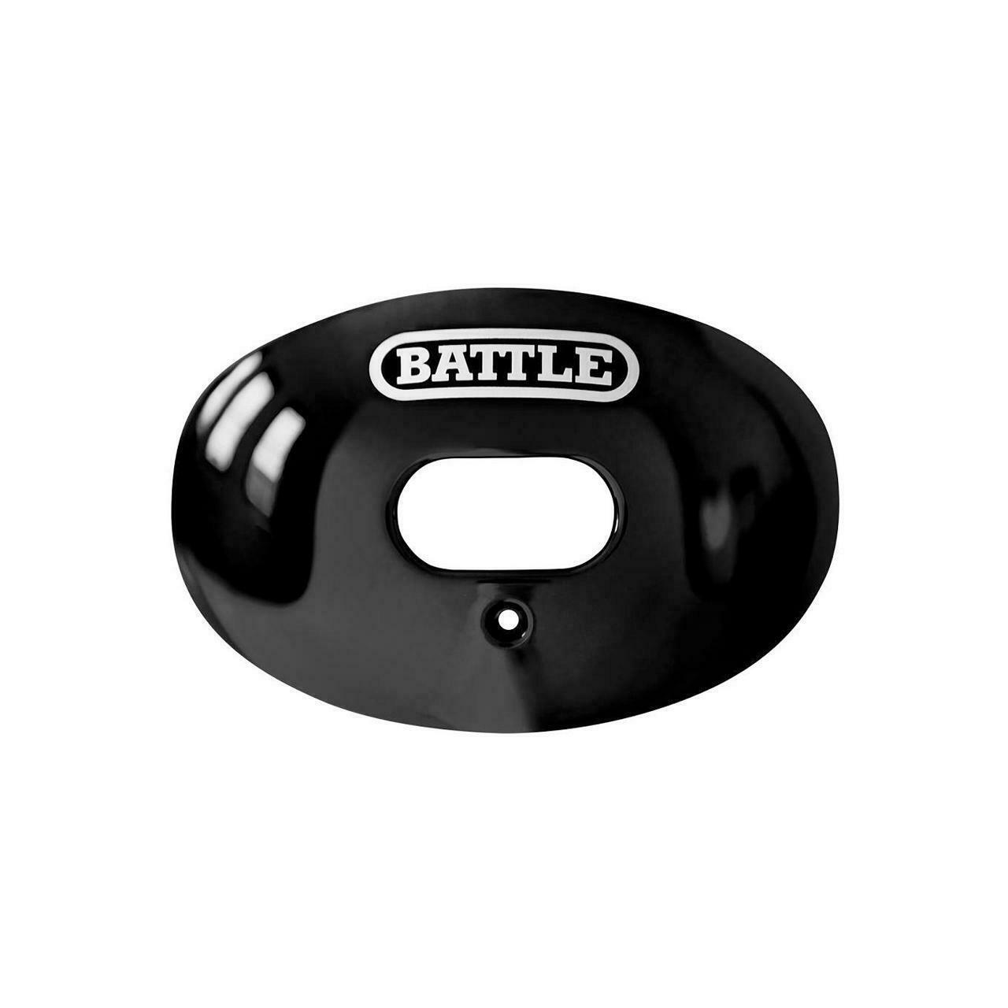
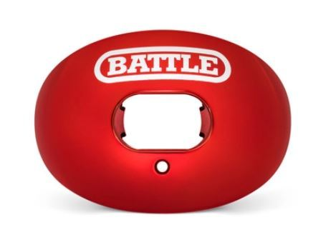
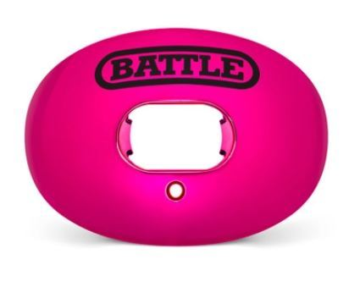
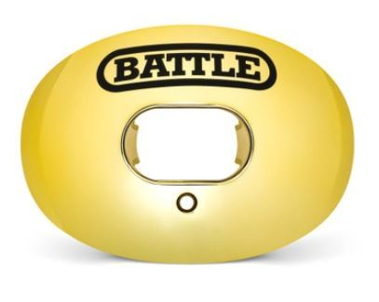
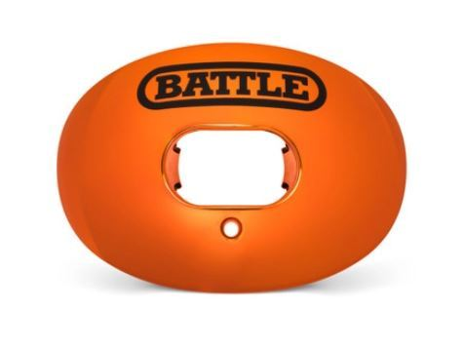
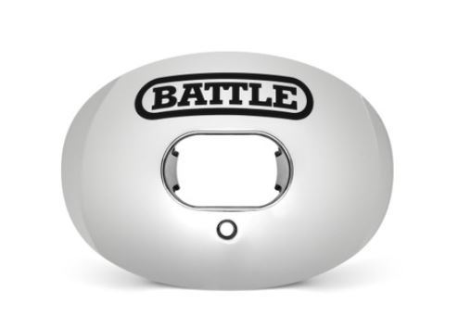
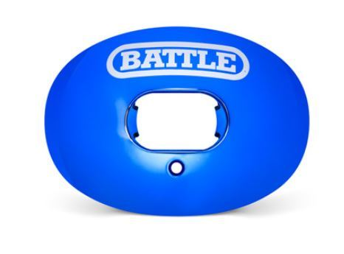
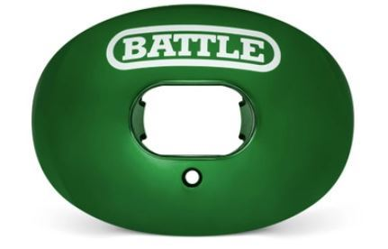
Oxygen - Chrome
Cost - $10.00 MSRP - $19.99
Red
Black
Pink
Gold
1MG000002
1MG000003
1MG000005
1MG000009
Orange
Green
Silver
Blue
1MG000013
1MG000014
1MG000016
1MG000011

Slide 4
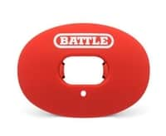
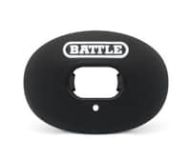
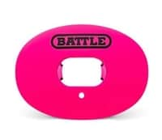
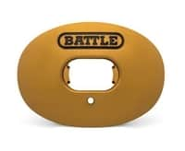
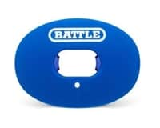
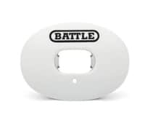
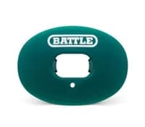
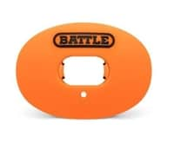
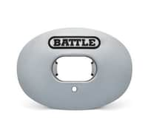
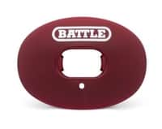
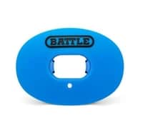
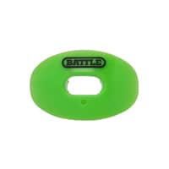
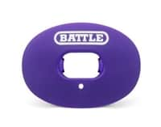
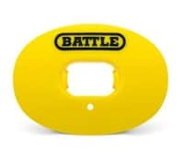
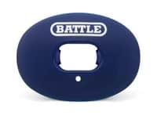
Oxygen – Convertible Strap
Cost - $8.00 MSRP - $15.99
Red
Black
Pink
Vegas Gold
Royal Blue
8204
8200
8216
8220
8206
White
Green
Orange
Silver
Maroon
8202
8208
8210
8212
8214
Purple
Yellow
Navy
Columbia Blue
Neon Green
8218
8222
8224
8226
8232

Slide 5
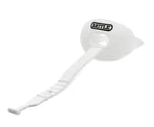
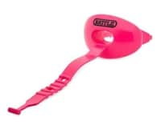
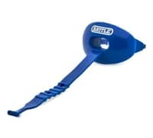
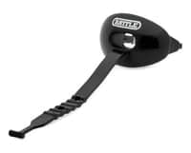
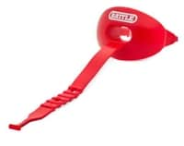
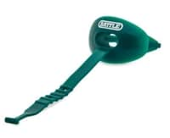
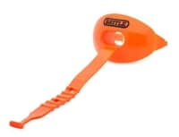
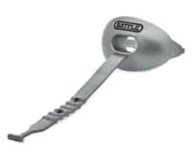
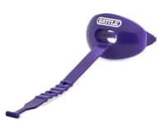
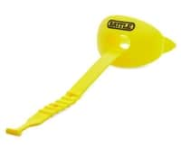
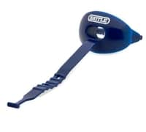
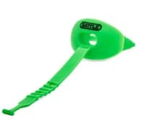
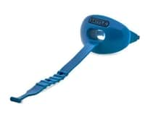
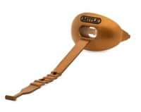
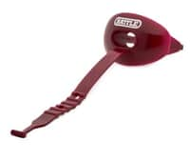
Oxygen – Convertible Strap
Cost - $8.00 MSRP - $15.99
White
Black
Pink
Red
Royal Blue
8802
8800
8816
8804
8806
Green
Orange
Silver
Purple
Yellow
8808
8810
8812
8818
8822
Navy
Neon Green
Columbia Blue
Gold
Maroon
8824
8828
8826
8820
8814

Slide 6
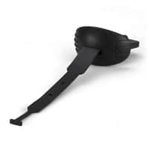
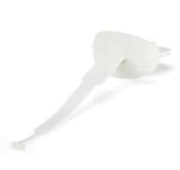
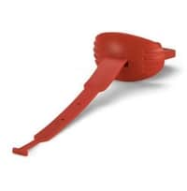
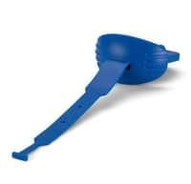
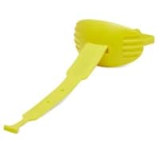
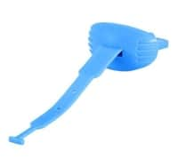
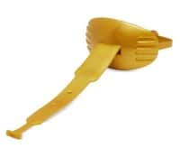
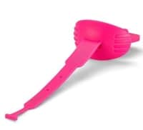
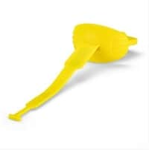
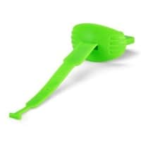
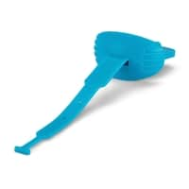
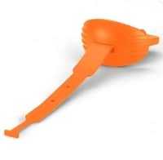
Oxygen – Speed
Cost - $8.00 MSRP - $15.99
Black
White
Red
Blue
33MG000003
33MG000001
33MG000002
33MG000011
Yellow
Columbia Blue
Gold
Neon Pink
33MG000021
33MG000036
33MG000009
33MG000028
Neon Yellow
Neon Green
Neon Blue
Neon Orange
33MG000015
33MG000014
33MG000029
33MG000013

Slide 7


Oxygen – Predator Chrome
Cost - $10.00 MSRP - $19.99
Gold/Black Fangs
Silver/Black Fangs
3MG000009
3MG000016

Slide 8






Oxygen – Predator
Cost - $10.00 MSRP - $19.99
Black/White Fangs
Red/White Fangs
White/Black Fangs
8250
8252
8258
Blue/White Fangs
Pink/Black Fangs
Neon Green/White Fangs
8266
8268
8262

Slide 9






Oxygen – 3D Diamonds
Cost - $15.00 MSRP - $29.99
White
Rose
Yellow
29MG000001
29MG000002
29MG000015
White Binky
Pink Binky
Yellow Binky
18MG400001
18MG400005
18MG400015

Slide 10

NEW Oxygen – 3D Diamonds
Cost - $15.00 MSRP - $29.99
USA Flag – Black/Gold
29MGUSA009

Slide 11




Oxygen – Iridescent
Cost - $10.00 MSRP - $19.99
Blue/Green
Blue/Purple
Yellow/Red
Red/Purple
22MG014011
22MG018002
22MG002015
22MG002018

Slide 12



Oxygen – Prism
Cost - $12.50 MSRP - $24.99
Blue/Green
Gold/Blue
Red/Orange
28MG014011
28MG009011
28MG002013

Slide 13



Oxygen – Speed Novelty
Cost - $10.00 MSRP - $19.99
Beware of Dog – White Strap
USA Flag – Blue Strap
Predator – Black with White Teeth
33MGBOD003
33MGUSA011
33MGFNG003

Slide 14




Oxygen – Carbon Chrome
Cost - $10.00 MSRP - $19.99
Black
Pink
2MG000003
2MG000005
Gold
Silver
2MG000009
2MG000016

Slide 15





Oxygen – 3D Predator
Cost - $12.50 MSRP - $24.99
Black/Pink
Black/Gold
Black/Silver
12MG000005
12MG000009
12MG000016
White/Gold
White/Red
12MG001009
12MG001002

Slide 16


Oxygen – 3D Apex Predator
Cost - $12.50 MSRP - $24.99
Black/Silver
Black/Gold
12MGG00016
12MGG00009

Slide 17


Oxygen – 3D Drip
Cost - $12.50 MSRP - $24.99
Gold/Black
Silver/Black
12MGD00009
12MGD00016

Slide 18


Oxygen – 3D Cross
Cost - $12.50 MSRP - $24.99
White/Gold
Gold/Black
12MGX01009
12MGX09003

Slide 19






Oxygen – Spinner
Cost - $12.50 MSRP - $24.99
Money – White/Green
Money – Black/Gold
Black/Gold
8MGBEN001
8MGBEN003
8MG000009
Black/Silver
Kaleidoscope
Padlock
8MG000016
8MGK00003
8MGPAD003

Slide 20





Oxygen – Binky
Cost - $12.50 MSRP - $24.99
Baby Blue/Pink
Red/White
Neon Green/White
18MG000005
18MG000002
18MG000004
Royal Blue/White
Pink/Baby Blue
18MG000011
18MG011005

Slide 21





Oxygen – Chrome Binky
Cost - $13.50 MSRP - $26.99
Chrome Gold
Chrome Silver
Chrome Pink
18MG200009
18MG200016
18MG200005
Chrome Blue/Pink
Chrome RWB
18MG205036
18MG2US002

Slide 22



Oxygen – Iridescent Binky
Cost - $13.50 MSRP - $26.99
Blue/Green
Yellow/Pink
Blue/Purple
18MG314011
18MG305015
18MG318011

Slide 23








Oxygen – Novelty
Cost - $10.00 MSRP - $19.99
Filthy Rich
Benjamin
Money Man
Graffiti
27MG200001
8282
32MG000005
30MG005001
Street Art
Street Art 2.0
Speed Freak
Neon Repeater
30MG000001
30MG200001
35MG000003
31MG036028

Slide 24








Oxygen – Novelty
Cost - $10.00 MSRP - $19.99
Ruthless – Black/White
Ruthless – Red/Black
Beware of Dog
Beware of Dog – Red/White
13MG000003
13MG000002
8292
8292R
Clown
Clown 23 - Red
Nightmare
No Trespassing
16MGCLO003
16MGCL2002
16MGPUR003
8283

Slide 25



NEW Oxygen – Novelty
Cost - $10.00 MSRP - $19.99
Nightmare 3.0
Alien – Pink/Blue
Wanted
16MGPUR004
16MGALN005
37MG000001

Slide 26






Oxygen – Novelty - Flags
Cost - $10.00 MSRP - $19.99
American Flag
Texas Flag
Maryland State Flag
8239
8278
8270
Chrome USA Flag 2.0
Chrome USA Flag Gold/Black
Chrome USA Black/White
9MG200002
9MG200009
9MG200003

Slide 27


Oxygen – Novelty – License Plates
Cost - $10.00 MSRP - $19.99
California Plate
Texas Plate
8289CAL
8289

Slide 28

Oxygen – Standard Ultra Slim
Cost - $9.00 MSRP - $17.99
Black
23MG000003

Slide 29





Oxygen – Chrome Ultra Slim (Grillz)
Cost - $10.00 MSRP - $19.99
Silver
Gold
Pink
25MG000016
25MG000009
25MG000005
Red
Blue
25MG000002
25MG000011

Slide 30










2 Color Mouthguards – 2 Pack
Adult – Cost - $6.50 MSRP - $12.99 / Youth – Cost $6.50 MSRP $12.99
Red
Royal Blue
Green
Yellow
Silver
7702A/7702Y
7704A/7704Y
7706A
7708A
7710A/7710Y
Orange
Purple
Dark Pink
Vegas Gold
Columbia Blue
7712A/7712Y
7714Y
7716Y
7718Y
7720A/7720Y

Slide 31









2 Color Mouthguards – 2 Pack
Adult – Cost - $6.50 MSRP - $12.99 / Youth – Cost $6.50 MSRP $12.99
Maroon
Red/Silver
Light Pink/White
Navy/Yellow
Red/Royal Blue
7722A/7722Y
7724A/7724Y
7738A/7738Y
7728A/7728Y
7730A/7730Y
White
Black/White
Navy
Neon Green
7732A/7732Y
7700A/7700Y
7726Y
7734A

Slide 32









Fang Mouthguards – 2 Pack
Adult – Cost - $9.00 MSRP - $17.99 / Youth – Cost $9.00 MSRP $17.99
Black/White
Red
Royal
Yellow
Black/Silver
8702A/8702Y
8704A/8704Y
8706A/8706Y
8708A/8708Y
8714A/8714Y
Black/Vegas
Neon Green
Pink
Red/Silver
8716A/8716Y
8718A/8718Y
8720A/8720Y
8712A/8712Y

Slide 33







Camo Mouthguards – 2 Pack
Adult – Cost - $7.50 MSRP - $14.99 / Youth – Cost $7.50 MSRP $14.99
Red
Neon Green
Pink
Blue
7741A/7741Y
7743A/7743Y
7744A/7744Y
7742Y
Black
Orange
Yellow
7740Y
7745A
7746A/7746Y

Slide 34






Ultra-Fit
Adult – Cost - $7.00 MSRP - $13.99 / Youth – Cost $6.50 MSRP $12.99
Black
Blue
Pink
10MG000003/
11MG000003
10MG000011/
11MG000011
10MG000005/
11MG000005
Purple
Red
Orange
10MG000018
11MG00002
10MG000013

Slide 35



Ultra-Fit - Novelty
Adult – Cost - $8.50 MSRP - $16.99
Emoji – Clown
Hollywood
Crib – Neon Pink
10MGCLO002
10MGHOL002
10MGCRB002

Slide 36




Chin Straps
Adult – Cost - $10.00 MSRP - $19.99 / Youth – Cost $10.00 MSRP $19.99
Black
White
Red
Blue
26AC000003/
26ACY00003
26AC000001/
26ACY00001
26AC000002/
26ACY00002
26AC000011/
26ACY00011

Slide 37
Gloves
Must order in Case Pack Quantity Increments of 2 units per style and size

Slide 38

Double Threat
Adult – Cost - $20.00 MSRP - $39.99 / Youth – Cost - $15.00 MSRP $29.99
Navy Red Pink Purple Black Orange Yellow Green Blue White Charcoal
9326 9320 9328 9323 9304 9322 9325 9324 9321 9302 9329

Slide 39

2024 Solid Color Assortment
Doom 1.0
Adult – Cost - $25.00 MSRP - $49.99 / Youth – Cost - $20.00 MSRP $39.99
White Black Pink Red
5GL000001/5GLY00001 5GL000003/5GLY00003 5GL000005/5GLY00005 5GL000002/5GLY00002

Slide 40

2024 Multi-Color Assortment
Ultra Stick
Adult – Cost - $20.00 MSRP - $39.99 / Youth – Cost - $15.00 MSRP $29.99
White/Gold Green/Black Black/Pink Red/White Blue/White Green/White
9327 9306 9307 9308 9309 9313
Pink/White Yellow/Black Black/White Black/Gold Silver/Black
9318 9312 9300 9310 9311

Slide 41








Doom – Graphic
Adult – Cost - $25.00 MSRP - $49.99 / Youth – Cost - $20.00 MSRP $39.99
Graffiti23
Beware of Dog
Beware of Dog -Red
Skull Face
1GLSKL003
7GLGF2001/7GLYG2001
5GLBOD003/5GLYBD003
5GLBOD002/5GLYBD002
Call Your Mom
Cash Money
USA
Filthy Rich 2.0 - Gold
7GLCYM001/7GLYCM001
5GLCSH014/5GLYCS014
5GLUSA003/5GLYUS003
9GL000009/9GLY00009

Slide 42



NEW Doom – Graphic
Adult – Cost - $25.00 MSRP - $49.99 / Youth – Cost - $20.00 MSRP $39.99
Wanted – Black/White
USA Glitter - Gold
Big Motion
5GLWAN001/5GLYWN001
5GLUSA009/5GLYUS009
2GL400001/2GLY40001

Slide 43


Ultra Stick – Palm Graphic
Adult – Cost - $22.50 MSRP - $44.99 / Youth – Cost - $17.50 MSRP $34.99
Finally Rich 2.0
Gang Gang - Black
6GLGNG003/6GLYGG003
2GL200001/2GLY20001

Slide 44








Ultra Stick – Back of Hand
Adult – Cost - $25.00 MSRP - $49.99 / Youth – Cost - $20.00 MSRP $39.99
Lil Evil
Nightmare
Nightmare 2.0
Clown23 - Red
1GLEVL999/1GLYEV999
1GLPUR999/1GLYPR999
1GLPUR034/1GLYPR034
1GLCLO002/1GLYCL002
Speed Freak - Black
Speed Freak - White
Alien - Pink
Alien - Turquoise
1GLFRK003/1GLYFK003
1GLFRK001/1GLYFK001
4GL004005/4GLY04005
4GL004035/4GLY04035

Slide 45


NEW Ultra Stick – Back of Hand
Adult – Cost - $25.00 MSRP - $49.99 / Youth – Cost - $20.00 MSRP $39.99
Nightmare 3.0
Alien – Blue/White
1GLPUR004/1GLYPR004
4GL001011/4GLY01011

Slide 46




Triple Threat– Palm Graphic
Adult – Cost - $25.00 MSRP - $49.99 / Youth – Cost - $20.00 MSRP $39.99
Money Man 2.0 – Green
Money Man 2.0 – Blue
3GL200004/3GLY20004
3GL200036/3GLY20036
Money Man 2.0 - Pink
Graffiti
3GL200005/3GLY20005
7GLGRF001/7GLYGF001

Slide 47
Backplates
Must order in Case Pack Quantity Increments of 6 units per style

Slide 48



Standard Backplates
Adult – Cost $20.00 MSRP $39.99 / Youth – Cost $17.50 MSRP $34.99
White
Black
Copper
7AC000001/8AC000001
9AC000003/10AC000003
11AC000009/12AC000009

Slide 49




Chrome Backplates
Adult – Cost $22.50 MSRP $44.99 / Youth – Cost $19.00 MSRP $37.99
Red Chrome
Gold Chrome
24AC000002/25AC000002
24AC000009/25AC000009
Silver Chrome
Blue Chrome
24AC000016/25AC000016
24AC000011/25AC000011

Slide 50




Flags Backplates
Adult – Cost $25.00 MSRP $49.99 / Youth – Cost $20.00 MSRP $39.99
Chrome Black/White American Flag 2.0
Chrome Red/White/Blue American Flag 2.0
24AC201003/25AC201003
24AC202011/25AC202011
Chrome Gold American Flag 2.0
Texas Flag
24AC209003/25AC209003
24ACTEX002/25ACTEX002

Slide 51



License Plate Backplates
Adult – Cost $25.00 MSRP $49.99
Texas
California
Florida
24ACTEX003
24ACCAL003
24ACFLA003

Slide 52


NEW License Plate Backplates
Adult – Cost $25.00 MSRP $49.99
Arizona
Ohio
24ACARZ003
24ACOHI003

Slide 53




Novelty Backplates
Adult – Cost $25.00 MSRP $49.99
Clown
Call Your Mom
Cash Money
Krazy Klown
24ACPEN999
24ACCYM003
24ACCSH014
24ACCHK999

Slide 54



Novelty Backplates
Adult – Cost $25.00 MSRP $49.99 / Youth – Cost $20.00 MSRP $39.99
Slow AF
Nightmare
Speed Freak
24ACSAF004/25ACSAF004
24ACPUR999/25ACPUR999
24ACFRK003/25ACFRK003

Slide 55




Novelty Backplates
Adult – Cost $25.00 MSRP $49.99 / Youth – Cost $20.00 MSRP $39.99
Graffiti
Clown23 - Red
24ACGRF001/25ACGRF001
24ACPEN002/25ACPEN002
Money Man
Clown23 - Yellow
24ACMON005/25ACMON005
24ACPEN015/25ACPEN015

Slide 56

NEW Novelty Backplates
Adult – Cost $25.00 MSRP $49.99 / Youth – Cost $20.00 MSRP $39.99
Big Motion
24ACBMO001/
25ACBMO001

Slide 57




Iridescent/Prism Backplates
Adult – Cost $30.00 MSRP $59.99 / Youth – Cost $25.00 MSRP $49.99
Iridescent Chrome
Prism Blue/Green
24AC001034/25AC001034
24ACPSM011/25ACPSM011
Prism Gold/Blue
Prism Red/Orange
24ACPSM009/25ACPSM009
24ACPSM002/25ACPSM002

Slide 58

Diamonds Backplate
Adult – Cost $30.00 MSRP $59.99 / Youth – Cost $25.00 MSRP $49.99
White
24ACDIA001/25ACDIA001

Slide 59


NEW Diamonds Backplate
Adult – Cost $30.00 MSRP $59.99 / Youth – Cost $25.00 MSRP $49.99
Gold
Rich Flex
24ACDIA009/25ACDIA009
24ACRCH014/25ACRCH014

Slide 60
Sleeves
Must order in Case Pack Quantity Increments of 3 units per style and size (when applicable)

Slide 61






Ultra – Stick Arm Sleeve
Adult – Cost $8.50 MSRP $16.99 / Youth – $8.50 MSRP $16.99
Adult Sizes S/M or L/XL – Youth Sizes S/M or L/XL
Black
White
Gold
9450
9451
9452
Pink
Blue
Red
9454
9456
9457

Slide 62


Leg Sleeve
Adult – Cost $10.00 MSRP $19.99 / Youth – $10.00 MSRP $19.99
Adult Sizes S/M or L/XL – Youth Sizes S/M or L/XL
White
Black
37AC000001/37ACY00001
37AC000003/
37ACY00003

Slide 63


Ultra-Stick Forearm Sleeve
Adult – Cost $7.50 MSRP $14.99 / Youth – $7.50 MSRP $14.99
Adult Sizes S/M or L/XL – Youth Sizes S/M or L/XL
White
Black
9410
9400

Slide 64


No Tack Full Arm Sleeve
Adult – Cost $8.50 MSRP $16.99
Adult Sizes S/M, L/XL, or XXL/XXXL
White
Black
44AC000001
44AC000003

Slide 65


Elbow & Forearm Padded Sleeve
Adult – Cost $12.50 MSRP $24.99
Adult Sizes S/M or L/XL
White
Black
9463
9462

Slide 66





Sock Sleeve
Adult – Cost $8.50 MSRP $16.99 / Youth – Cost $8.50 MSRP $16.99
Adult Sizes S/M or L/XL – Youth O/S
White
Red
Black
Pink
Blue
35AP400001/35AP4Y0001
35AP400002/35AP4Y0002
35AP400003/
35AP4Y0003
35AP400005/35AP4Y0005
35AP400011/35AP4Y0011

Slide 67
Accessories
Must order in Case Pack Quantity Increments of 3 units per style and size (when applicable)

Slide 68






Skull Wraps
Cost $8.50 MSRP $16.99
White
Red
Black
9711
9712
9710
Pink
Blue
Gold
9717
9713
9714

Slide 69






Lightweight Mesh Skull Wraps
Cost $8.50 MSRP $16.99
White
Red
Black
41AC200001
41AC200002
41AC200003
Pink
Blue
Neon Green
41AC200028
41AC200011
41AC200004

Slide 70




Head Ties
Cost $8.50 MSRP $16.99
White
Red
Black
Blue
9742
9743
9740
9741

Slide 71



Turf Tape
Cost $12.50 MSRP $24.99
*Must be ordered in Case Pack increments of 12
White
Pink
Black
33AC000001
33AC000005
33AC000003

Slide 72





NEW Turf Tape
Cost $12.50 MSRP $24.99
*Must be ordered in Case Pack increments of 12
Red
Neon Green
33AC000002
33AC000004
Navy
Royal
Neon Orange
33AC000017
33AC000011
33AC000013

Slide 73




Football Towel
Adult – Cost $8.50 MSRP $16.99 / Youth – Cost $8.00 MSRP $15.99
White/Black
White/Gold
Pink
Black
18AC000001/
22AC000001
18AC009001/
22AC009001
18AC000005/
22AC000005
18AC000003/
22AC000003

Slide 74




Streamer Towel
Cost $8.00 MSRP $15.99
White
Pink
Black
Neon Green
18AC200001
18AC200005
18AC200003
18AC200004

Slide 75




Arm Band (2 per Pack)
Cost $5.00 MSRP $9.99
White
Pink
Blue
Black
20AC000001
20AC000005
20AC000011
20AC000003

Slide 76




Thick Arm Band (2 per Pack)
Cost $5.00 MSRP $9.99
White
Pink
Green
Black
20AC200001
20AC200005
20AC200004
20AC200003

Slide 77


Hand Warmer
Adult – Cost $16.50 MSRP $32.99 / Youth – Cost $16.50 MSRP $32.99
White
Black
16AC000001/17AC000001
16AC000003/17AC000003

Slide 78





Performance Mask
Cost $12.50 MSRP $24.99
White
Red
46AC000001
46AC000002
Neon Pink
Black
Royal Blue
46AC000028
46AC000003
46AC000011

Slide 79








Long Socks
Adult – Cost $10.00 MSRP $19.99 / Youth – Cost $10.00 MSRP $19.99
Adult sizes S/M or L/XL – Youth O/S
White
Red
Blue
Athletic Gold
35AP300001/
35AP3Y0001
35AP300002/
35AP3Y0002
35AP300011/
35AP3Y0011
35AP300024/
35AP3Y0024
Navy
Pink
Purple
Black
35AP300017/
35AP3Y0017
35AP300005/
35AP3Y0005
35AP300018/
35AP3Y0018
35AP300003/
35AP3Y0003

