Slide 1



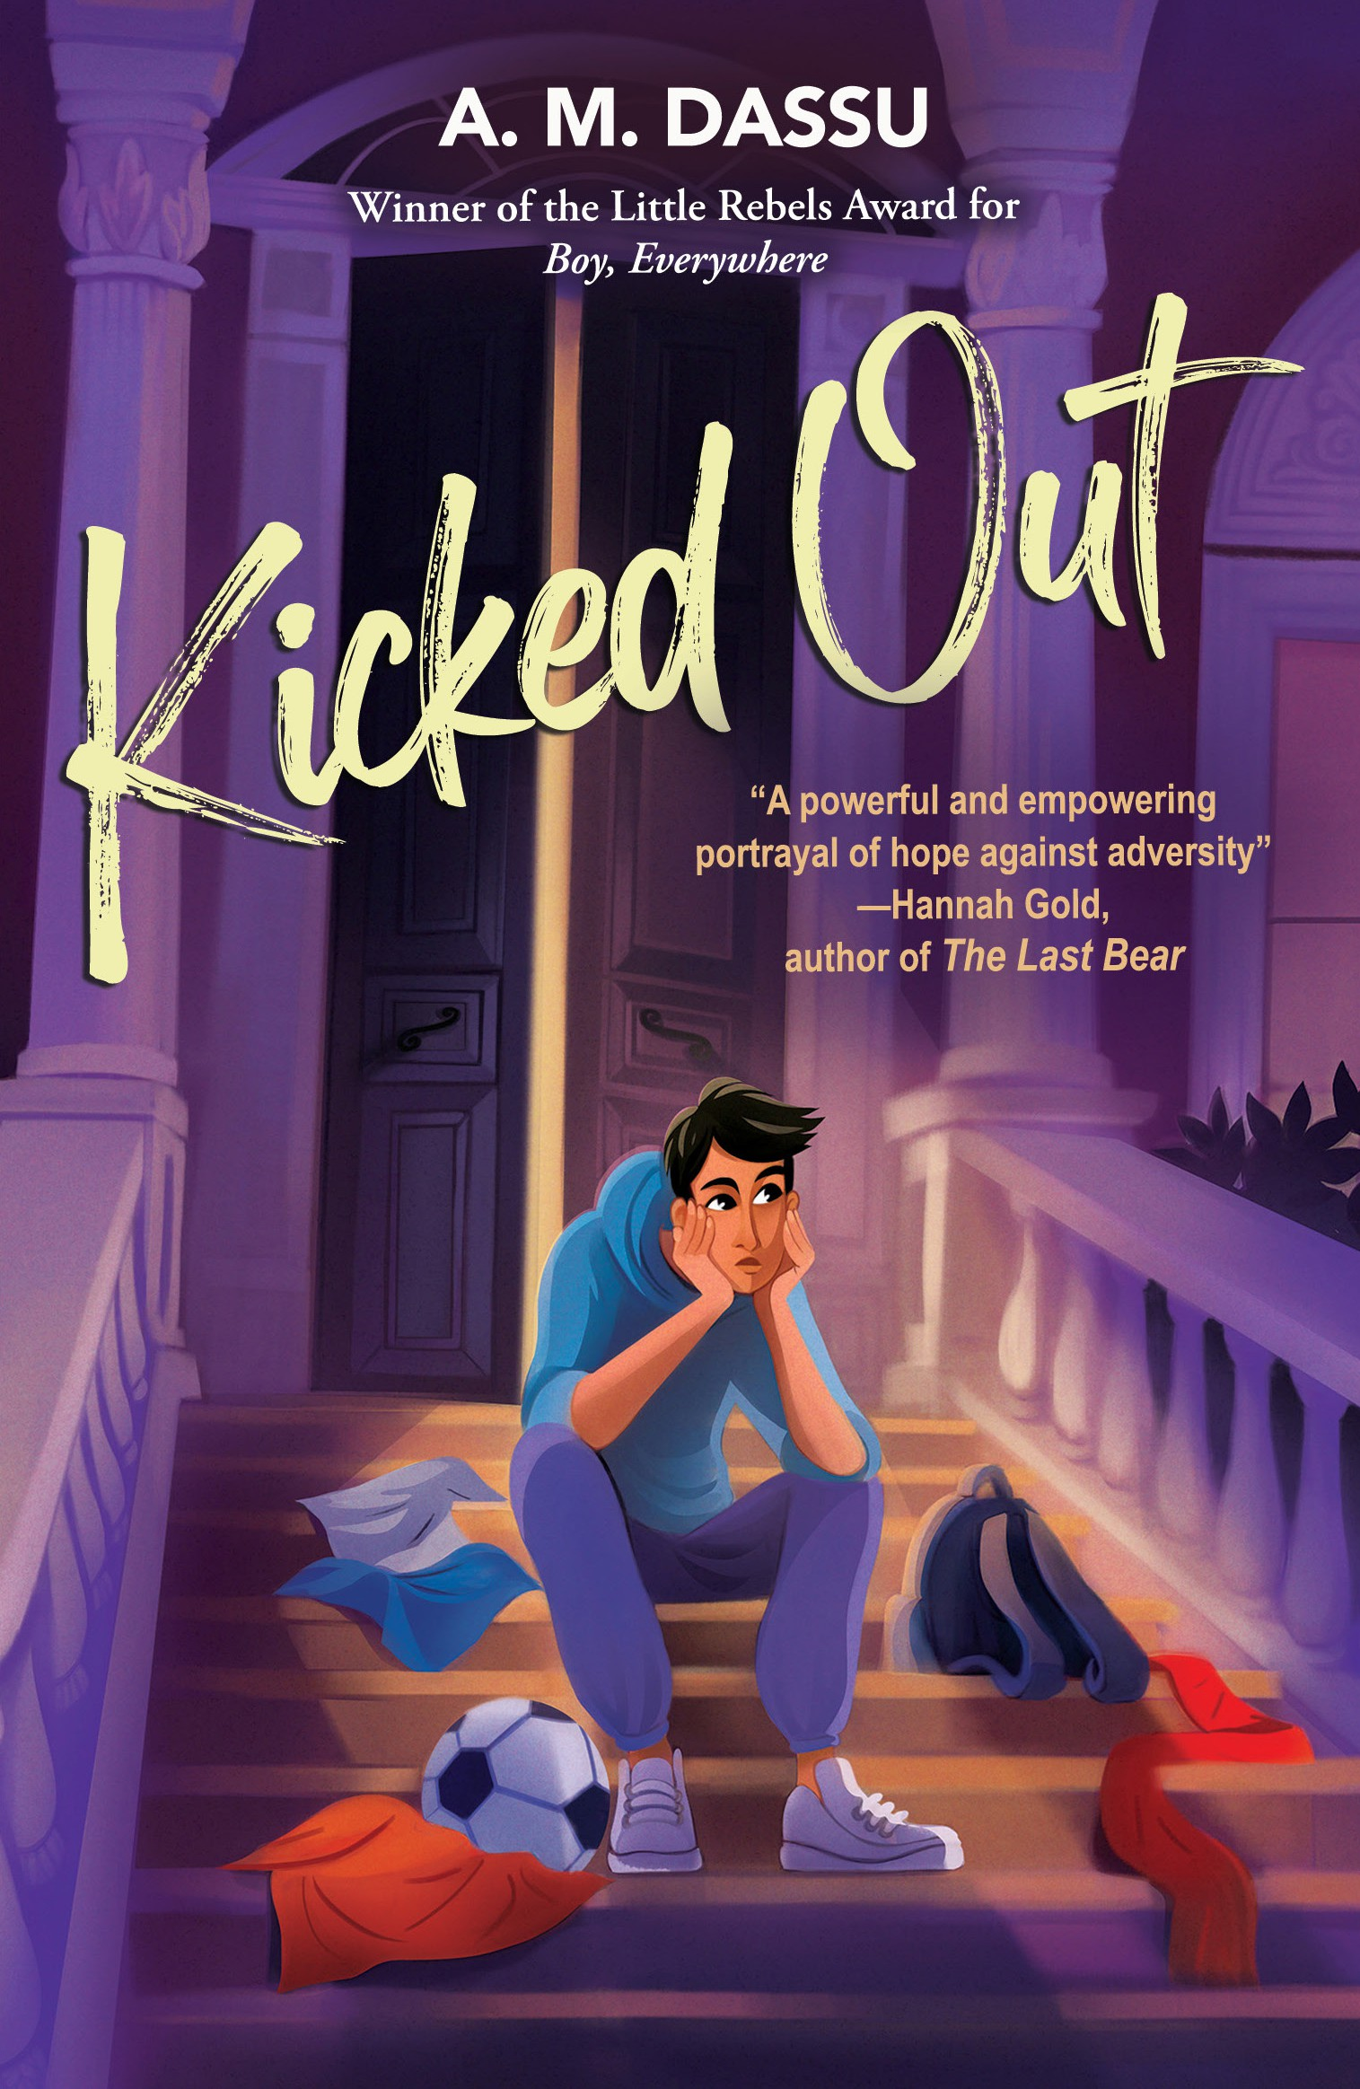

A Teaching Resource based on the book by A. M. Dassu
Created by Sajeda Amir and Kaye Tew
Notes:
Note to teachers:
This resource is not a scheme of work for the book. Rather, it is a set of tasks that you can select to use in order to engage your pupils as they read the book. Each task section is designed to allow teachers to develop their own lesson plans which can then be built into a scheme of work.
Please feel free to copy and paste the tasks. However, we ask that any work that is produced using these tasks is credited back to the authors and not sold on sites such as TES etc. Each slide has curriculum links for your reference.
A copy of this ppt, along with other, supporting documents making up this resource, can be found via the Manchester Poetry Library Learning Page. https://www.mmu.ac.uk/poetry-library/learn/learning
Let us know how you get on by tagging @McrPoetryLibrary on X or Instagram. Or by emailing k.tew@mmu.ac.uk or poetrylibrary@mmu.ac.uk

Slide 2

1. Judging the book by its cover
Curriculum links:
Inference and deduction Visual literacy
Making connections between text and image
The central image
What is the main image depicted on the cover?
What is the character’s posture or expression? What does this tell you about the character?
Why do you think he is sitting the way he is?
Does the image provide any clues about the genre of the book (realistic fiction, coming-of-age, etc.)?
The Title
Does the font style create a specific mood (serious, playful, etc.)?
What are the connotations of the phrase ‘Kicked Out’ ?
What feelings does this phrase evoke? Are these feelings generally positive or negative? How can you link this to the central image?
Symbolism
Are there any symbolic elements present on the cover (e.g. a specific object, clothing)?
What could these symbols represent in the context of the story’s themes?

Slide 4
Judging the book by its cover
Curriculum links:
Inference and deduction Visual literacy
Making connections between text and image
Suggestion: Kicked Out is the sequel to Boy, Everywhere.
Using the questions below, compare and contrast the two
front covers to see potential connections and thematic differences
The central image
Boy, Everywhere: Does the book feature a single character? What is their age and expression?
Kicked Out: Compare the character on the cover. Are they the same as Boy, Everywhere? What is their posture and expression compared to the previous book? What links can you make between these two characters?
Colour Scheme
Boy, Everywhere: What is the dominant colour palette? Does it evoke a sense of movement, journey, or new beginnings?
Kicked Out: Compare the colour scheme. Is there a shift in tone (brighter, darker) compared to Boy, Everywhere? Do the colours suggest a change in the themes of the books?
The Text
Boy, Everywhere: Analyse the font style and size of the title and author’s name. Does it convey a sense of adventure or exploration?
Kicked Out: Compare the text elements. Is there a significant difference in font style or size compared to Boy, Everywhere or are these the same? Why do you think the author and illustrator made these choices? What are they trying to convey?
Notes:
Note to teachers: for this task, you might want to print out the two covers so students can see this side by side as they work through these question.

Slide 5
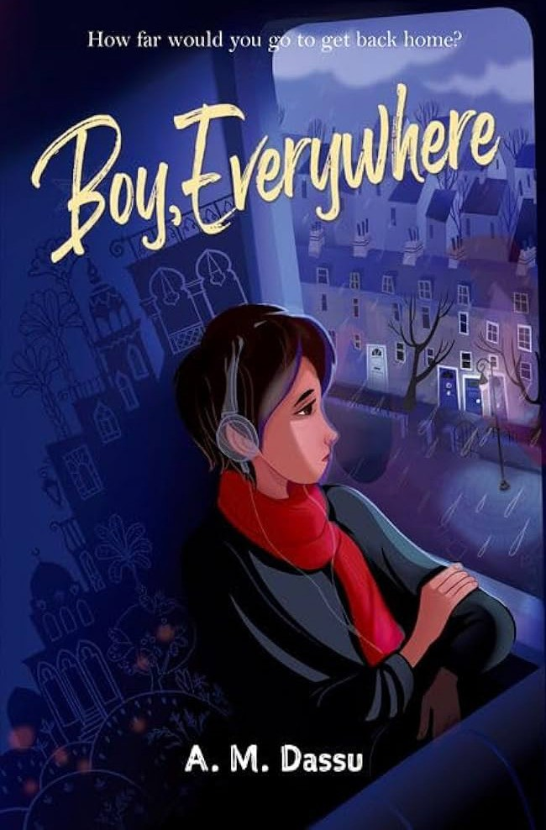

Slide 6
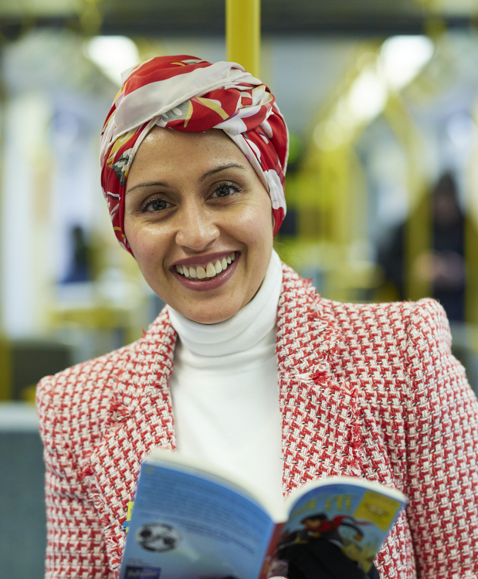
2. What’s it all about? The author introduction
Curriculum links:
Understanding of the link between a text and its context
Emphasis on developing fluency, accuracy, and confidence in spoken communication.
Suggestion: Kicked Out is the sequel to Boy, Everywhere. Using the questions below, compare and contrast the two front covers to see potential connections and thematic differences
The author introduces the book here
Listen to the author introducing the book and discuss the following questions as a group. Each group will feedback on what they have discussed:
Plot: How would you react if one of your best friends was accused of theft? What would you do to prove their innocence?
Character analysis: The author mentions that Ali’s father reappears in his life and there is a mention of a half-brother. How do you think young people can be affected by the absence of a parental figure? How can a young person navigate the feelings of discovering a sibling that they might not have grown up with?
Theme analysis: How do you think the novel explores the theme of resilience based on what the author says? What other themes does the author mention and how do you think these things can shape a young person?

Slide 7
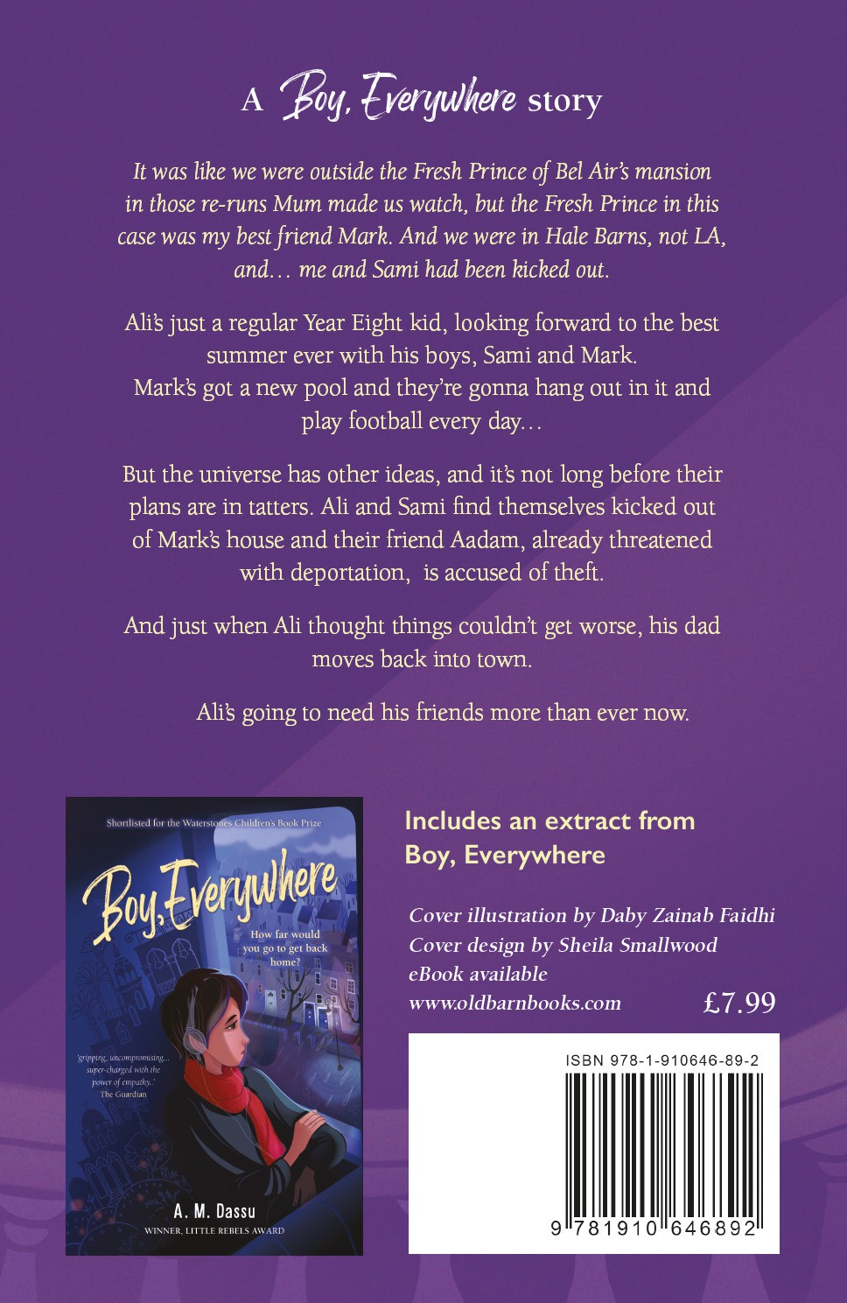
3. The Blurb
Curriculum links:
Referring to evidence from a text
Think – Pair – Share
Read the blurb and find evidence to show that book is about the following themes:
Friendship and loyalty
Facing challenges
Personal Growth
Social issues
Focus on the words used by the author and ‘explode’ them with connotations.

Slide 8
Curriculum links:
Written creative response
Communicating imaginatively adapting tone, style and register
3. The Blurb
Creating Blackout Poetry
Blackout Poetry is a process of narrowing down the words you don’t want from any piece of writing, then selecting and arranging the words that are left to create a poem.
Steps
Using a copy of the Blurb from the back of Kicked Out, draw boxes around anything you think is meaningful: words, images, phrases, and ideas.
- Get messy and use your paper to create a bank of ideas, words and phrases.
- Black out anything you don’t want to use and read through what is left. Do you want to add anything? Does it make sense in the order it comes on the page? Or do you want certain words to connect in different directions? Draw an image outline around the text, or use arrows to expand on ideas.
- There are no rules to how you present your poem. You might want to see your working out, or to illustrate or colour it, or you may want to take your new poem and present it on a clean page or over a new copy of the blurb.

Slide 9



Curriculum links:
Learning new vocabulary, refine research skills: using more complex information sources, conducting focused research using keywords and search filters.
4. Research - unaccompanied young person
In the author’s introduction, A. M. Dassu mentions the term ‘unaccompanied young person.’
Using the following websites conduct research on what the phrase means and how children are affected by displacement:
Migrant and displaced children | UNICEF Search | UNHCR
Refugee (nationalgeographic.org)
Use the PDF guide to help you through each section.
Prepare a PPT in your group with your findings for each section. This should be in your own words. You will then present this to another group.
Notes:
Note for Teachers: See the accompanying PDF for additional documents to support this task.

Slide 10
Curriculum links:
Inference and deduction
Emphasis on developing fluency, accuracy, and confidence in spoken communication.
PSHE links
5. The first chapter
– reading and discussion
There is a video of author A. M. Dassu reading the first chapter of Kicked Out here
Chapter 1 is interesting in this book because we are thrown into the middle of Ali’s family dynamic as well as learning very early on the plights faced by Aadam.
The book starts with Ali telling us he is ‘Living.My.Best.Life.’ What does that mean for an (almost) 13-year-old? What kinds of things does he enjoy? Is that like what most young people would enjoy?
Ali tells us he has to be ‘the man of the house.’ What responsibilities do you think that entails? Discuss what you think family means in his house. Does this look different to families as you understand the word?
Why do you think the author chose Ali as the narrator of this story?
He mentions his friend Sami. For those of you who have read Boy, Everywhere, how does it make you feel seeing Sami here? For those that haven’t read Boy, Everywhere, Sami is a refugee from Syria recently settled in the UK. His life was very different a couple of months ago. How does that leave you feeling about him?
We meet Aadam, the unaccompanied young person. Discuss the hardships that he is going through and relate this to the research that you conducted in the last section.
In this first chapter, we have encountered many themes. What do you think these are and why do you think the author chose to relay these big ideas right in the very first chapter of the book?

Slide 11
5. The first chapter
Suggestion
List the characters we meet in the first chapter and draw a relationship tree to show how the characters connect.
Draw connections between friends and family, so it is easier for you to track the story as we go along.

Slide 12
6. Character analysis
Mark’s mum is not a main character in the story. She is, however, very important. We’re going to analyse three different sections of the book where Mark’s mum appears, to see how she has changed throughout the book
Extract 1
“ ‘Mum’s ordered margherita and chicken feast pizzas, that okay?’ asked Mark as his mum closed the double glass doors behind her.
‘Oh thanks! We can’t eat the chicken one though,’ said Sami.
‘She’s ordered them from Roosters; I told her to…..they’re halal right Ali.’…”
After her boyfriend questions her why she ordered three pizzas she responds with..
“ ‘Oh it’s all right, there’s plenty more…after having a bare fridge for so long, let my boy eat properly with his mates.’ Mark’s mum smiled at us.”
How does Mark’s mum come across in this extract? What is her attitude to the boys? Highlight the words/phrases to demonstrate your understanding
Notes:
Note to teachers: the individual extracts have been included here as separate slides to allow for use with Higher and Lower Ability pupils

Slide 13
Extract 2
“ His mum – she’d been so nice! Why did she let her boyfriend kick us out before explaining?...
The front passenger window lowered down. Mark’s mum leaned across the passenger seat, her face twisted. ‘Mark, you’re not to hang around with this lot anymore, I told ya!’”
Context: After this, Mark tells the boys he doesn’t want to argue with his mum because it’s the first time he’s seen her happy since his dad has died.
How has Mark’s mum changed in this extract? Who has been influencing her and why do you think she lets this happen? Highlight the words/phrases in the extract to demonstrate your understanding.
Notes:
Note to teachers: the individual extracts have been included here as separate slides to allow for use with Higher and Lower Ability pupils

Slide 14
Extract 3
“ ‘Mum’s finally seen what Callum’s really like…she’s determined to tell [the police] what a nasty, racist bully he is.’
‘I have to say sorry to you all….I was tricked into believing some really bad things about you kids, even though I knew you were good and loyal friends of my Mark…I was so stupid to have listened to him.’”
How has Mark’s mum changed by the end of the book? What has she realised and why do you think it’s taken her this long?
Highlight the words/phrases in the extract to demonstrate your understanding.
Notes:
Note to teachers: the individual extracts have been included here as separate slides to allow for use with Higher and Lower Ability pupils

Slide 15
6. Character analysis
Suggestion 2
Get students to answer the question:
How has Dassu used language to present the character of Mark’s mum in Kicked Out?
Use the WHAT – HOW – WHY strategy to answer the question
What? - What is the writer trying to tell us about Mark’s mum?
What do they want us to feel as an audience?
How? - How are they doing this? How do they use language/language devices/structure to show this?
Why? - Why are they doing this?
Why did they choose that language/structure?
Why might they want us to interpret this in different ways?
Suggestion 1
Get students to research the word 'radicalisation' and right-wing extremism and make specific links to Mark’s mum and her relationship with Callum. This can be a great opportunity to make connections to the PSHE curriculum, especially about identity and relationships, health and wellbeing and focussing on prevention: equipping students with knowledge and critical thinking skills to identify and resist extremist ideologies.
Curriculum links:
Showing understanding of a text and selecting evidence
Analysing how writers use language and structure Understanding of the link between a text and its context
PSHE links
Notes:
Note to teachers: The WHAT – HOW – WHY task will most likely need to be scaffolded dependent on the ability of your group. There are several ways to do this. You can include an introductory sentence and get them to finish the paragraph or alternatively, you can provide LAP students with a writing frame. I would recommend modelling this under a visualiser first and talking through your thinking process.

Slide 16
7. Creative responses
Curriculum links:
Written creative response
Communicating imaginatively adapting tone, style and register
After finishing the book, take some time to reflect on what you have read and choose a way to respond creatively to express your ideas about the story, the characters motivations, their fears, their experiences, their passions. There are no wrong ways to do this but here are a few ideas:
Which of the characters in the book affected you most? It can be a character you like or dislike. Or choose a character from the story who didn’t really feature much. but, on a large piece of paper, write the name of the character in the centre and delve deeper to try to understand them, either alone or in a small group with others who also chose this character.
How do they present themselves to others? How do they feel inside? What motivates them? What are their fears? Who do they care about? Who is their nemesis? How have their experiences affected them? You can have differing ideas and doing this in small groups allows for more discussion and exploration. Try ‘hot-seating’ the character, with one person in the group taking on the character’s persona and the others asking them questions.
Once the group has explored the character together you have a bank of ideas and lines. Individually, try free-writing for 5 minutes, in the voice of your character. No rules, start with your character’s name ‘I am xxxxx and I …’ Try to inhabit their personality, taking ideas from your group analysis.
When your time is up, take a highlighter pen and go back through what you have written to pick out six lines, phrases or sentences that you like. Or do this in pairs, with each person highlighting six lines, phrases or sentences from their partner’s writing.
Take one or more of the lines or phrases from your own or your partner’s work and use this to start a poem. You could write this in the voice of your character or make it about them.
Kicked Out is a book that is set in Manchester, in the North of England. The Portico Sadie Massey Awards invite young people aged 7-17 to submit book reviews or short stories set in the North of England. https://www.theportico.org.uk/ portico-sadie-massey-awards Write a review of Kicked Out or write a short story inspired by one of the book’s characters and enter it for the competition.
Using the Blackout Poetry techniques described in the section on ‘The Blurb’, print out some of the research you have done on extremism or radicalisation and create a blackout poem.

Slide 17
Livin’ my best life? Used to think that was true, Sun on my face, future vast and new.
Bros by my side, dreams chased with a grin, But life’s a tricky game, lets you tumble right in.
Dad, a stranger, walks back in the scene,
Words like empty promises, intentions are mean. A half-brother appears, a burden I face,
Sharing this space, a constant misplaced.
Then Aadam, my brother, caught in the snare, Accused, judged, a future to bear.
Deportation looms, a threat cold and stark, Anger’s a fire, leaving its mark.
But mates stick together, that’s the code we know, Can’t let the system just watch him go.
A fundraiser, a game, a penalty kick,
Every pound counts, for a future less bleak.
Heart thumps in my chest, the whistle does blow, Focus and aim, watch the keeper below.
Ball hits the net, a collective roar,
A single kick, maybe that’s what life’s for.
This city’s a jungle, concrete and cold, But even here, compassion takes hold.
We fight for each other, a team, hand in hand, Building our own future, taking a stand.
So the best life, it’s not just sunshine and ease,
It’s facing the storm, finding strength in the breeze. It’s loyalty, laughter, the moments we share,
Even when shadows linger, there’s always a prayer.
This ain’t the ending, just a chapter ahead, With hope as our compass, wherever it leads. Living my best life, redefined by this fight,
For family, for friends, with all of my might.
7. Creative responses
Here is a poem, written by Sajeda, in Ali’s voice.
Poems are meant to be taken off the page so, when you’ve written your own poem, why not have a go at performing it, inhabiting the voice of the character in your poem and speaking their words.
Ali is the character who narrated Kicked Out. The poem retells key points of the story, as seen by Ali. It is written as a spoken word poem. As a class, you could perform this poem, or use it as inspiration or a starting point for your own poem.
Sajeda started her poem with the line ‘Livin’ my best life’, the opening line of A.M.Dassu’s book. You could also take a line from Sajeda’s poem and use it to start another poem of your own.
Or write the line ‘Livin’ my best life’ at the top of your page and see where it takes you.
Curriculum links:
Emphasis on developing fluency, accuracy, and confidence in spoken communication.
Written creative response
Communicating imaginatively adapting tone, style and register
.

Slide 18
Curriculum links: Inference and deduction
Referring to evidence from a text
8. Spoiler alert
Don’t do this section until the students have read about Mustafa and Ali’s dad!
Using the following prompts analyse the changing relationship between Ali, his dad and his half- brother Mustafa. Use the quote bubbles on the next slide to help you answer the questions.
Foundation: How did they meet? What events shaped their initial connection?
Dynamics: Is their relationship one-sided or mutually beneficial?
Power Balance: Does one character hold more power or influence over the other?
Communication: How effectively do they communicate with each other?
Conflict: Do they have disagreements or opposing viewpoints? How do they handle them?
Change and Growth: Does their relationship evolve throughout the story? How?
Dialogue Writing: Write a conversation between the two characters (either Ali and Mustafa or Ali and his dad) from a different point in the story. This could be a scene that never happened in the book, revealing a hidden aspect of their relationship.
OR

Slide 19

CH1
“Because of my loser dad, I had to be the ‘man’ of the house.”
CH1
“I wondered what life would’ve been like if dad hadn’t left us all behind like stale milk.”
CH5
“My grin dropped when I saw someone familiar behind Sami and Aadam. I felt like I had been zapped and frozen…I swear that was my dad.”
CH6
“He named him Mustafa which meant ‘the chosen’ one.
That made me…the rejected one.”
CH6
“Mustafa, his other son too. Ugh. My heart sank to
somewhere near my socks”
CH6
About Mustafa
“I felt hate seethe through my veins – something I’d never experienced
before.”
CH7
“how was he always having so much fun? …I suppose having your dad around meant you had less to worry about.”
CH11
“My dad scrambled out the car..looked at us all and did a double take. He smiled widely. ‘You look just like my Mustafa.’… His Mustafa? He didn’t even recognise me as his son.”
CH6
“He named him Mustafa which meant ‘the chosen’ one.
That made me… the rejected
one.”
CH16
“ ‘Do you know who I am?’[Mustafa]
I thumped the table and screamed in his face. ‘I do know who you are, but I don’t want to know you!
Just leave me alone.’”
CH21
“I can’t even go to the mosque because I don’t have dad to take me.”
CH27
“It wasn’t Mustafa’s fault that dad only loved him. But still, I was going to make sure that I didn’t have to see him or our dad anymore.”
CH28
When Ali goes to visit his dad for the first time. “He came across like he was a good dad and as if he’d been present. And he looked like he was a good dad now.”
CH30
“Did he just call me his son? I felt my chest swelling and suddenly I felt taller.”
CH31
“I watched Mustafa take it all in And it hit me that he was struggling too.”
CH37
“It was dad. He was here too.. was it possible he’d come for me? Just for me? Whoa. He was here just for ME! Maybe he really wanted to be my dad too.”
CH37
Ali’s dad to Ali
“I just wanted to tell you that I’m so proud of you. Your mum has raised an amazing young man. You have the heart of
a lion…I see how bright you shine and I can’t tell you how much it pleases me…I hope Mustafa turns out to be like you.”
Epilogue
“I realised that maybe I should let dad back in too. Maybe bad relationships could get repaired.”

