Slide 1

Notes:
Lesson 11: The Parables of Jesus
Lesson Aim
To learn more about the Kingdom of God through the parables of Jesus.
Learning Outcomes
By the end of this lesson the students should be able to:
be aware of the power of story to communicate meaning and truths;
appreciate the power and importance of story to our understanding of the world around us;
understand the meaning and purpose of parables;
identify the key characteristics of the Kingdom of God revealed through the parables of Jesus.
Key Concepts
Parable
Story
Kingdom of God
Glossary Terms
Parable
Kingdom of God
Symbols
Teaching Strategies
PowerPoints
Discussion
Worksheets
Video
Pair work
Group work/Storyboard
Guided reflection
Assessment
Completion of worksheets
Participation in discussion
Responses to questions
Resources needed
A Bible, or access to an online Bible, for each group of four students (for ‘Examining Jesus’ Parables’ activity)
Overview of Lesson
Introduction to the theme of story
Explain to the students that today’s lesson will focus on story as a powerful teaching tool.
We will begin by giving the students the opportunity to recall the stories they have grown up with and to reflect on what they have learned from these stories.
We will then explore the parables that Jesus told his followers and, through these explorations, discover more about the Kingdom of God and what it means.
Childhood stories
Use these or similar questions to open up a discussion about the stories the students can recall from their childhood:
What stories do you remember being told as a child?
Did you read stories at bedtime, or did someone read stories to you? Which did you prefer?
What kind of stories did you like best as a child? Stories with happy endings? Mysteries? Scary stories?
Can you remember how any of these stories from childhood made you feel?
Can you remember any stories your family liked to tell at family get-togethers? Are there things you learned from these stories about your family, about yourself?
Think, Pair, Share
Invite the students to form pairs.
Ask them to think of a story that stands out for them for whatever reason and to tell their partner about it. They should try to explain to their partner why they have chosen this story and what it is about the story that makes it so memorable or important for them.
This activity will be a good lead-in to the following exploration of how stories communicate meaning and truth.
Show Slide 2.

Slide 2
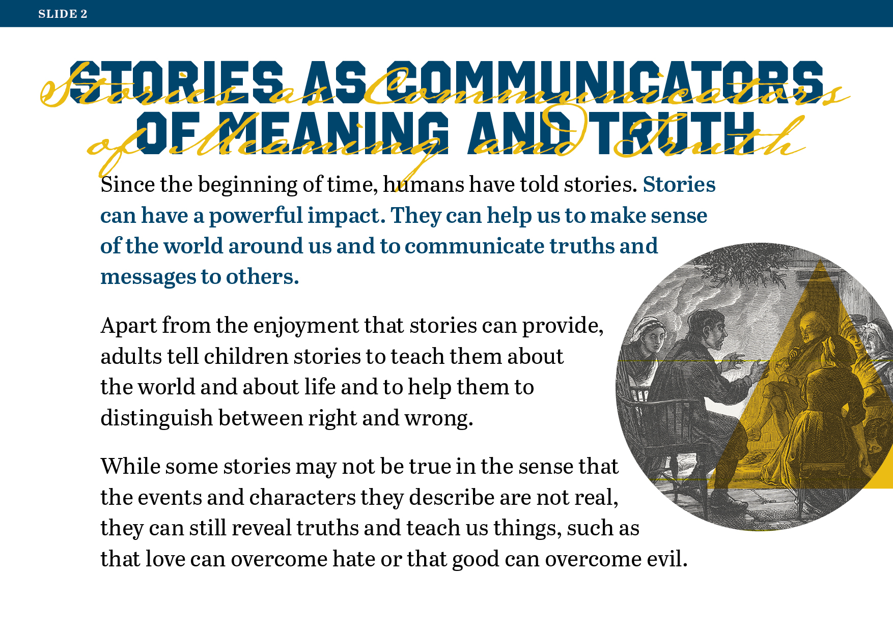
Notes:
Stories as communicators of meaning and truth
Read and discuss Slides 2 and 3, which explain how stories can reveal truths and teach lessons about life, even if the events they record and the characters involved are fictitious.
Show Slide 3.

Slide 3
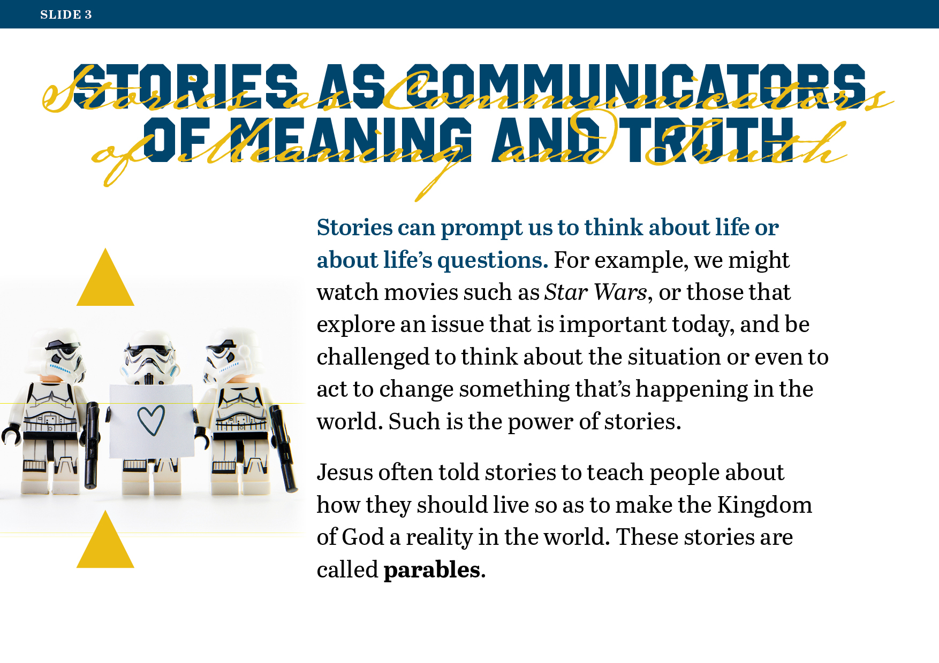
Notes:
Pair/Group Work
Invite the students to form into pairs or small groups and identify stories they have read or heard or experienced in a movie that contained important messages and perhaps had an impact on them in some way or changed or influenced how they view the world around them.
Invite some volunteers to share their examples with the class.
Show Slide 4.

Slide 4
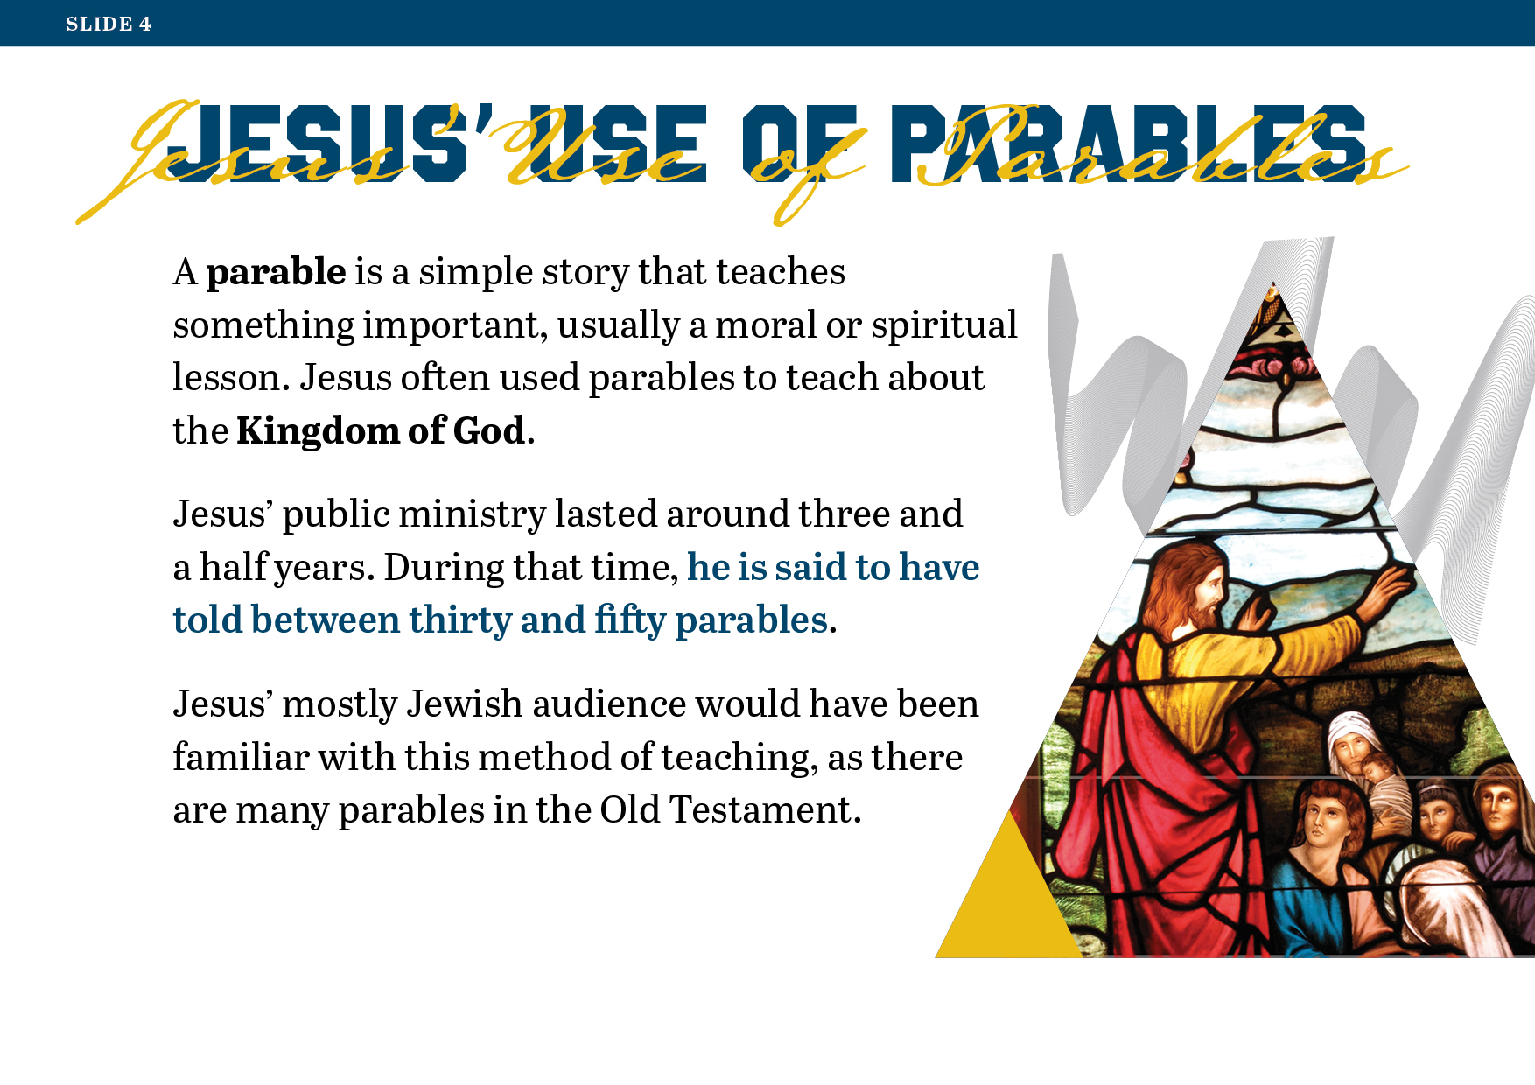
Notes:
Exploring Parables
Read and discuss Slides 4, 5 and 6, which introduce the topic of Jesus’ use of parables.
Show Slide 5.

Slide 5
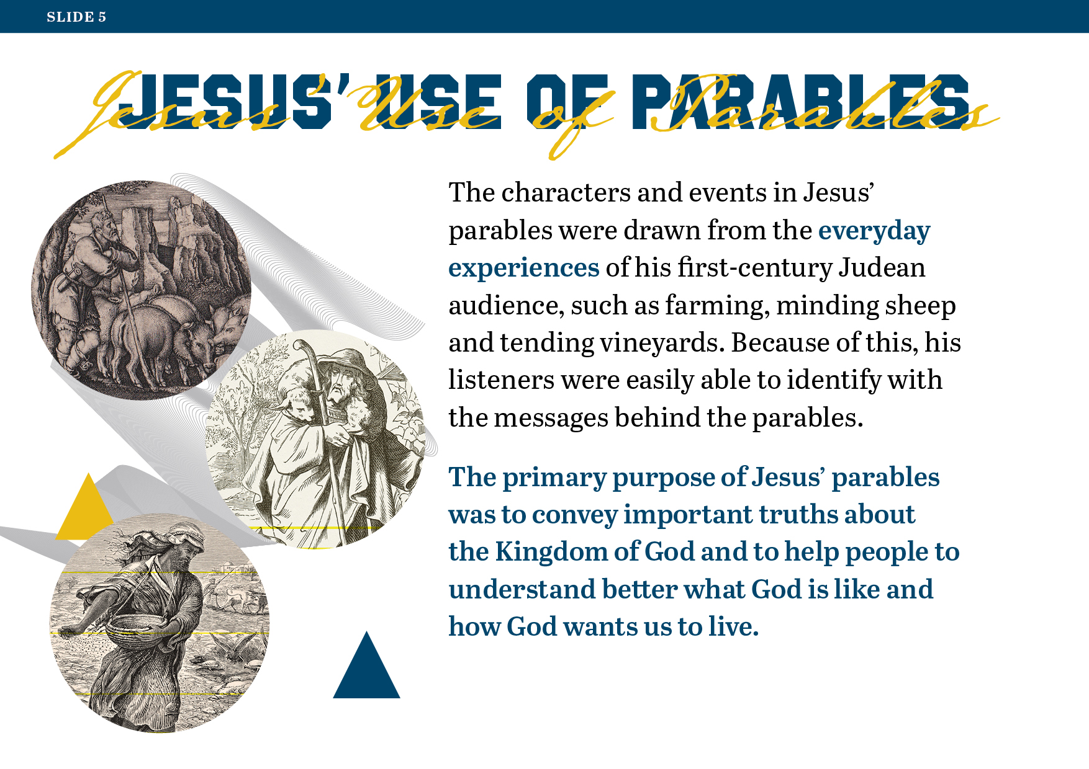
Notes:
Show Slide 6.

Slide 6
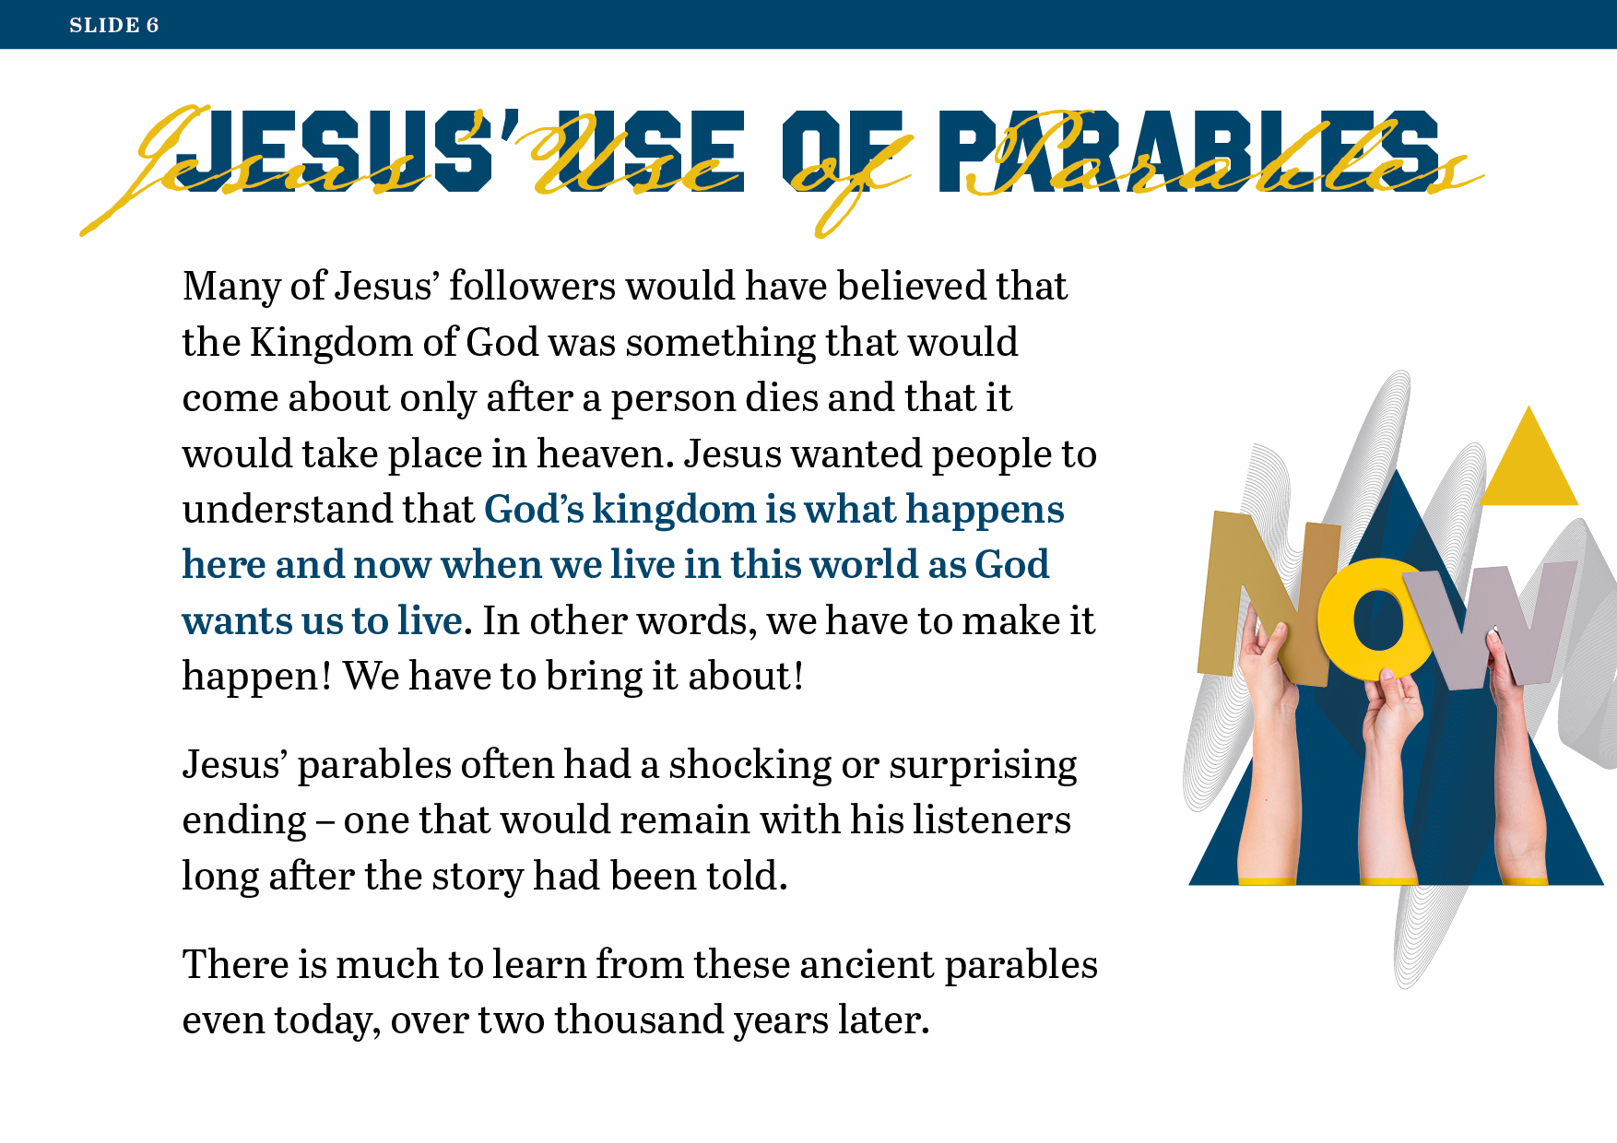
Notes:
Show Slide 7.

Slide 7
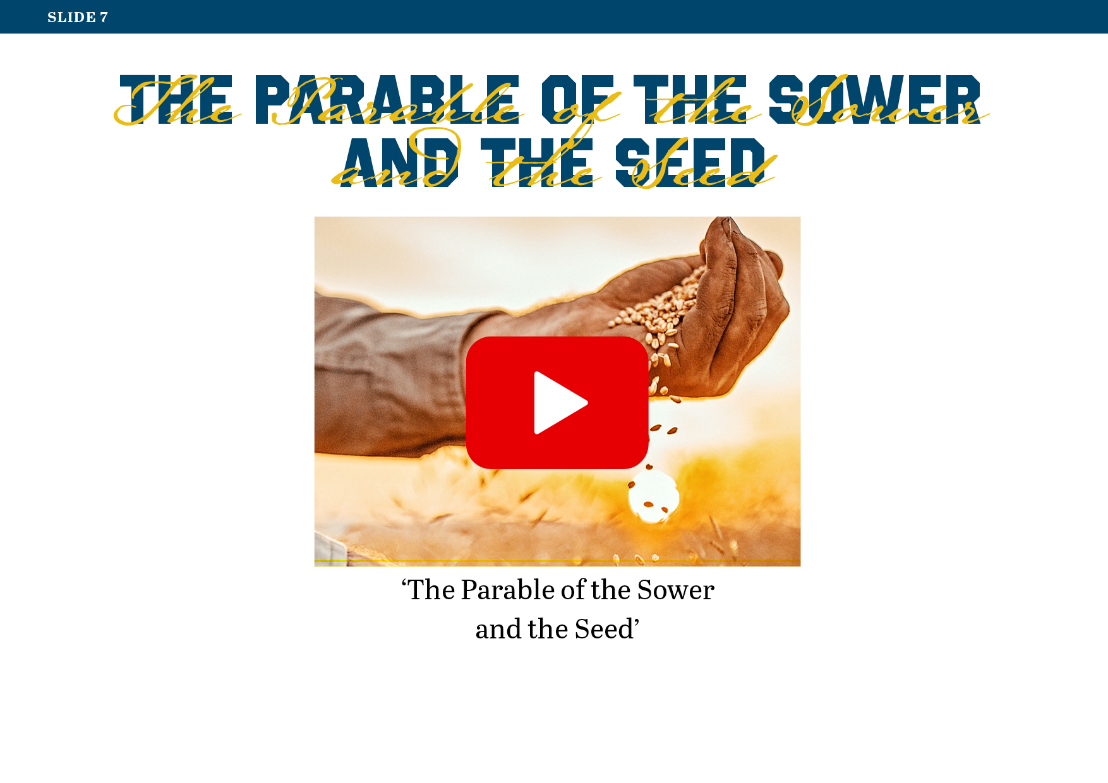
Notes:
Exploring the Parable of the Sower
Play the video in which Jesus is depicted telling the Parable of the Sower and the Seed from the link on Slide 7.
Show Slide 8.

Slide 8
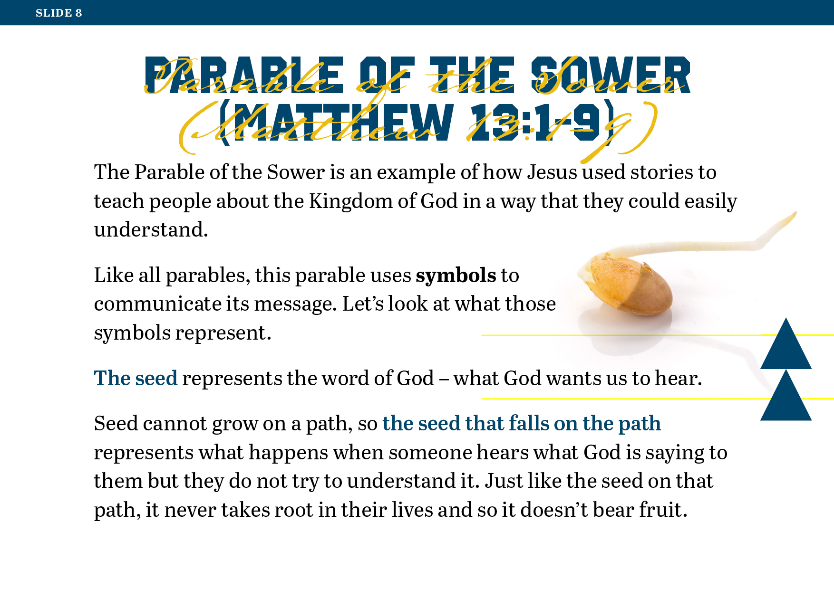
Notes:
Read and discuss Slides 8, 9 and 10, which explain the main points of the Parable of the Sower and the deeper meaning behind its symbols.
Show Slide 9.

Slide 9
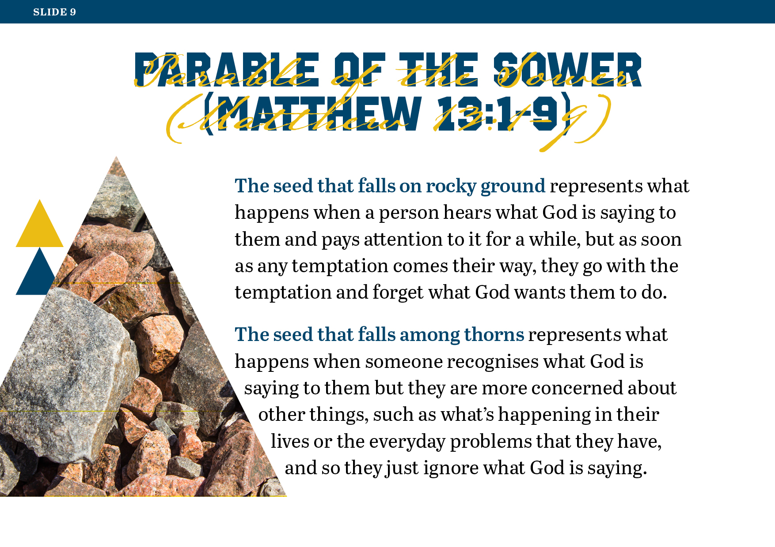
Notes:
Show Slide 10.

Slide 10
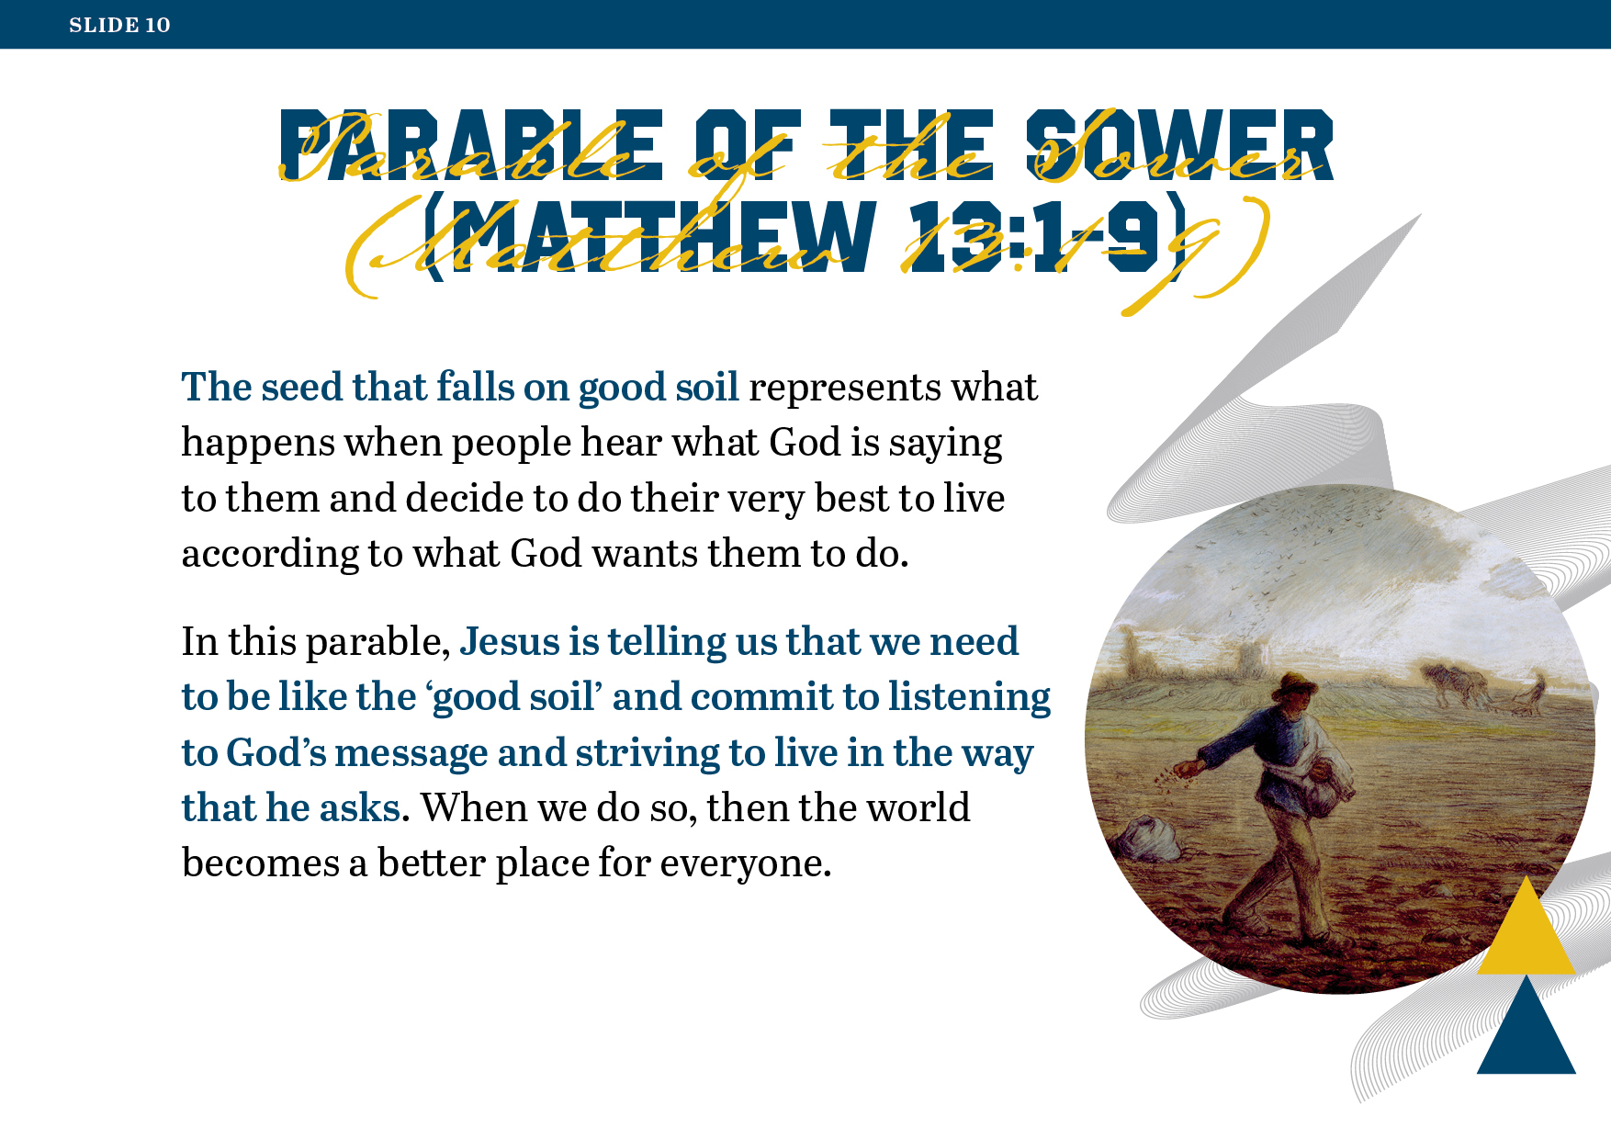
Notes:
Worksheet Exercise
Refer the students to Worksheet 41: ‘Exploring the Parable of the Sower’, where they will find the parable itself, along with Jesus’ own explanation of its meaning.
When the students have completed the worksheet, invite volunteers to share their answers with the class.
Group Work: Examining Jesus’ parables
Note: You will need a Bible, or access to an online Bible, for each group of four students.
The students will now be given the opportunity to examine some of Jesus’ other parables in light of what they have learned about how Jesus’ parables have underlying meanings.
Divide the students into groups of four.
Give each group a Bible, or provide access to an online Bible resource, e.g. www.biblegateway.com, which is the web address for the New Revised Standard Version (NRSV) Bible, the version from which quotations in Look Up! have been taken. (There are further instructions on this activity on the next slide and in the accompanying notes.)
Show Slide 11.

Slide 11
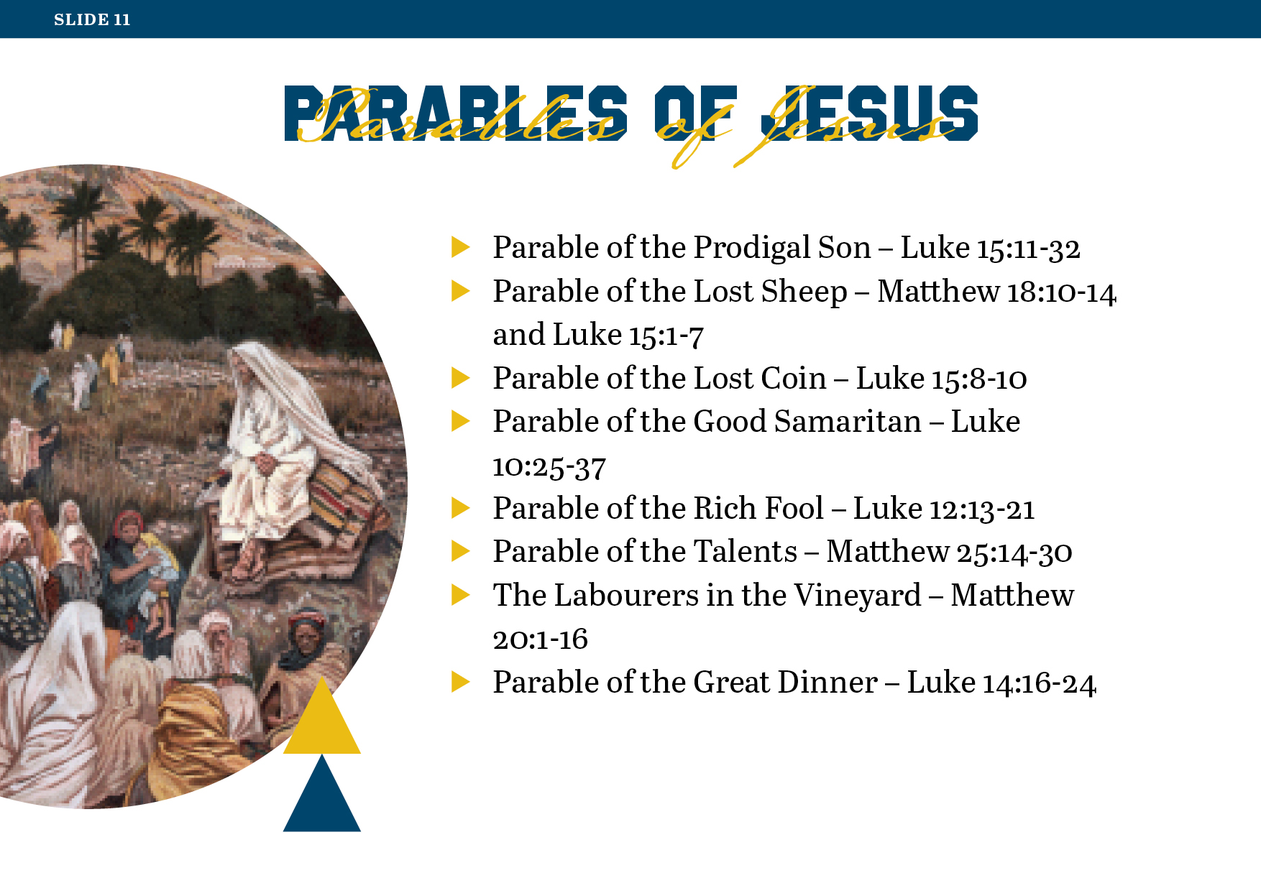
Notes:
Allocate each group a parable to read from the list on Slide 11, ensuring that each group has a different parable.
Once the groups have been assigned their parable and read through it, ask them to work with the other members of their group to complete Worksheet 42: ‘Parable in Pictures’, which requires them to create a visual storyboard.
When the students have completed the worksheet, invite one member of each group to present their work to the rest of the class.
Show Slide 12.

Slide 12
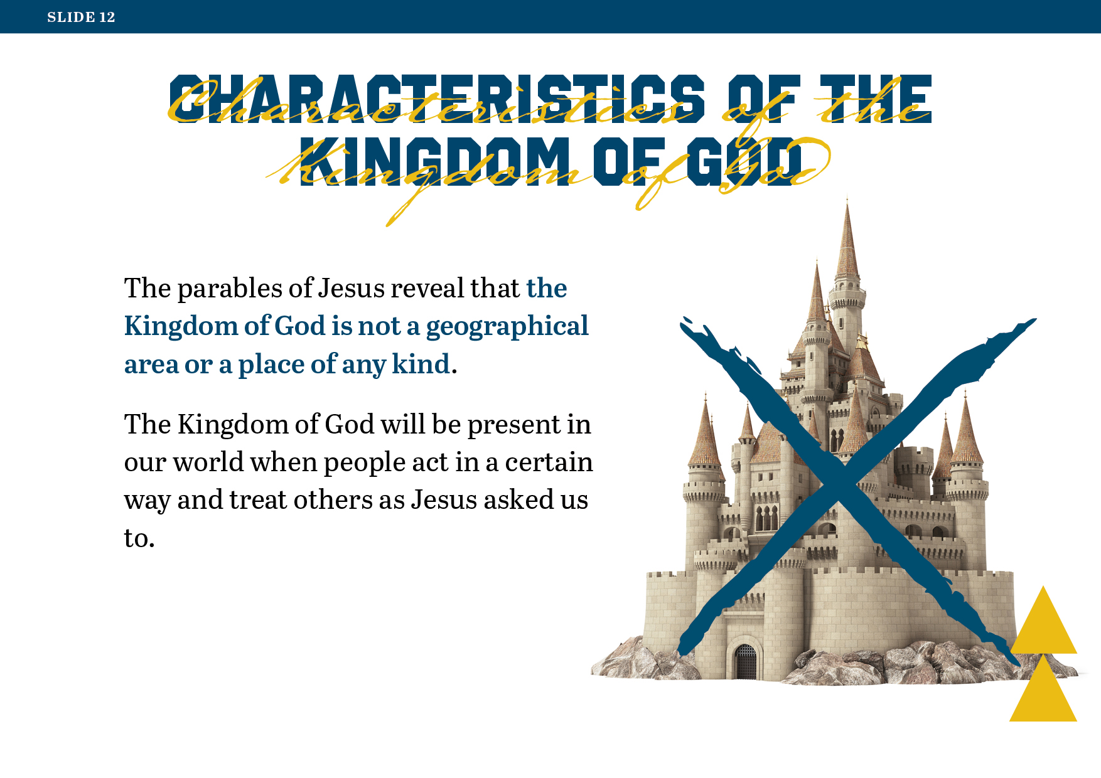
Notes:
Characteristics of the Kingdom of God
Read and discuss Slides 12 and 13, which summarise the characteristics of the Kingdom of God as revealed to us through the parables of Jesus.
Show Slide 13.

Slide 13
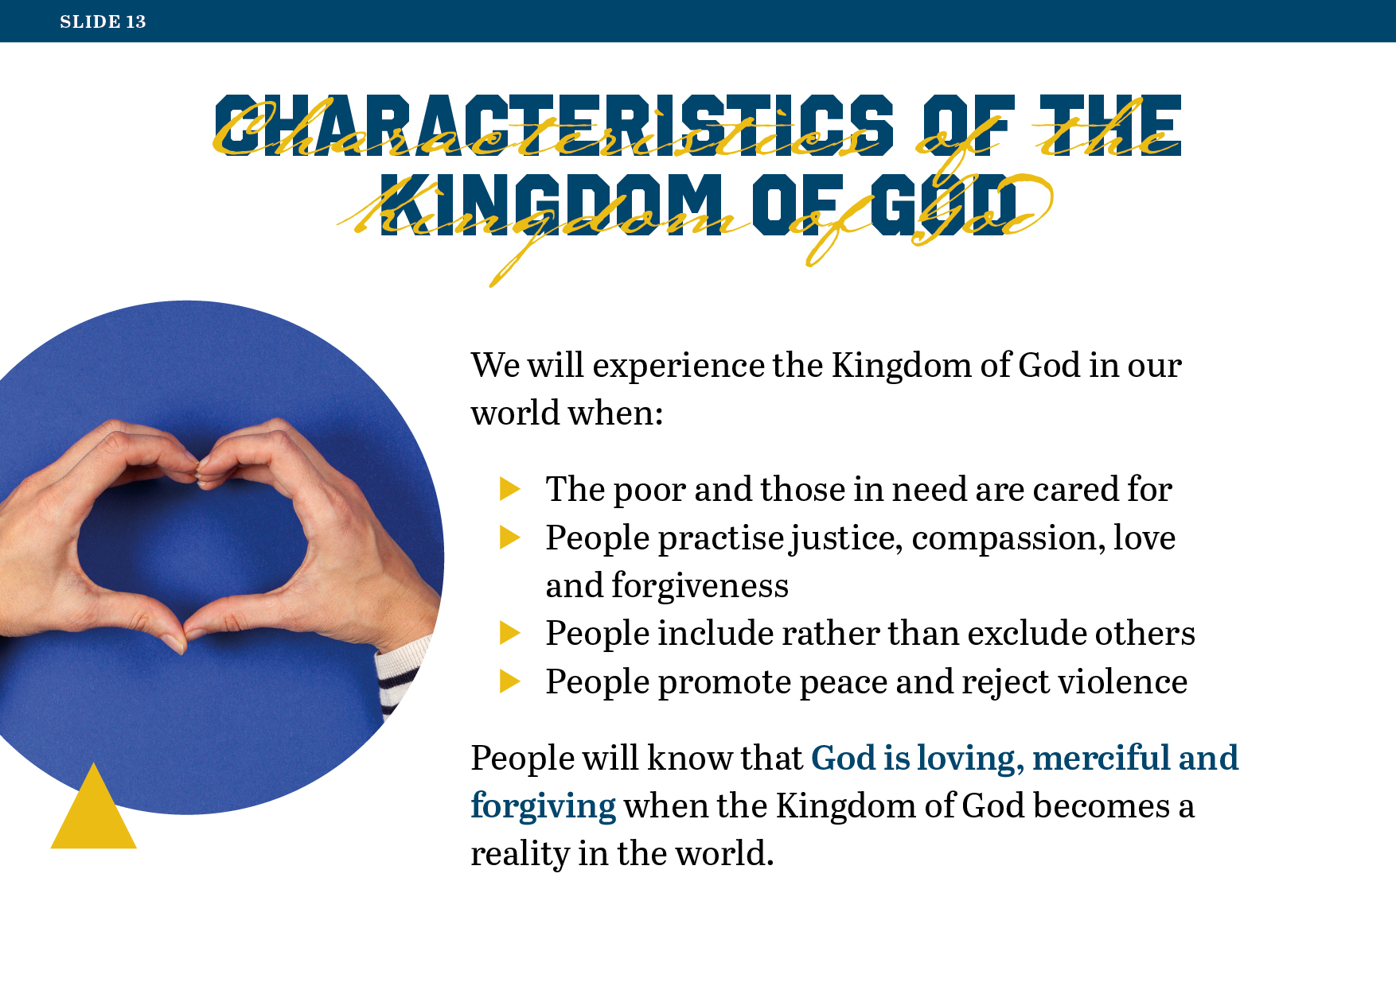
Notes:
Reflective Journal Exercise
Invite the students to reflect on and complete the following on Worksheet 43: ‘Looking back over Lesson 11’.
Describe in your own words, using one or more examples, some of the things you have learned from this lesson about the power of story to communicate meaning and truths.
Describe some of the things you have learned from any of the parables of Jesus that you have explored in this lesson about how Jesus wants people to live.
Have you any further questions about the parables of Jesus, or any additional comments you would like to make about the content of this lesson? If so, write those here.
Note: When checking the responses to the third item on this worksheet, you might take note of the ‘questions’ the students still have, or what comes up in their ‘comments’, and perhaps dedicate a little time to discussing these, or even have the students research some of the topics for discussion during the next class period.
Remind the students of the ‘Personal Reflections’ page that comes after the worksheets for this lesson in the students’ journal, where they may record any additional thoughts or insights or questions they have at this point about any of the content they have covered so far.
Show Slide 14.

Slide 14
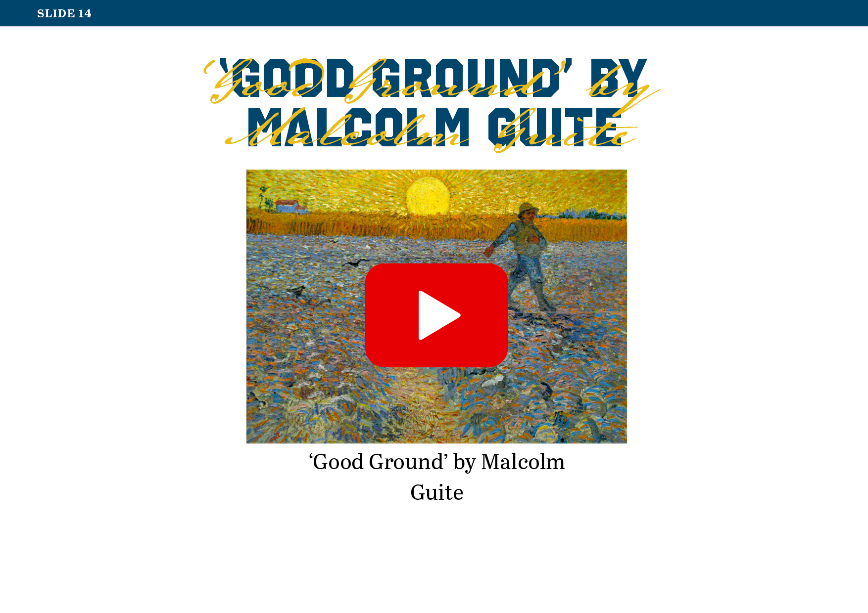
Notes:
Closing Reflection
Prepare students to engage meaningfully with the closing reflection by inviting them to make themselves comfortable in their seats and close their eyes.
Display Malcolm Guite’s poem ‘Good Ground’ using the link on Slide 14.
Invite the students to listen carefully as you read the poem aloud for them.
Allow the students a moment of quiet after reading the poem, before inviting them to open their eyes.

