Slide 1
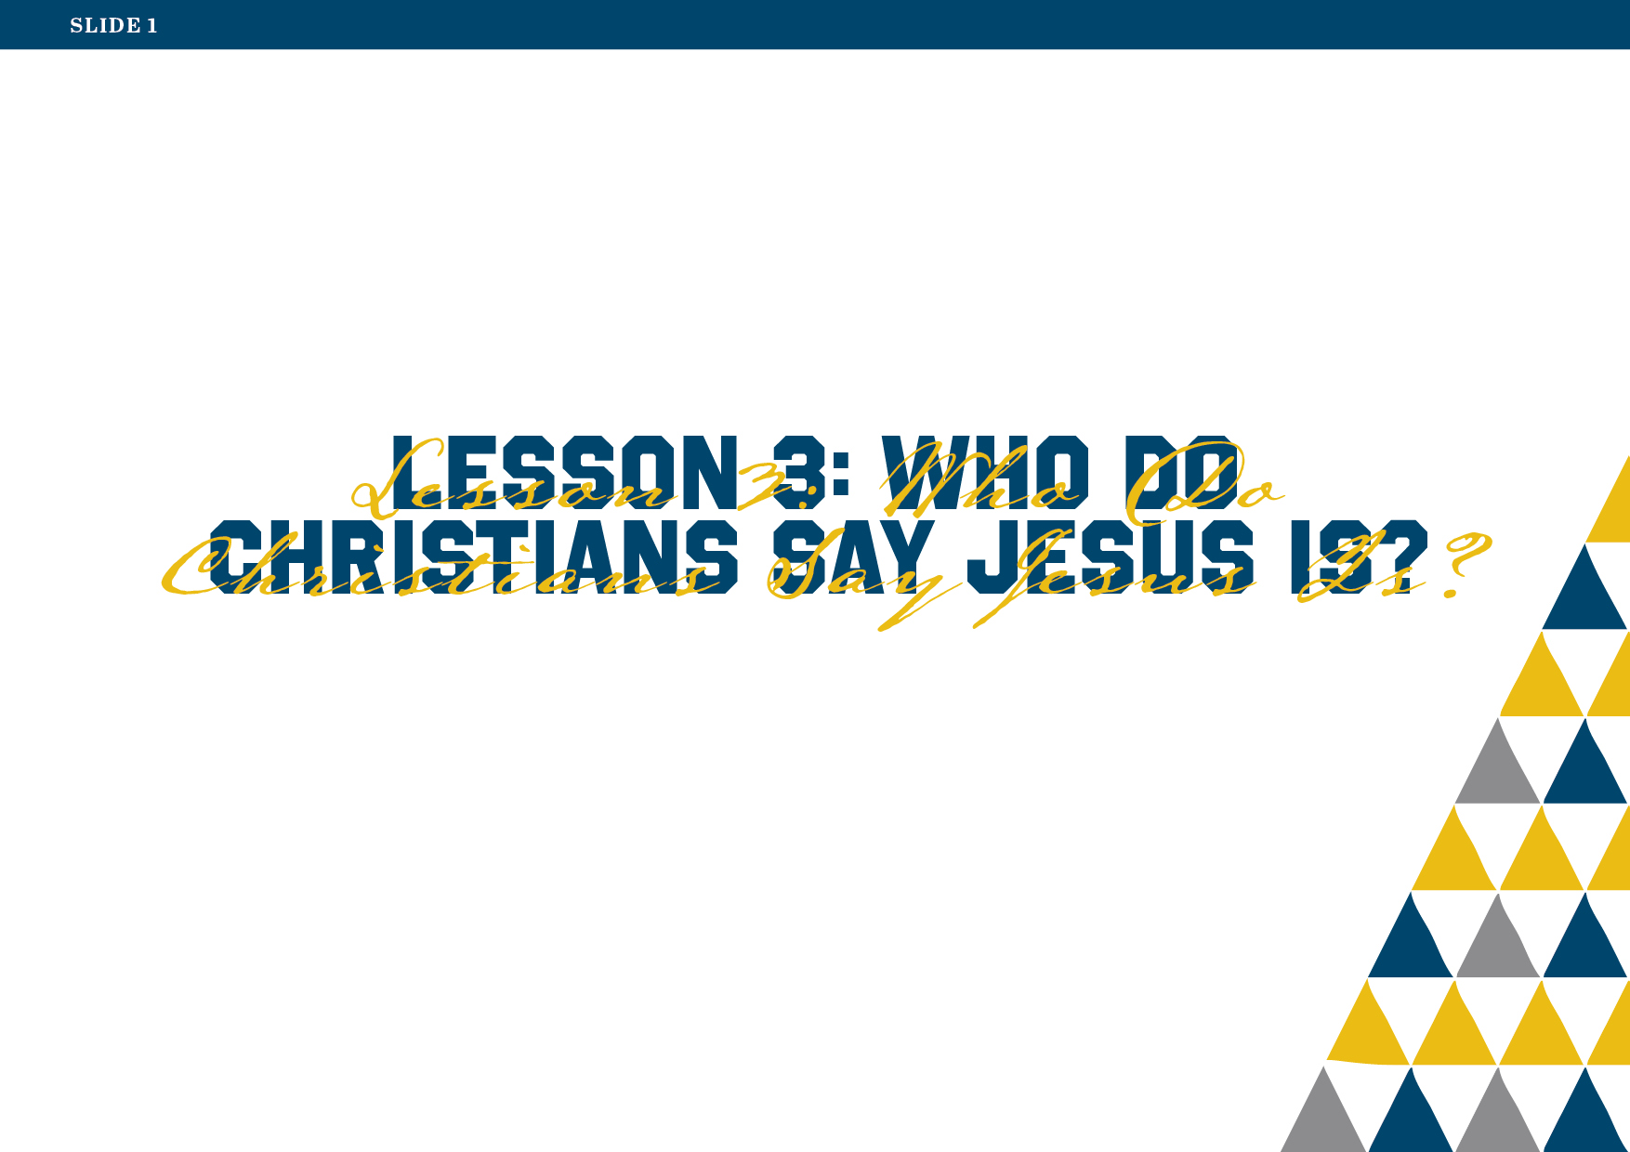
Notes:
Lesson 3: Who Do Christians Say Jesus Is?
Lesson Aim
To enable the students to understand the key Christian beliefs about Jesus.
Learning Outcomes
By the end of this lesson the students should be able to:
articulate some of the beliefs that Christians hold to be true concerning Jesus;
understand better the nature of the relationship between Jesus and the other two Persons of the Blessed Trinity;
explain why and how the Gospel is ‘Good News’.
Key Concepts
Jesus and the Gospel as Good News for the world
Jesus – fully human and fully divine
Trinity
Glossary Terms
Christian
Gospel/Gospels
Trinity
Saviour
Redeemer
Eternal life
Incarnation
Resurrection
Teaching Strategies
PowerPoints
Storyboard
Mind mapping
Worksheets
Making posters
Pair work
Discussion
Video
Silent reflection
Assessment
Completion of worksheets
Participation in discussion
Responses to questions
Resources needed
A3 sheets and colouring materials (for poster activity)
Overview of Lesson
Note: Tell students that over the next five lessons they will be learning about who Jesus is from Jewish and Muslim perspectives and about depictions of Jesus in secular sources. In this lesson they will explore the Christian understanding of Jesus.
Worksheet/Mind Map Exercise
Refer the students to Worksheet 8: ‘Mind Map on Jesus’.
Ask them to write ‘Jesus’ in the centre box of the mind map.
Then, give the students three to five minutes to write in the other boxes things they have learned about Jesus and the kind of person he was. (You might like to do a brief recap on Lesson 2 before the students begin this task.)
Pick three or four students to explain their completed mind maps to the rest of the class.
News – good news and bad news
Introduce the concept of ‘news’. We usually think of ‘news’ as the stories we hear about the things that are happening in the world at a particular time.
What are some of the good news stories of recent times? What are some of the bad news stories?
Why is ‘good news’ important? How does ‘good news’ make us feel?
Worksheet/Storyboard Exercise
Invite the students to work in groups of four and make a storyboard illustrating a ‘good news’ event using the template provided on Worksheet 9: ‘Good News Storyboard’. This can be a current or historical event.
Appoint one person from each group to present their storyboard to the class.
Show Slide 2.

Slide 2

Notes:
The ‘Good News’ of the Gospel
Read and discuss Slides 2 and 3, which explain how and why the Gospel is the ultimate ‘Good News’ for the world.
Show Slide 3.

Slide 3
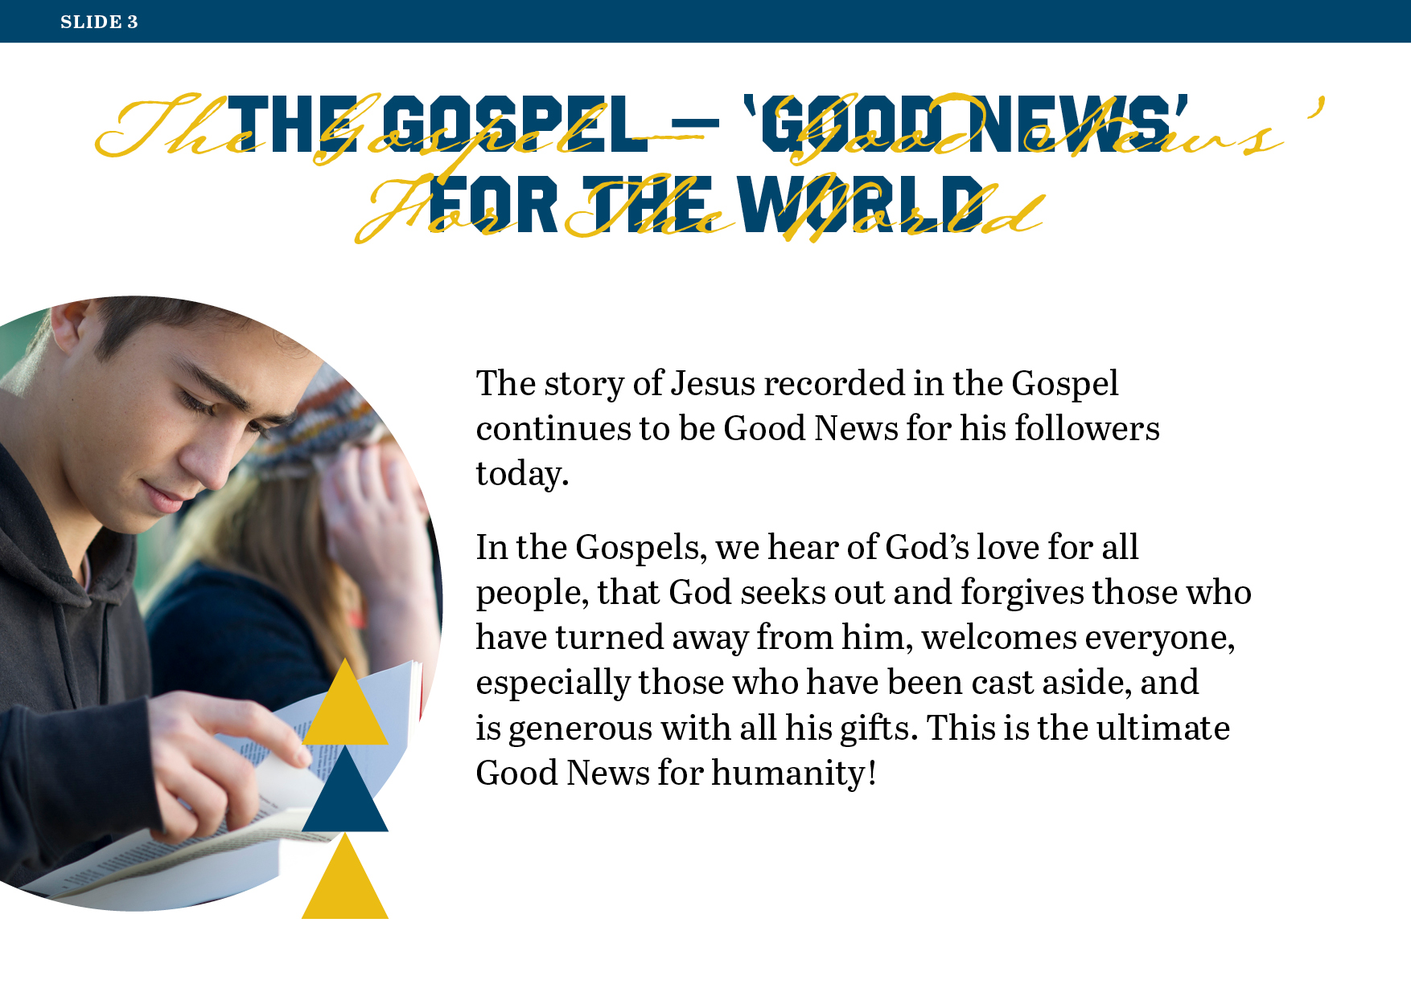
Notes:
Show Slide 4.

Slide 4
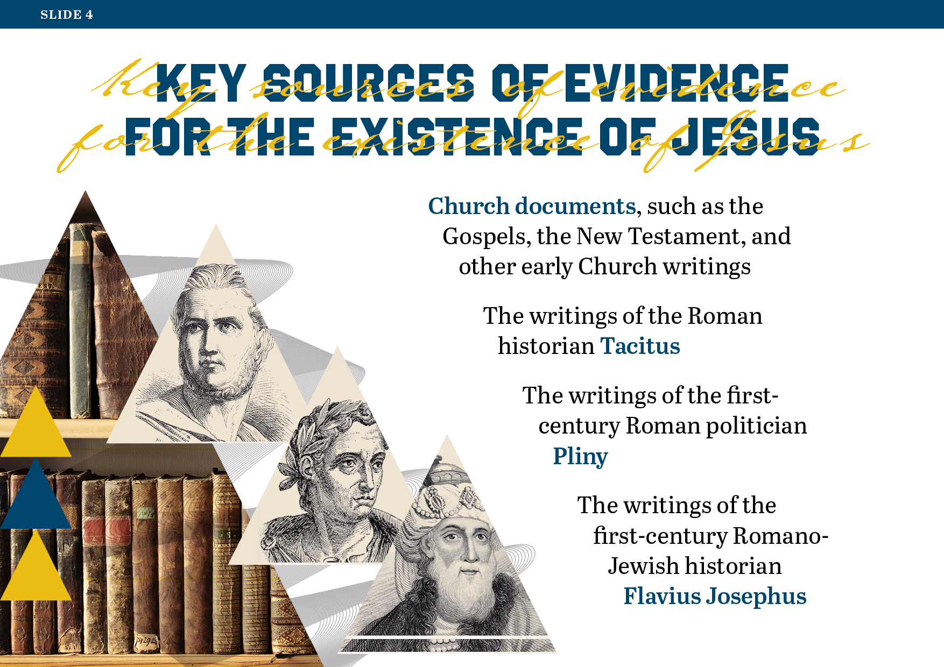
Notes:
Read and discuss Slide 4, which lists some of the key sources of evidence for the existence of Jesus.
Show Slide 5.

Slide 5
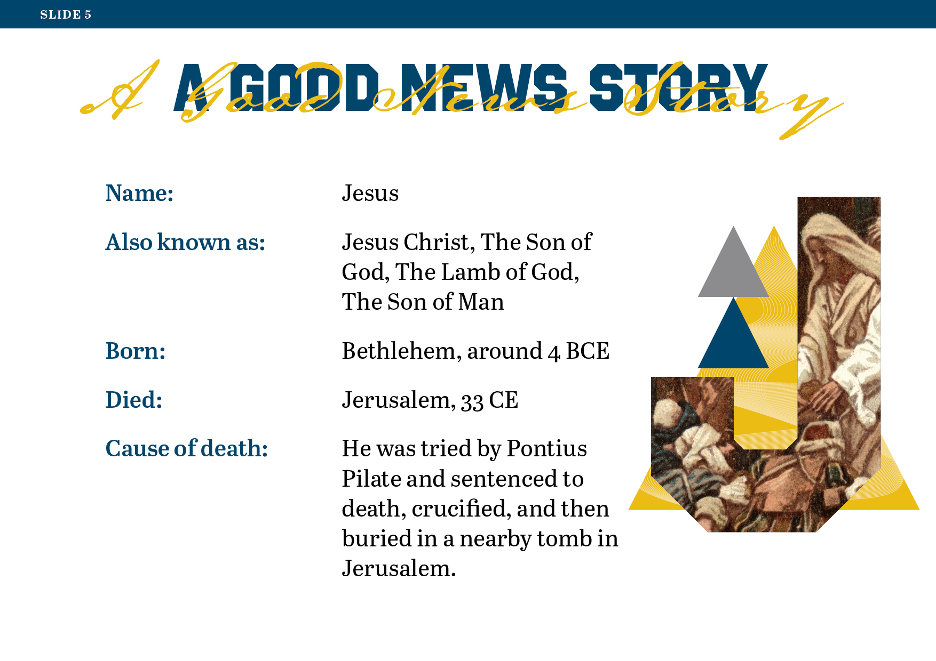
Notes:
Introduce the students to the ‘good news’ story that is spread over Slides 5–10. This story is a snapshot of the life of Jesus and the Good News of the Gospel. Most of the information on these slides will be familiar to the students. There will be an opportunity for discussion and feedback afterwards.
Show Slide 6.

Slide 6
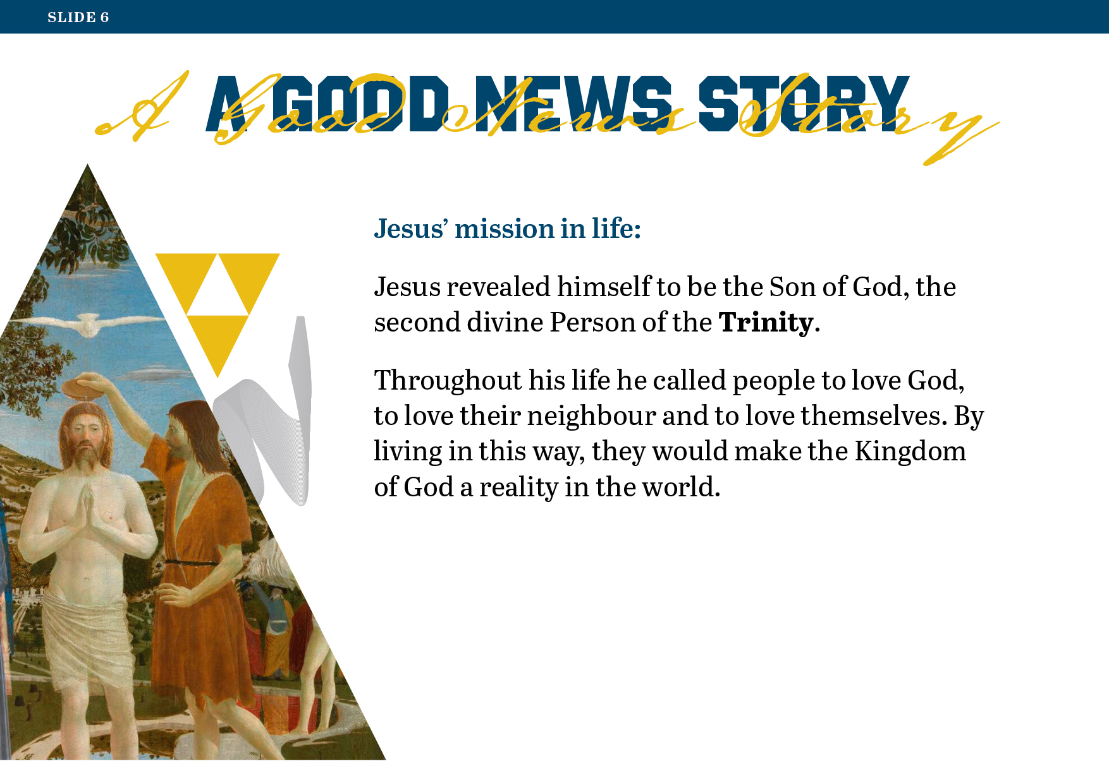
Notes:
Show Slide 7.

Slide 7
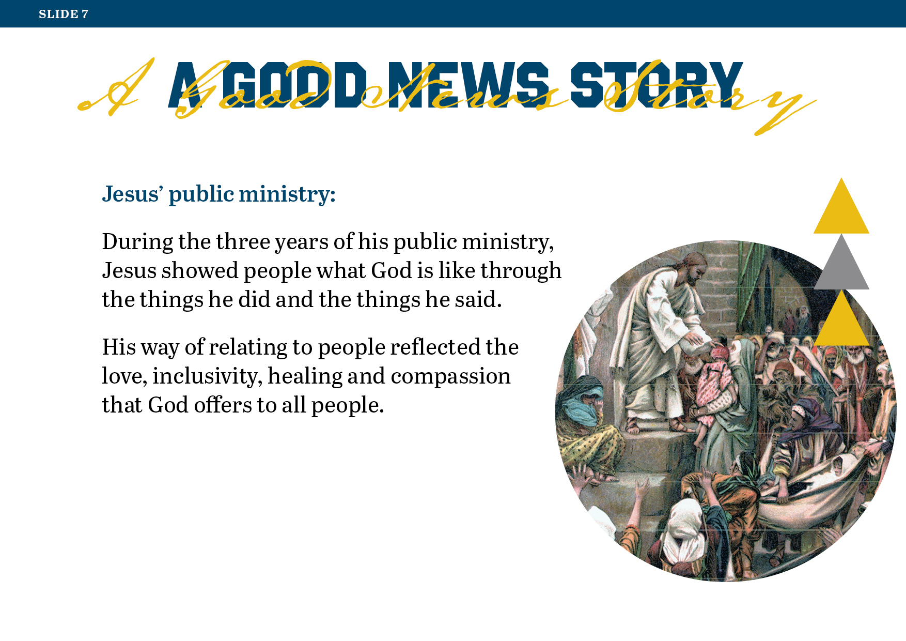
Notes:
Show Slide 8.

Slide 8
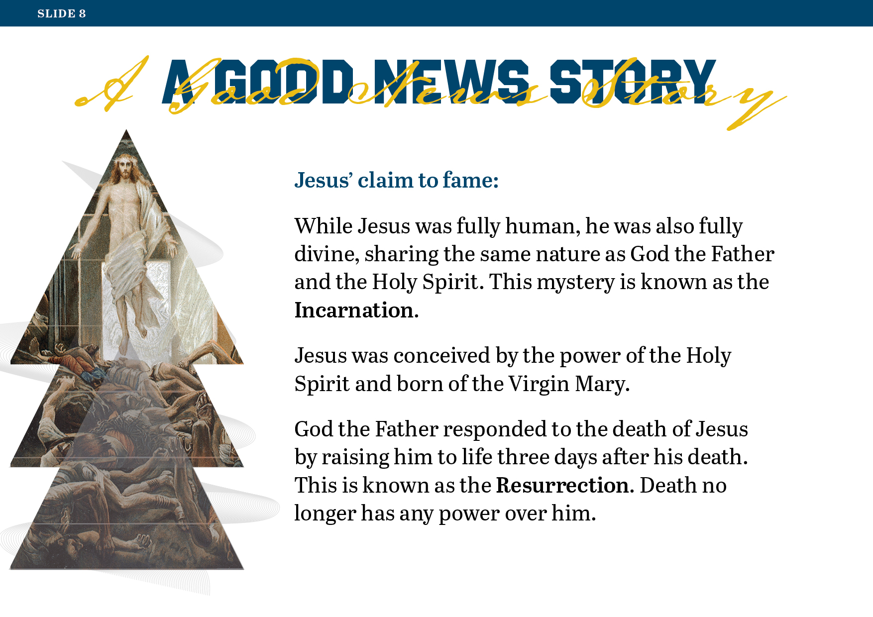
Notes:
Show Slide 9.

Slide 9
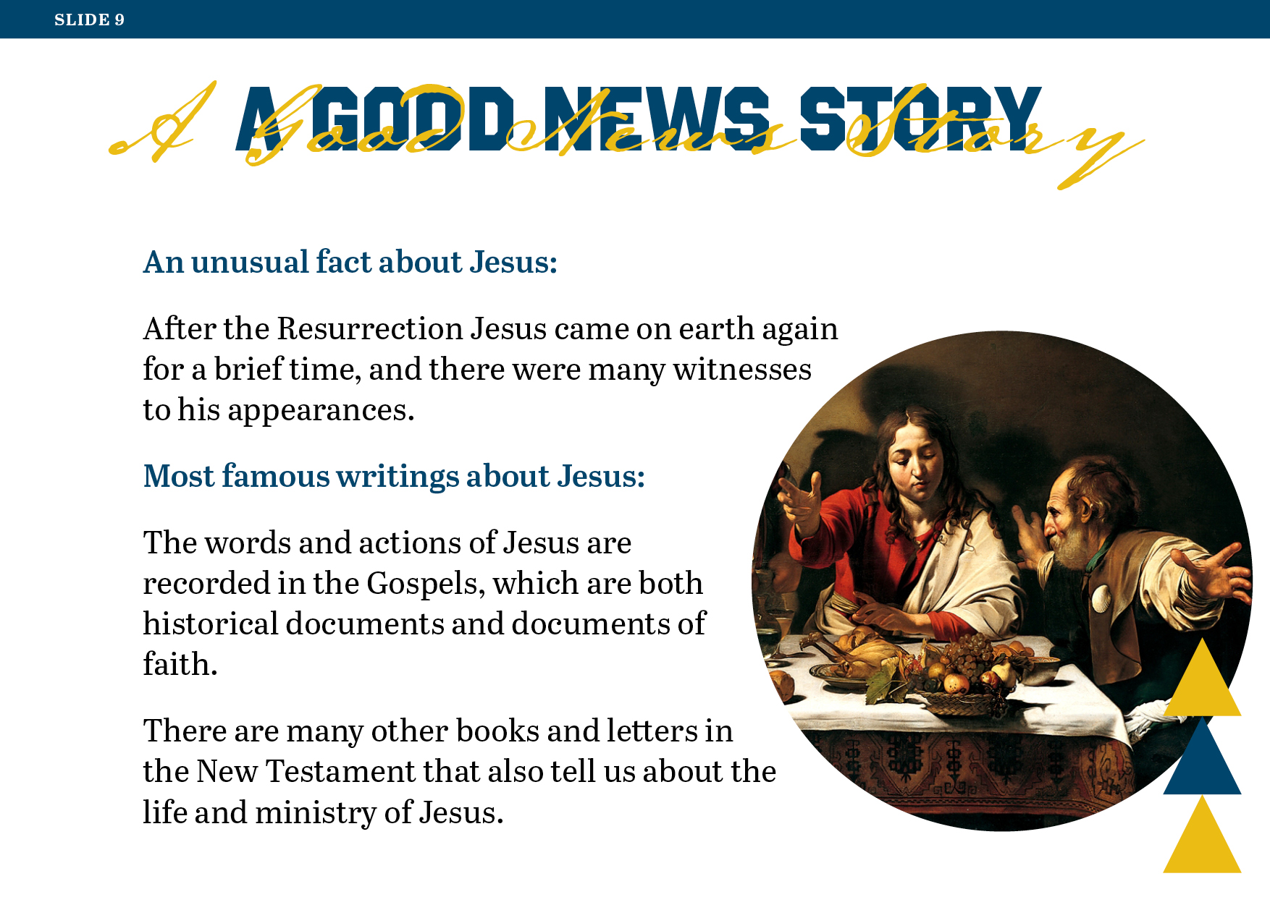
Notes:
Show Slide 10.

Slide 10
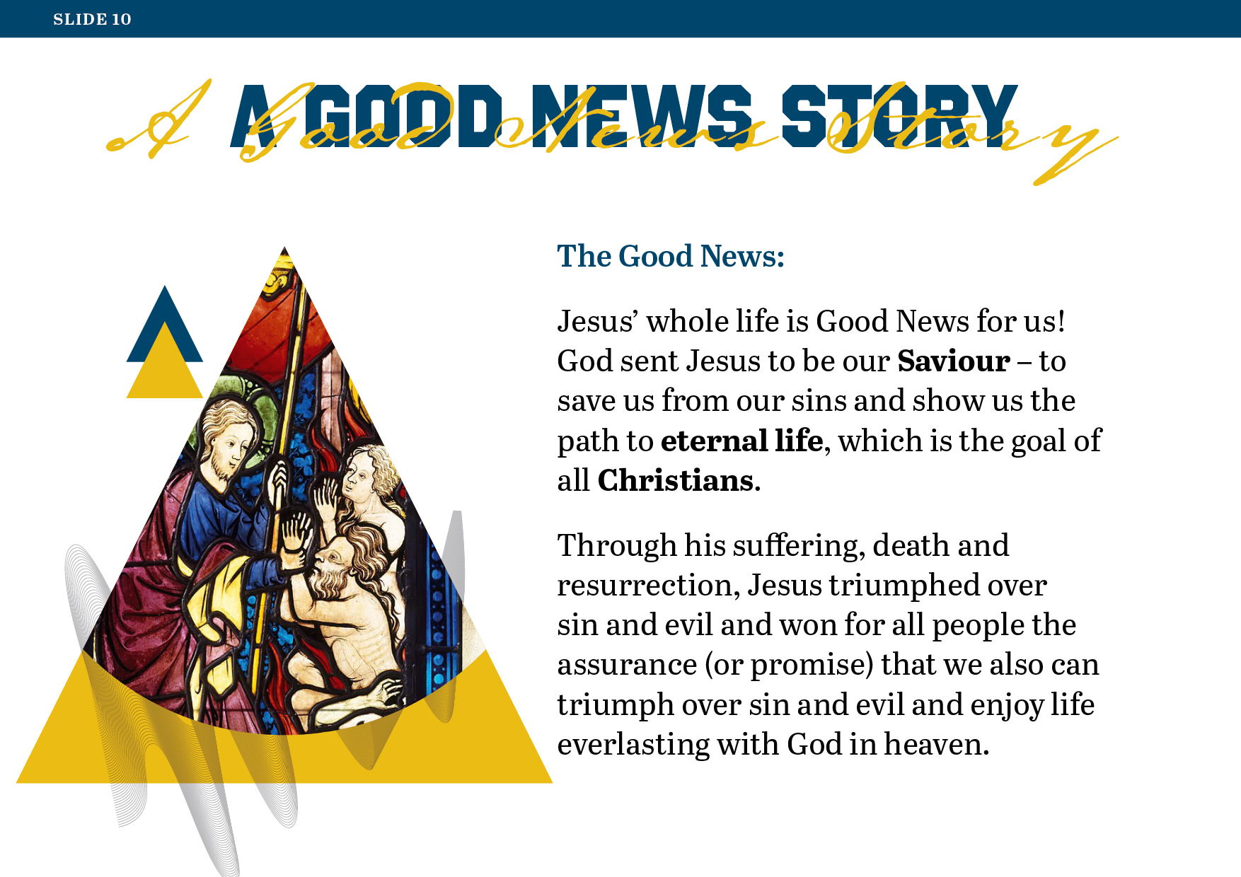
Notes:
Show Slide 11.

Slide 11
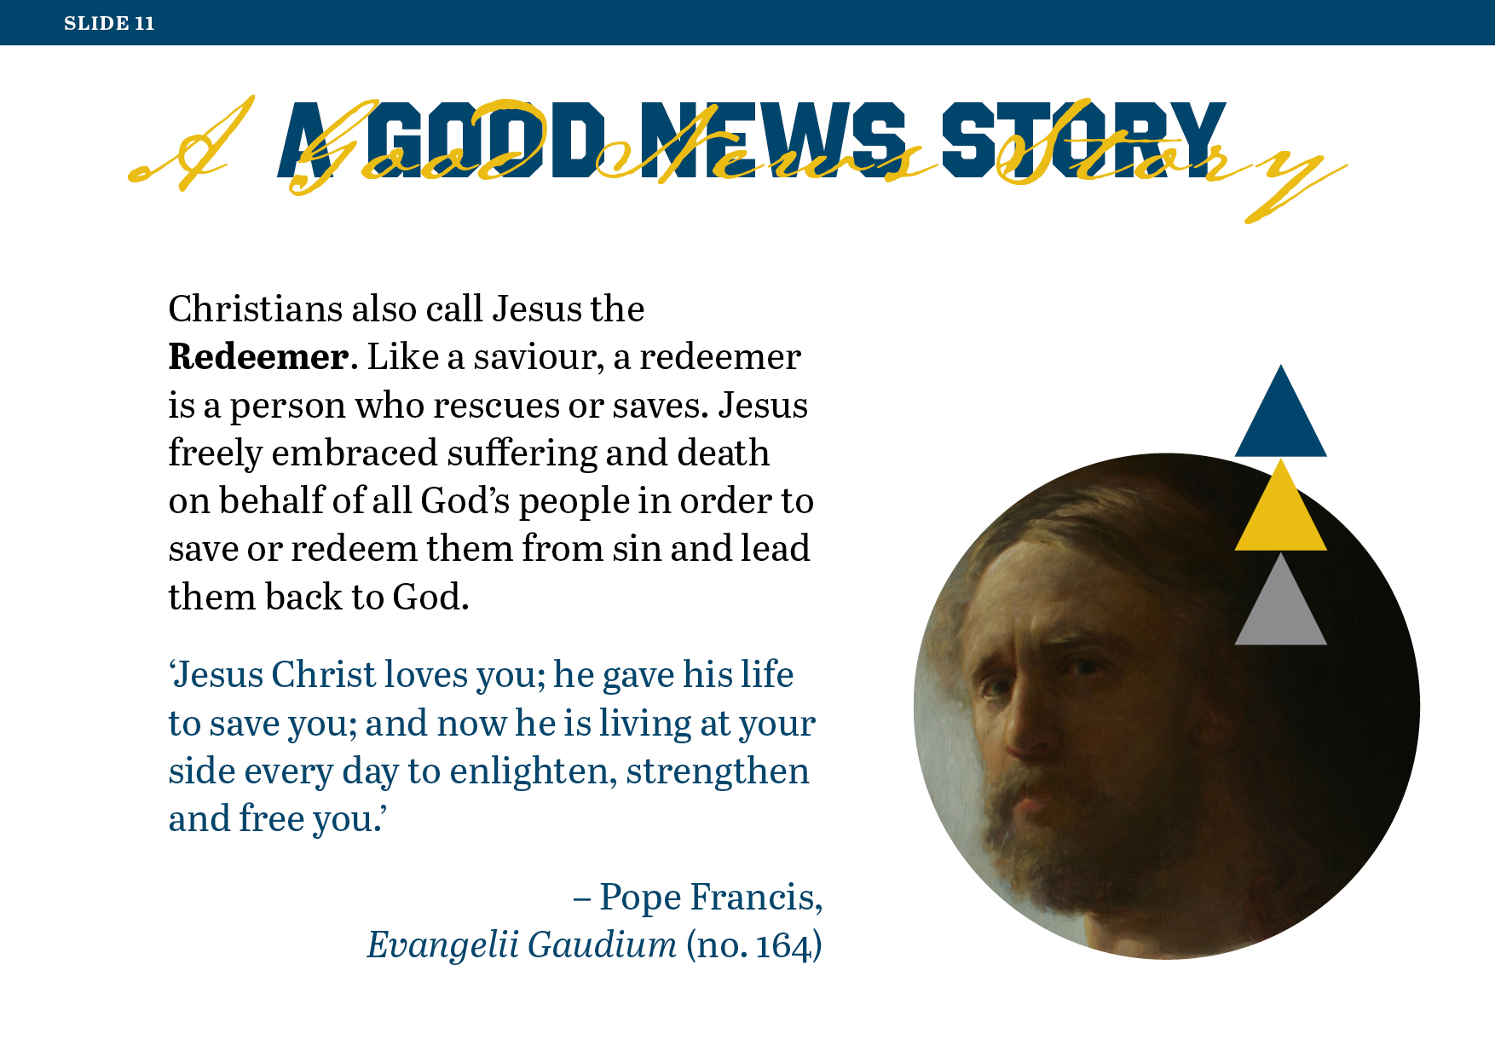
Notes:
Theological background material for teachers, from the Catechism of the Catholic Church:
452: The name Jesus means ‘God saves’. The child born of the Virgin Mary is called Jesus, ‘for he will save his people from their sins’ (Matthew 1:21).
481: Jesus Christ possesses two natures, one divine and the other human, not confused, but united in the one person of God's Son.
561: ‘The whole of Christ's life was a continual teaching: his silences, his miracles, his gestures, his prayer, his love for people, his special affection for the little and the poor, his acceptance of the total sacrifice on the Cross for the redemption of the world, and his Resurrection are the actualisation of his word and the fulfilment of Revelation’ (John Paul II, Catechesi Tradendae, 9).
619: ‘Christ died for our sins in accordance with the scriptures’ (1 Cor 15:3).
Think, Pair, Share
Invite the students to form pairs.
First, ask them to identify the aspects of the story of Jesus that they were already familiar with.
Then invite them to identify anything new that they have learned.
Show Slide 12.

Slide 12
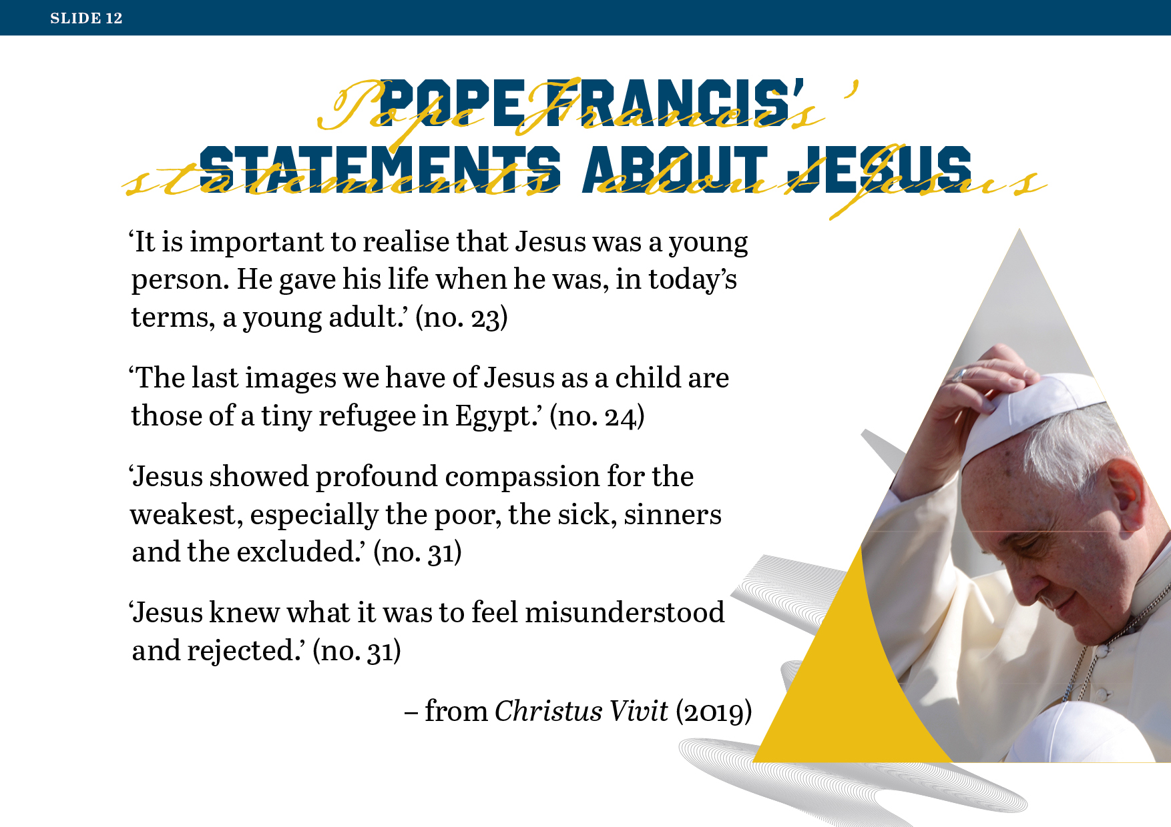
Notes:
Poster Activity: Describing Jesus
Note: You will need A3 sheets and colouring materials for the students.
Read and discuss Slide 12, which contains some of the things Pope Francis said about Jesus and the kind of person he was in his apostolic exhortation Christus Vivit (2019).
Ask the students which of these statements from Pope Francis is most effective in helping them to imagine and relate to what Jesus was like during his time on earth. Invite them to share the reasons for their choice.
Then invite the students to write their own statements about Jesus and to make a poster using these statements.
They may work individually or in groups.
Show Slide 13.

Slide 13
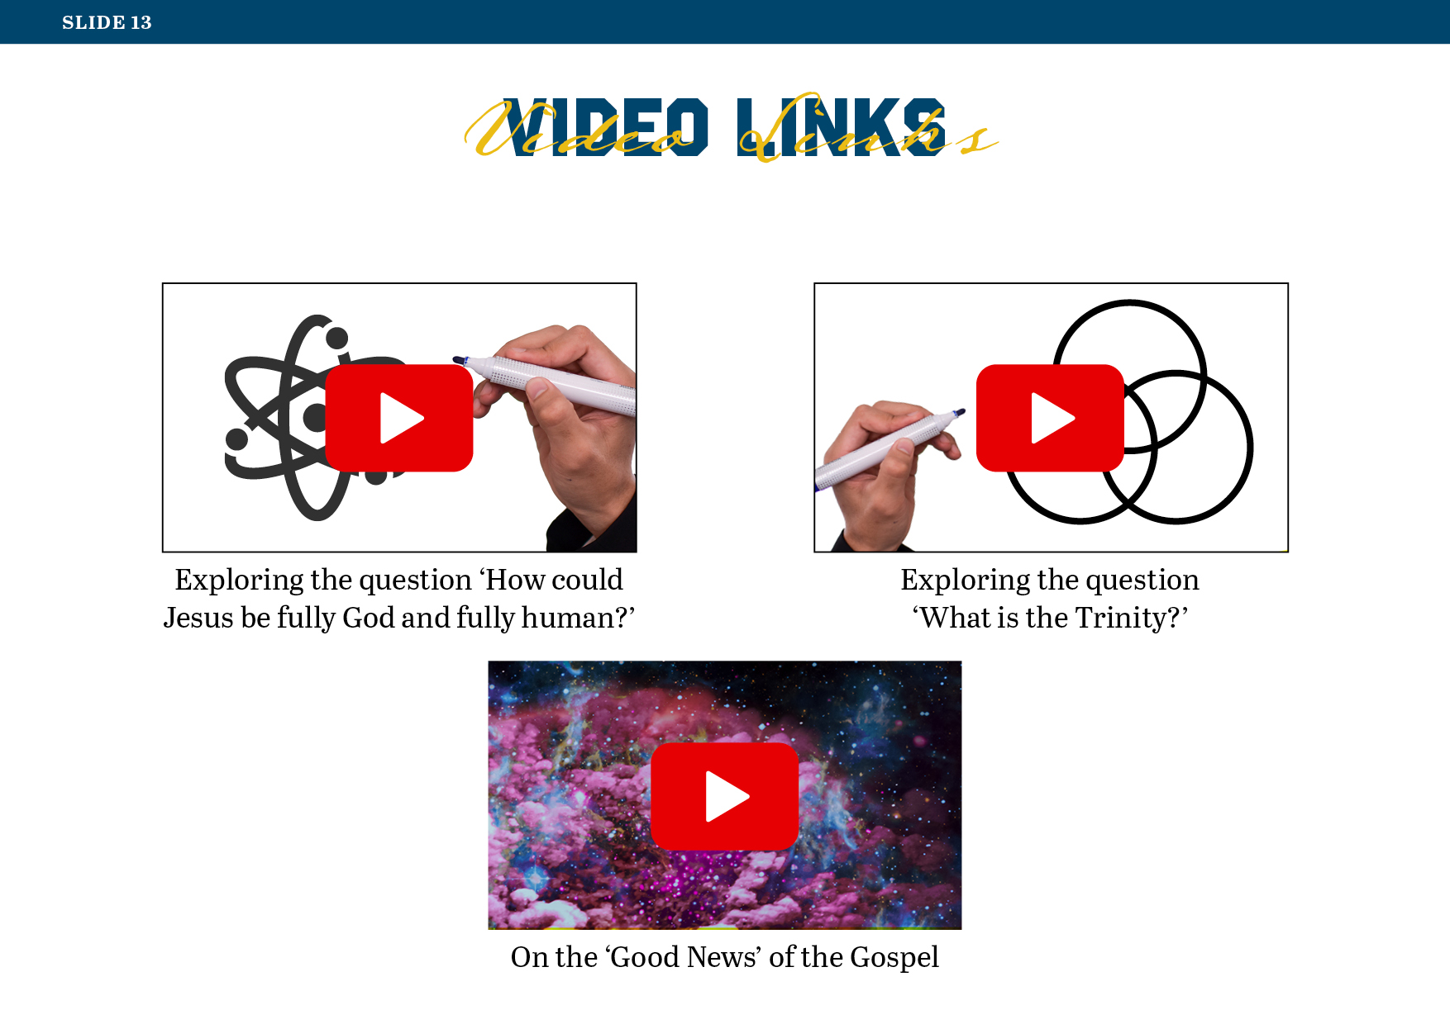
Notes:
Supplementary Activity
You may wish to check out the videos listed on Slide 13 and share them with the students.
Worksheet Exercise
Refer the students to the email template on Worksheet 10: ‘Email to a Friend’.
Ask them to imagine that their best friend has moved abroad. This friend has been in touch with them looking for some help with a project on Jesus that they are doing in their new school. Invite them to write to their friend in the email template outlining some of the things they have learned from this lesson about who Jesus is from the Christian perspective.
Reflective Journal Exercise
Invite the students to reflect on and complete the following on Worksheet 11: ‘Looking back over Lesson 3’:
Identify one or more of the Christian beliefs about who Jesus is that fit best with your own beliefs about Jesus, and say why that is the case.
Describe how you think the Good News of the Gospel is relevant to you personally. For instance, how does, or how could, the message of the Gospel impact on the way you live your life? Give some specific examples in your response.
Have you any further questions about the Christian understanding of Jesus, or any additional comments you would like to make about the content of this lesson? If so, write those here.
Note: When checking the responses to the third item on this worksheet, you might take note of the ‘questions’ the students still have, or what comes up in their ‘comments’, and perhaps dedicate a little time to discussing these, or even have the students research some of the topics for discussion during the next class period.
Remind the students of the ‘Personal Reflections’ page that comes after the worksheets for this lesson in the students’ journal, where they may record any additional thoughts or insights or questions they have at this point about any of the content they have covered so far.
Closing Reflection
Invite the students to sit in silence with their eyes closed for a few moments as they think about the following teaching of Jesus and what it means. Tell them that Jesus made this statement after he was asked the question, ‘Who is the greatest in the kingdom of heaven?’
Jesus said, ‘Truly I tell you, unless you change and become like children, you will never enter the kingdom of heaven.’ (Matthew 18:2).
Prompt the students’ reflection by slowly reading the following notes, pausing as indicated to allow them to reflect between each item:
What could Jesus have meant by ‘change and become like children’? Let’s explore that for a moment. Think about how children tend to approach new experiences … with open minds, without preconceptions … with a willingness to trust that what they are hearing or seeing is true … with a readiness to experience and express awe and wonder and delight … above all, without worrying, as adults sometimes do, about whether their reactions are the expected or appropriate reactions, or whether others will respond in the same way. (Pause)
Think also about how children tend to respond to new information with curiosity and an openness to accepting that there are many things they don’t know but are learning more about all the time … and how children are often excited and eager rather than fearful or resistant to new knowledge and new experiences … (Pause)
Think about how all of this might relate to what Jesus said: ‘Truly I tell you, unless you change and become like children, you will never enter the kingdom of heaven.’ Might he have been referring to how adults sometimes tend to disbelieve … to be hesitant or reluctant to accept or trust or experience what they cannot fully understand or explain … to be governed by what others think and do? Think about how such attitudes might stop people from listening to the teachings of Jesus and putting them into practice. (Pause)
To conclude this reflection, let us pray that we will allow ourselves to listen to the message of the Gospel – all the Good News that Jesus shared with us – with the openness and eagerness and curiosity of children, ready to trust that it will lead us, as Jesus promised, to ‘the kingdom of heaven’.

