Slide 1
Module 1
INTRODUCTION

Slide 2
WELCOME
Module 1 – Introduction gives an overview of the research that underpins WRITE!, examining the changes we can make to improve writing instruction in schools.
Module 2 – Foundations introduces you to Part I of the WRITE! series: Foundations. It includes suggestions for using lessons in the classroom.
Module 3 – Models examines WRITE! Part II: Models. Again, teaching suggestions are provided.

Slide 3
MODULE 1 OBJECTIVES
In this introduction, you will learn about …
what the international research on writing says
about the current state of writing instruction in Australian schools
why writing is so important for students
how WRITE! builds writing skills.

Slide 4
THE NEGLECTED “R”
A report by the US National Commission on Writing (NCW) states that “education will never recognize its potential as an engine of opportunity and economic growth until a writing revolution puts language and communication in their proper place in the classroom”.
The NCW recommends that the “amount of time students spend writing should be at least doubled”.
Nearly all primary students spend less than three hours a week on writing assignments.
More than 90% of mid-career professionals recently cited the “need to write effectively” as a skill “of great importance” in their day-to-day work.

Slide 5
WRITING IN AUSTRALIAN SCHOOLS
“Good literacy is an essential skill for coping with the many demands of life in contemporary Australian society. Tasks ranging from reading the directions on a bottle of medicine, completing a tax return or accessing information on the Internet all require a reasonably high level of English literacy. People who are unable to complete such tasks independently are at a considerable disadvantage.”*
“In Year 7, when students are in their first term of high school, only about 15 per cent used correct punctuation ‘most’ of the time, while 10 per cent used effective and accurate paragraphs and 4 per cent used correct and varied sentences.”**
“Up to 8 million Australians do not have the required reading and writing skills … [that] industry needs.”***
* Australian Bureau of Statistics, “Adult Literacy,” http://www.abs.gov.au/AUSSTATS/abs@.nsf/Lookup/4102.0Chapter6102008
** Ferrari, J 2014 (29 November), “Writing’s on the wall: Kids failing basic literacy,” The Australian, http://www.theaustralian.com.au/national-affairs/education/writings-on-the-wall-kids-failing-basic-literacy/story-fn59nlz9-1227138940282
*** “Poor reading and writing skills holding industry back” 2011 (5 April), ABC, http://www.abc.net.au/news/2011-04-05/poor-reading-and-writing-skills-holding-industry/2629362az

Slide 6
FIVE ACTIONS ESSENTIAL TO
SOUND THEORY AND PRACTICE
Students should …
understand the criteria (standards, rubrics, genres)
analyse various models (discuss models as a class)
respond to other’s writing (meaningful feedback)
reflect on their own writing (“students often [learn] how to be self-reflective from the thoughtful response they [receive] from others about their work”)
rehearse the performance (students must be prepared for the realities of test day)
Wolf, SA & Wolf, KP 2002 (January), “Teaching True and To the Test in Writing,” Language Arts, vol. 79, no. 3, pp. 229–240

Slide 7
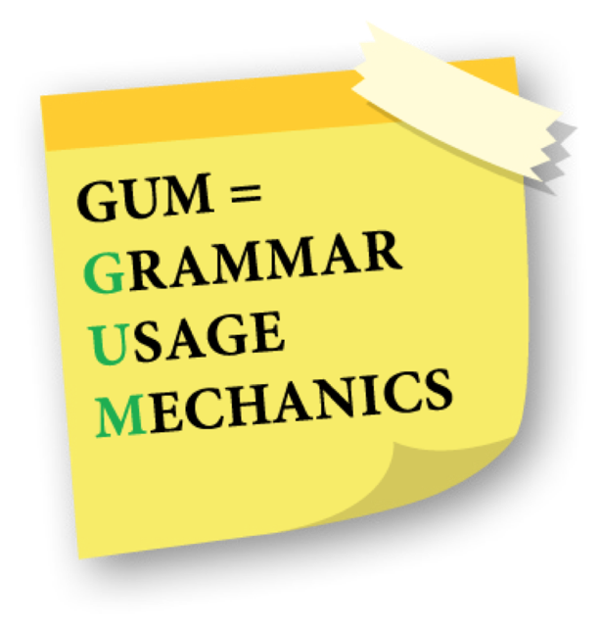
THE WRITE! SERIES
research-based writing program for Years 1–9
builds foundations by teaching grammar, usage and mechanics (GUM) within the context of writing
builds proficiency by providing writing models for students to analyse, correct and discuss
models peer and teacher comments to foster meaningful feedback
features writing prompts, graphic organisers and rubrics
test-preparation sections prepare students to show what they know.

Slide 8
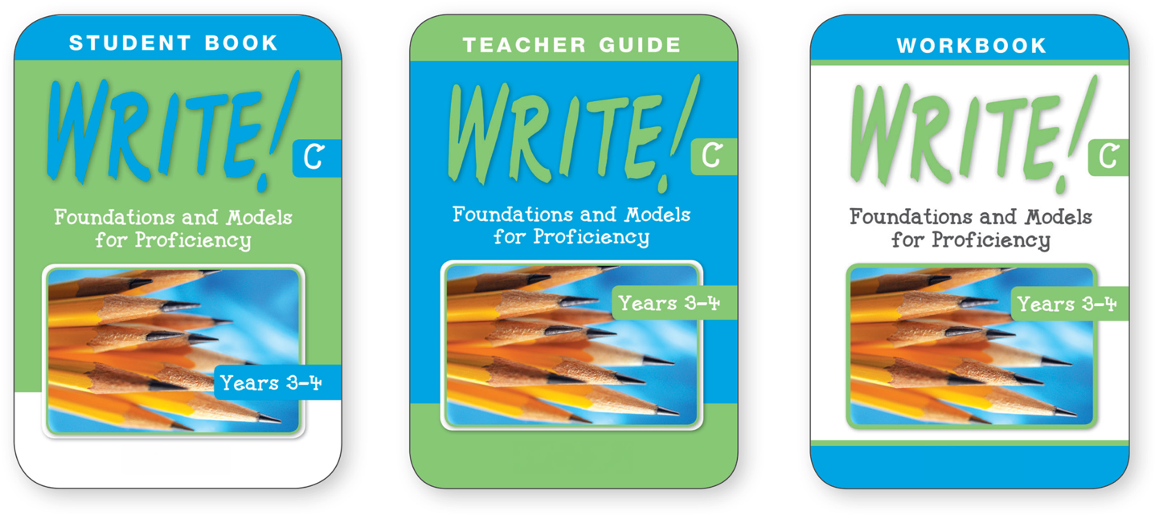
WRITE! COMPONENTS
Student Books
Student Books (A–H)
Teacher Books (A–H)
Workbooks (C–H)

Slide 9
Module 2
FOUNDATIONS

Slide 10
MODULE 2 OBJECTIVES
In this module you will learn …
what lessons are included in Foundations
how the Foundations lesson are formatted
how to use the Foundations lessons effectively
how to use Prepare for a Test, Part I
how to use WRITE! Part I: Foundations in the classroom

Slide 11
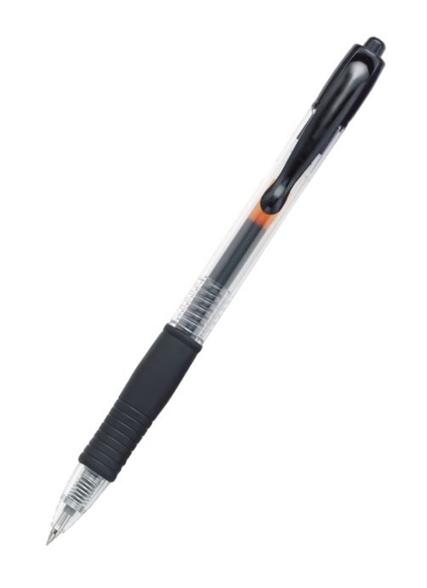
WRITE! PART I: FOUNDATIONS
30 lessons teach grammar, usage and mechanics (GUM) within the context of writing.
Lessons cover the following categories:
Using Words in Writing (parts of speech)
Giving Form to Writing (sentences)
Giving Voice to Writing (capitalisation and punctuation)
Giving Structure to Writing (paragraphs)
Revising and Editing (proofreading)
Prepare for a Test, Part I features GUM skills test preparation.

Slide 12
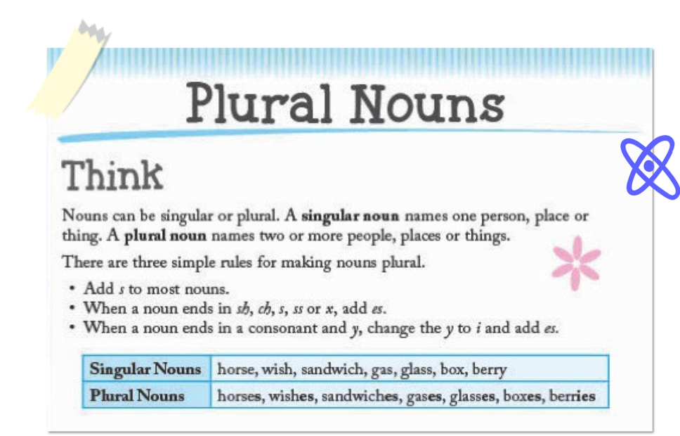
THINK
Each Foundations lesson begins with Think, a brief introduction to the GUM skill.
Examples are given to show students how the skill is applied.
Teachers should guide the class through this part of the lesson first.

Slide 13
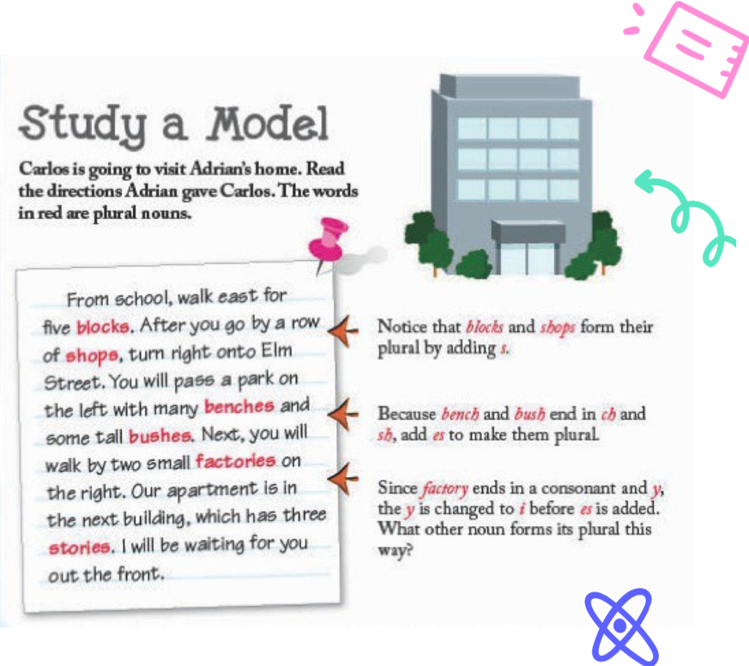
STUDY A MODEL
Models come from various genres and show the GUM skills in context.
The models are always examples of quality writing.
In the sample, the words in red are plural nouns.
Additional information about the nouns is included in the notes section.

Slide 14
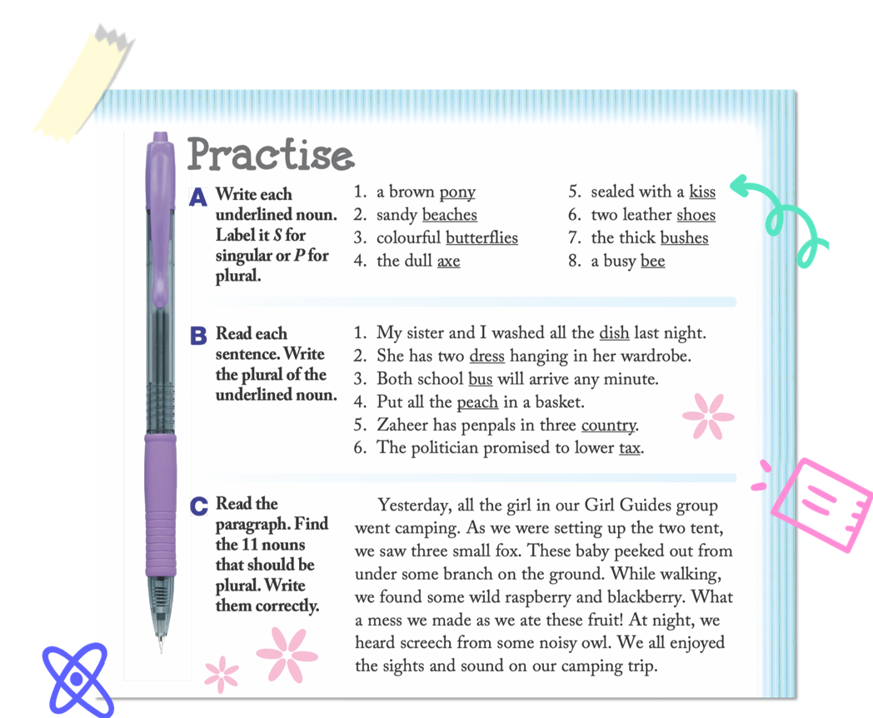
PRACTICE
Students practise using the GUM skill in three activities (one in Book A).
The activities progress in difficulty.
One or two items can be modelled before students begin.
Activities may be used to differentiate instruction.
They can be completed independently, in small groups or as a class.
Answers can be recorded in the WRITE! Workbook (levels C–H).

Slide 15
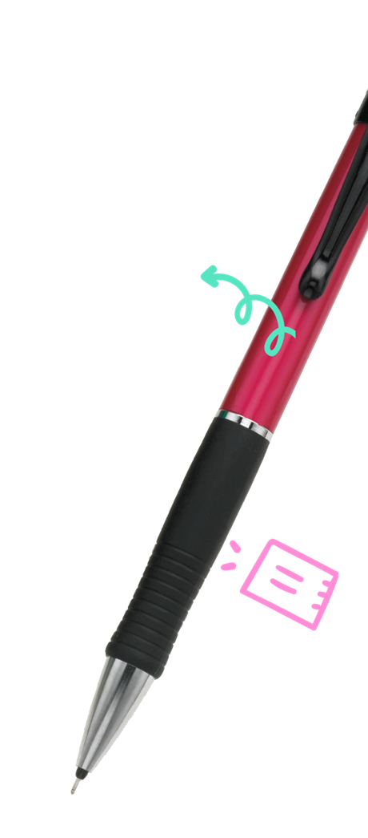
GUM RULE
Following the Practice activities, students will find a summary of the GUM rule relating to the GUM skill in the lesson.
This rule serves as a reminder for students as they continue to the final part of the lesson: the independent writing activity.
Add s to most nouns to make them plural. Add es to nouns that end in sh, ch, s,
ss or x. When nouns end in a consonant and y, change the y to i and add es.

Slide 16
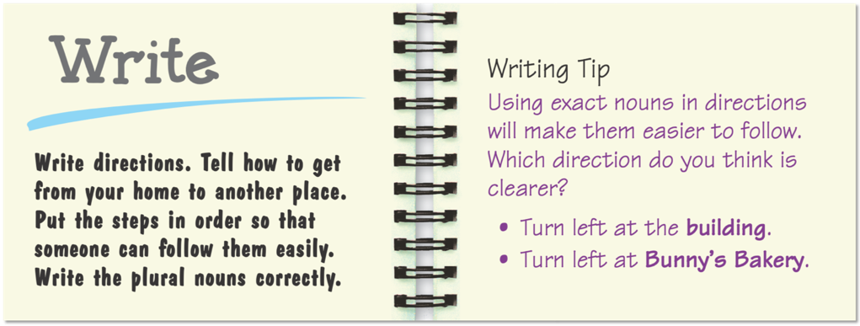
WRITE
Students write a passage that incorporates the lesson’s GUM skill.
The genre for the writing activity is the same as the model the students studied.
The Writing Tip helps students apply the GUM skill for more effective, interesting writing (Books C–H only).
The Write activity may be done as classwork or as homework.

Slide 17
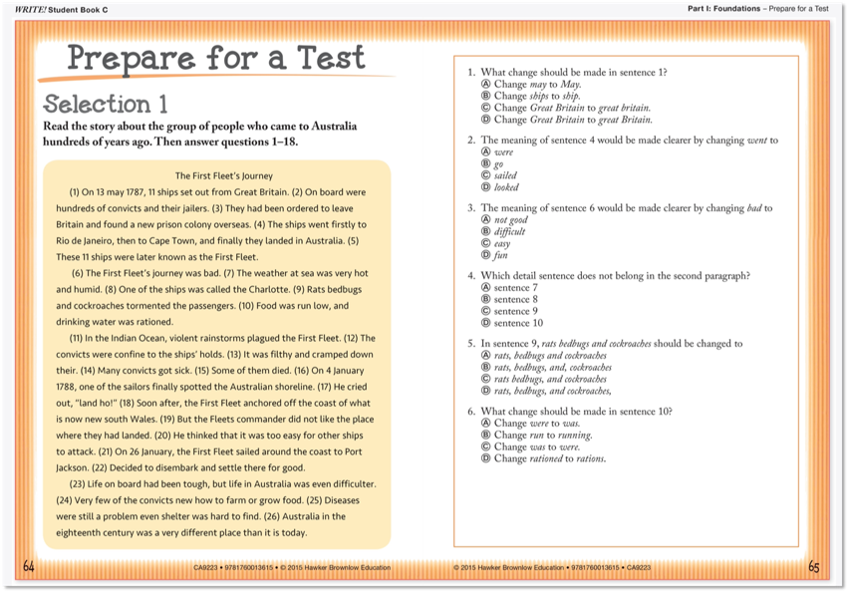
PREPARE FOR A TEST, PART I
Prepare for a Test, Part I includes three passages written in various nonfiction genres. (1 fiction and 1 nonfiction selection in Books A and B)
Each passage is followed by 18 selected-response questions (10 questions in Books A and B)
A “bubble sheet” answer form is provided in the Workbook or as a reproducible in the Teacher Guide.

Slide 18
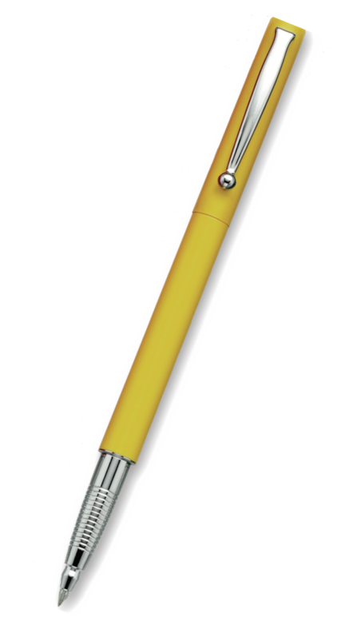
USING WRITE! PART I: FOUNDATIONS IN THE CLASSROOM
Mini-lesson (10–15 minutes)
Teacher reviews the GUM (grammar, usage and mechanics) concepts in Part I.
Teacher models the GUM concept using authentic literature.
Students and teacher Study a Model.
Independent work time (25–30 minutes)
Students complete Practice activities.
Students complete Write activity.
Teacher conferences with students about their work.
Sharing session (5–10 minutes)
Students and teacher discuss the Practice activities.
Students share their writing from the Write activity.
Teacher reinforces GUM concepts and clarifies misconceptions.

Slide 19
Module 3 MODELS

Slide 20
MODULE 3 OBJECTIVES
In this module, you will learn …
why the WRITE! series uses rubric-scored models (Books C–H)
how the lessons in Part II are formatted
how to use the lessons in Part II effectively
how to use Prepare for a Test, Part II.

Slide 21
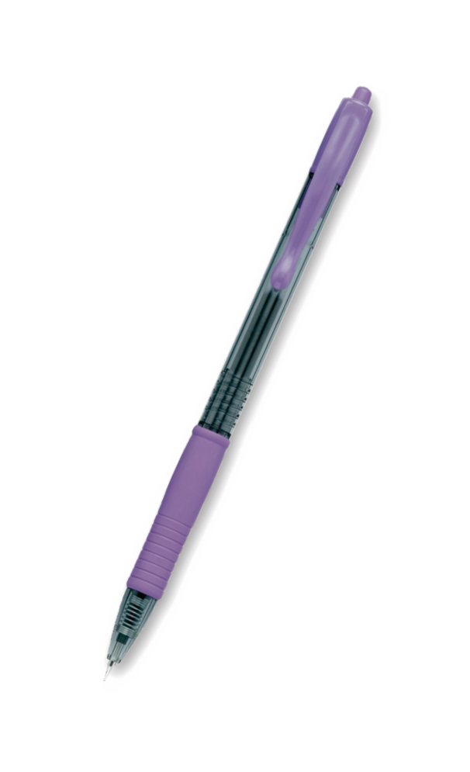
WHY USE WRITING MODELS?
Writing models allow students to see what different levels of writing in various genres look like.
Writing models give students tangible connections to rubric scores.
Other models give students examples of peer and teacher comments.

Slide 22
INTRODUCTION
Each lesson focuses on a different writing genre:
descriptive essays
personal narratives
ﬁctional narratives
informative essays
persuasive essays
summaries
research reports
instructions (Books A and B)
book reports (Book A)
One error-free model of writing in the genre is provided
Writing Tips give students ideas for interesting and effective writing in the specific genre.

Slide 23
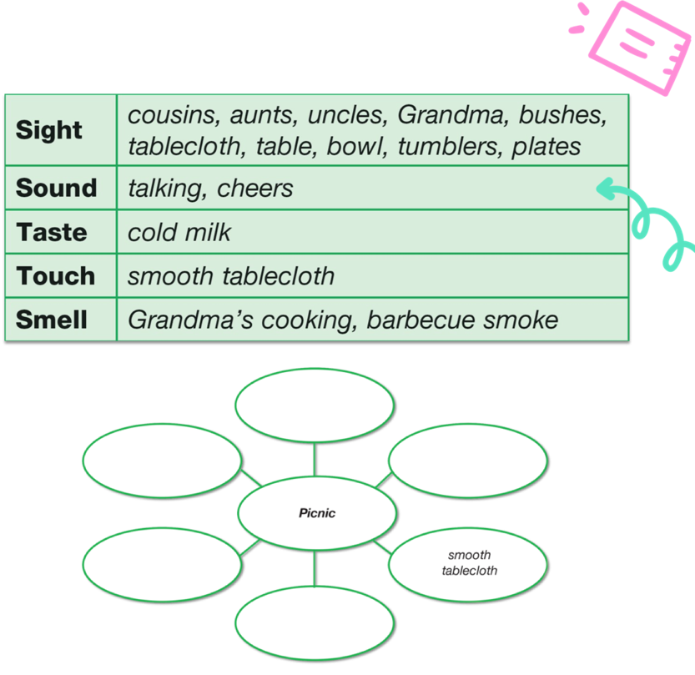
GRAPHIC ORGANISERS
Students learn about two graphic organisers appropriate for the lesson’s writing genre (one graphic organiser in Books A and B).
When students create and discuss the information in a graphic organiser they reread, talk, reason and see relationships that were not obvious before.
First, students analyse a graphic organiser that has been completed.
Then students complete a second graphic organiser with relevant information. (The graphic organiser in Books A and B is partially completed.)

Slide 24
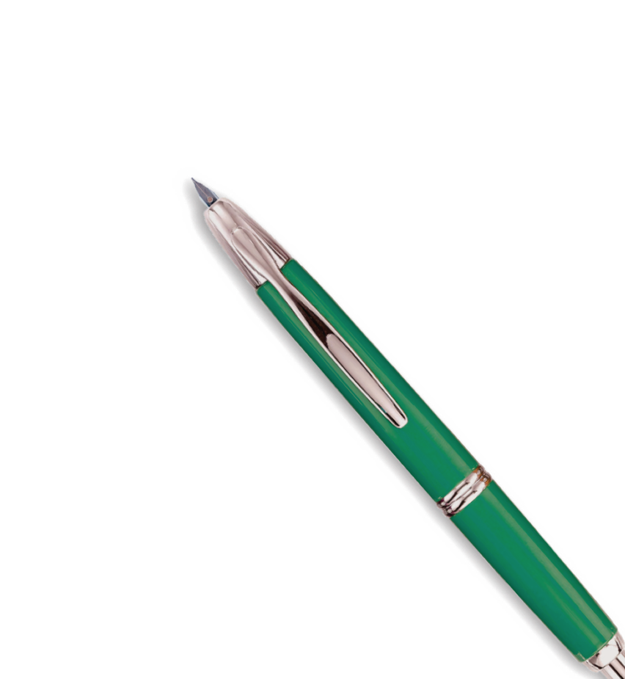
PART II: MODELS IN WRITE!
BOOKS A AND B
In WRITE! Student Books A and B, Part II: Models differs from Books C–H in several ways:
There are no writing rubrics in Student Books A and B (reproducible rubrics are provided in Teacher Guides).
The writing prompt from the first page of the lesson is repeated.
Student Books A and B feature the following sections:
Think – blank graphic organiser to plan writing
Write – students write a passage in the featured genre
Read – students use a simple checklist to review their writing
Listen – students check a partner’s writing using guiding questions
Check – a checklist refers students to relevant GUM skills from Part I
Write Again – students produce a clean final of their work draft
At the end of each lesson, students complete a self-assessment of their work.

Slide 25
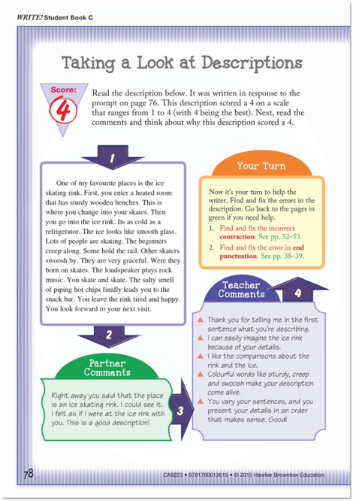
TAKING A LOOK
Students read a model for each rubric score (1–4).
Partner Comments help students respond thoughtfully and constructively to other’s writing.
Teacher Comments model the kinds of responses the writer can expect to see from teachers. They focus on the overall composition of the writing.
Teacher Comments also refer students to lessons in Part I for relevant GUM skills review.
Students ﬁnd and ﬁx the GUM errors in each model.
Students refer to the Foundations lessons to correct the GUM-speciﬁc errors.

Slide 26
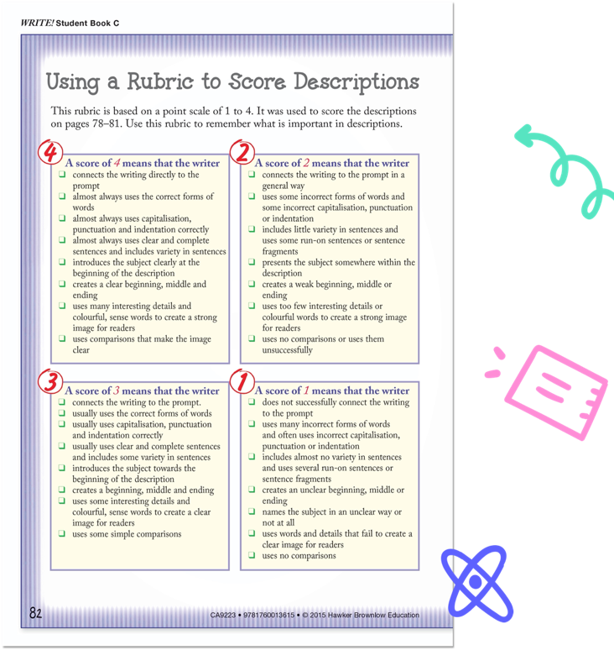
RUBRICS
WRITE! rubrics demystify the concept for both students and teachers.
Mastery of WRITE! rubrics will lead to confidence in coping with the rubrics used to mark standardised tests.
As you look through and discuss the score on each rubric, refer students back to the model for that score.
Ask students to point out examples in the models as you discuss the criteria.

Slide 27
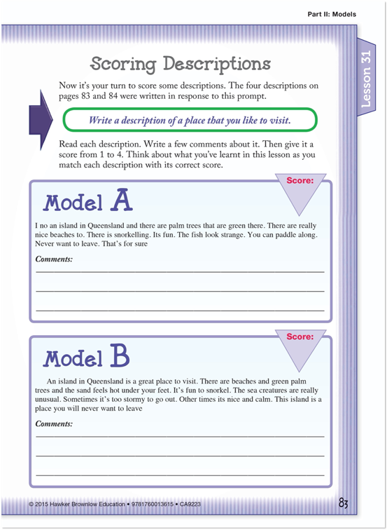
SCORING PASSAGES
Students read four models and assign a score to each one.
Students also write comments for each model.

Slide 28
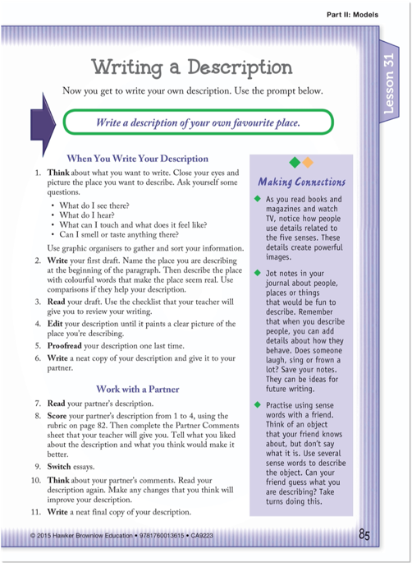
WRITING IN THE GENRE
Students complete the lesson by creating their own piece of writing in the genre.
They use graphic organisers to think about, gather and sort information.
After writing a ﬁrst draft, students use a checklist to proofread their work.
Students edit their writing and create a second draft.
Then students work with a partner to score one another’s writing using the applicable rubric.
Students also complete a Partner Comments sheet.
Finally, students think about their partner’s comments and write a ﬁnal draft.
Making Connections features activities that connect writing to various aspects of life.

Slide 29
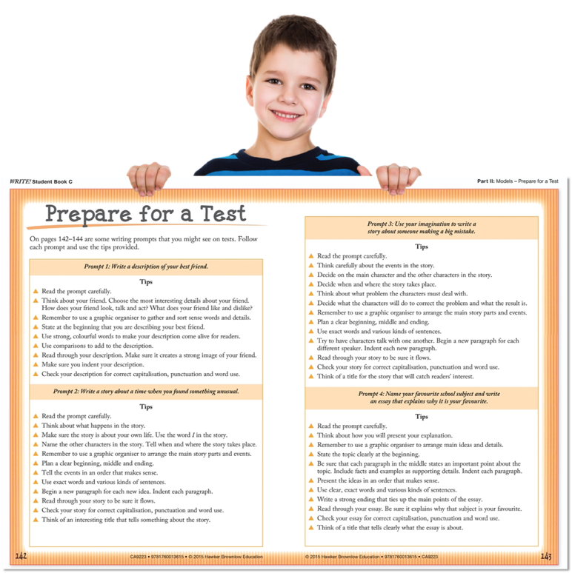
PREPARE FOR A TEST, PART II
Students practise responding to a writing prompt.
Prepare for a Test, Part II should simulate the conditions under which students will be tested.

Slide 30
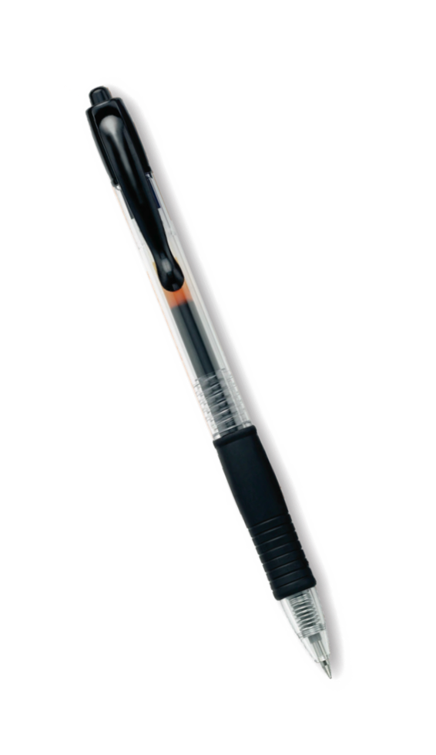
USING WRITE! PART II: MODELS IN THE CLASSROOM
Modelled writing
Teacher introduces the writing genre using WRITE! Part II lessons.
Teacher models the structure of the genre using the WRITE! Model.
Teacher may then compose another text while thinking aloud about the features the genre should include (write-aloud).
Shared writing
Teacher explains and demonstrates the use of graphic organisers.
Teacher records students’ ideas as they complete a graphic organiser together.
Students and teacher complete another graphic organiser and compose a short text.
Guided and independent writing
Students study the different models in WRITE! with teacher guidance.
Students and teacher read and discuss Partner Comments and Teacher Comments.
Students complete Your Turn.
Students score models.
Students write, proofread, edit and work with partners.

