Slide 1
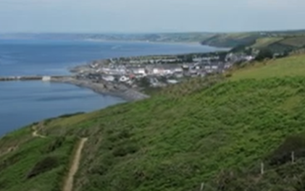
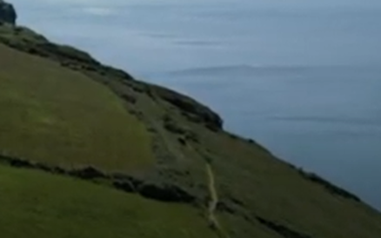
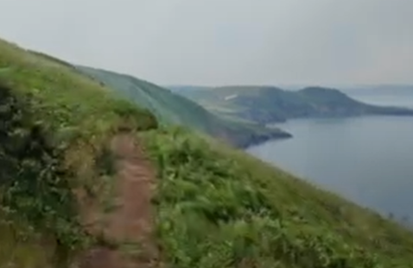
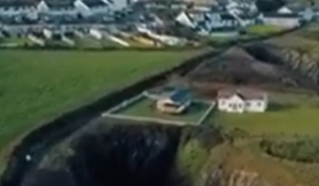
Cynefin Arfordirol - Coastal Cynefin
Llwybr Arfordir Cymru
Wales Coast Path
Llwybr Arfordir Cymru o Aberaeron i Gilfach yr Halen.
Wales Coast Path from Aberaeron to Gilfach yr Halen.
Llwybr Arfordir Cymru yn edrych i’r de tuag at Ceinewydd.
Wales Coast Path looking south towards New Quay.
Cliciwch ar y lluniau.
Click on the pictures.
Llwybr Arfordir Cymru gerllaw Cwmtydu.
Wales Coast Path near Cwmtydu.
Llwybr Arfordir Cymru o Aberporth i Dresaith.
Wales Coast Path between Aberporth and Tresaith.

Slide 2
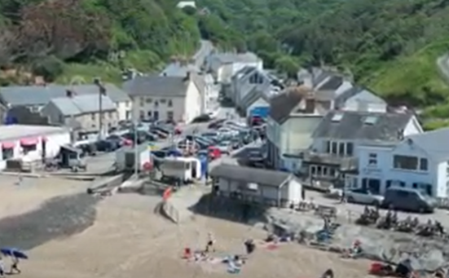
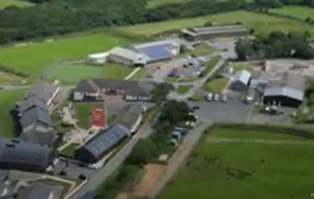
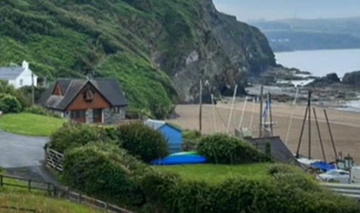
Cynefin Arfordirol - Coastal Cynefin
Pentrefi Ceredigion
Ceredigion Villages
Pentref Llangrannog
Llangrannog village
Cliciwch ar y lluniau.
Click on the pictures.
Gwersyll yr Urdd,
Llangrannog
Pentref Aberporth
Aberporth village

Slide 3
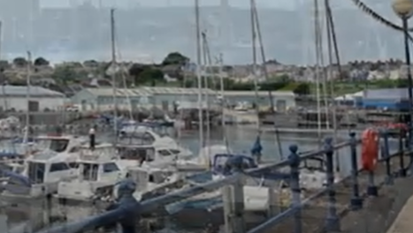
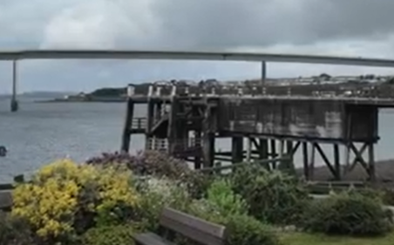

Cynefin Arfordirol - Coastal Cynefin
Aberdaugleddau
Milford Haven
Cliciwch ar y lluniau.
Click on the pictures.
Marina Aberdaugleddau
Milford Haven Marina
Hen lanfa fferi Burton a’r bont newydd ger Neyland.
The old Burton ferry jetty and new bridge near Neyland.
Lluniau - Images

