Slide 1
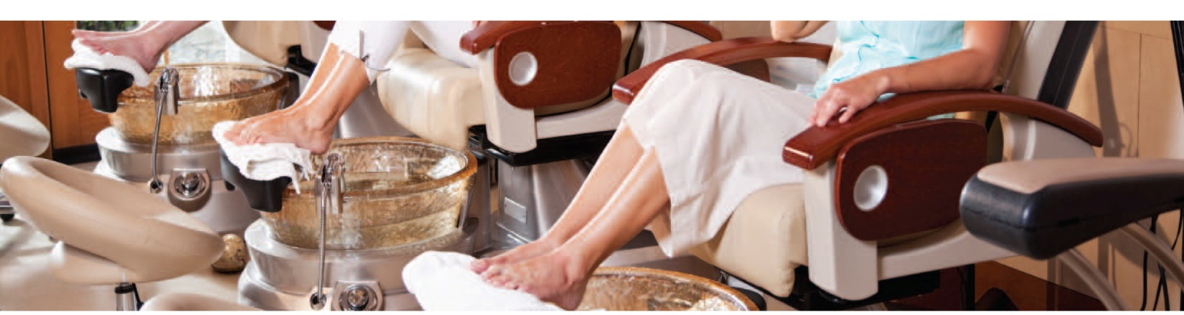

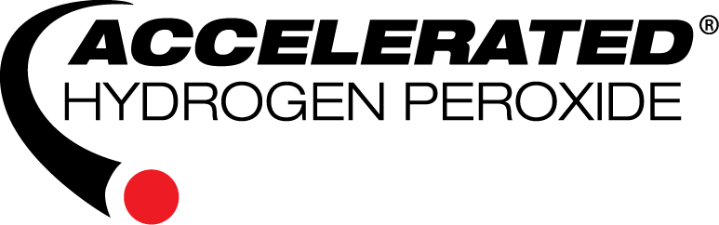
POWERED BY:
© 2016 CBON Copyright Material, any unauthorized use of it in full or part is strictly prohibited

Slide 2
TABLE OF CONTENTS
CBON Mission Statement 3
What the Media is Saying 4
What are Health Authorities Saying: York Public & Toronto Region 8
Current News: Flu 20
Reasons for Infection Control in Salons & Spas 24
What exactly is Infection Control? 25
The Spread of Microorganisms 28
Hand Hygiene 31
General Requirements for Cleanliness 35
Infection Prevention and Control Requirements 36
Basic Microbiology 43
What is Biofilm? 46
Understanding Disinfection 50
Understanding some differences of chemical disinfectant technologies 54
Active Ingredients for Disinfectants in the Salon & Spa Industry 56
PREempt 62
-What is AHP?
-Pillars of Strength
PREempt protocol - Areas of public health concern 68
-PREempt for SURFACES & NON-CIRCULATING FOOTBATHS
-PREempt for PROFESSIONAL TOOLS
-PREempt for CIRCULATING FOOT BATHS & HAIRDRESSER TOOLS

Slide 3

MISSION STATEMENT
BEING AN EFFECTIVE AND ACTIVE ADVOCATE for BEST PRACTICES IN INFECTION CONTROL ….
CBON, alongside Virox Technologies are committed to providing the information and education required for best infection control practices in the beauty industry.
It is our mission to ensure the salon and spa standard of infection control be at a level that can be recognized and accepted by the government, local health inspectors and industry standards, while also being safe, effective and environmentally responsible.
POWERED BY:
WB #3

Slide 4




What the media is saying about the spa industry

Slide 5
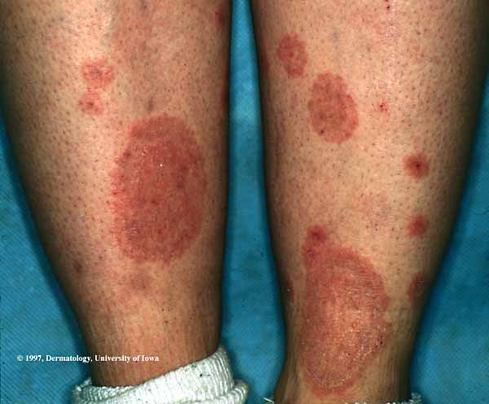
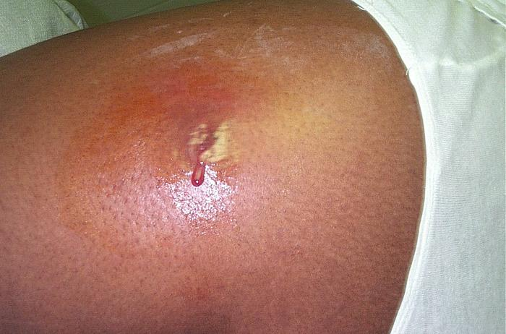
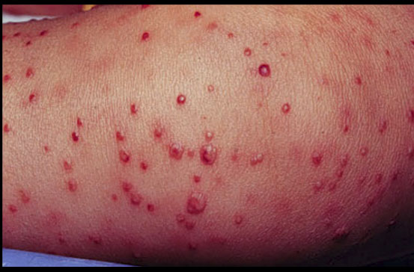
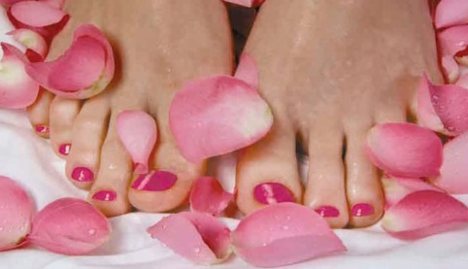
California 2000
One of the largest outbreaks took place in a California nail salon in September 2000. At the end of the investigation, 110 customers were infected. In each case, after getting pedicures, small sores developed on their lower legs and after several weeks or months, they became large, tender, boils with some cases progressing to skin ulcers. It was concluded that the bacterium entered the salon through the tap water, grew in accumulated debris of hair, skin and nails behind the footbath inlet screens, which were never cleaned. When interviewed, the owner said that he had never cleaned or disinfected his machines in the year they had been operating. M. fortuitum can be found in any water source and soil on the ground, and most of the time it does not cause a problem when it comes in contact with the epidermis. However, when given a proper breeding environment with the right temperature, it multiplies very rapidly. The incident could have been avoided had the organic debris behind the screens been cleaned out and the footbath & screen disinfected between clients.
Skin infections caused by Pedicures where Infection Control was ignored.
Fungal skin infection
Bacterial skin infection
Viral skin infection
Infection prevention and control is no longer a luxury item when considering salon budgets.
It has become a priority!

Slide 6

Cont’…
California 2004
Singer and American Idol judge Paula Abdul recently had a thumbnail surgically removed after developing a severe infection. Abdul claimed she received the infection after a Studio City, California manicurist poked Abdul's thumb while working on the celebrity's nails. The salon denies they were responsible.
ABC News's 20/20 program reported on an investigation revealing that of 27 discount nail salons tested by an independent laboratory, 24 showed evidences of bacteria or fungi that could lead to infection. The 20/20 site features a lengthy article summarizing their investigation.
(Internet Blog)
Paula Abdul: Clean 'Em Up!
Entertainer Paula Abdul is urging California legislators to force nail salons to clean up their act. The 43-year-old dancer/choreographer/actress and "American Idol" judge talked about her own year long health ordeal caused by an unsanitary manicure.
Abdul said a trip in April 2004 to a Studio City nail shop that used unclean equipment sent her in and out of the hospital, and made her the butt of late-night talk show jokes.
Customers are vulnerable to bacterial infections if manicurists do
not properly sanitize their tools between jobs.
© 2009 The Associated Press. All Rights Reserved
Family sues salon over death after pedicure
FORT WORTH, Texas 2006— Kimberly Kay Jackson loved getting pedicures each month, especially with bright pink nail polish, although as a paraplegic she couldn’t feel the massages and bubbling water on her feet.
But after her heel was cut with a pumice stone during a July pedicure, she developed an oozing wound that wouldn’t heal despite repeated rounds of antibiotics, relatives said. The 46-year-old died in February of a heart attack triggered by a staph infection, said the family’s attorney, Steven C. Laird.
Now, her three teenage children are suing Angel Nails and its owner for unspecified damages. The lawsuit, filed last week, claims the Fort Worth salon did not follow state regulations for disinfecting the whirlpool and instruments.
© 2012 The Associated Press. All rights reserved.

Slide 7
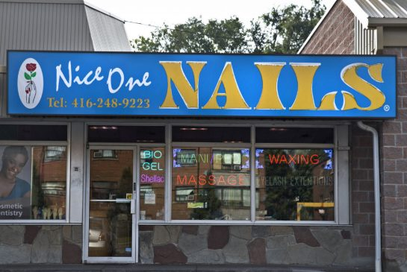

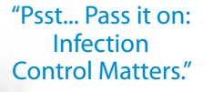
Manicure, spa and tattoo health violations disclosed
By: Robert Cribb Foreign,
Published on Fri Sep 12 2014
TORONTO 2014
Nice One Nails salon at 2210A Jane St. is the first "personal service setting" to receive a court conviction under the city’s new online disclosure system. The salon's operator pleaded guilty to re-using pumice stones and wax rollers, which must be disposed of after each use to prevent the spread of bacteria.
On June 17, inspectors cited the Nice One Nails salon for used pumice stones “found at every footbath station,” reads an inspection report obtained by the Star. “Pumice stones cannot be cleaned and disinfected between uses. They are single use.”
Pumice stones, used to scrape the skin, are rough and can cause bleeding that can lead to the spread of disease if used repeatedly on different people, says Cecilia Alterman, Toronto Public Health’s manager of infection control and infectious disease.
“If somebody has a blood-borne infection, it could remain on the pumice stone that’s used on you and you could get an infection. There’s a risk there.”
“With waxing you have open pores on your body and perhaps some bleeding,” says Alterman. “They roll it over and over in the same area and there is a possibility of bacterial infections that could go back into the wax.”
Because of the three straight incidents, Toronto Public Health chose to take the charges to court rather than the typical approach of issuing a ticket, she said.
http://www.thestar.com/news/world/2014/09/12/manicure_spa_and_tattoo_health_violations_disclosed.html

Slide 8
YORK PUBLIC & TORONTO HEALTH:
WHAT ARE THEY SAYING

Slide 9


Slide 10
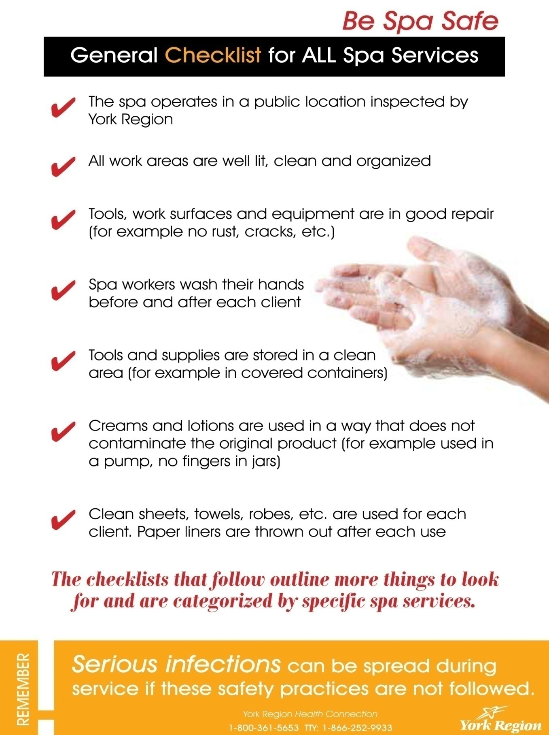

Slide 11
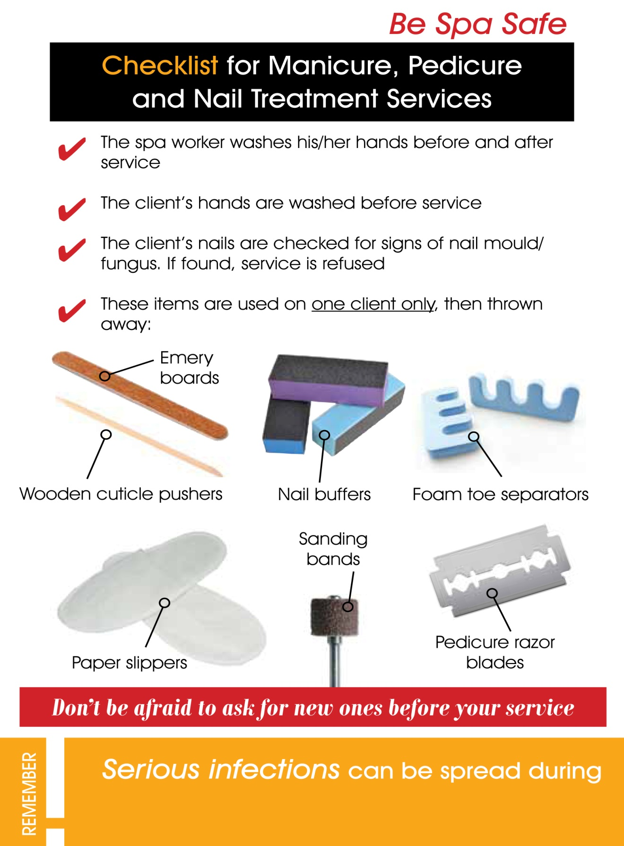

Slide 12
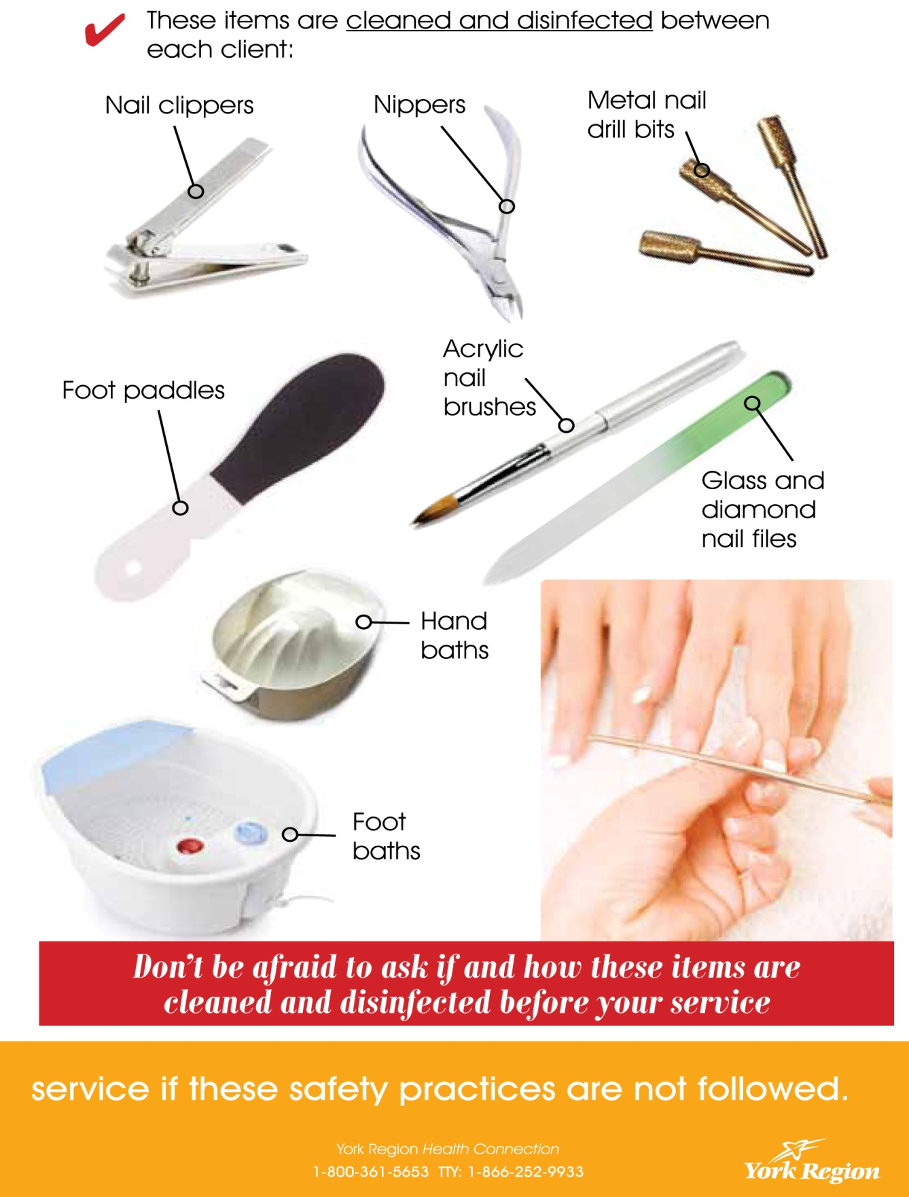

Slide 13
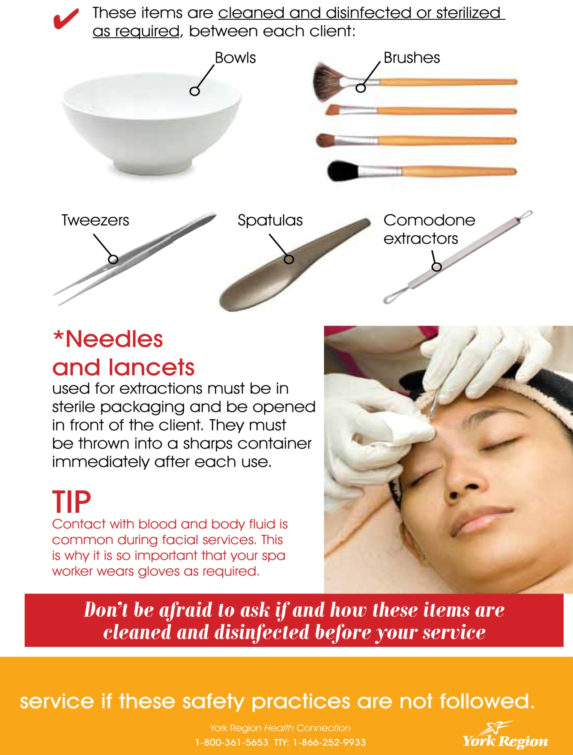
To access the complete Be Spa Safe Guide go to: www.york.ca/bespasafe

Slide 14
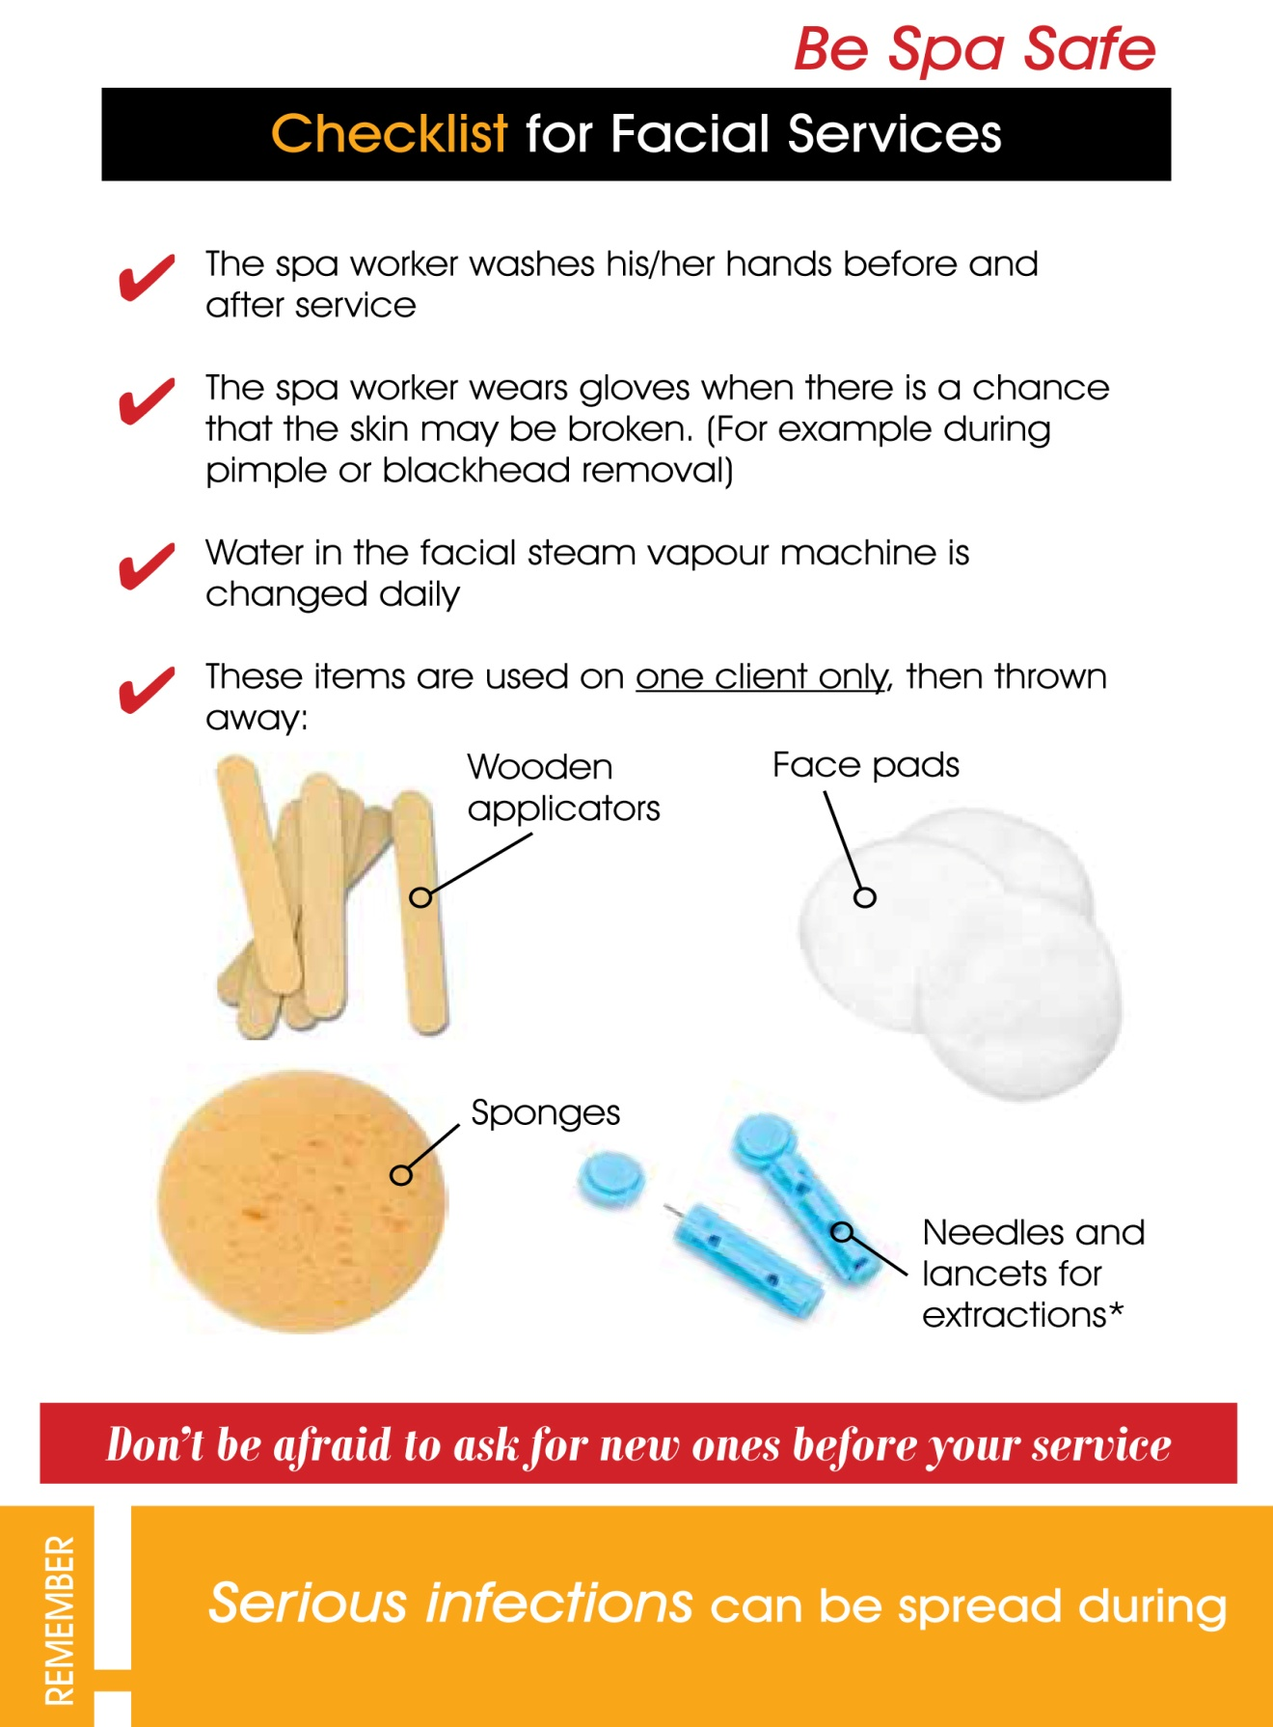

Slide 15
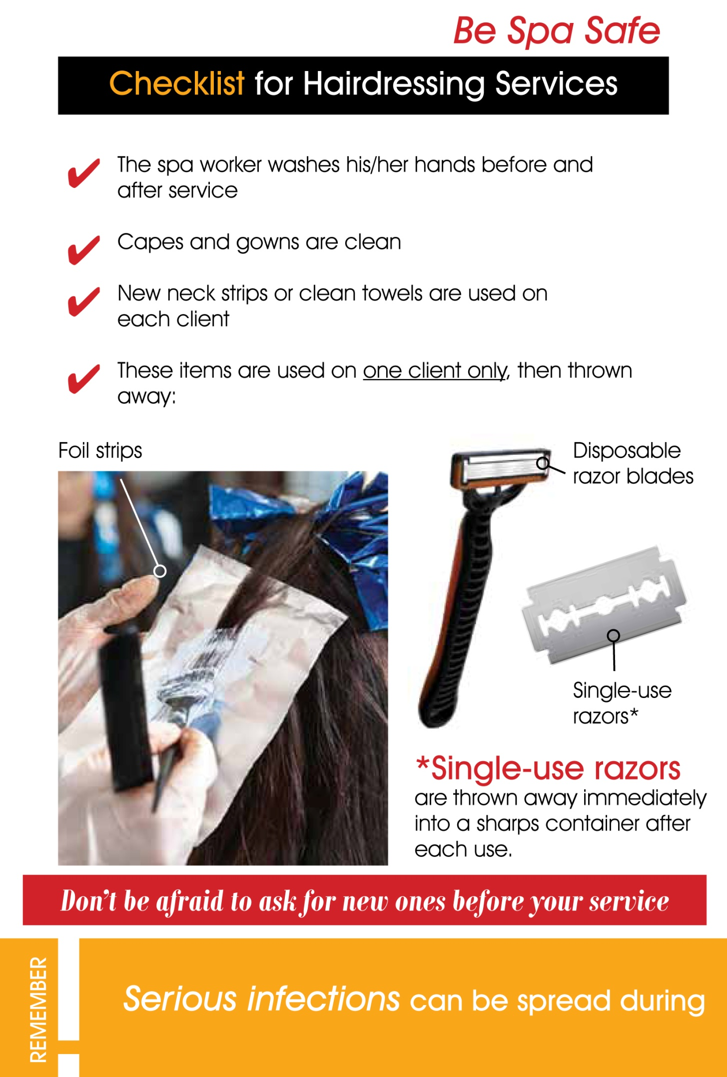

Slide 16
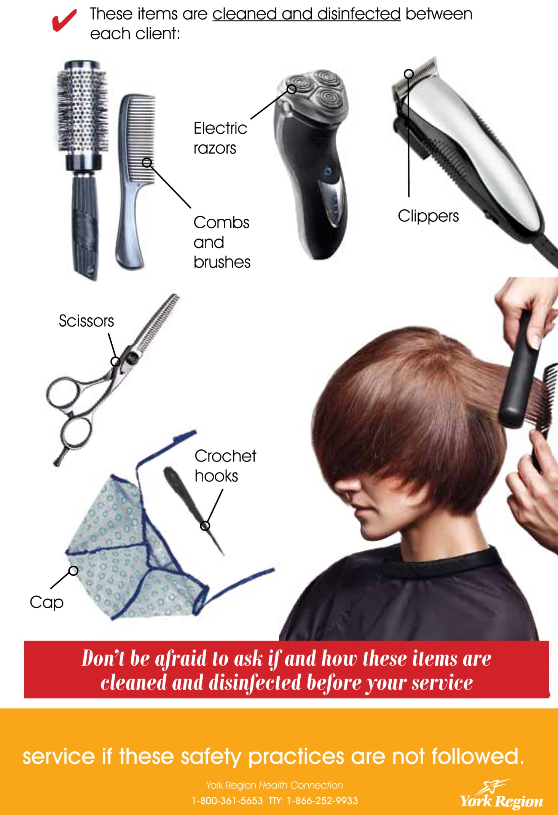

Slide 17





BodySafe Inspection Program
The purpose of the BodySafe program is to ensure that personal services settings (PSS) are clean and use practices that prevent the spread of infections.
Starting July 1, 2013, … all establishments offering hairstyling or barbering services will be required to get a PSS licence and post their inspection notices at or near the entrance of the business, so that it is clearly visible to the public.
All these establishments will also be included on the BodySafe website.
Establishments offering other services such as tattooing, micropigmentation, ear and body piercing, electrolysis, manicures, pedicures and aesthetics will be phased in over the next few years.
PASS
CONDITIONAL
SERVICE(S) / ESTABLISHMENT
What colour do you think you are ?

Slide 18
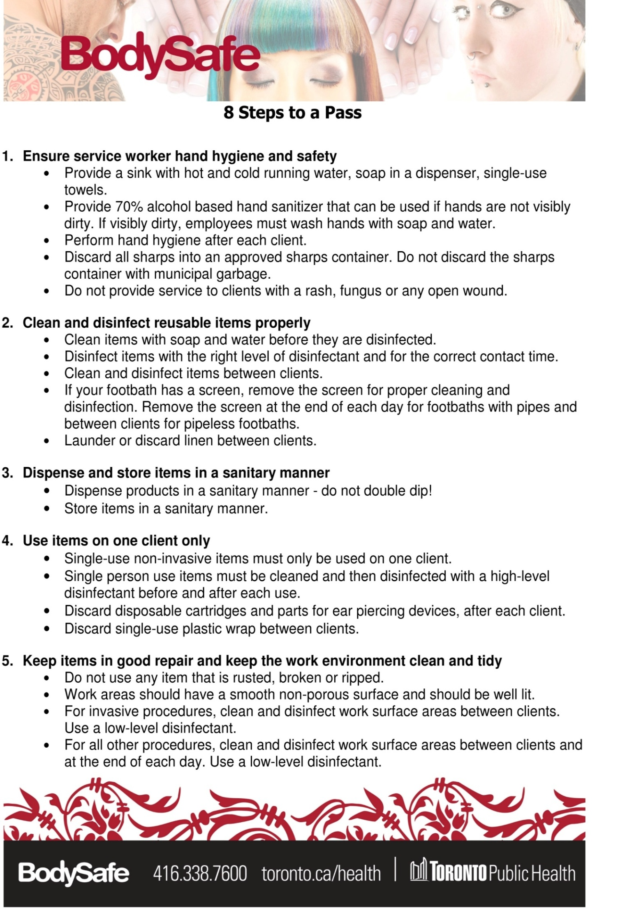

Slide 19
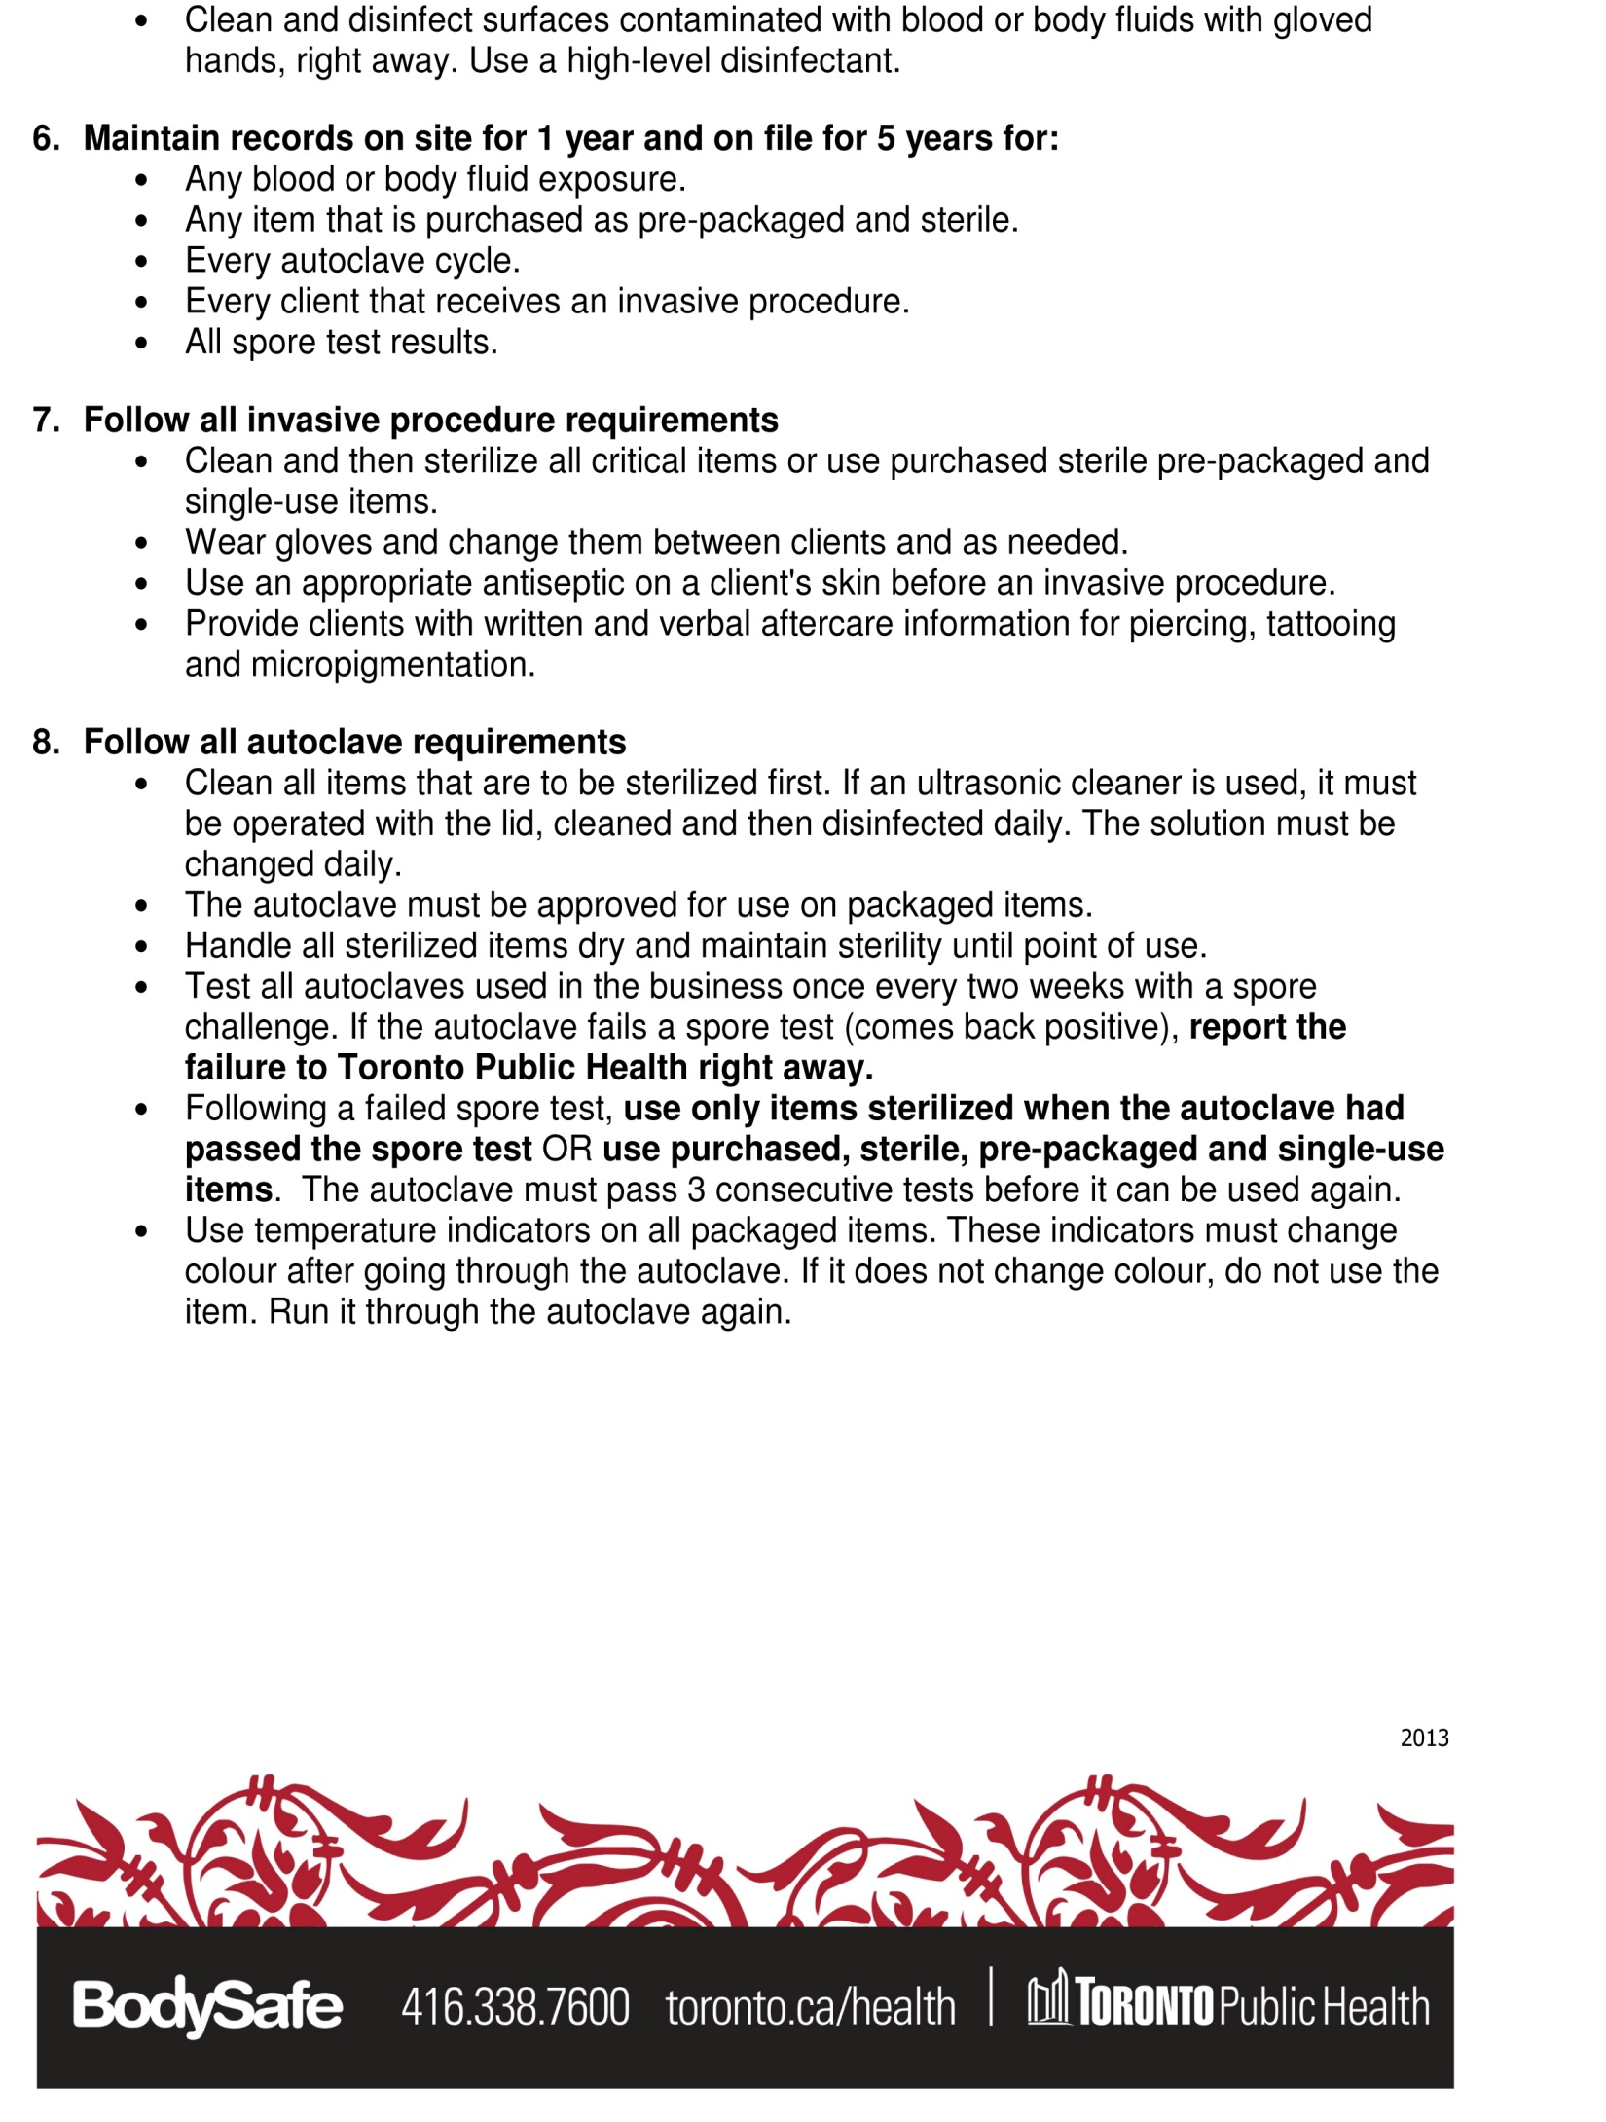

Slide 20
CURRENT
NEWS

Slide 21

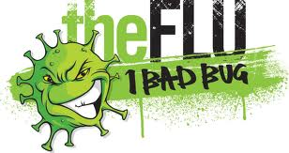
Government of Canada
Prevention
How can influenza be prevented?
The flu shot:
It is recommended that everyone older than 6 months should get a flu vaccine. This is especially important for people who are at higher risk of complications.
Getting a flu vaccine:
    protects you if you are exposed to the virus
    stops you from getting very sick
    prevents you from passing on the virus to others.
However, it is important that you get a new flu vaccine every year. There are two reasons for this. The effects of the flu vaccine can wear off, so you need a booster every flu season.
    The flu virus usually changes from year to year, so the vaccine must be updated to protect people fully.
Speak to your health care provider, pharmacist or local health unit about getting the vaccine. Find a clinic near you where you can get a flu shot.
TAKE CARE OF YOURSELF
Here are some other ways to stay healthy and prevent the spread of the flu.
    Clean your hands frequently and thoroughly.
    Cough and sneeze into the bend of your arm, not into your hand.
    Avoid touching your eyes, nose and mouth with your hands.
    Clean and disinfect things and surfaces that a lot of people touch, like doorknobs and TV remotes.
    Keep your immune system strong: eat healthy foods and be physically active.
Finally, if you do get sick, stay home until your symptoms are gone! You will get well faster, and you will not give the flu to anyone else.
Date modified: 2014-09-19

Slide 22
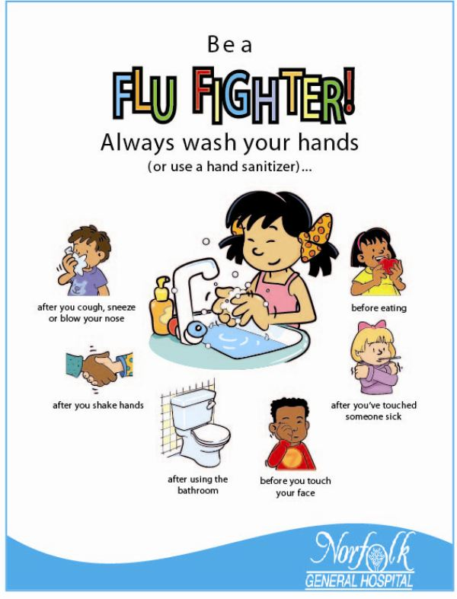

Slide 23


THE POWER OF SOCIAL MEDIA

Slide 24
Reasons why infection control procedures need to be incorporated into the salon and spa work place…
There are more…
Elderly clients
Long-term cancer therapy recipients
Transplant recipients
People with diabetes, respiratory disease, alcoholism, or HIV
Overworked staff
Population is more mobile
…seeking your services!
WB #4

Slide 25
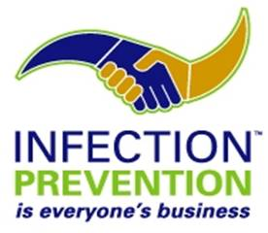
INFECTION
CONTROL

Slide 26
What exactly is infection control?
Definition: The process of minimizing the risks of spreading infection.
Proper infection control consists of a 2 step process. All guidelines state that there are 2 steps to infection control
2. DISINFECT or STERILIZE
1. CLEAN
first
CLEANING (a.k.a. SANITIZE):
The physical removal of organic matter or debris from objects, usually done using water, detergent, and friction. This process removes microorganisms primarily by mechanical action but does not destroy those remaining on the object.
DISINFECTION:
A process that kills or destroys most disease-producing micro-organisms, with the exception of high numbers of bacterial spores. There are different levels of disinfection and they can be achieved by physical or chemical methods.
-- OR – NOTE: Disinfection and Sterilization are not the same!
STERILZATION:
The process where all the living microorganisms, including bacterial spores are killed. Sterilization can be achieved by physical, chemical and physiochemical means. Chemicals used as sterilizing agents are called chemosterilants.
  Disinfectants do not work unless you clean first because organic matter INACTIVATES disinfectants.
  All surfaces must be cleaned BEFORE using a disinfectant.
  Cleaning and Disinfecting surfaces effectively will interrupt the spread of germs from contaminated surfaces to clean surfaces.
WB #5

Slide 27
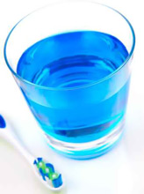
Is mouthwash strong enough?
Can you clean your teeth with mouthwash alone?
What about rinsing with toothpaste?
What’s needed - ABRASIVE ACTION!
Hence the importance to always clean first, before attempting to disinfect!

Slide 28
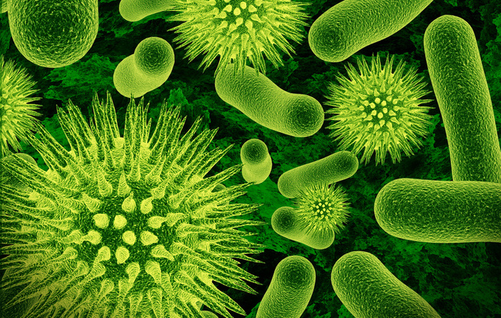
The Spread of Microorganisms
Bacteria populations can double every 20 minutes at room temperature
If you have 1 bacteria at 8:00 AM, by 5:00 PM you have 134,217,728
Because of the fast multiplying nature, bacteria are easily spread, especially in the salon/spa. Bacteria can spread through:
  Surfaces
  Hands
  Instruments
  Pedicure Chairs
In the salon/spa, you can prevent the spread of bacteria by:
  properly cleaning and disinfecting surfaces (work stations)
  properly cleaning and disinfecting (high level) or sterilizing tools
  properly cleaning linens and towels
  washing hands frequently and correctly (both clients and staff)
  perform proper client consultations (ensure you are working on clean, unbroken, uninfected skin)
  wearing gloves when necessary
.
WB #6
Notes:
TEACHER’S NOTES:
Q: What is the ideal environment for bacteria to thrive in?
A: Damp, Dark, Dirty and Warm
The information above is based on room temperature environment.

Slide 29
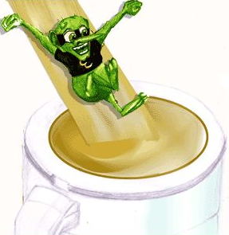
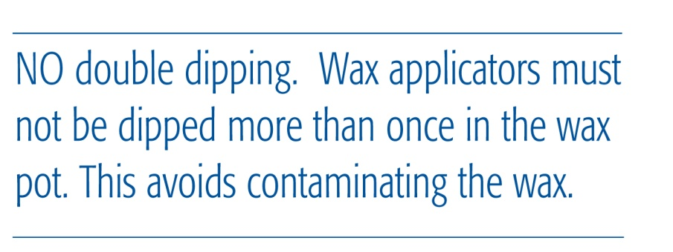
Cross-Contamination
Contamination is the spread of microorganisms to an object.
Even a disinfected item that has been touched or exposed to air is contaminated.
Cross-contamination is the transfer of bacteria from one item or surface to another.
To avoid cross-contamination, you should avoid touching a clean object or utensil with hands that have touched the client’s skin.
Objects or utensils that help to avoid cross-contamination are:
  Gloves: should be worn during all treatments that involve touching client’s skin, especially waxing, electrolysis, extractions, etc.
  Spatulas: these are objects which are used to remove a product from it’s container, without touching it with your hands. These implements must be cleaned, or you will be cross-contaminating.
WB #7

Slide 30
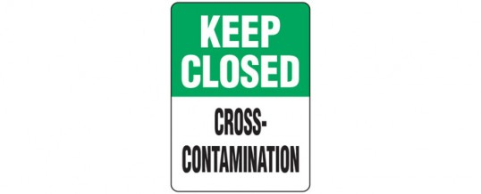
Aseptic Procedure
An aseptic procedure is the process of handling sanitized and disinfected objects so that you prevent the possibility of cross-contamination.
Examples are:
Before beginning a treatment, lay out all implements you will use, including tools, gauze, cotton, etc, on a clean towel. This way you are less likely to open a container to get supplies, after touching the client’s skin. Any object touched during treatment should be discarded or properly sanitized and disinfected.
Never open containers with gloved hands, this is cross-contamination. If you have to get more product or utensils, remove gloves, sanitize hands, get objects, re-sanitize hands, and reapply gloves.
For each client use clean towels, sheets, headbands, etc.
Wear gloves during entire treatment, especially waxing, electrolysis, etc. Creams and products should be removed by pumps, squeezing, or spatulas. Never dip into product with hands, and never double dip with spatula
After treatments, laundry should be placed in a covered basket, disposable items in a covered trash can, any unused product discarded and any tools/implements to be re-used should be cleaned and disinfected/sterilized
All surfaces should be wiped down with a cleaner and disinfectant before next client

Slide 31
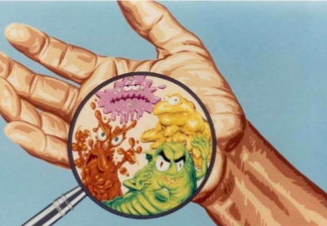
Hand Hygiene
Adapted from Community and Hospital infection Control Association – Canada
Why is hand hygiene important?
Hand hygiene refers to removing or killing microorganisms (germs) on the hands.
When performed correctly, hand hygiene is the single most effective way to prevent the spread of communicable disease and infections.
Hand hygiene may be performed either by using soap and running water, or with alcohol-based hand rubs.
When should hand hygiene be performed?
Hand hygiene is required: before and after contact with a client, their body substances or items contaminated by them
Between different procedures on the same client
Before putting on and after taking off gloves
Before performing any aseptic procedure
After performing personal functions (e.g. using the toilette, blowing your nose)
When hands come in contact with secretions, excretions, blood and body fluids
When should soap and water be used?
Hand washing with soap and running water must be performed whenever hands are visible soiled.
Any type of plain soap may be used. (Bar soaps not recommended)
Liquid soap containers should be used until empty and then discarded.
When should alcohol-based hand rubs be used?
Alcohol based hand rubs/gels/rinses are the preferred method for decontaminating hands
must contain more than 60% alcohol.
Using alcohol-based hand rub is better than washing hands (even with antibacterial soap) when hands are not visibly soiled.
WB #8

Slide 32
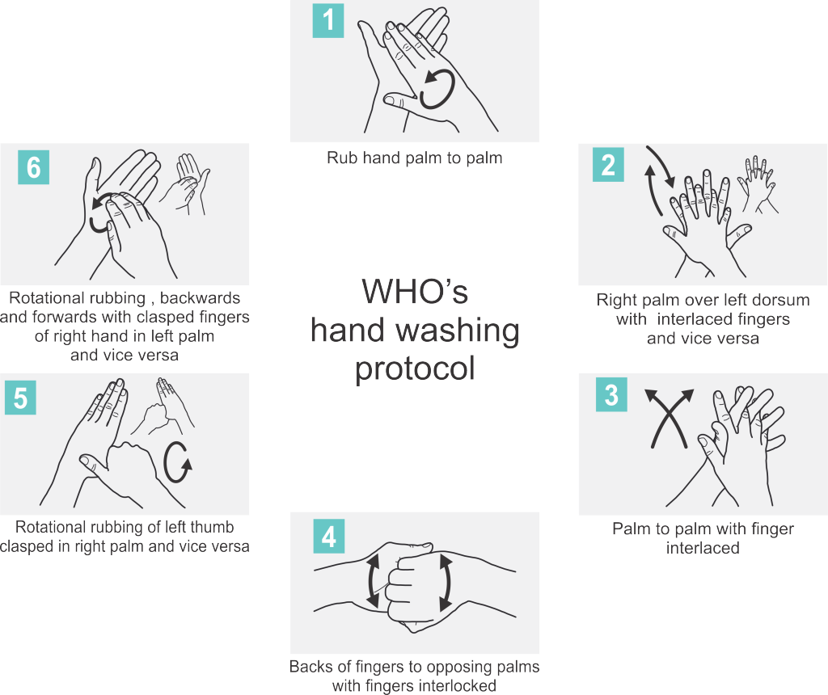
Hand Washing Technique
Removing all dirt and contaminants from the skin is extremely important. Hands and other soiled parts of the body should be cleaned at least at the end of each work period, prior to breaks, or when visiting the toilet.
The correct method of cleaning is also important. Developing a good hand washing technique is imperative to ensure hands are thoroughly clean
It is usual to wet hands before dispensing a dose of soap into a cupped hand.

Slide 33
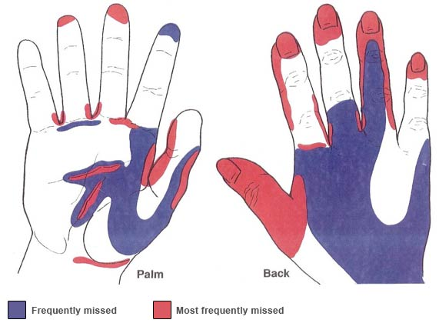
con’t…
It is not always possible to protect the skin against various contaminants in the workplace. Therefore, cleaning and taking care of the hands is an important part of developing a proactive, holistic stance against work related skin disorders.
Separate washroom studies from around the world show that only 70% of people wash their hands and only 30% of people actually use soap when washing their hands
People do not wash their hands frequently or adequately enough - The average person washes their hands for around 10 seconds. This will remove around 90% of germs from their hands
Bacteria grow and double in number in less than 20 minutes
The image below shows the most frequently missed parts of the hands when the correct hand washing technique is not adopted.

Slide 34
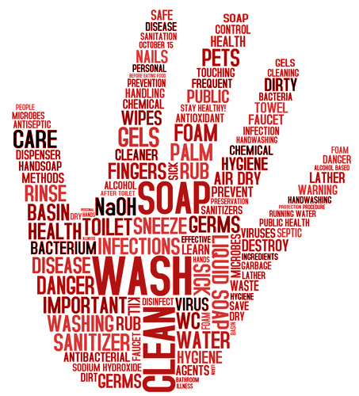
con’t…
How do I use alcohol-based hand rubs?
Alcohol-based hand rubs should only be used if no visible dirt is present on the hands.
Remove hand and arm jewelry.
Apply antiseptic (about the size of a quarter) onto your hands, enough when you rub your hands together to cover all areas of your hands, including under your nails (1-2 pumps).
Use a rubbing motion to evenly distribute the antiseptic product over all surfaces of the hands, particularly between fingers, fingertips, back of hands and base of thumbs.
Rub hands until your hands feel dry (minimum 15-30 seconds).
What are some mistakes I should avoid regarding hand hygiene?
DON'T leave hand jewelry on when performing hand hygiene. Jewelry is very hard to clean and hides bacteria and viruses from the mechanical action of the washing/rubbing.
DON'T use artificial nails, nail enhancements or long (>3-4mm) nails, as they trap bacteria and are difficult to keep clean.
DON'T wear chipped nail polish, as bacteria may become trapped along the edges
DON'T use a single damp cloth to wash a group of client’s hands.
DON'T use a standing basin of water to rinse hands.
DON'T use a common hand towel.
DON'T use sponges or non-disposable cleaning cloths. Remember
that germs thrive on moist surfaces.
Does improved hand hygiene really reduce
the spread of microorganisms in personal
service settings?
Yes! Numerous studies show that proper
hand hygiene reduces the spread of bacteria
various healthcare settings.

Slide 35
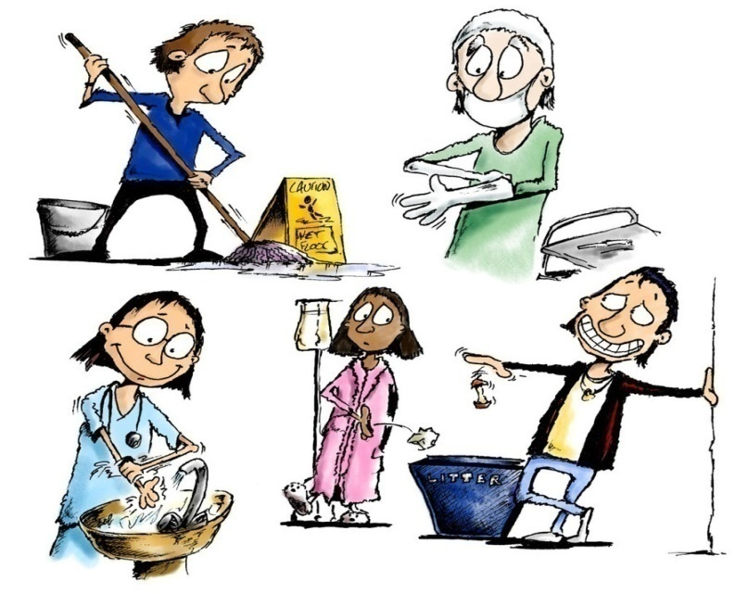
General Requirements for Cleanliness
Work area must be clean, tidy and well lit
Hand wash sink(s) must be:
- located near the work area(s)
- supplied with hot and cold running water, liquid soap in a
dispenser and single-use paper towels at all times
Premise must be equipped with a sink(s) for cleaning of equipment and instruments
Work contact surfaces must be cleaned and disinfected with a low to intermediate level disinfectant after each client
Used needles must be placed in an approved sharps container
Have all required supplies for service available and in easy reach
Remove any items not required, from the work area
Cover any work surfaces with disposable coverings or clean linen, when necessary
Store multi-use tools in a clean, covered container when not in use
WB #9

Slide 36

Infection Prevention and Control Requirements
Aesthetics
Piercing (Body, Ear)
Electrolysis and Laser Hair Removal
Hair Stylists and Barber Shops
Manicures, Pedicures and Nail Treatments
Massage Therapy
Tanning Salons

Slide 37
AESTHETICS
Hands must be washed for at least 15 seconds with soap and warm running water:
-before and after each client/treatment,
-before and after wearing gloves, and
-in between breaks and service.
Alcohol based hand sanitizers may be used if hands are not visibly soiled.
Wear single use gloves for each client.
Dispense creams and lotions for each client:
-with a single use disposable applicator, or
-into a clean single use container and discard after each use.
When using the roll-on wax method, the individual cartridge of wax must be discarded after each client, or sold to the client.
Clean rollers with soap and water or PREempt Wash, and disinfect at intermediate-level disinfection, follow with rinse for best practice standpoint.
Examine client’s skin prior to waxing and if it’s broken, infected, or irritated, do not wax.
Clean and disinfect client’s skin with a skin antiseptic prior to waxing.
Use pre-packaged, single-use, sterile needles for extractions. Discard used needles after each use in appropriate SHARPS container.
Make-up brushes must be washed.
Use single use applicators for applying eye make-up. DO NOT DOUBLE DIP!
Eyeliner and lip liner crayons must be re-sharpened after each client. Clean sharpener after each client
Water in steam/vapor machine must be changed at least daily.
All reusable equipment (excluding tools) that come in contact with the skin, must be thoroughly cleaned and disinfected (intermediate level disinfectant)
All reusable tools that come in contact with the skin, must be thoroughly cleaned and disinfected (high level disinfectant ) or sterilized.

Slide 38

con’t…
MANICURES, PEDICURES, and NAIL TREATMENTS:
Hands must be washed for at least 15 seconds with soap and warm running water:
-before and after each client/treatment,
-before and after wearing gloves, and
-in between breaks and service.
Alcohol based hand sanitizers may be used if hands are not visibly soiled.
Wear single use gloves for each client when required
Client must wash and dry his/her hands thoroughly prior to nail treatment.
Examine the client’s nails for infection prior to offering the service. Do not provide nail services for a client who has signs of a nail infection.
Avoid piercing the client’s skin, especially when cutting cuticles or filing the nails.
•All instruments must be cleaned and disinfected (high level disinfectant). Rinse with clean water and store appropriately.
Instruments that accidentally break the skin during a procedure must be cleaned, rinsed and wiped dry and then disinfected (high level) or undergo sterilization by chemosterilant or autoclave.
Glass bead sterilizers and ultra violet light devices are NOT sterilizers.
Single use instruments such as emery boards, orangewood sticks, buffers, must be disposed of after each client, or sent home with them.
Reusable nail files must be cleaned and disinfected (high level disinfectant) or sterilized.
Keep client records and accidental blood and body fluid exposure records on site for one year
PEDICURE SPAS:
Routine infection and prevention control practices must be followed when performing any procedure
Ensure the area of the client’s body you will be working on is free from any cuts, wounds, rashes or visible infections.
Ensure that your work station has been effectively cleaned and disinfected between each client.
(You do not have to see blood/body fluid on the instruments or surfaces for a risk of infection)

Slide 39
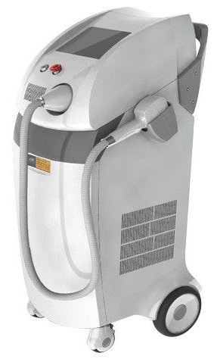
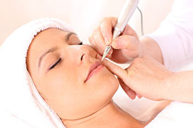
con’t…
ELECTROLYSIS AND LASER HAIR REMOVAL:
Hands must be washed for at least 15 seconds with soap and warm running water:
-before and after each client/treatment,
-before and after wearing gloves, and
-in between breaks and service.
Alcohol based hand sanitizers may be used if hands are not visibly soiled.
Wear single use gloves for each client.
Use single use gloves for each client.
Use single-use, pre-packaged disposable, sterile needles and discard immediately after use into appropriate sharps container.
The removable tip/cap of the epilator needle/probe holder must be cleaned and disinfected with high-level disinfectant after each client.
The epilator cord must be protected with an non-absorbent single-use disposable cover and changed between each client or cleaned and disinfected between each client.
Equipment/instruments used in laser hair removal must be clean, then high level disinfected after each client.
Instruments used to hold sterile items (e.g. tweezers) must be high-level disinfected
Single use sterile needles are used to expose ingrown hairs.
Instruments NOT used to remove ingrown hairs,
but used only to pull the hair must be cleaned first then
disinfected with high level disinfectant between uses.
(You do not have to see blood/body fluid on the instruments or surfaces for a risk of infection)

Slide 40

MASSAGE THERAPY
Hands must be washed for at least 15 seconds with soap and warm running water:
-before and after each client/treatment,
-before and after wearing gloves, and
-in between breaks and service.
Alcohol based hand sanitizers may be used if hands are not visibly soiled.
Wear single use gloves for each client when necessary
Dispense creams and lotions for each client:
-with a single use disposable applicator,
or
-into a clean single use container and discard after each use.
If re-using container, be sure to wipe down entire unit after each client
Dispose of soiled articles used to clean the unit in a garbage receptacle.
Ensure the area of the client’s body you will be working on is free from any cuts, wounds, rashes, or visible infections.
Take accurate health history to ensure safety between client and therapist.
Hot stones must be cleaned with soap after each use. Please note that it is impossible to disinfect or sterilize stones as they have a porous surface. Examine client’s skin carefully to ensure use of hot stones is acceptable.
If working in a wet massage room, clean and scrub walls, floors, handles, light switches, sinks, equipment (including any hoses/tubing) and entire room environment at the end of each day to prevent growth of bacteria in molds, mildew and dust due to the damp environment. Clean air vents at least monthly for quality, allergen reduced air flow.

Slide 41

HAIR STYLIST AND BARBER SHOPS
Hands must be washed for at least 15 seconds with soap and warm running water:
-before and after each client/treatment,
-before and after wearing gloves, and
-in between breaks and service.
Alcohol based hand sanitizers may be used if hands are not visibly soiled.
After each client: clean, then disinfect scissors, hair clippers and re-usable instruments
Single use, disposable blades used for shaving must be discarded in a sharps container immediately after use.
Blade holder must be cleaned, rinsed and dried and then disinfected
Blade handles should be wiped down after each client
Instruments that accidentally break the skin during a hair-cut or shave must be thoroughly cleaned and disinfected at a high level disinfection
Keep client and accidental blood and blood fluid exposure records for a minimum of one year.
Use styptic powder or liquid form to stop bleeding if necessary.
Brushes, combs and rollers which are notorious for spreading dandruff, ringworms, lice and myriad scalp ailments must be cleaned. Do not allow to soak for long periods of time.
Scissors, clippers etc. should be cleaned and disinfected at least at intermediate level.
Combs should be cleaned.
(You do not have to see blood/body fluid on the instruments or surfaces for a risk of infection)

Slide 42
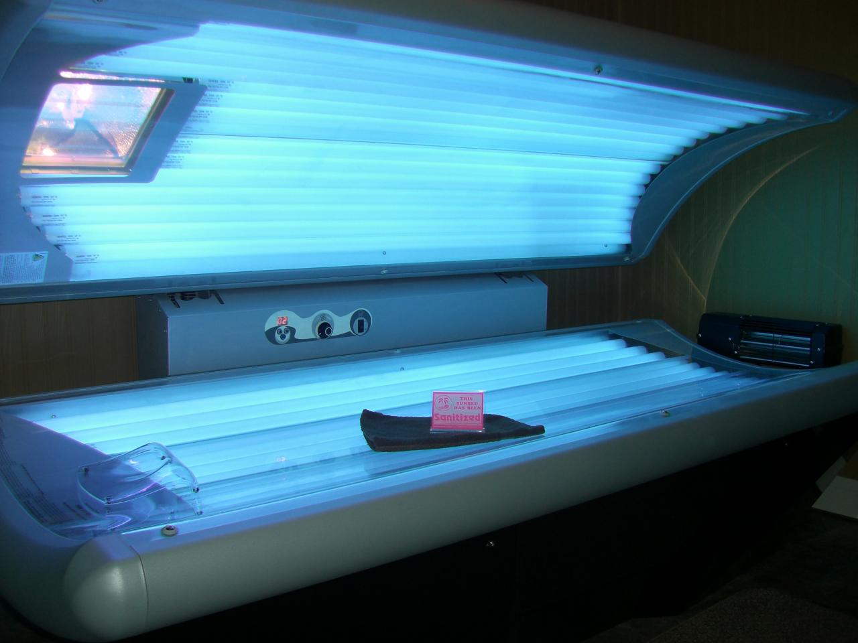
TANNING SALONS
Clients must wear protective eye-wear to prevent damage to their eyes during the tanning session.
Eyewear must be cleaned and then disinfected after each use
Clean bathing suits or undergarments must be worn at all times
Instructions should be posted describing the proper use of the tanning bed/booth including safety precautions in a visible public location
Tanning equipment must be CSA or FDA approved
Staff must be well informed on guidelines, the equipment used, cleaning and disinfecting of the equipment, and able to answer client’s questions regarding tanning safety.
To avoid electrical shock or damage to the bed/booth, consult tanning bed/booth manufacturer’s recommendations for cleaning the unit.
Contact surfaces must be cleaned and disinfected with a low to intermediate level disinfectant after each client.
Wash hands after cleaning and disinfecting client contact surfaces for at least 15 seconds with soap and warm running water.
Alcohol based hand sanitizers may be used if hands are not visibly soiled.
Turn off tanning lights to allow surface to cool otherwise
the disinfectant will evaporate too quickly.
Wipe down tanning surface after each session.
Used towels, robes, linens must
be laundered or discarded after
each client.
Dispose of soiled articles used to
clean the unit in a garbage
receptacle

Slide 43
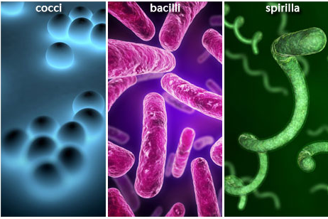
Basic Microbiology
BACTERIA: Microscopic living organisms, usually one-celled, that can be found everywhere and in abundance in dust, dirt, refuse and diseased tissue. Bacteria are named depending on their structure and cell wall. Cocci (spherical), Spirilla (helical), Bacilli (elongate). Bacteria are extremely adaptable life forms, and are able to replicate quickly.
If conditions are not favorable for growth, they also have the ability to form highly resistant spores until suitable growth conditions are encountered. Examples of disease producing bacteria are: Staphylococci, Streptococci, Syphilis, influenza, tuberculosis. Various bacterial infections can spread through direct person to person contact, through mucous membranes and breaks in the skin, or through a bite.
WB #10

Slide 44
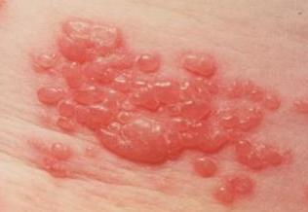
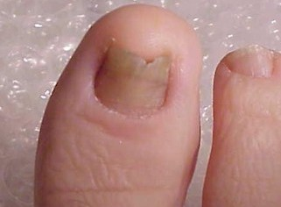
Con’t
VIRUS: Intracellular parasites or parasitic microorganisms – microparasites that are capable of growing and reproducing inside the cells of a host. They invade the cells of living organisms and use RNA/DNA to replicate themselves. When conditions are favorable, it will replicate itself and produce symptoms of disease (sometimes months or years later). Examples of viruses are shingles, herpes, H1N1, Hepatitis A, B, C, D and E.
Cold sore
Viral infections can sprea d by direct contact, inhalation and ingestion.
FUNGUS: are simple organisms that cannot make their own food, so they parasitize other tissues, including that of the human body to survive. Fortunately most fungi are self-limiting to infections of the skin and subcutaneous tissue. Non the less, they can cause severe problems. Fungi usually start with a contact to skin or inhalation. Examples are nail fungus, ringworm, athlete’s foot and Candida albicans.
Nail fungus

Slide 45
WB #11

Slide 46
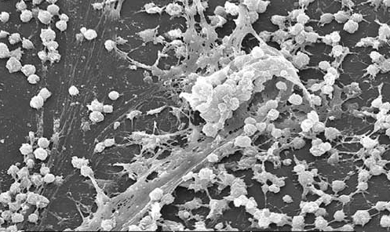
What is Biofilm?
Scientific definition: Thin layer composed of cells of microorganisms such as bacteria, fungi, yeasts, protozoa and other microorganisms that are attached to a surface.
Can be evident in any environment that has a flow of water and a surface to which to stick (plaque on teeth, slippery slime on river stones, gel-like film on the inside of a flower vase, unsightly stains in toilet bowls, gunk that clogs your drains, hot tubs and footbaths.
Simply put - “life-slime”
Some biofilms can be dangerous or beneficial depending on where they are found and of which organisms they are comprised.
Spa owners deal with the biofilms that grow in pedicure foot baths, in the tub and behind the walls within the pipes. Biofilms can cause huge problems by corroding pipes, clogging water filters and harboring bacteria that contaminate water.
WB #12

Slide 47
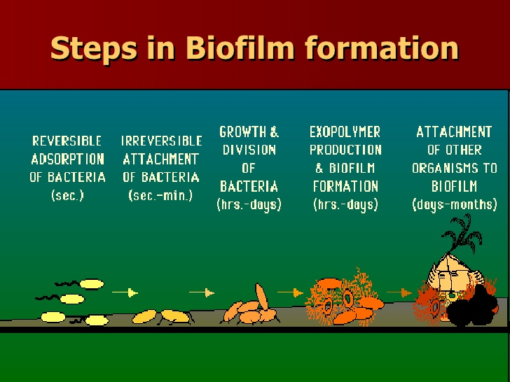
Con’t
HOW DO BIOFILMS FORM?
A free floating microorganism (bacteria or fungi) attaches to a surface. Initially it is a weak attachment, but if not immediately separated, they anchor themselves permanently using cell adhesion molecules. Biofilms begin to form when bacteria attach to surfaces in a wet environment and begin to excrete a slimy, glue-like substance (extracellular polysaccride) that helps them anchor to all kinds of materials such as metals, plastics, rocks, implanted medical devises and even tissue. The bacteria and slime layer can now trap other materials such as clay, organic material, dead cells or any other particle that floats over the biofilm, which adds to the size and diversity of the biofilm colony. Much like a snowball rolling down hill, getting even larger, this growing biofilm serves as a magnet for attachment and growth of other organisms, thus increasing it size and diversity.
CONDITIONS FOR GROWTH:
Water (not sterile), tap water, warmth, plastic is ideal, however can form on any surface that is not clean. Biofilm forms in hours and becomes resistant to disinfectants in just a few days. Problem with foot baths is they provide ideal conditions for biofilm growth.

Slide 48
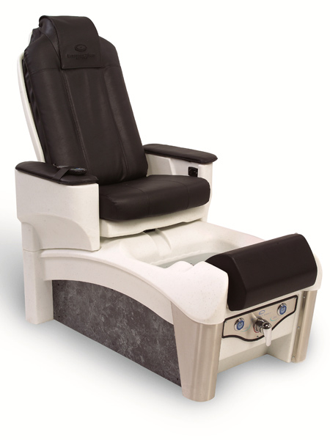
Con’t
HAZARDS: There are two real hazards from biofilm in one of these foot baths. First, bacteria are shed from the biofilm and from other clients, and are present in the water. Sores or breaks in the skin may become infected as a result of this exposure. The more significant hazard is not in the water at all. When a tub’s jet system is turned on, small segments of biofilm can break free and become aerosolised, bouncing along on the haze above the water surface which then can become a respiratory hazard. As well when biofilm has accumulated in the pipes of circulating footbaths then this can present staph infection.
Biofilms have been found to be involved in a wide variety of microbial infections in the body, by one estimate 80% of all infections.
BIOFILM CHARACTERISTICS:
Once formed a biofilm is resistant to most chemicals/disinfectants. Disinfecting alone will not remove a biofilm, there must be the step of cleaning/sanitizing. It takes 1,000 times as much disinfectant to kill a biofilm organism (which is why chlorine needs to be diluted at a 1 to 10 ratio and circulated for 10 minutes – this is not practical because of the smell, and corrosion to piping).
“If you are unfortunate enough to aspirate (breath-in) a biofilm, the
bacteria have a 100% chance of surviving in your lungs.”
w. Costerton, Centre for Biofilm Eng. Montana

Slide 49

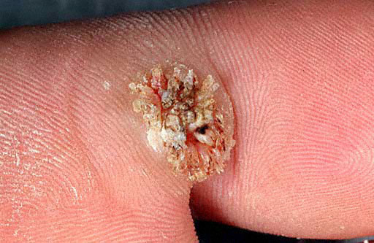
What is lurking in your pedicure water…
NOT JUST WATER IN OUR FOOTBATHS:
Microorganisms (water, pipes, filters and feet)
Heat
Soaps & oils
If all left alone, all of these contribute to the formation of biofilm within the pedicure spa. Remember that biofilm forms in HOURS, and becomes RESISTANT in just a few days.
HOW TO REMOVE A BIOFLIM:
You need physical abrasion – scrubbing must be done. Most chemicals are not effective. For instance, Quats will not remove biofilm. For pipe systems, oxidizing agents are required since physical abrasion cannot be performed.
Oxidizing Agent | Positives | Negatives
Chlorine | Effective | Must be at a 1:10 dilution to be effective. Problem: the smell will linger in a salon throughout the day, VOC’s a concern to staff and clients. Also very corrosive to piping.
Hydrogen Peroxide | Effective | Unstable in water (unless properly formulated)
Disease causing pathogens are very viable organisms; they do not give in without a fight. They can be found in swimming pools, hot tubs and pedicure spas if proper measures are not taken to disinfect properly. They turn into this :
Fungal skin infection/staph
Fungal skin infection/plantar wart
WB #13

Slide 50
Understanding Disinfection
(Terms that should be recognized and understood!)
LOW-LEVEL DISINFECTION | Level of disinfection required when processing noncritical equipment/devices or some environmental surfaces. Low-level disinfectants kill most vegetative bacteria and some fungi as well as enveloped (lipid) viruses. Low-level disinfectants do not kill mycobacteria or bacterial spores. Equipment/devices must be thoroughly cleaned prior to low-level disinfection
INTERMEDIATE-LEVEL DISINFECTION | Level of disinfection required when processing some semi-critical equipment/devices. Intermediate level disinfection kills mycobacteria, most viruses, and bacteria. Equipment/devices must be thoroughly cleaned prior to intermediate level disinfection
HIGH-LEVEL DISINFECTION | The level of disinfection required when processing some semi-critical equipment/devices. High level disinfection processes destroy vegetative bacteria, mycobacteria, fungi and enveloped (lipid) and non-enveloped (non-lipid) viruses, but not necessarily bacterial spores. Equipment/devices must be thoroughly cleaned prior to high level disinfection .
STERILIZATION: | Destruction of all forms of microbes. Required for critical and high-level disinfection items that come into contact with the mucous membranes or any human fluid. Such as, blades, lancet, hypodermic needles, and etc.
CONTACT TIME (for a disinfectant): | The length of time a chemical disinfectant needs to be in wet contact in order to effectively disinfect a surface of micro-bacteria.
WB #14

Slide 51
Item Classification of tools in the Beauty Industry &
Understanding the Best Method of Infection Control for each
(when sterilization is required or when a specific level of disinfection is required)
CRITICAL ITEMS | Instruments that enter/penetrate the skin or mucous membranes (scissors, needles, surgical instruments, cuticle cutters, corn and callous slicer)
method of infection control | STERILIZATION
SEMI-CRITICAL ITEMS | Instruments that do not penetrate the skin, but can come in contact with non- intact (open) skin or mucous membranes (nippers, comedone extractors, nail cutters, cuticle pushers, nail scissors)
method of infection control | INTERMEDIATE TO HIGH LEVEL DISINFECTION STERILIZATION (opt)
NON-CRITICAL ITEMS | Instruments that touch but never enter/penetrate the skin or mucous membranes
method of infection control | LOW-LEVEL DISINFECTION
NON-CRITICAL ENVIRONMENTAL SURFACES | Hand contact surfaces (door knobs, neck rests, light switches, chairs, counter top)
method of infection control | LOW-LEVEL DISINFECTION
STERILIZATION by
autoclave, dry-heat, liquid and chemical sterilants, chemi-claves
* note: glass bead, UV methods and boiling water are NOT sterilization
HIGH LEVEL DISINFECTION by
Accel AHP 7% and 2%
Glutaraldehyde 2%,
Or sterilization methods.
INTERMEDIATE LEVEL DISINFECTION by
Accel AHP
Alcohols (ethanol 70%, Isopropanol)
Halogens (Bleach)
LOW LEVEL DISINFECTION by
Accel AHP
Quats: Ultracare, Barbicide, Zephiran, Faltrol Plus
WB #15

Slide 52
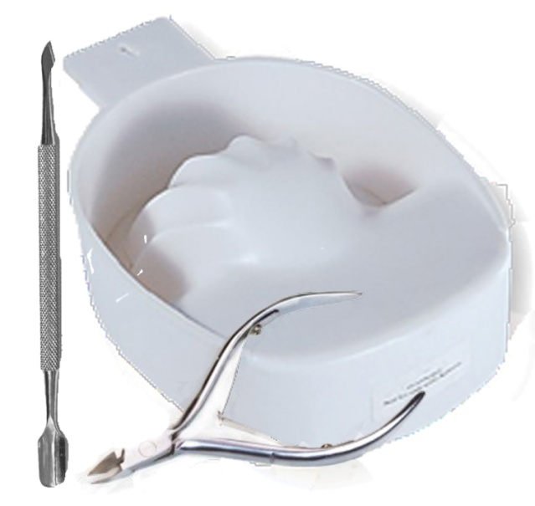
Proper Disinfection of Multi-Use Tools and Equipment
Multi-use items/implements are designed to be used more than once, and for use on
more than one client. They are often referred to as “disinfectable”, which means that
the implement can be properly cleaned and disinfected while retaining it usefulness
and quality. Hence, they require proper cleaning and disinfection between each use,
and each client.
Examples of multi-use implements are cloth towels, manicure bowls, nippers,
pushers and certain abrasive files and buffers.
Multi-Use items come in three varieties
Hard and non-absorbent items constructed of materials that do not absorb liquid (i.e. metal, glass, fiberglass or plastic). These should be cleaned and disinfected appropriately.
Porous and/or non absorbent items constructed of materials such as cloth or wood with surfaces that may absorb or are penetrated by liquids (i.e. scrub brushes for nails, cushioned abrasive buffers, cloth towels, and chamois). These should be cleaned and disinfected appropriately.
Self-disinfecting items that will not support the growth of bacteria, viruses or fungi. Examples are application brushes used for nail polish, primers along with artificial enhancement application brushes. Due to the nature of these products, the brushes do not require disinfection and should be cleaned, used and stored only as recommended by the product manufacturer.
Individual Client Packs
Items/implements kept in individual packs must be properly cleaned and disinfected after each use. If a client provides their own implements/tools, they must be properly cleaned and disinfected before use. All implements/tools should be cleaned and disinfected before each use – even if used by the same client! Improperly cleaned and/or disinfected items may grow disease causing organisms before the client returns for their next visit! This increases risk of infection.
WB #16

Slide 53

The checklist below is a way to identify your level of knowledge and concern for infection control in the personal services setting.
QUICK CHECKLIST: Check if yes, leave blank if no
Are you currently practicing any methods of infection control within your business?
Do you feel that you had been given adequate infection control training in your schooling?
Are you familiar with at least 3 products that are available for disinfection for your tools and implements?
If you work with pedicure foot baths, do you follow procedures to clean and disinfect between each client?
If you are a manicurist or pedicurist, have you ever given treatment to someone who you could visually see had nail fungus, an open wound or sore in the treatment area, or plantar warts?
Prior to performing a pedicure spa, do you ask your client if they had just shaved or waxed their legs?
Do you have health concerns regarding the chemicals you use in your workplace?
Are you aware about movements towards creating a more clean and healthy environment?
If you are currently using any disinfectants, are you familiar with any precautions associated with them?

Slide 54
Understanding some difference of chemical disinfectants
Considerations you should be aware of when deciding which chemical disinfectant to use for infection control in your workplace.
Existing technologies “FAIL” in one or more of the key decision making criteria when selecting a cleaner/disinfectant.
  Cleaning Efficacy (sometimes a product can disinfect but it does not function to clean/sanitize)
  Disinfection Capability (read instruction labels carefully and identify what level of disinfection is the technology capable of)
  Personal Health & Safety (is this technology safe to the user and customers entering the workplace?)
  Environmental Responsibility (with the current trend towards “greener” products, is the technology truly safe to the environment?)
There is a growing demand for new technology that makes the decision maker and staff feel Confident and Responsible when cleaning, disinfecting and sterilizing.
WB #17

Slide 55

Ask the question…
How safe are your current products and are there environmental concerns?
Chemical germicides/disinfectants vary greatly in their potential to damage the environment. When choosing a product to use in the workplace, it is important to research effectiveness as well as environmental safety.
Some main environmental concerns to consider are:
Does the technology produce volatile organics (VOCs)?
What is the biodegradability of the disinfectant?
Does the technology pose toxicity issues to aquatic life?
-Does the technology pose concern for endocrine disruption (hormone)?
-Does the technology create heavy metal byproducts?
What are some serious concerns related to the use of chemical disinfectant?
Toxicity? Chlorine is toxic to humans and may damage the environment. Formaldehyde is a potential carcinogen
Irritating? example chlorine in high concentrations can burn skin/eyes. Phenolics may cause liver damage, skin de-pigmentation and skin burns. Glutaraldehyde can cause respiratory sensitization and contact dermatitis
Damaging? Hydrogen peroxide can cause bleaching and corrosion unless formulated and used properly
Environmental load? Volatile organics contribute to smog. Volatile organics can affect indoor air quality and workplace safety. Germicides or their by-products can disrupt the activity of hormones
Severe precautions in use? Accidental misuse or ingestion may result in poisoning
Inadequate cleaning or disinfection capability? Undesirable microbes can grow in germicides that are stored improperly. Germicide resistance may make bacteria resistant to certain types of antibiotics (consider C. Diff outbreaks)

Slide 56
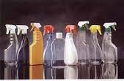
Active Ingredient Chemicals for Salon & Spa
There are five chemicals found in 99% of all infection control products in the beauty industry.
1. Glutaraldehyde
Hospital smell – rarely used in hospitals
2. Chlorine
Used in jetted circulating foot baths
3. Quaternary Ammonia Compounds
Also known as Quats / BM 32 / Ultronics / Barbicide
4. Phenols
Not used in our industry anymore, due to high allergic reactions.
5. Alcohols - Ethyl, Isopropyl
Must be betweem70% - 90%. Dries too fast to act as a disinfectant. Must stay wet for 10 minutes, but cannot. Potential damage to leather, tools and metals. If used for soaking tools, must be changed daily.
WB #18

Slide 57
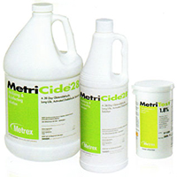
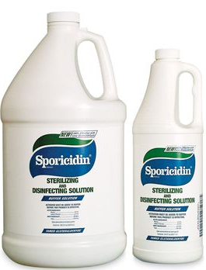
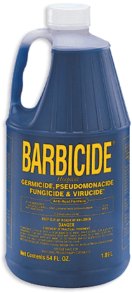
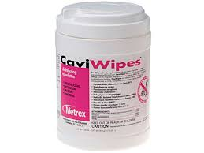
GLUTARALDEHYDE & QUATS
Glutaraldehydes have a wide microbiocidal activity and are sporocidal and fungicidal. They are partly inactivated by organic matter and have slight residual activity.
Some bacteria have developed resistance to glutaraldehyde, and it has been found to be toxic, causing severe eye, nose, throat and lung irritation, along with headaches, drowsiness and dizziness. Has been implicated in literature as a cause of respiratory irritation and asthma among health care workers. Also has the ability to induce allergic contact dermatitis.
Quaternary ammonium compounds (or Quats) 2, such as benzalkonium chloride, are a large group of related compounds. Quats have varied germicidal activity and are generally used in low-level sanitization as they are effective against bacteria, but not against some species of Pseudomonas bacteria or bacterial spores. They are also effective disinfectants against enveloped viruses. Quats are biocides which also kill algae and are used as an additive in large-scale industrial water systems to minimize undesired biological growth. Their main advantages are that they are odorless, non-staining, non-corrosive to metals and are relatively non-toxic at use-dilution concentrations. As sanitizers they exhibit a wide latitude in germicidal activity when used in hard water and are effective over a wide pH range. Quats leave a non volatile residue on surfaces to which they are applied, rendering the surfaces bacteriastatic for a given time.
Health Concerns:
- immune system toxicant
- can irritate the skin, eyes and respiratory system
contamination concern with formaldehyde
(a known carcinogen)
Environmental Concerns:
Found in river water
WB #19

Slide 58

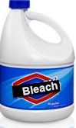
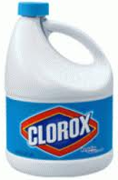
CHLORINE BLEACH
Excellent Disinfectants, But Poor Cleaners
Household and institutional chlorine bleaches contain 5.25% active sodium hypochlorite when they are manufactured. The remaining 94.75% is primarily water. Chlorinated compounds such as sodium hypochlorite when diluted in water form hypochlorous acid. This acid is extremely effective against many
types of microorganisms including bacteria, fungi and viruses. For instance, the product label for Purex household bleach claims it is effective against staphylococcus and streptococcus bacteria, Influenza A and B viruses and athletes foot fungus. However, the label also says a surface must be pre-cleaned before using the chlorine bleach solution.
Disadvantages of Using Chlorine Bleach
As a Disinfectant
1. Lack detergency – Contain no wetting agents to
allow the disinfecting agent to penetrate soils, so
surfaces MUST be pre-cleaned before the chlorine bleach will effectively kill germs.
2. Very caustic to human tissues – Can burn skin and eyes
3. Fumes can be irritating and affect the human respiratory system. Effects differ from coughing and chest pains, to water retention in the lungs. Also harmful to aquatic freshwater life.
4. Extremely corrosive to metals – Chlorine bleach can attack and corrode metal surfaces as well as permanently discolor countertops.
5. Damage floor finishes – Chlorine bleach can attack the floor finish coatings on the floor requiring them to be removed and replaced.
6. Rapidly inactivated by organic debris (blood, tissue, saliva, microbes)
7. Diluted solutions quickly lose their effectiveness. Chlorine bleach is unstable and can lose its oxidizing and disinfecting strength rapidly .
8. Are expensive to use – The recommended dilution ratio for proper disinfecting of surfaces is 1:10
WB #20

Slide 59
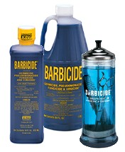
BARBICIDE
Barbicide - clear blue solution often used to disinfect hairdressing and barbering equipment, such as combs, brushes, and scissors. It is a quaternary ammonium product that health Canada categorizes as a low-level disinfectant.
Not suitable for Esthetic tools such as nippers, clippers etc…
1. CLEAN TOOLS BEFORE USING BARBICIDE a dirty tool cannot be properly disinfected. Placing a soiled item (e.g. comb with hair strands) in a container filled with Barbicde will not disinfect the item – it will only contaminate the solution and all other items placed in it. All tools must be thoroughly cleaned with soap/detergent, scrubbed with a brush then rinsed with potable water BEFORE placing them in the Barbicide solution. 2. PUT THE BARBICED BY THE SINK Put the Barbicide container next to the sink rather than the work station. This will make it easier to wash items first before disinfecting with Barbicide. | 3. FOLLOW INSTRUCTIONS Always follow the manufacturer’s instructions about Proper dilutions How often it needs to be changed The amount of time the disinfectant muse remain wet on the surface of the instrument 4. CHECK EXPIRY DATE check the expiry date of the Barbicide to ensure the product has not expired.
Huron County Healthy Unit/, 2010
I want to disinfect …. | Can I use Barbicide?
NON-CRITICAL TOOLS (Tools that come in contact with intact skin. Some non-critical tools require and intermediate level of disinfection after cleaning | YES – Only after cleaning
Can Include: Combs and brushes – hair rollers instruments for razoning/feathering hair | YES – Only after cleaning
Clippers Scissors | YES – Only if they have NOT nicked the skin. If skin is nicked the item must be treated as a semi-critical tool.
SEMI-CRITICAL TOOLS (Tools that may come in contact with blood or body fluids or accidentally penetrate body surfaces). | NO – Can use an intermediate to high-level disinfectant after cleaning
Can include: “crochet hooks” for cap highlights | NO – may scratch the scalp. Can use an intermediate to high-level disinfectant after cleaning
Straight razors | NO – generally not recommended for use, cleaning sharps are hazardous to the worker. Can use an intermediate to high level disinfectant after cleaning
Tweezers (Nail Service equipment and instruments | NO – can use an intermediate to high-level disinfectant after cleaning
CRITICAL TOOLS: (Instruments that are intended to penetrate skin | NO – Sterilization of item after thorough cleaning.
WB #21
Notes:
Barbicide is classified as a LOW-level disinfectant and for the most part, it is NOT being used correctly.
Ask the class the following questions:
What are the correct steps to using barbicide to disinfect combs?
How often should you change the barbicide solution?

Slide 60
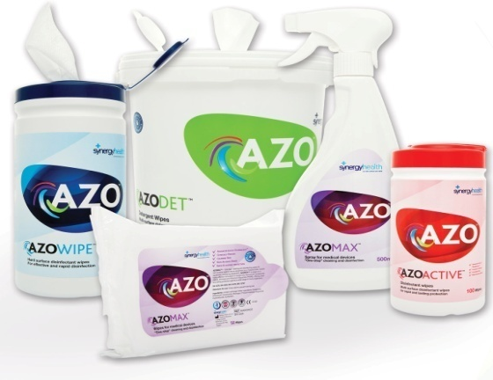



ALCOHOL SPRAYS & WIPES
According to APIC, ethyl alcohol and isopropyl alcohol are not effective in sterilizing instruments because they lack sporicidal activity and cannot penetrate protein-rich materials. Isopropyl alcohol also lacks the ability to kill hydrophylic viruses. For this reason alcohol is classified as an intermediate disinfectant.
High concentration alcohol-based
Lysol I.C. Disinfectant Spray has a broad spectrum of antimicrobial activity with 79% ethyl alcohol and has a recommended surface contact time of 10 minutes. High concentration alcohol products are generally not advocated for instrument immersion since the high alcohol content volatilizes easily, and thus diminishes antimicrobial activity. Additionally, alcohols cannot be used as cleaners, which then requires the user to purchase a separate cleaner.
Prolonged exposure to alcohol has been known to disrupt adhesives, damage seals, cause certain plastics to swell and harden, which could make them more brittle and prone to break.
http://www.infectioncontroltoday.com/articles/2000/11/a-comparison-of-commonly-used-surface-disinfectan.aspx
QUAT & ALCOHOL BLENDS
WB #20

Slide 61
Disinfection Technology Comparison Accelerated Hydrogen Peroxide (AHP) vs. Alcohol
Criteria of Ideal Disinfectant: | Accelerated Hydrogen Peroxide Ie. PREempt RTU & Wipes | Alcohol Ie. BioText | Comparative Selling features, functions and benefits
Health Canada DIN Registered* | ✓ YES | ✓ YES
Active Ingredient (%) | 0.5% Accelerated Hydrogen Peroxide | Ethanol (19.9%) | Msds says 71% Alcohol is a volatile flammable liquid
Dilutions | Ready to Use and Concentrate | Ready to Use
Shelf Life | 24 Months | Unknown | As a soaker for tools, will need to change daily . – HLD5/CS20 have 14 day reuse
Label Claims Validated by Health Canada*
Bactericidal Claim on Label | ✓ YES (3-5 minutes) | ✓ YES (NON-HOSPITAL GRADE) | What do you mean by non hospital grade ?
Virucidal Claim on Label | ✓ YES (3-5 minutes) General Virucide Claim: effective against BOTH enveloped & non-enveloped Viruses | ✓ YES (5 Minutes) Only effective against Canine Parvovirus (irrelevant to Salon/Spa Industry) | Is it classed as an intermediate disinfectant ?
Fungicidal Claim on Label | ✓ YES (3-5 minutes) | NO | Check website and msds
Tuberculocidal Claim on Label | ✓ YES (3-5 minutes) | ✓ YES (5 minutes)
Broad-Spectrum Sanitizer Claim on Label | ✓ YES (30 seconds) | NO | Not effective for surfaces – Not a cleaner and evaporates
Testing completed in soil load
One Step Cleaner Disinfectant | ✓ YES |  | Less effective for surfaces
Validated by Third Party Labs
Non Toxic | ✓ YES | NO | Volatile liquid
Non-irritating to Eyes | ✓ YES | NO | Volatile liquid
VOC Free | ✓ YES | NO | Volatile liquid
Third Party Green Certifications*
EcoLogo Certified | ✓ YES (Accel PREVention) | NO
WB #22

Slide 62


Introducing hospital grade cleaner, disinfectant and chemosterilant for the Beauty Industry:
New chemistry, AHP - Accelerated Hydrogen Peroxide
AHP is the technology, Accel is the brand
This is NOT the 3% Hydrogen Peroxide that you buy in stores.
This is the newest technology in the last 25 years
hospital grade
D.I.N (Drug Identification Number)
Eco-logo certified
products for use for infection control within the beauty industry, that are effective, fast, and considerate to the health of users and the environment.
The 4 Pillars of Strength
WB #23

Slide 63
FASTER
PREempt RTU has a 3 minute contact time against TB and Polio I, compared to other chemical disinfectants at 10 minutes.
Disinfectants that have long contact times or those that dry before their label contact time will most likely not achieve disinfection.
Faster means less delays, with the ability to accomplish necessary and effective sanitation and disinfection between clients.
STRATEGY:
clean surfaces with PREempt RTU spray and wipes to show clientele that you follow Best Practices relating to infection control.
SUSTAINABLE
Whenever possible, choosing “greener” is a responsible thing to do! Sustainable solutions contain safer ingredient choices
PREempt is environmentally responsible. Breaks down into Oxygen, Water, Biodegradable soaps
AHP was the first Disinfectant-Cleaner to receive EcoLogo Certification in Canada and AHP cleaning products have Green Seal certification in USA
Does not emit dangerous fumes or bad odors
Not dangerous to the aquatic life
MARKET YOURSELF!
When discussing infection control practices with your clients, inform them how environmentally safe PREempt brand is.

Slide 64
CLEANER
Superior cleaning action of AHP allows you to use PREempt RTU/WIPES as a cleaner as well as a disinfectant.
Most disinfectants on the market are considered poor cleaners and therefore require the surface to be pre-cleaned in order for them to make their germicidal claims.
Regular cleaning of work environment reduces employee sick days
If client comes in sick, employee adds barrier of protection so germs do not spread
Health scares (such as STAPH infections, nail fungus and H1N1) adversely affect the salon/spa industry
STRATEGY:
Do things right! Effectively clean first and then disinfect your business/work area to build trust in your clients so that they will want to return to you and your business. Don’t take the risk of skipping proper infection control. You do not want to be the location where they “acquired” an infectious disease such as nail fungus and Staph.
Cleaning Efficacy
AHP has been proven to clean up to 7X better than a quaternary ammonia compound. Quats are the standard floor cleaners in hospitals.
Canadian Standards Board Test CGSB 2.16-87 Cleaning Efficacy
Result Parameter: 80% cleaning efficiency is considered acceptable per Government testing standards.

Slide 65
RESPONSIBLE
Chemicals that are safer for users and occupants provide for a healthier indoor environment.
The personal health and safety of users and occupants where there is exposure to chemical germicides is a growing concern and an emerging issue.
AHP based disinfectants are:
  Non-toxic
  Non-corrosive to skin
  Non-irritating to eyes
  Contain no Volatile Organic Compounds (VOC’s)
  No added dyes or fragrances (clean should never have a smell)
Keeps both client and service provider safer
Effective and fast without being hazardous. Other chemical disinfectants are known to be drying and/or rough on the skin, and or hazardous to air quality. Worst case – carcinogenic!
No client wants to be exposed to harmful chemicals in a salon/spa setting. They are coming to ‘improve’ themselves, not put themselves at a health risk.
There are increasing instances of chemical sensitivities and trends towards “fragrance free” products – be ahead of the game with no fragrance sanitation and disinfection!
STRATEGY:
During a treatment, have a conversation with your client(s) and explain the health and safety of using AHP in your business. This will build stronger and longer lasting relationships!

Slide 66
COMPARE CHEMICAL CLEANERS, using the 4 Pillars
found in your work environment
Disinfectant chemicals act to disrupt significant cellular structures or processes in order to kill or eliminate microorganisms. A number of different chemicals have been commercialized as disinfectants
*note: Time refers to scientific research performed in laboratory on TB strain bacterium. This is a standard of measurement.
CHEMICAL | CLEANER | CONTACT TIME (as a disinfectant) | RESPONSIBLE | SUSTAINABLE
Aldehydes | Not a cleaner (can bind micro organisms to surfaces) | 45 mins (TB) Sterilize 8-12 hours Must pre-clean | Toxic fumes Avoid contact with skin | Must be neutralized to be thrown out. Damaging to environment
Halogens/ Chlorine | Not a cleaner | 10 mins Must pre-clean | Toxic fumes Burns skin Bleaches clothing Carcinogenic | Breaks down But it is the concentration that causes environmental harm
Phenols | Not a cleaner Leaves build-up | 10 mins (TB) Must pre-clean | Carcinogenic | Pollutants – cannot dispose down drain in major cities
Alcohols | Not a cleaner (used to bind microorganisms to surfaces) Can have cleaning properties if mixed with other emollients | 10 mins. (But dries too quickly) | Fumes can cause headaches | Non-polluting by itself, but when with other chemicals, can be a pollutant
Quats | Good cleaner | 10 minutes low level Not polio to TB | Are NPE’s (hormone disrupters) | Pollutants
AHP – accelerated hydrogen peroxide | Excellent cleaner 30 seconds broad spectrum | 3 - 5 mins. Polio and TB | No fumes No fragrance No NPE’s No toxic chemicals | 100% biodegradable (chemical breaks down to oxygen & water, 7 biodegradable surfactants

Slide 67
A QUICK LOOK – DISINFECTANT CHARACTERISITCS
DISINFECTANT TYPE
 | Iodine | Alcohol | Phenols | Chlorine | Quats | AHP
Volatile Organic Compounds |  | X | X | X | X
Active Residuals | X |  | X | X | X
Substrate Impact | X | X | X | X | X
Toxic / Irritant |  | X | X | X
Environmental issues | X | X | X | X | X
Narrow-Spectrum Germicide |  |  | X |  | X
Organic Neutralization | X |  |  | X
Restrictions In Use | X | X | X | X
Poor Cleaning | X | X | X | X | X
Note that AHP has no “X’s”
There are over 1946 Registered Disinfectant Products available in the Canadian Market Today! (Health Canada, 2001) 99% of these products contain 1 or a combination of these chemicals.

Slide 68

PRODUCTS & PROTOCOLS
Group #1 – surfaces & non-circulating footbaths
PREempt RTU & WIPES
Group #2 – professional tools
PREempt WASH
PREempt HLD5
PREempt CS20
Group #3 – circulating footbaths & hairdresser tools
PREempt Concentrate
WB #24

Slide 69


SURFACES & NON-CIRCULATING FOOT BATHS
  BROAD SPECTRUM SANITIZER (30 sec)
  BACTERICIDE – Staph Infection, Salmonella (3 min)
  GENERAL VIRUCIDE – Polio, HIV, Norwalk like viruses, H1N1
  Effective against enveloped and non-enveloped viruses (3 min)
  FUNGICIDE (3 min)
  TUBERCULOCIDE (3 min)
24 month shelf life
Ideal for cleaning and disinfection when a greater degree of care is desired
WB #25

Slide 70




SURFACES/PROTOCOLS
Cleaning/Sanitizing (30 seconds)
Spray/wipe surface and using scrubbing action,
physically remove debris
Wipe and dry surface with a clean paper towel
Disinfecting (3 minutes)
Spray/wipe and leave surface wet for 3 minutes
Wipe and dry surface with a clean paper towel
Ecologo on RTU 1L/4L
WB #25

Slide 71

SURFACES
Where to use?
Manicure table. Clean and disinfect between clients.
Non-circulating Foot Baths
This type of foot bath system is considered a “surface”, therefore infection control procedures to be followed are those referring to surfaces, unlike a water circulating system.
Reception counter tops
Telephones
Door knobs / handles
Shared pens
Chairs
Leather sofas (does not damage leather)
Railings
Bowls
Bathrooms (toilet, sink, faucet …)
WB #25

Slide 72
NON-CIRCULATING FOOT BATHS/PROTOCOLS
Cleaning & Disinfecting Pipeless Foot Baths (air-jetted)
Between Each Client
Remove and take apart jets/filters
Spray/wipe surface, bowl and jets/filters
Using scrubbing action, physically remove debris
Rinse
Spray/wipe surface, bowl and jets/filters and leave wet for 3 minutes
Rinse and replace jets/filters
WB #26

Slide 73

PROFESSIONAL TOOLS
  ENZYME FREE INSTRUMENT CLEANER
  BACTERISTATIC
  LOW FOAMING
  3% AHP CONCENTRATE
Replaces detergents or soaps used to wash tools.
Rinses completely and easily unlike soaps that always leave a residue which can inactivate the disinfectant or chemosterilant.
WB #27

Slide 74

PROFESSIONAL TOOLS
MANUAL CLEANING:
Dilute Accel Wash at 1:128 at 20°C into a container.
Place instruments into the solution and scrub for 30 seconds. Solution can be used for soaking instruments until ready to be cleaned appropriately.
Remove the instruments, rinse with potable water, inspect for cleanliness and proceed with the appropriate disinfecting step.
Change solution daily or as needed.
Ratio | Per Gallon / 4L Water
1:128 | 1 oz / 30ml

Slide 75




PROFESSIONAL TOOLS
Specially Formulated for Hard Metal and Hard Plastic Medical Devices
  TUBERCULOCIDAL (5 min )
  FUNGICIDAL (5 min )
  BACTERICIDAL (5 min)
  VIRUCIDAL (5 min)
  SPORICIDAL (6 hours)
  2% Hydrogen Peroxide
  12 month shelf life (in original packaging)
  14 day Re-Use (Test Kit: AHP2)
  Solution may be re-used for up to 14 days

Slide 76



PROFESSIONAL TOOLS
Cleaning/Sanitizing
Dilute PREempt Wash (1:128) in lukewarm water
Using scrubbing action, physically remove debris.
High Level Disinfecting (5 minutes)
Dry tools and place them in soaker containing
PREempt HLD5 (use disinfecting tongs or
removable tray).
Do not use fingers, or place soiled tools into
solution as this will contaminate and
potentially shorten the 14 day re-use claim.
Let soak for 5 minutes, remove,
rinse and dry thoroughly
Store in clean & sealed container
until use
WB #27

Slide 77

PROFESSIONAL TOOLS
Specially Formulated for Hard Metal /Hard Plastic & Medical Devices
  SPORICIDAL (20 min at 20°C)
  TUBERCULOCIDAL (20 min at 20°C)
  FUNGICIDAL (20 min at 20°C)
  7% hydrogen peroxide
  12 month shelf life
  14 day re-use *Test Strip (AHP7)
WB #28

Slide 78



PROFESSIONAL TOOLS
Cleaning/Sanitizing
Dilute PREempt Wash (1:128) in lukewarm water
Using scrubbing action, physically remove debris.
Sterilization (20 minutes)
Dry tools and place them in soaker containing
PREempt CS20 (use disinfecting tongs or
removable tray).
Do not use fingers, or place soiled tools into
solution as this will contaminate and
potentially shorten the 14 day re-use claim.
Let soak for 20 minutes for sterilization ,
remove, rinse and dry thoroughly
Store in clean & sealed container until use
WB #28

Slide 79



CIRCULATING FOOTBATHS & HAIRDRESSER TOOLS
PRODUCTS & PROTOCOLS
Specially Formulated for Cleaning and Disinfecting Surfaces, Salon tools (hard plastic/metal) and Circulating Foot Baths
  BROAD SPECTRUM SANITIZER (30 sec)
  TUBERCULOCIDAL (5 min )
  FUNGICIDAL (5 min )
  BACTERICIDAL (5 min)
  VIRUCIDAL (5 min)
  7% Hydrogen Peroxide
  24 month shelf life (in original packaging)
•NO DYES added
•THE ONLY product of its
kind in the salon industry
certified ECOLOGO
WB #29

Slide 80


CIRCULATING FOOTBATHS
.
Cleaning/Sanitizing (30 seconds)
Fill tub above jets with cool water and add approximately 128ml of PREempt Concentrate (for an average size foot bath bowl).
Turn on jets and circulate for 30 seconds
To reduce foam, add 2-3 drops of DEFOAM PLUS
Drain and rinse
Ratio | Per Gallon / 4L | Average foot bath bowl (4 gallons)
1:128 | 32ml | 128ml
WB #29

Slide 81
CIRCULATING FOOTBATHS
.
Disinfection Between Each Client ( 5 minutes)
Fill tub above jets with cool water and add approximately 400ml of PREempt Concentrate (for an average size foot bath bowl).
Turn on jets and circulate for 5 minutes
To reduce foam, add 2-3 drops of DEFOAM PLUS
Drain and rinse
PREVENTS THE FORMATION OF BIOFILMS
Ratio | Per Gallon / 4L | Average foot bath bowl (4 gallons)
1:40 | 100ml | 400ml
WB #29

Slide 82



HAIRDRESSER TOOLS
.
Cleaning/Sanitizing (30 seconds)
Dilute PREempt concentrate (1:128) in cold water
Using scrubbing action, physically remove debris
Disinfecting (5 minutes)
Dilute PREempt Concentrate (1:40) in soaker jar or tray
Soak tools for 5 minutes
Rinse and dry before use
Store tools in an clean and disinfected area
prior to use
Suitable for combs, brushes,
rollers etc…
WB #30

Slide 83




AUTOCLAVE
An autoclave is a specialized piece of equipment designed to deliver steam and heat under pressure to a chamber for the purpose of sterilizing the tools and implements in the container. Sterilization is the total destruction of microorganisms present. This occurs when the tools and instruments are first pre-cleaned, then subjected to the steam at a specific temperature for a specific period of time.
78

Slide 84

THANK YOU

