Slide 1

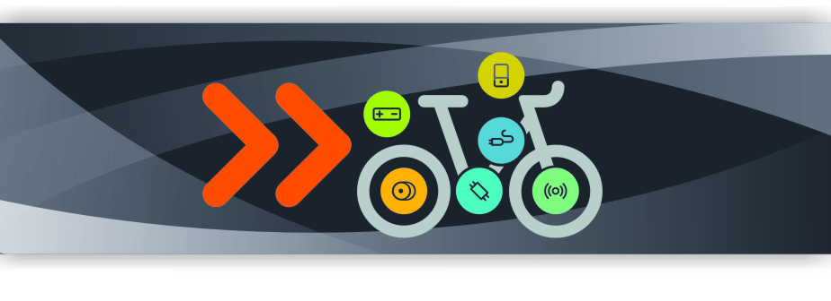
Power Your Life
Bafang Electric (Suzhou) Co., Ltd
1

Slide 2
Code | Error 07
Led Display | The second LED flickers 7 times in rapid succession
Description | The battery voltage is higher than the defined over-voltage value
Target | Battery, Controller
Solution | 1. Change a New battery to check if the Battery is available 2. Change a new controller to check if the controller is available

Slide 3
Code | Error 08
Led Display | The second LED flickers 8 times in rapid succession
Description | Motor hall signal abnormity
Target | HMI, Controller, Motor
Solution | 1. Please check the cable connector, make sure that they connect properly 2. Change the motor extension cable to check If the cable is available 3. Change the display to check the Display is available 4. Change the motor to check the motor is available 5. Change the controller to check the motor is available

Slide 4
Code | Error 09
Led Display | The second LED flickers 9 times in rapid succession
Description | Motor phase wire failure
Target | HMI, Controller, Motor
Solution | 1. Please check the cable connector, make sure that they connect properly 2. Change the motor extension cable to check If the cable is available 3. Change the display to check the Display is available 4. Change the motor to check the motor is available 5. Change the controller to check the motor is available

Slide 5
Code | Error 10
Led Display | The first LED flickers 1 time
Description | The controller temperature reaches the protection value
Target | Controller, Motor
Solution | 1. If the Error shows when you are riding. The system is cooling down, don't worry 2. If the Error shows when the bike doesn't work too much. Change the motor to check the motor is available. Change the controller to check the controller is available

Slide 6
Code | Error 11
Led Display | The first LED flickers 1 time and alternate to the second LED flickers 1 time
Description | Controller temperature sensor abnormity
Target | Controller
Solution | 1. If the Error shows when you are riding. The system is cooling down, don't worry 2. If the Error shows when the bike doesn't work too much. Change the controller to check the controller is available

Slide 7
Code | Error 12
Led Display | The first LED flickers 1 time and alternate to the second LED flickers 2 times in rapid succession
Description | Current sensor breakdown
Target | Controller
Solution | 1. Update the software of the controller to check the latest software 2. Change the controller

Slide 8
Code | Error 13
Led Display | The first LED flickers 1 time and alternate to the second LED flickers 3 times in rapid succession
Description | The temperature sensor within the battery is abnormal
Target | Battery, Controller
Solution | 1. If the Error shows when you are riding or the bike stay under the sun for too long. The Battery is cooling down, don't worry 2. If the Error shows when the bike doesn't work too much. Change the battery to check the battery is available. Change the controller to check the controller is available

Slide 9
Code | Error 14
Led Display | The first LED flickers 1 time and alternate to the second LED flickers 4 times in rapid succession
Description | Motor temperature sensor failure
Target | Controller, Motor
Solution | 1. Update the software of the controller to check the latest software 2. Change the motor to check the motor is available 3. Change the controller to check the controller is available

Slide 10
Code | Error 21
Led Display | The first LED flickers 2 times in rapid succession and alternate to the second LED flickers 1 time
Description | The RPM sensor within the motor or the external speed-detecting sensor is abnormal
Target | HMI, Controller, RPM sensor
Solution | 1. Please check the RPM sensor connector connect properly 2. Please check the magnet is lock on the proper place 3. Update the software of the controller to check the latest software 4. Change the RPM sensor to check the RPM sensor is available 5. Change the display to check the display is available 6. Change the controller to check the controller is available

Slide 11
Code | Error 22
Led Display | The first LED flickers 2 times in rapid succession and alternate to the second LED flickers 2 times in rapid succession
Description | The controller fails to receive the BMS data from the battery
Target | HMI, Battery, Controller
Solution | 1. Update the software of the controller to check the latest software 2. Check the battery communication connector connect proper 3. Change the battery communication cable to check the cable is available 4. Change the display to check the display is available 5. Change the battery to check the battery is available 6. Change the controller to check the controller is available

Slide 12
Code | Error 24
Led Display
Description | Light sensor fault
Target | Light, Display, Controller
Solution | 1. Chang the display to check the display is available 2. Update the software of the controller to check the latest software 3. Change the controller to check the controller is available

Slide 13
Code | Error 23
Led Display
Description | Light fault
Target | Light, Controller
Solution | 1. Check the light connector connect proper 2. Change the light cable to check the cable is available 3. Change the light to check the light is available 4. Change the controller to check the controller is available

Slide 14
Code | Error 25
Led Display | The first LED flickers 2 times in rapid succession and alternate to the second LED flickers 5 times in rapid succession
Description | Torque sensor torque signal failure
Target | HMI, Controller, Torque sensor
Solution | 1. Please check the cable connector, make sure that they connect properly 2. Change the torque sensor to check the torque sensor is available 3. Change the display to check the display is available 4. Update the software of the controller to check the latest software 5. Change the controller to check the controller is available

Slide 15
Code | Error 26
Led Display | The first LED flickers 2 times in rapid succession and alternate to the second LED flickers 6 times in rapid succession
Description | Torque sensor torque signal failure
Target | HMI, Torque sensor
Solution | 1. Please check the cable connector, Make sure that they connect properly 2. Change the torque sensor to check the torque sensor is available 3. Change the display to check the display is available 4. Update the software of the controller to check the latest software 5. Change the controller to check the controller is available

Slide 16
Code | Error 30
Led Display | The first LED flickers 3 times in rapid succession
Description | The display fails to receive data from the controller
Target | HMI, Controller
Solution | 1,Check the cable Connector if connect proper 2,Change the display to check the display is available 3,Update the software of the controller to check the latest software 4,Change the Torque/Cadence sensor to check it is available 5,Change the controller to check the controller is available

Slide 17
Thank you
Power Your Life

