Slide 1
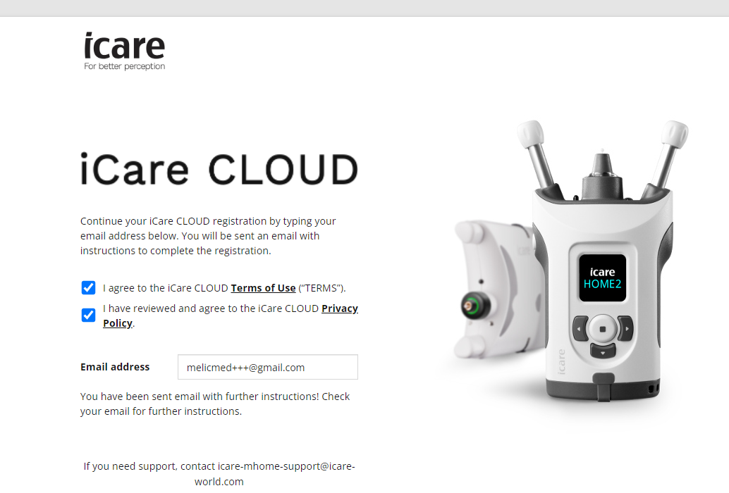
Register iCare HOME2
Go to www.icare-world.com/us/cloud/registration/

Slide 2
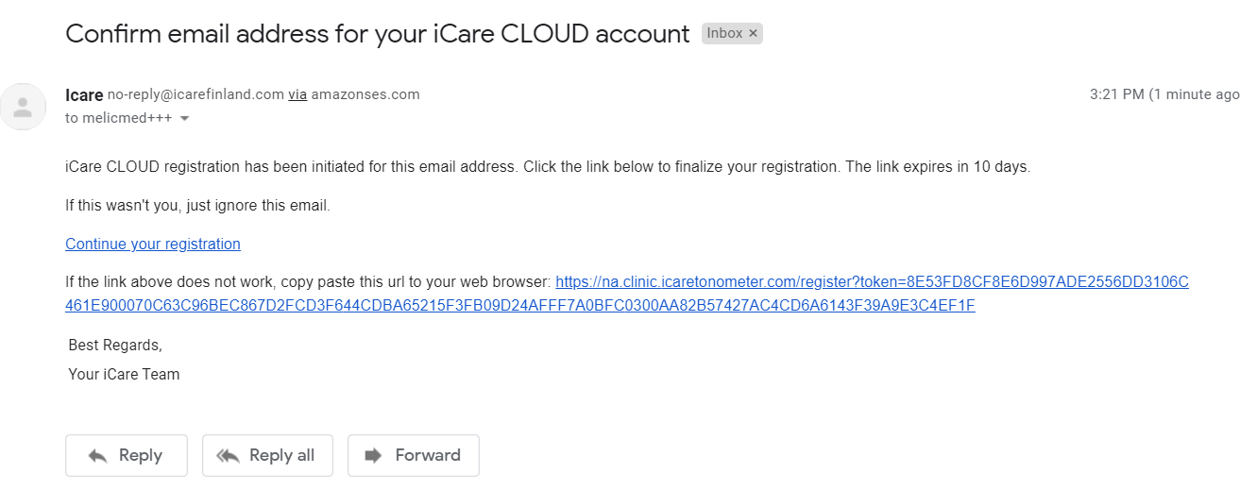
Confirm Email
Open email from no-reply@icarefinland.com & follow the link to complete registration

Slide 3
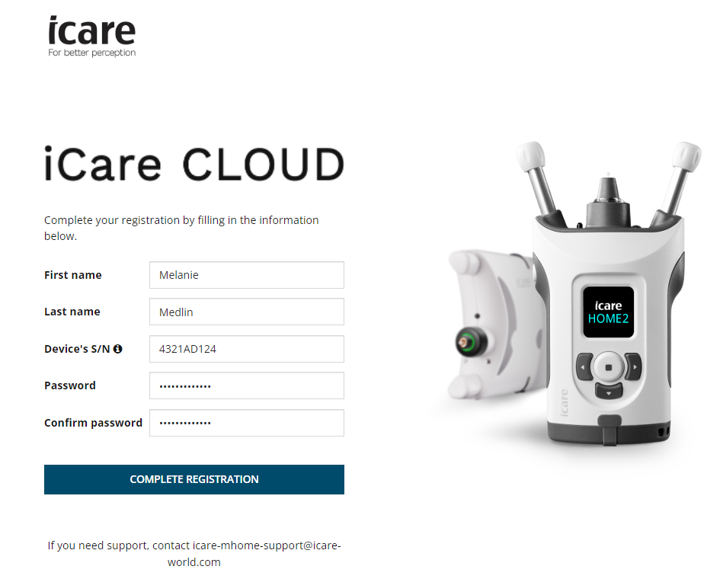
Complete Registration
*Click here to find out how to find your serial number (S/N)

Slide 4
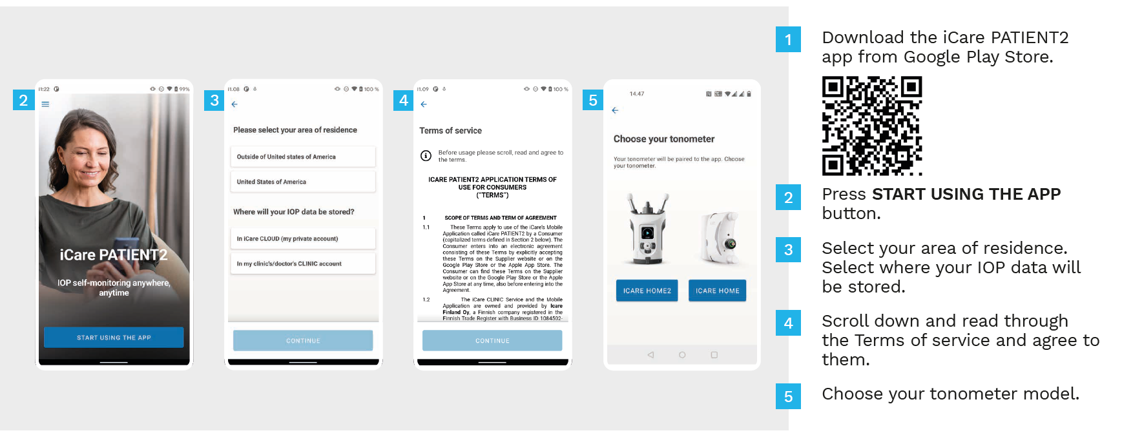
PATIENT2 app for Android
Getting started

Slide 5
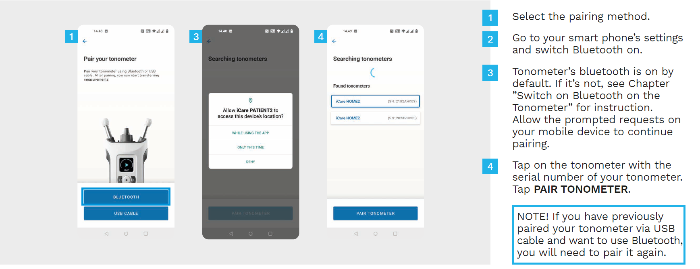
Pairing HOME2
Pair via Bluetooth to set device time/date & transfer measurements
Click here for instructions on transferring measurements through a wired connection
Click here for instructions on turning on HOME2 Bluetooth

Slide 6
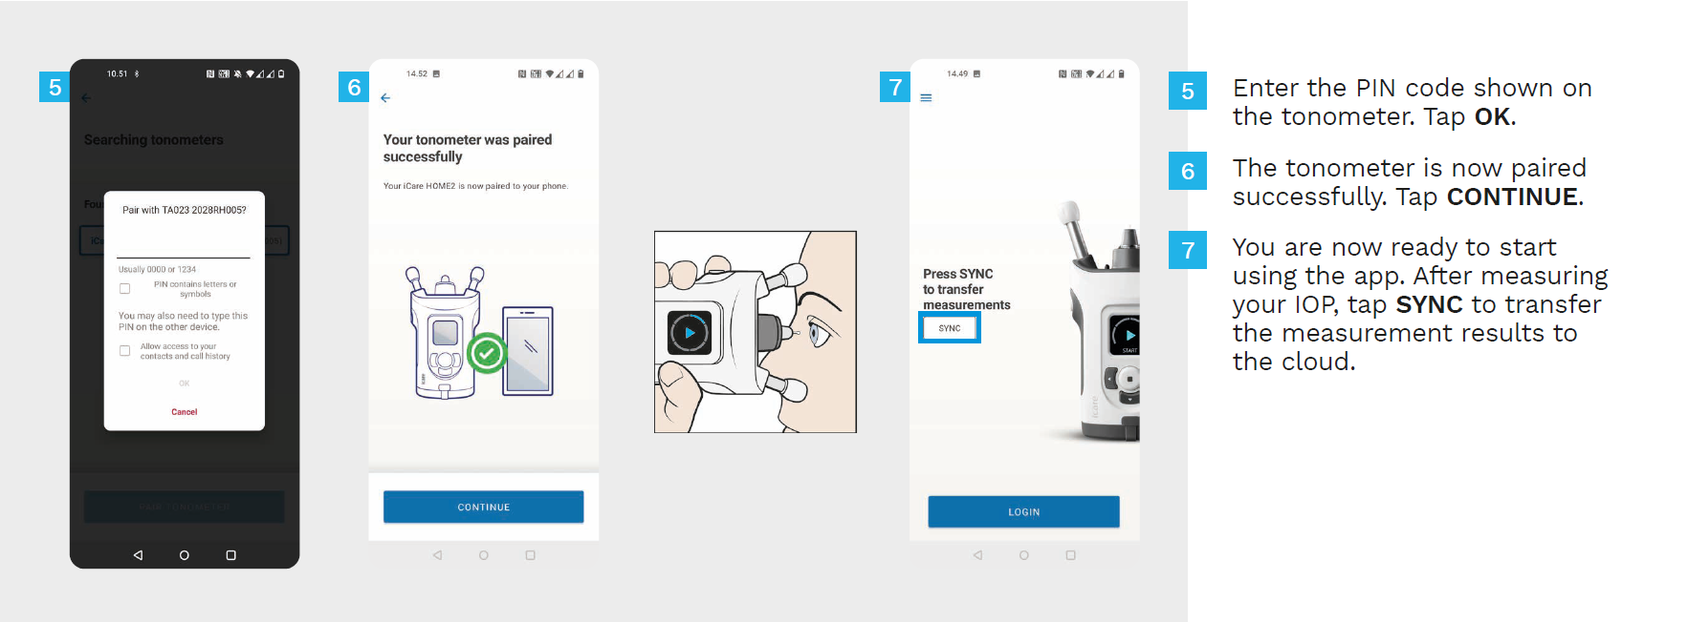
Pairing Bluetooth

Slide 7
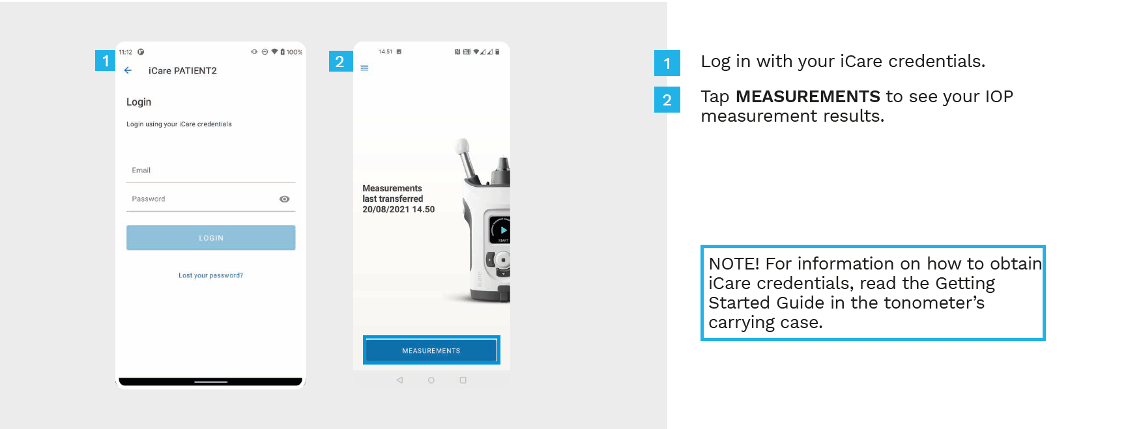
Login to CLOUD from PATIENT2 app
To login from the web: https://na.clinic.icaretonometer.com/login

Slide 8
Start taking measurements
Link to HOME2 instructional video on YouTube: https://youtu.be/-adL6jI5LMU

Slide 9
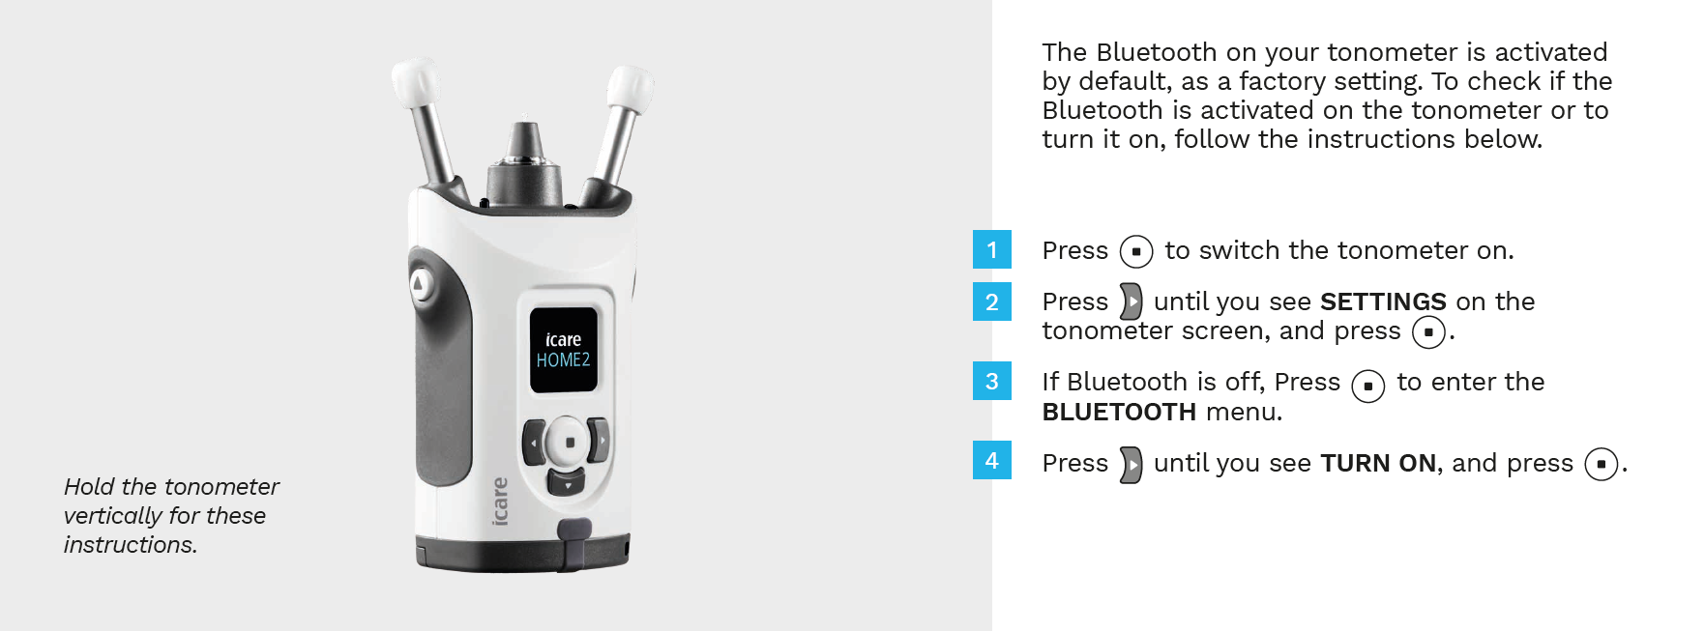
Turning on HOME2 Bluetooth
Click here to go back to instructions

Slide 10
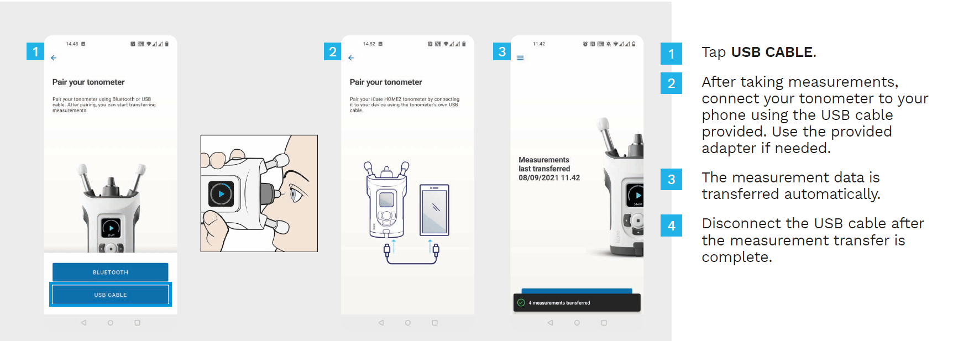
Pairing via USB
Click here to return to instructions

Slide 11
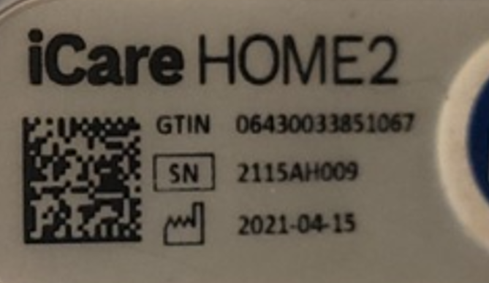
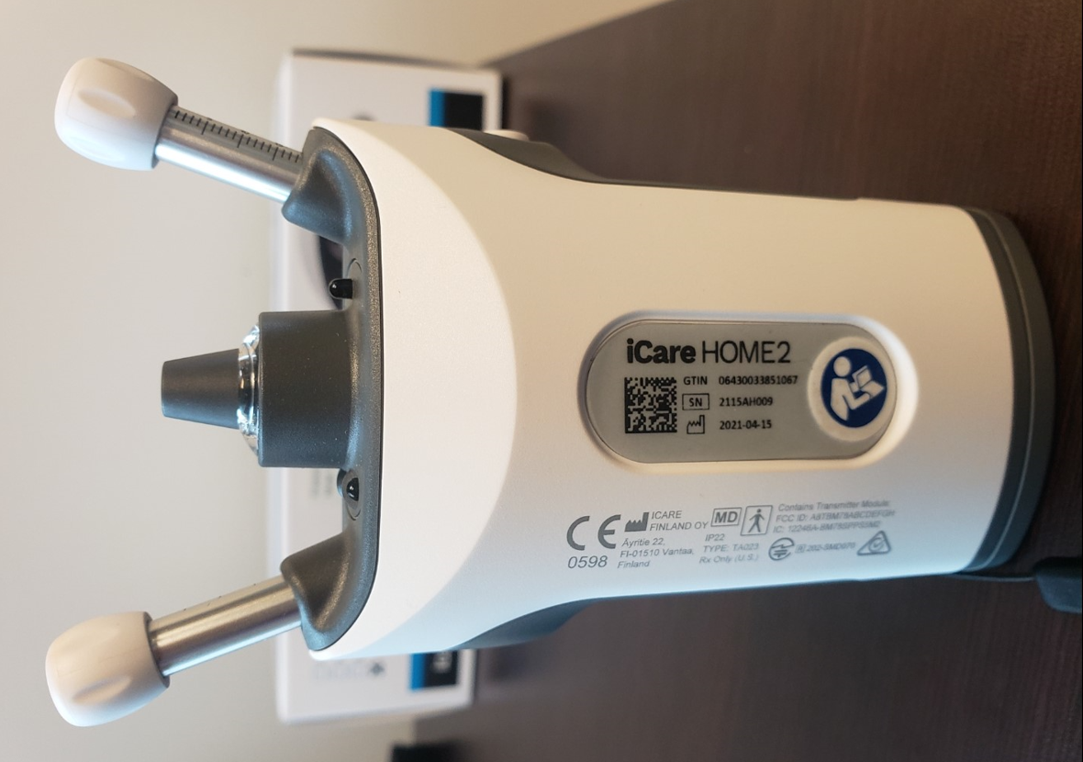
Finding your serial number
Serial number is located on back of device
Click to go back to instructions

