Slide 1
Pink Rot Prevention and Management: Best Practices for Field and Storage
Julie Pasche
Potato Pathology
Julie.Pasche@NDSU.edu

Slide 2
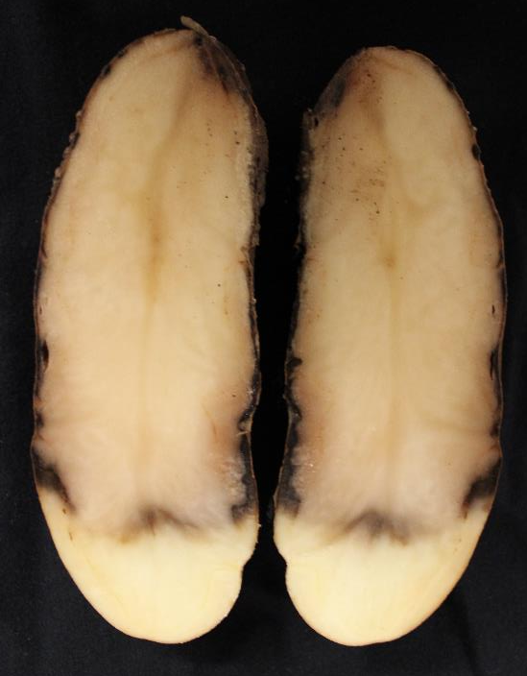
Pink Rot
Caused by Phytophthora erythroseptica
Soil-borne organism
Infection favored by:
  Saturated soils
  Soil temperatures of 68-77F
Infection through stolons, eyes
  Wounds made at harvest
Chemical control important
  Mefenoxam
  Phosphorous acid
  Others

Slide 3
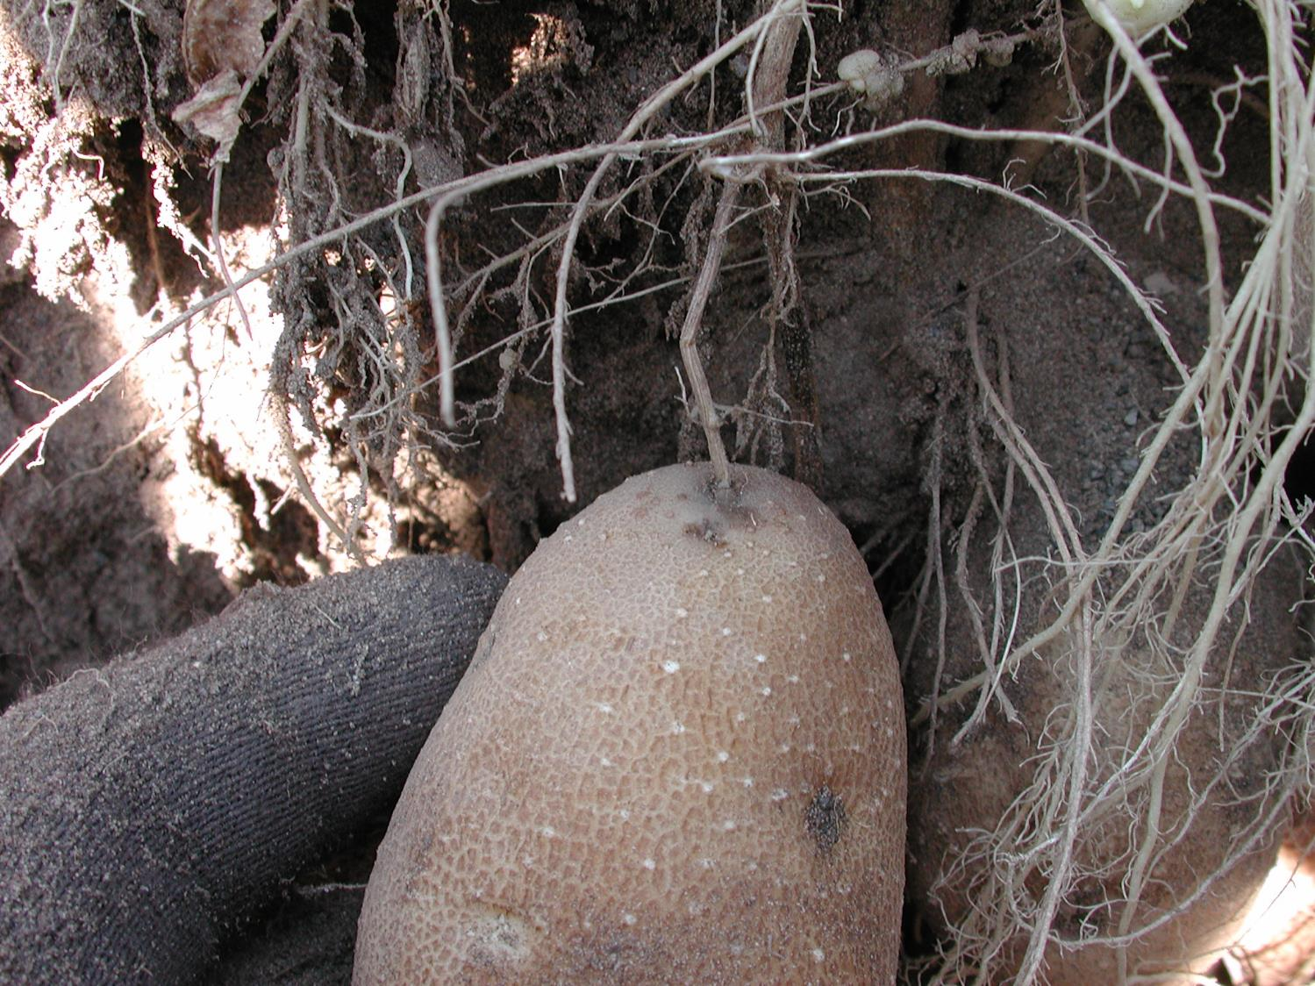
Photo courtesy: J. Miller; Miller Research

Slide 4
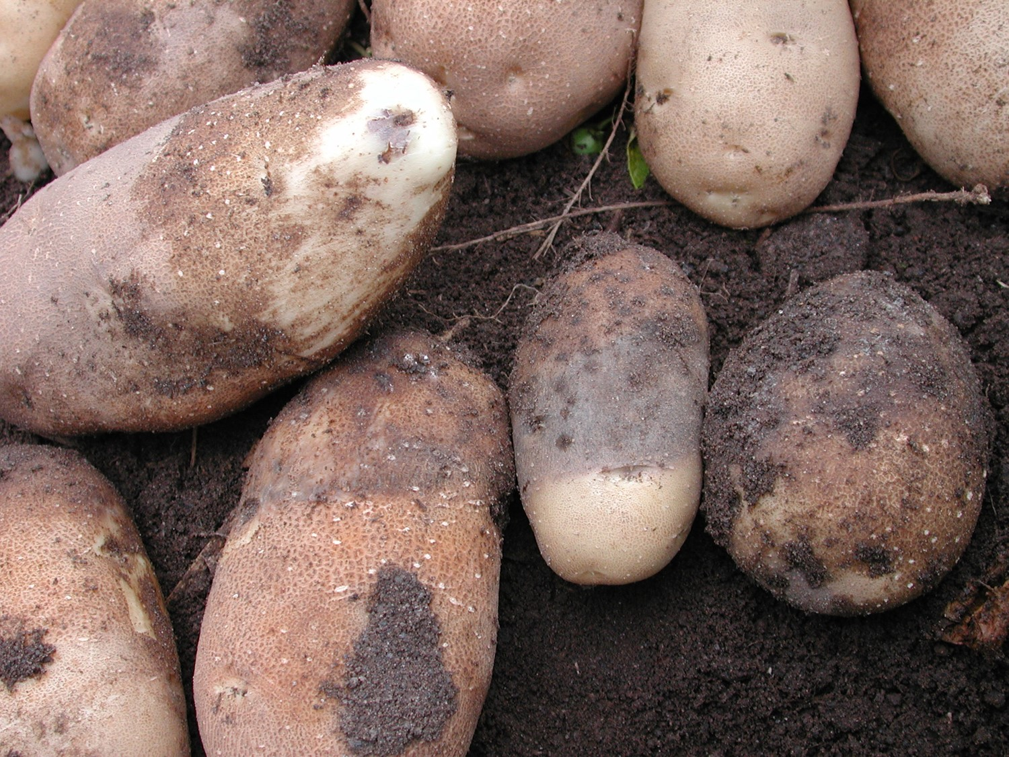
Photo courtesy: J. Miller; Miller Research

Slide 5
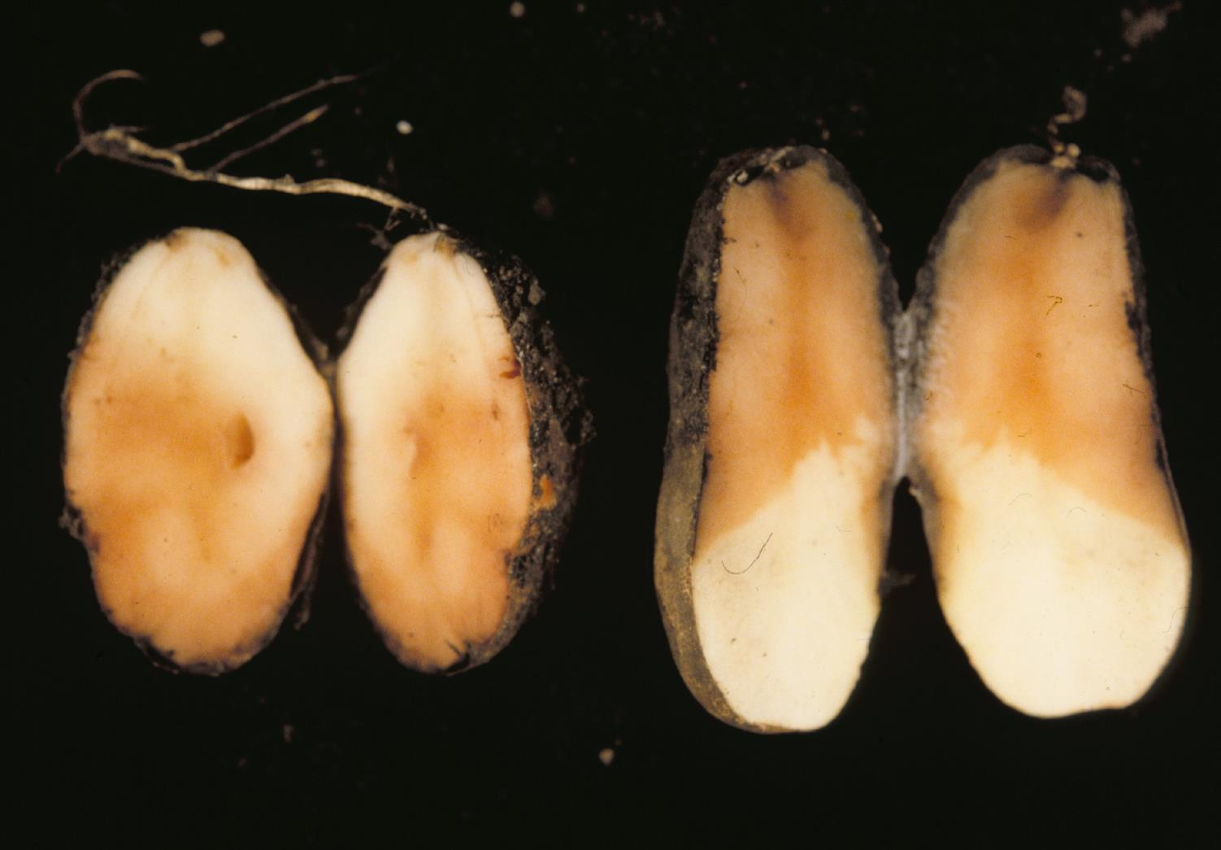
Bud End Eye Infection
Stolon Infection

Slide 6
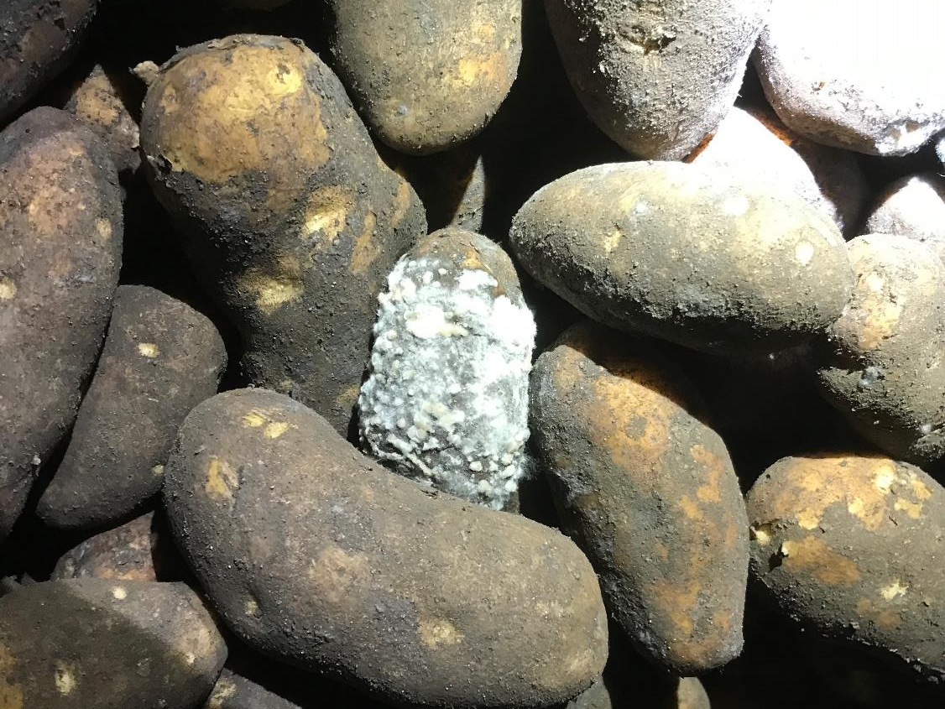

Slide 7
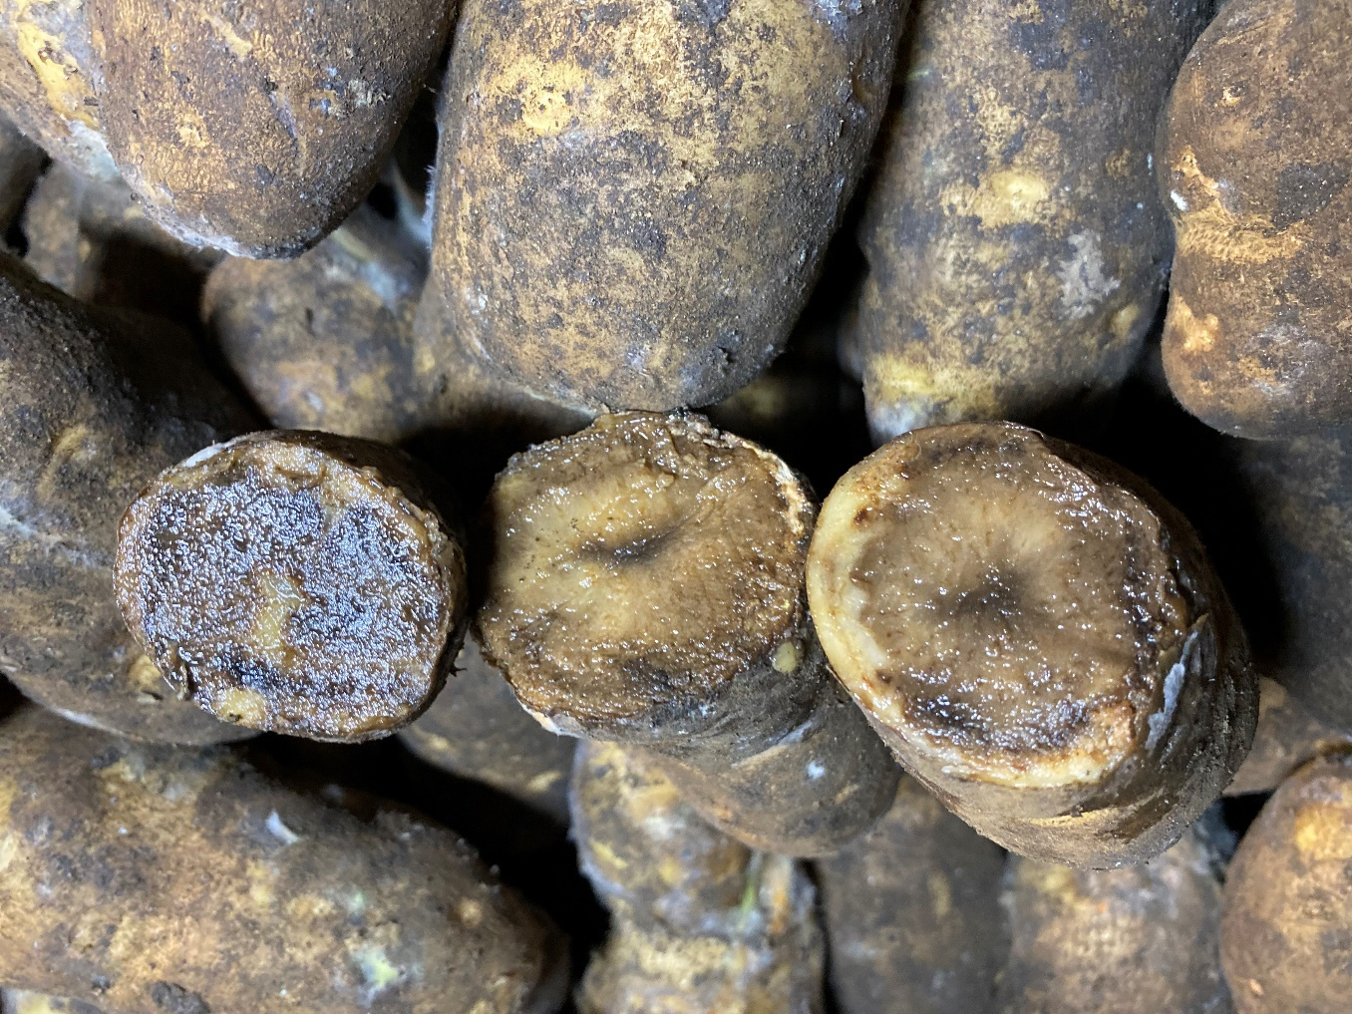
Leak
Primarily caused by Pythium ultimum
Soil-borne organism
Infects primarily through wounds made at harvest
Tuber pulp temps >65F favor infection
Mefenoxam/ metalaxyl-m provide a moderate level of suppression
Photo: N Gudmestad
Notes:
Mefenoxam/metalaxyl products
- Ridomil

Slide 8
Photo courtesy: J. Miller; Miller Research
Notes:
Top – Pink Rot; Middle – Leak; Bottom – Both
External – Leak enters though eye, lenticel, mostly wound
- pink rot – eye, mostly stolon
- both dark brown, wet/slimmy, lenticels dark brown to black
Internal – leakl; soft, grey to dark
- pink rot; backed potato, creamy-white, turns pink with time, sometimes dark border

Slide 9
Some Factors That Affect Pink Rot and Leak
High soil moisture
Chemical application
Wounding
Pulp temperatures

Slide 10
High Soil Moisture
P. erythroseptica (pink rot) and Py. ultimum (leak) produce zoospores with flagella → they swim
High soil moisture conditions at end of season (>90% of field capacity) promote soil borne disease development
A combination of either rain and/or irrigation can provide a suitable environment for infection and disease development
  High rainfall amounts (>2” generally)
  Significant rainfall (>1”) after an irrigation
Notes:
Rainfall and irrigation recommendations are from NCG observations over years ND to MI - upper mid-west

Slide 11
Irrigation Management – Pink Rot
Miller Research; Minidoka, ID 2010; non-inoculated

Slide 12
How Does Soil Moisture Affect Pink Eye (Periderm Disorder Syndrome)?
There is no pathogenic cause of pink eye (PDS) – abiotic
Pink eye ‘wounds’ do not heal
Under field conditions pink eye development is associated with high soil moisture conditions and warm soils (>80F)
Areas of early vine senescence are susceptible
Dying plants do not remove moisture from the soil
  Soil saturation → sun heats soil → pink eye (PDS) → pink rot
Notes:
AJPR 2018 - Lulai - 2014-2015 - Current evidence suggests that pink eye is the result of localized hypoxia (E. Lulai)
AI:
Potato pink eye is a physiological disorder that causes pink areas to appear on the skin of immature potatoes. It's most commonly found around the potato eyes and at the stem end of the tuber.
Symptoms
-Pinkish swellings on the skin of the potato
-Pink areas that dry up and turn brown
-Corky patches or "bull hide" on the skin of the potato
-Brown patches in the flesh of the potato
Causes
-Excessive moisture: Water-logged soils, especially late in the growing season
-Warm temperatures: High soil temperatures
-Soil compaction: Compacted areas that reduce water drainage
-Loss of foliar canopy: Fields that have lost foliage or senesced early
Management
-Deep tillage: Breaks up compacted areas and improves water drainage
-Careful irrigation: Helps buffer soils from high summer temperatures
-Keep the crop canopy healthy: Shades the soil and helps keep soil temperatures down
-Control verticillium wilt and Rhizoctonia: These diseases are often associated with pink eye

Slide 13
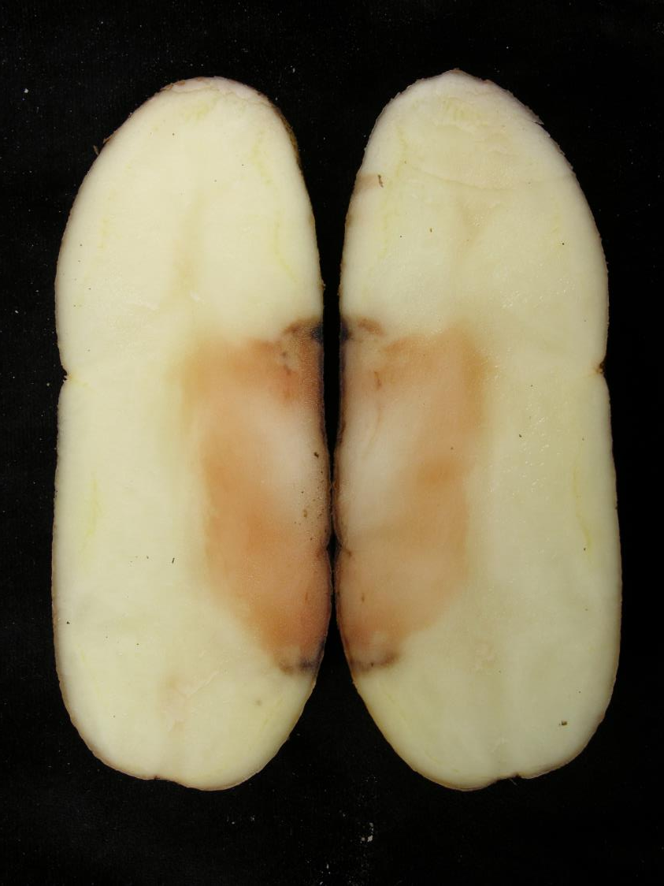
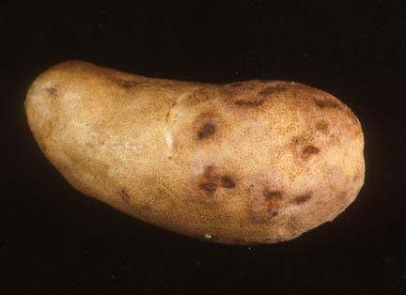
Pink eye
Pink rot

Slide 14
Effect of Pink Eye on Pink Rot Development
Taylor and Gudmestad, 2006

Slide 15
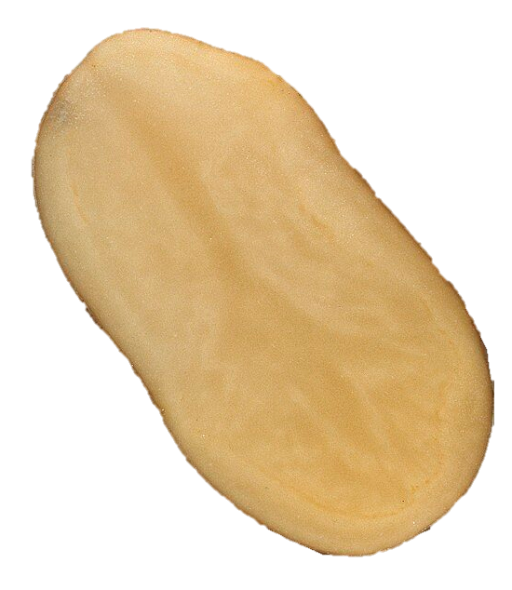
Potato Tuber Anatomy
Vascular Ring
Cortex
Medullary Tissue
Metalaxyl concentration
= 0.012-0.030 µg/ml
0.033-0.055 µg/ml Metalaxyl
Periderm
Bruin et al., 1982

Slide 16
Mefenoxam Insensitivity – Pink Rot
In-field inoculation with a mixture of isolates
Chapara et al. unpublished
Notes:
Figure 3. Percentage of rot at harvest. Russet Burbank was treated with Ridomil ® in-furrow or Phostrol ® at tuber-set and 14 days later and inoculated with 25% to 75% of a mefenoxam-insensitive P. erythroseptica isolate. Results from a 2009 field trial (Chapara et al. unpublished).

Slide 17
2022 and 2024 Pink Rot Field Trials
Notes:
timing to start applications - first tuber as dime-sized
2022-2024 Pink Rot New Fungicides - Osage Series 1700
Note - inoculated with sensitive isolate
natural field pressure - likely a mix - may be different each year
Orondis Gold DC and old formulation are both dispersable concentrates

Slide 18
Timing Between Irrigation and Phos Acid Application
Recommendation: Wait at least 12 hrs between application and irrigation
Post-harvest challenge inoculation
Courtesy: J. Miller; Miller Research

Slide 19
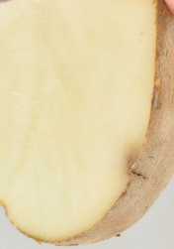
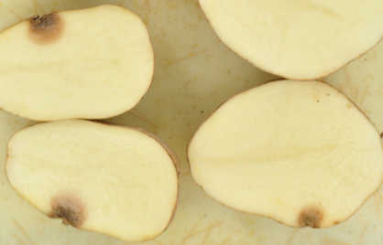
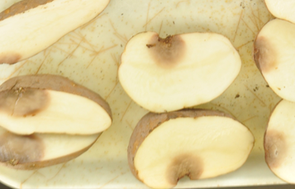
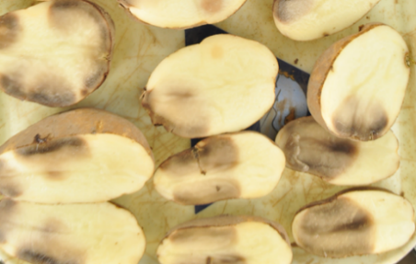
Effect of Wounding
Day 1 Day 2 Day 3 Day 4
Courtesy: N. Olsen; U of ID

Slide 20
Effect of Wounding on Disease Incidence of Non-Treated Tubers
Taylor et al., 2004. Plant Dis. 88:301-307

Slide 21
Effect of Drop Height and Cultivar on Bruise
7.6 cm 17.8 cm 30.5 cm
Bruise Temp: 8.9C (48ºF)
Courtesy: N. Olsen; U of ID
Notes:
The overall shatter bruise incidence shows that some varieties are more prone to shatter (not shown), **click** but as impact force is increased, some varieties like Teton have a lot more shatter bruise incidence. And others, like Dakota had very minimal shatter bruise incidence at all the drop heights.

Slide 22
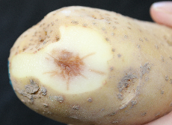
Effect of Pulp Temperature on Shatter Bruise
7.2C 12.8C 18.3C
Courtesy: N. Olsen; U of ID

Slide 23
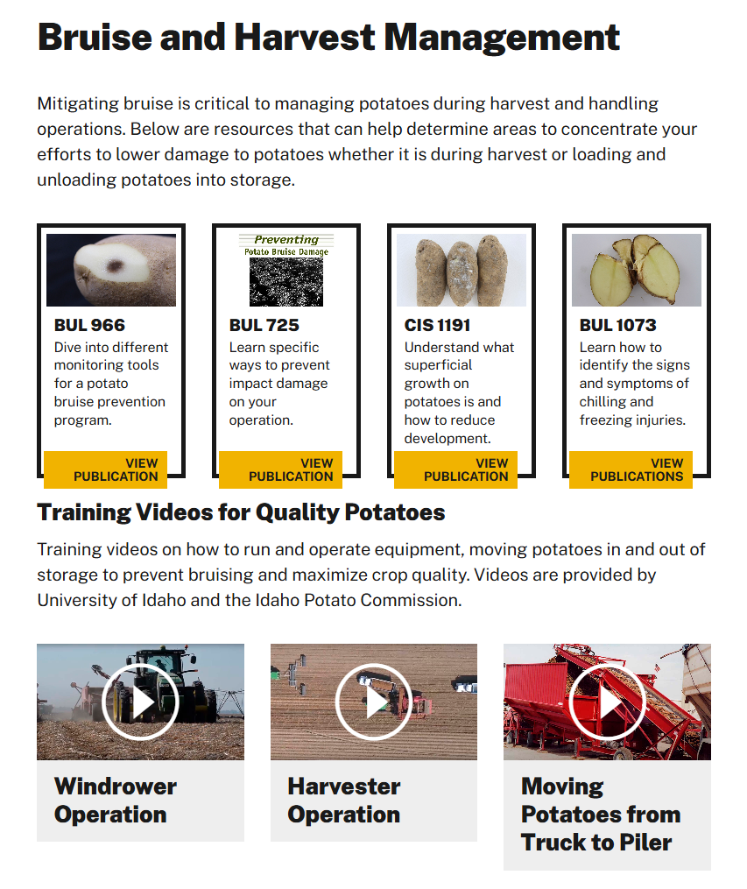
University of Idaho
(uidaho.edu/potatoes)
Wounding
  Reduce drop distance
  Pad hard surfaces
  Run equipment at capacity (full of potatoes)
Temperature
  Tuber pulp 45-65F

Slide 24
Risk When Harvesting Outside the Ideal Temperature Range
RISK
RISK
7.2C
(45ºF)
12.8C
(55ºF)
18.3C
(65ºF)
Adapted from: N. Olsen; U of ID
Notes:
Squiggly lines.

Slide 25
Pink Rot / Leak Management
Avoid self-induced wet soil conditions (>90% FC) in August/September
Minimize wounds and bruising at harvest
  80-85% field moisture from vinekill through harvest to decrease bruise
Shut down harvest when tuber pulp temperatures reach 62F (16.7C), do not exceed 65F (18.3)!
Reduce pulp temperatures in storage (Olsen; U of ID)
  During ramping, ensure the temperature differential between the top and bottom of the pile is no more than 0.5ºF
  Set temps 2ºF cooler than coolest tubers
  Reduce pulp temps to 55ºF in a stair-step manner
If rot develops in storage → remove water
Notes:
NCG notes: gain a degree every hour for first 4 hours
need to wick away so tubers underneath dont get wet - 6 tubers damp to wet under a rotting tuber - threshold to pay attention- means there is enough moisture - 2ndary soft rot moves in

Slide 26
Pink Rot Chemical Management
Phosphorous acid (Phostrol®, Rampart®, Confine®) provides excellent pink rot control
Metalaxyl-m/mefenoxam-based fungicide in furrow at planting
  Not recommended in the presence of insensitive isolates
  The only fungicide known to provide suppression of leak
Metalaxyl-m/mefenoxam alternatives
  Oxathiapiprolin (Orondis Gold DC®)
    Efficacy can be inconsistent
  Ethaboxam (Elumin®)
    Efficacy can be less than desired
Notes:
Canada - all Phostrol, Rampart, no Confine aerial label - is Phostrol the same as in the US.
Post-harvest - table market for scurf, some post-harvest because heavy irrigators, don't want to turn the pivots off - very few
If you feel like you are getting good control of pink rot – the population is likely mainly susceptible
2021 bulletin

Slide 27
Pink Rot / Leak Management
Management Strategy | Pink Rot | Leak
In-Season Water Management | ++ | ++
Minimize Wounds at Harvest | +(+) | ++
Tuber Pulp Temperature <62F | ++ | ++
Mefenoxam-Based Fungicides | +(+) | +
Phosphorous Acid Fungicides | ++ | -
Other Fungicides | + | -

Slide 28

Thank You
Photo courtesy: J. Miller; Miller Research

Slide 30
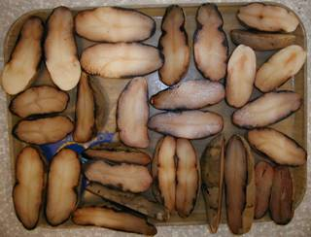
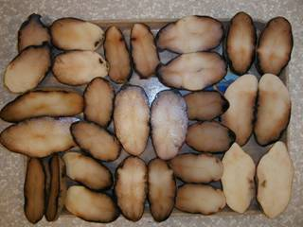
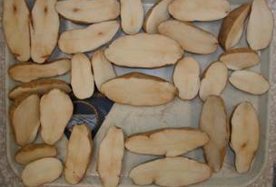
Pink rot
Untreated control
Hydrogen Peroxide Peracetic Acid (Storox) 1:50
Phos Acid 12.8 fl. oz
Courtesy: N. Olsen; U of ID

Slide 31
Effect of post-harvest treatment on pink rot incidence (December 2005)
Courtesy: N. Olsen; U of ID

Slide 32
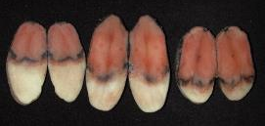

Post-Harvest Pink Rot
% Incidence (Challenge inoculation)
Field Treatment: Post-Harvest Treatment:
Resist 57 (10 pt/acre, 3X) Resist 57 (12.8 fl oz/ton)
Courtesy: N. Olsen; U of ID

Slide 33
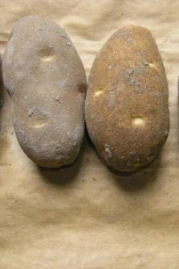
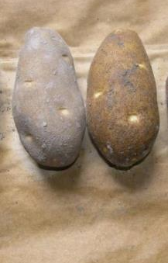
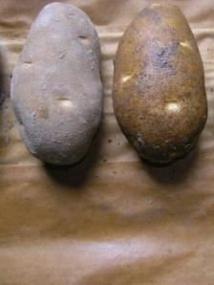
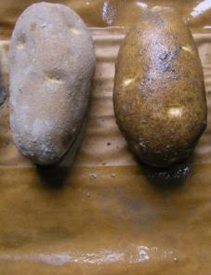
Post-harvest spray application volumes
Dry and 0.25 gal/T
Dry and 0.50 gal/T
Dry and 1.0 gal/T
Dry and 2.0 gal/T
Courtesy: N. Olsen; U of ID

Slide 34
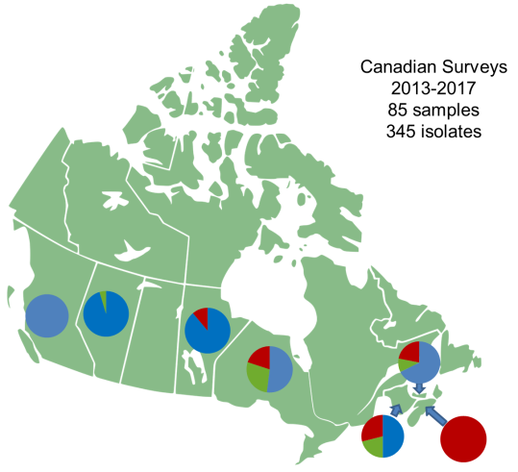
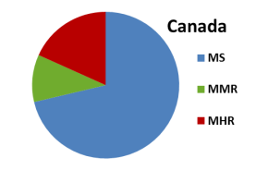
MS = metalaxyl sensitive
MMR = metalaxyl moderately-resistant
MHR = metalaxyl highly-resistant
Adapted from Peters et al. 2017 PAA

Slide 35
Timing Between Irrigation and Phos Acid Application
Courtesy: J. Miller; Miller Research
Notes:
We start at nickel, +14 days, +28 days
- total = 20 to 30 pts
Miller start at dime or row closure (14 days after dime), +14 days, +28 days - total = 30 pts

Slide 36
Mefenoxam Insensitivity – Pink Rot
Minnesota
North Dakota
Adapted from Chapara et al. 2010
Notes:
Situation in MB – likely similar where some insensitivity was detected a few years ago but no evaluations have been done recently.
Figure 1. Frequency of P. erythroseptica isolates sensitive (EC50 < 1 µg/ml), intermediate (EC50 1-99.9 µg/ml), and insensitive (EC50 >100) to metaxyl/mefenoxam in Minnesota. Adapted from Chapara et al. 2010.
Figure 2. Frequency of P. erythroseptica isolates sensitive (EC50 < 1 µg/ml), intermediate (EC50 1-99.9 µg/ml), and insensitive (EC50 >100) to metaxyl/mefenoxam in North Dakota. Adapted from Chapara et al. 2010.

Slide 37
Effect of Temperature on Pink Rot
Salas, et al., 2000

