Slide 1
Brise Audio New Product Release - FUGAKU
2024.5.25
Notes:
Thank you for coming to the launch event for BriseAudio's new product today.
This is the first time for our company to announce a new product at a venue like this, so
let me first explain a little about ourselves.

Slide 2
About Brise Audio
Members
Representative Director Keiichi Watanabe High-End Cable R&D, Mfg.
Director Naoki Okada Conducting & Marketing
Engineer Ryo Sasaki Acoustic Product R&D. & Mfg.
Engineer Ryoichi Kurokawa Electronics Product R&D. & Mfg.
Notes:
Brise Audio is currently operating with a small team of four members (Watanabe, Okada, Sasaki, and Kurokawa) and several staff members.

Slide 3
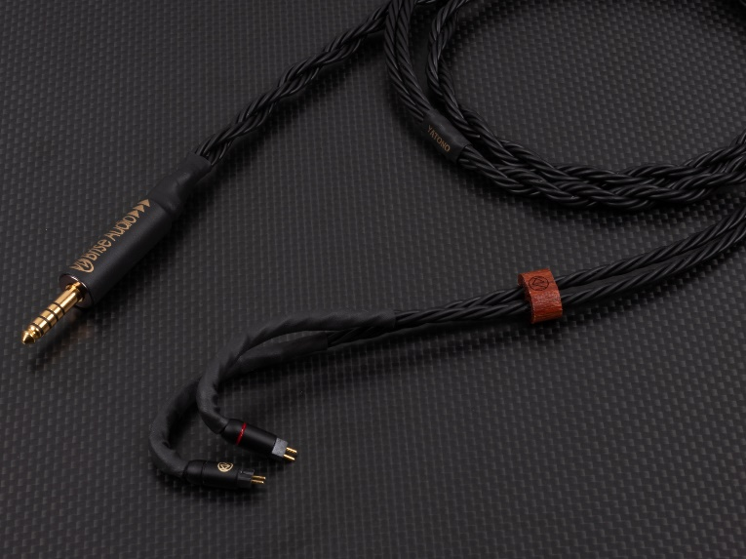
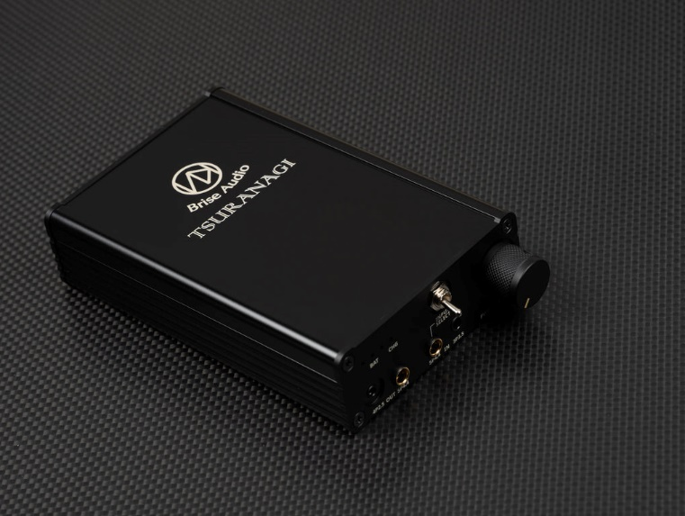
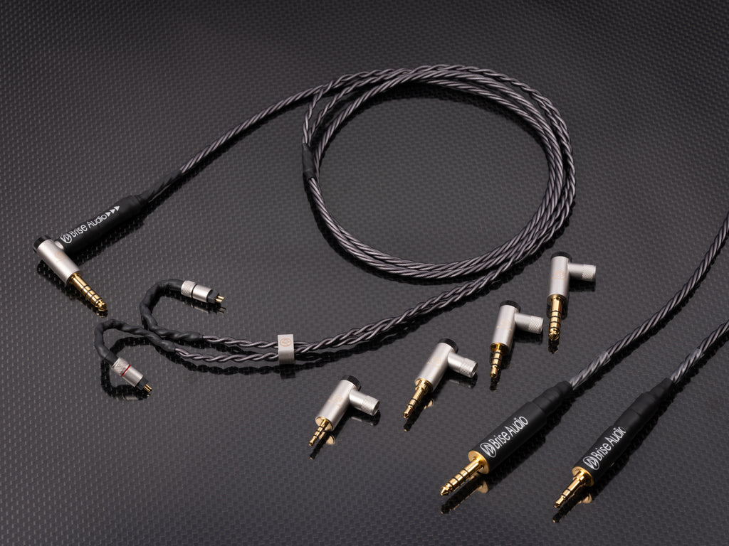
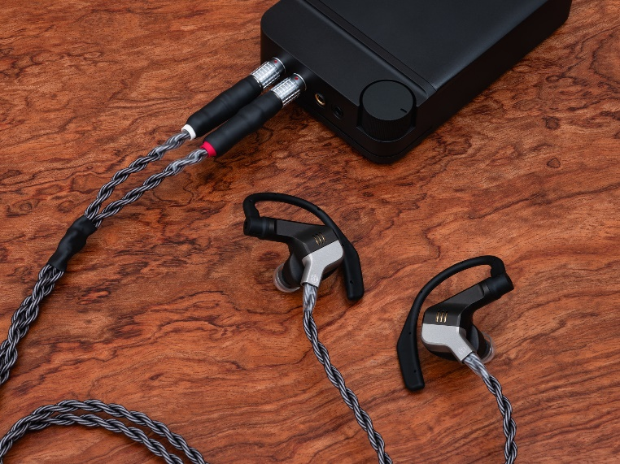
About Brise Audio
Brise Audio Timeline
High Performance High Pure Copper
UPG001
Spiral77
Architecture
YATONO
Portable Amplifier
TSURANAGI
Pure Silver Cable
SHIROGANE
Founded
FUGAKU
2015
2016
2018
2021
2023
2024
Notes:
Brise Audio may be familiar to some of you, but
is based in Gunma and manufactures and sells audio equipment, with a focus on audio cables.
It was founded in 2015, and nine years have already passed.
I had been making audio cables on my own through work such as assembling PCs for music production, measuring speaker performance, and developing units.
Then, one of my audio friends, Okada, who was using the cables I had made in his own high-end audio system, suggested that I start a business with them, and that's how Brise Audio got started.
At first, we sold cables for home audio, but it wasn't a rosy situation where expensive cables from unknown manufacturers were immediately accepted.
At that time, we turned our attention to the rapidly growing portable audio market, and thought that we could get more people to try our cables there, so we expanded our business to include cables for earphones and other products.
We introduced our unique approach to tuning the sound quality of cables using various materials, which we had developed for home audio, and our custom-made system of making cables using the most suitable connectors for the customer's environment
were also introduced to the portable audio market, and this proved to be very popular, allowing us to reach a wider audience.
In 2018, we developed a wire material called YATONO that not only has a high conductivity due to its large amount of conductive material, but also focuses on the structure of the stranded wire, achieving both a thick yet delicate sound and flexibility.
As the company grew, it became possible to develop new types of wire and parts such as connectors that deliver high sound quality, and more and more people came to use our products.
In 2021, we released our first electronics product, the “TSURANAGI” portable balanced amplifier.
At the time, so-called portable amplifiers were going out of fashion as players became capable of higher sound quality, but
as a result of applying our common approach to product development, which is to maximize sound quality by investing in materials and costs, to the TSURANAGI,
it received high praise both in Japan and overseas, and became a bestseller despite being a product in a new category.
And last year, in 2023, we released our first cable series, SHIROGANE, which uses pure silver conductors.
supported by many customers, our company continues to develop, manufacture, and sell products that seek to maximize sound quality.
Next, we will explain the basic approach to product development at Bliss Audio.

Slide 4
About Brise Audio
Brise Audio Thought
3.
Ideal
Sense-able Comfortable Sound
2.
Hearing-based Design
Steadfast in Source, Regardless of Genre
1.
Theory-based Design
Physically and Mathematically Outstanding Performance
Path and Priority in Reaching Perfection
Notes:
Our ideal is to create products that produce sounds that listeners find pleasant.
In order to achieve this, we design our products with the aim of creating sound quality that is faithful to the source and that is suitable for all genres of music.
While auditory perception, or sound quality, is more important, we recognize that this can only be achieved through a design based on theory.
In addition, based on our experience that the more numerically high-performance a product is in terms of measurements, the closer it is to the sound we are looking for, we make our products with the idea of first firmly establishing a solid foundation based on logic.
There are various metrics for quantification, and some of them are trade-offs, so we use our own criteria to decide which metrics to prioritize.

Slide 5
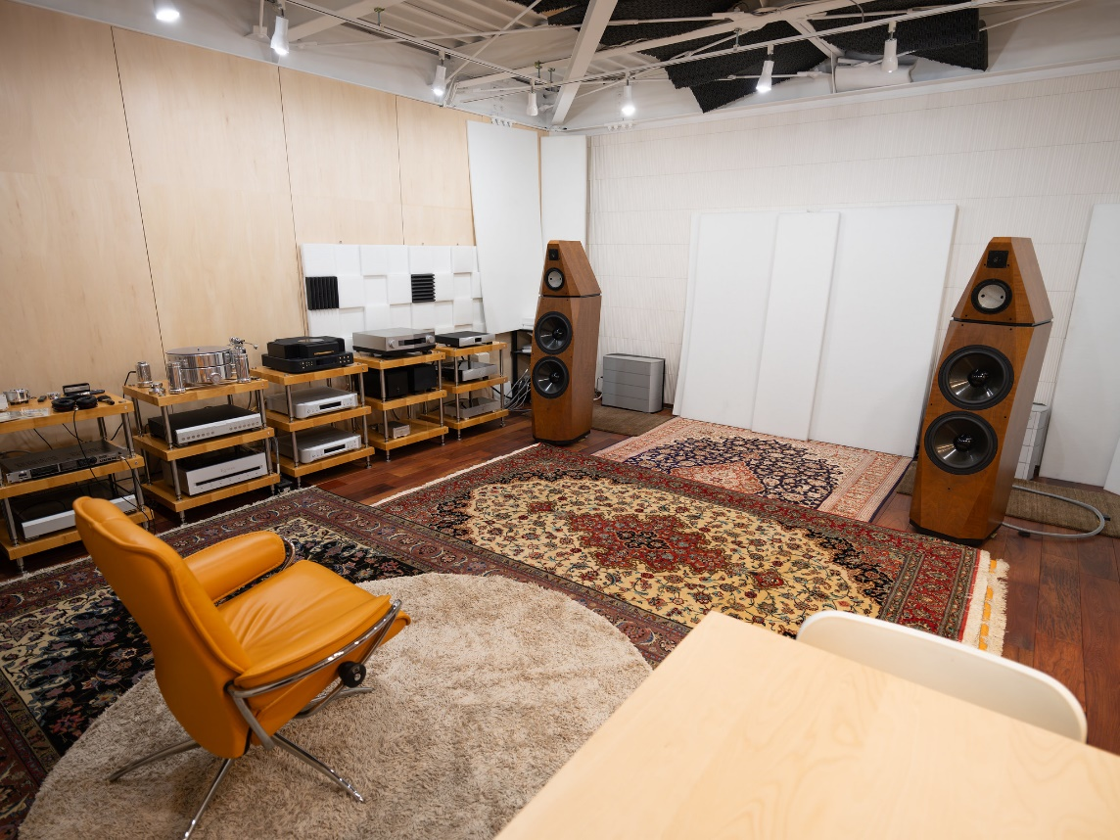
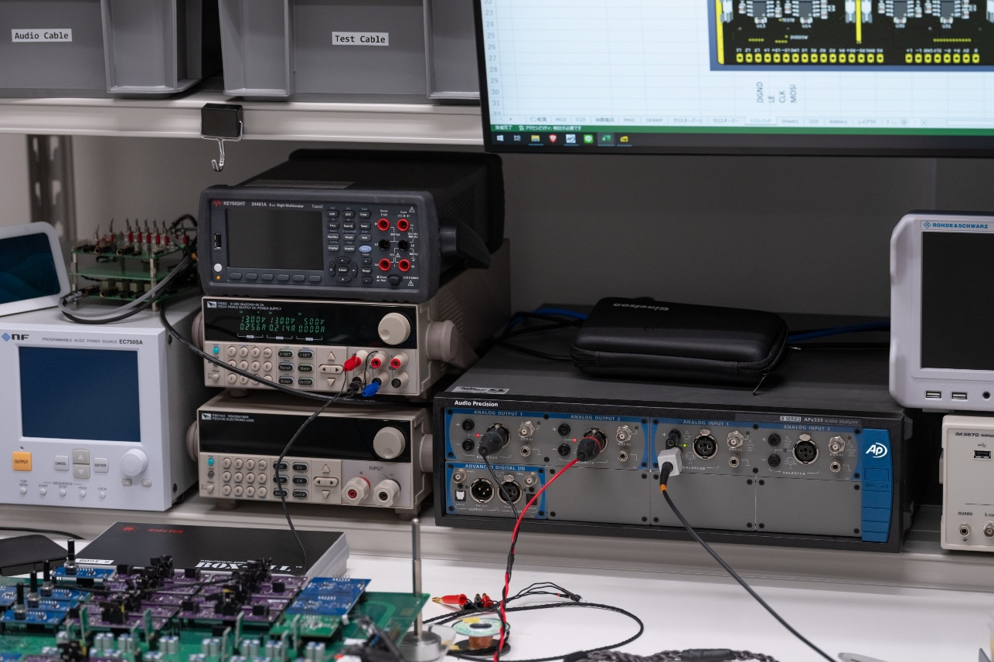
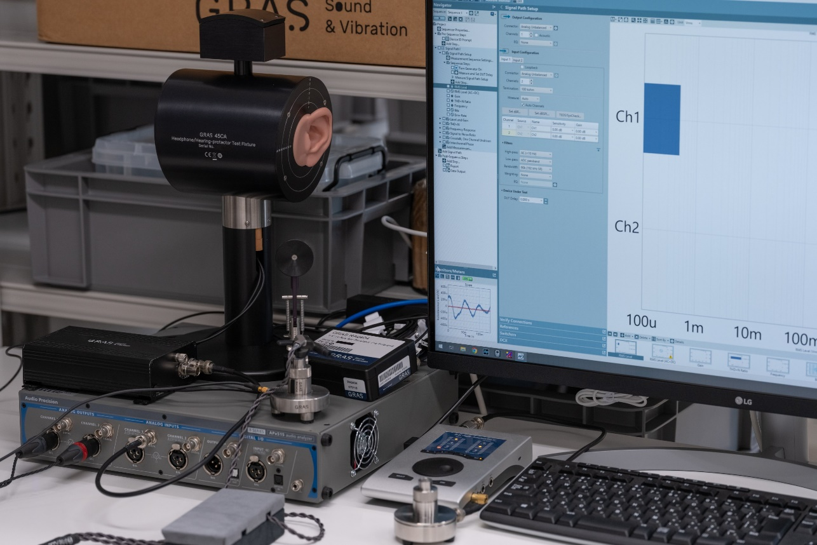
About Brise Audio
Hearing-based Evaluation
Listening room
High-end speaker system
High-end headphone system
Measurement-based Evaluation
Earphones and headphones acoustic measurement
Electrical characteristic evaluation for amplifiers
Engineers in working space
Notes:
In order to make an assessment based on auditory perception, it is necessary to be exposed to sound on a regular basis, gain experience, and have a firm standard of what constitutes good sound,
we have a dedicated audio room, speaker system and headphone listening system that we use to help us build our standards.
Although there are subtle differences in taste between each of us, we believe that our similar tastes and the fact that this environment functions as a pillar have led to the reputation that Brise Audio enjoys today.
In addition, in order to make accurate evaluations based on measurements, it is necessary to have good measurement equipment to ensure this.
In order to develop products with a solid foundation, Brise Audio uses a variety of measurement equipment, including industry-standard equipment such as Audio Precision and GRAS,
and each engineer handles them to make the most of them in development.
I've gone on a bit, but I'll finish introducing our company here and move on to introducing our new products.

Slide 6
Summary of FUGAKU
Name FUGAKU
Content Earphone+Amplifier+Cable Multi-Amplifier Earphone System
Concept -Ultimate Portability Audio System
-Most desirable product by ourself
-Existing industry yet cannot fulfill
MSRP JPY 2,500,000
Notes:
The name of this new product is FUGAKU.
It is a multi-amp earphone system that comes with a set of three items: earphones, a dedicated amp, and a dedicated cable,
we call it the Ultimate Portable Audio System.
The concept is an ultimate portable audio system that we ourselves would want to have, and a configuration that is not bound by existing frameworks.
This product was developed to achieve our long-held goal of providing a complete lineup of our own products, even down to the sound output.
The name FUGAKU comes from the Japanese name for Mt. Fuji, the highest mountain in Japan, and
We chose this name with the hope that it would deliver the ultimate music experience to listeners.
The suggested retail price is 2.5 million yen including tax.
We will begin taking orders in May, with shipments scheduled to begin in August.

Slide 7
Features of FUGAKU
Earphones
PVD Black coated pure titanium housing.
Ear hanger structure stable wearing.
8 Drivers 5-way Structure
Ultra-High : xMEMS MEMS Speaker x1
High : Knowles BA Drivers x2
Middle : Knowles BA Drivers x2
Mid-low : Sonion BA Driver x1
Low : Φ8mm LCP Dynamic Drivers x2
Up to 100kHz Frequency Response
Original 7-pin connector to multi-amplifier
Crossovers arranged within amplifier side
Notes:
Next, we will introduce the main features of FUGAKU.
First of all, the earphone part is made of a pure titanium housing with a PVD black coating,
and the ear-hanger structure improves stability when wearing it.
The driver configuration is 8 drivers on each side, 5-way
As you can see in the slide, it has a hybrid configuration using three types of drivers: MEMS, BA, and dynamic drivers, and is characterized by its wide frequency response of up to 100kHz.
In addition, by using an original 7-pin connector and connecting each driver to a multi-amp, only the drivers are mounted on the earphone side, and the crossover circuit is integrated on the amp side.

Slide 8
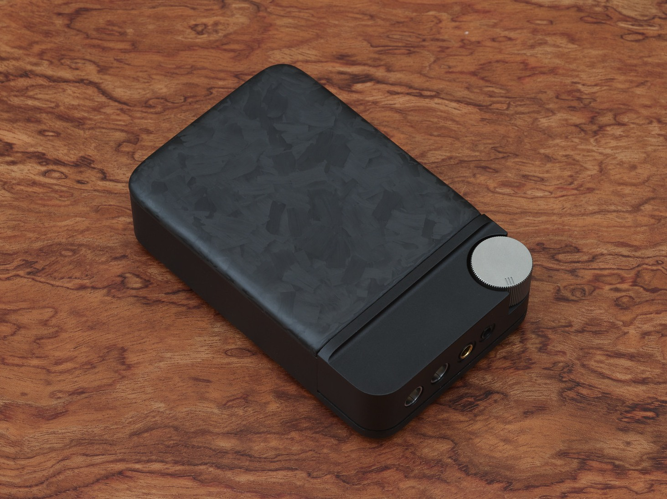
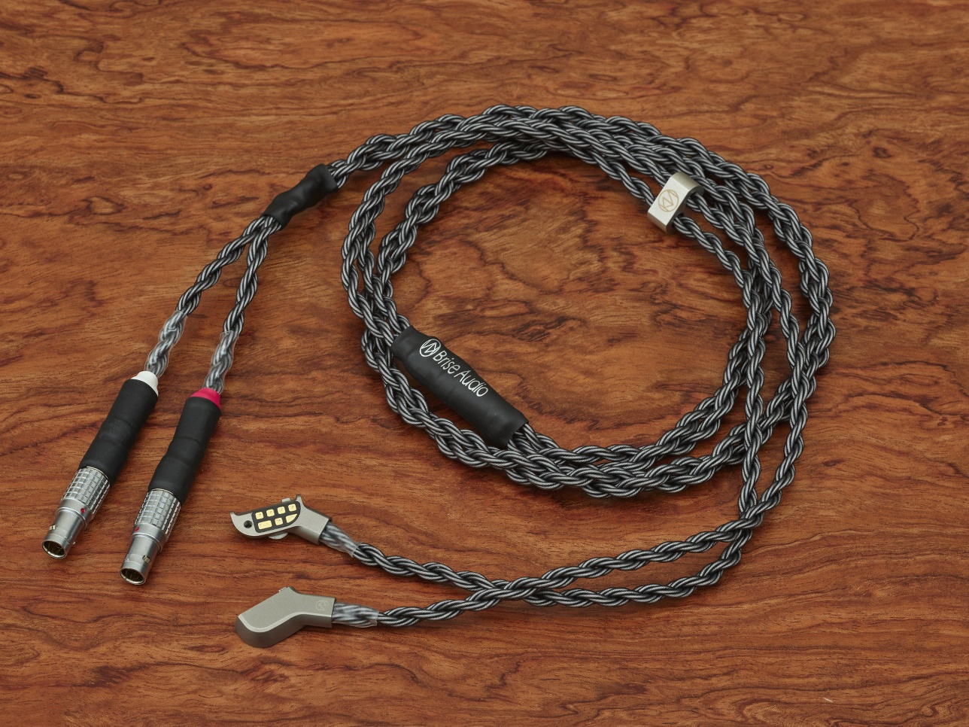
Features of FUGAKU
Dedicate portable amplifier
Chassis made of Aluminum and Forged Carbon Fiber. (Plan)
Stacked boards with 4-layer(Power) and 8-layer(Amplifier).
Electronic volume control by MUSES72323.
Left and right in total 10ch active filters.
Left and right in total 12ch power amplifiers.
Driving Types:
BA&MEMS: Single-ended Driving
Dynamic Driver: Balanced Driving
Battery life: approx. 6 hours
Dedicate Cable
Original cable made of 16-wire pure silver
Specially designed Ultimate Grade high quality manufacture
Notes:
This is a dedicated portable amplifier, but it is designed exclusively for FUGAKU, and can only be used with this system.
The chassis is a hybrid structure made of an aluminum body and a forged carbon top panel.
The internal structure uses a two-story structure with two parts: a power supply circuit using a 4-layer substrate and an amplifier circuit using an 8-layer substrate, which increases the mounting density.
The volume can be adjusted using the latest MUSES72323 electronic volume IC.
As mentioned in the overview of the earphones, a total of 10 active crossover circuits are installed to split the bandwidth into 5-ways on each side on the amplifier side.
In addition, a total of 12 power amplifier circuits are installed in the output stage to drive each driver.
The MEMS and BA are single-ended, but in order to provide balanced drive for only the dynamic driver responsible for the low range, a large-scale amplifier circuit with a total of 12 channels has been integrated into a compact size that allows portability.
It runs on an internal battery, so it can be used for about 6 hours, and continuous use is also possible by connecting it to a power supply with a USB Type-C cable.
Finally, the dedicated cable also uses a FUGAKU-specific connector,
It is an original cable that uses a total of 16 pure silver conductors on both sides.
Like our other cable products such as the YATONO Ultimate and SHIROGANE Ultimate, the Ultimate grade high-quality processing has been applied after being adjusted specifically for FUGAKU.
So far, we have explained the outline and main features of FUGAKU, but now we will hear from Mr. Sasaki and Mr. Kurokawa, who were involved in the development, who will explain some of the more detailed aspects.
Thank you all for coming to the FUGAKU launch event.
I was in charge of the design and development of the FUGAKU earphone section, as well as the sound tuning using an active crossover. My name is Sasaki from Brise Audio.
Before going into the details of the earphone section, I would like to first explain what is meant by the term “multi-amp” as used in this system, and compare it with conventional methods.

Slide 9
Features of FUGAKU
Amplifier
Earphones
Amplifiers
Earphones
Passive Filters
Drivers
Drivers
Active
Filter
H
H
Active
Filter
L
L
The limitation of existing approach
Difficult to fit more complex filters due to size constraints.
Parallel components between amplifier and driver introducing loss.
Overload when one amplifier feeding multiple drivers.
The advantages of FUGAKU
High design degree of freedom allows advanced frequency response.
Improved driving capacity by eliminating passive crossovers.
Loads spreading out over amplifiers achieves lower distortion.
Notes:
The left is a conventional earphone system, and the right is a system using FUGAKU's multi-amp system, each of which is a simple 2-way diagram.
First, with the conventional method, the signal from the amplifier flows through the passive filter and driver inside the earphone, and the sound is reproduced.
This is the most common style, and most earphones and speakers on the market use this configuration.
As this is the most popular style, users can freely combine amplifiers and earphones from different companies, which is a benefit for users.
Also, even if there are multiple drivers, only one stereo amplifier is needed, making it economical.
However, one of the disadvantages is that there is a passive filter circuit between the amplifier and the driver to split the frequency band, so the amplifier cannot directly drive the driver.
This means that the signal lost through resistance is input into the driver, etc., and in terms of sound, the sense of directness is lost.
In addition, passive filters need to be small due to size constraints, which means they can only be housed in the earphone casing, and the filter design becomes rather simple.
As a result, it becomes difficult to achieve the ideal frequency response that the designer had in mind.
In addition, since multiple drivers are driven together by a single amplifier, the more drivers you add, the lower the impedance becomes, and the higher the load on the amplifier, making it more prone to distortion,
there are several negative factors in terms of sound quality in exchange for versatility.
In contrast, FUGAKU uses a method called multi-amp.
This method has existed in the world of speakers for a long time, but
First, the audio signal is divided into bands, and each driver is driven by an amplifier prepared for each band.
By dividing the frequency bands before the amplifier, the passive filters inside the earphones become unnecessary.
When used in earphones, the advantage is that you can use complex filters and high-quality components without being restricted by the size of the housing.
In addition, because the amplifier and drivers are directly connected, it is easy to achieve a high driving force and a direct sound,
as each driver in each band is driven by a separate amplifier, even if the number of drivers increases, the load on each amplifier does not become heavy, and this is another good point of this method as it is less prone to distortion.
Another advantage is that, because it is a specially designed system, it is possible to design the earphone and amplifier side to be closely integrated, making it easier to achieve synergy.
The disadvantages of the multi-amp system are the flip side of the advantages of the conventional system.
Since the number of amplifiers required is equal to the number of bandwidth divisions, and since the filter circuit is built into the amplifier, a dedicated amplifier and dedicated cable combination is required for the earphones.
As a result, there are disadvantages such as increased costs and reduced versatility, but we decided to adopt this method because we felt that the sound quality benefits far outweighed these disadvantages.
Also, with the multi-amp speaker system, it is often necessary to prepare a pre-amp, active filter, and power amp in separate enclosures, but
FUGAKU has been able to integrate this into a single amplifier housing, making it possible to provide the ultimate sound with a scale equivalent to the conventional combination of DAP and portable amp.
FUGAKU is the world's first system to use a hybrid full-analog multi-amp earphone design that uses three different drivers, including MEMS.
Next, let's move on to the details of the earphone part.

Slide 10
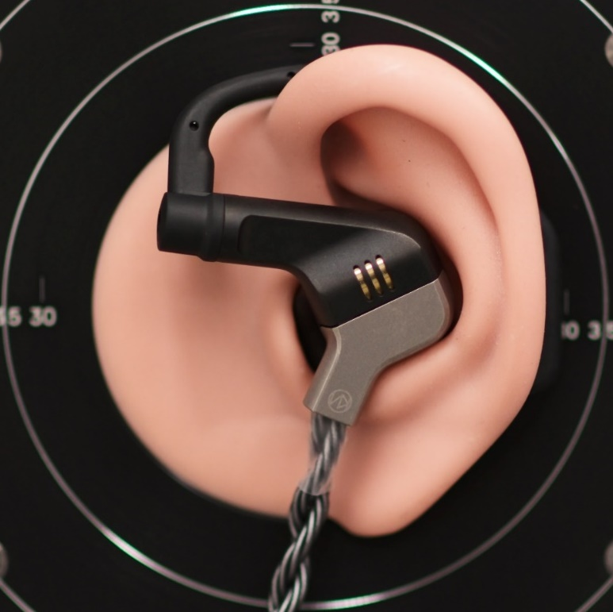
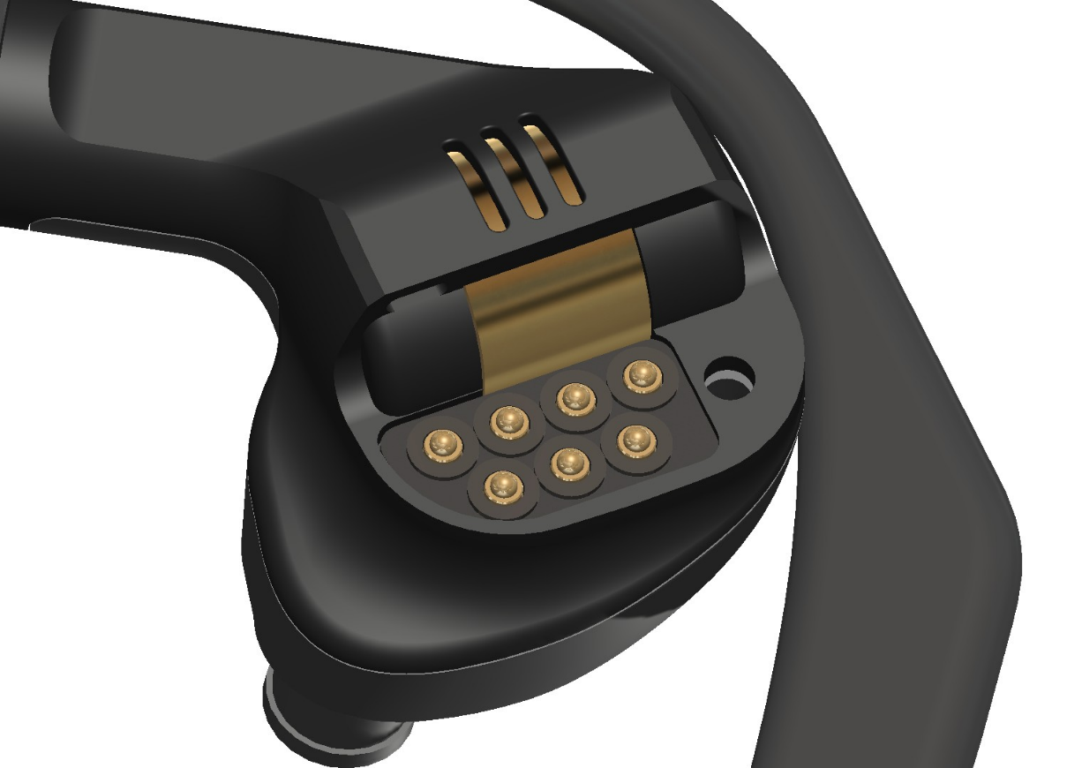
Features of Earphones
Beautiful Outlook with Stable Wearing
Designed for comfortable long time wearing
Pure Titanium +PVD Black Coating
Ear hanger realizes highly stabilized
Earphone with integrated connector
AZLA XELASTECII Earpieces
Notes:
First, let's take a look at the exterior.
The FUGAKU earphone was developed by an experienced developer who has been involved in the production of custom IEMs and earphones for many years, and together with an external industrial designer, they created a housing design that combines a good fit and aesthetic appeal.
The casing material is pure titanium, which is strong and has a distinctive metallic resonance with minimal quirks, and a PVD black coating has been applied to the surface to improve durability.
The three slits representing the three pillars of cables, amplifiers and earphones reveal a gold-plated OFC ring that houses the dynamic driver, expressing the combination of the corporate colors of black and gold.
One of the main features of these earphones is that they come with an ear hook, but
the so-called “sure hook” method of using the cable by hanging it over the ear can cause the earphones to rotate and shift position during use due to the weight of the cable, or the cable can dig into the base of the ear and become painful,
we have adopted the ear-hanger style to solve this problem.
The cable is positioned downwards, and the downward force is supported by the TPE ear hook, which improves the stability of the fit.
The earhanger has a built-in memory wire, which allows you to adjust the bend.
In addition, because of the multi-amp system, each amp output and each driver needs to be connected independently,
there was no existing connector that was both small and had 7 contacts, and that was also compatible with the design of the earphone housing, so we designed an original connector using pogo pins.
This is to allow replacement in the event of a breakage, and it is not intended that customers should replace them themselves.
We have adopted AZLA's XELASTECII for the included earbuds, which offer excellent fit and sealing.
A total of 6 sizes are included, with one pair of each size.
In order to experience FUGAKU's excellent low-range expression, it is very important that the left and right sides are sealed tightly, so we hope you will find a size that fits.

Slide 11
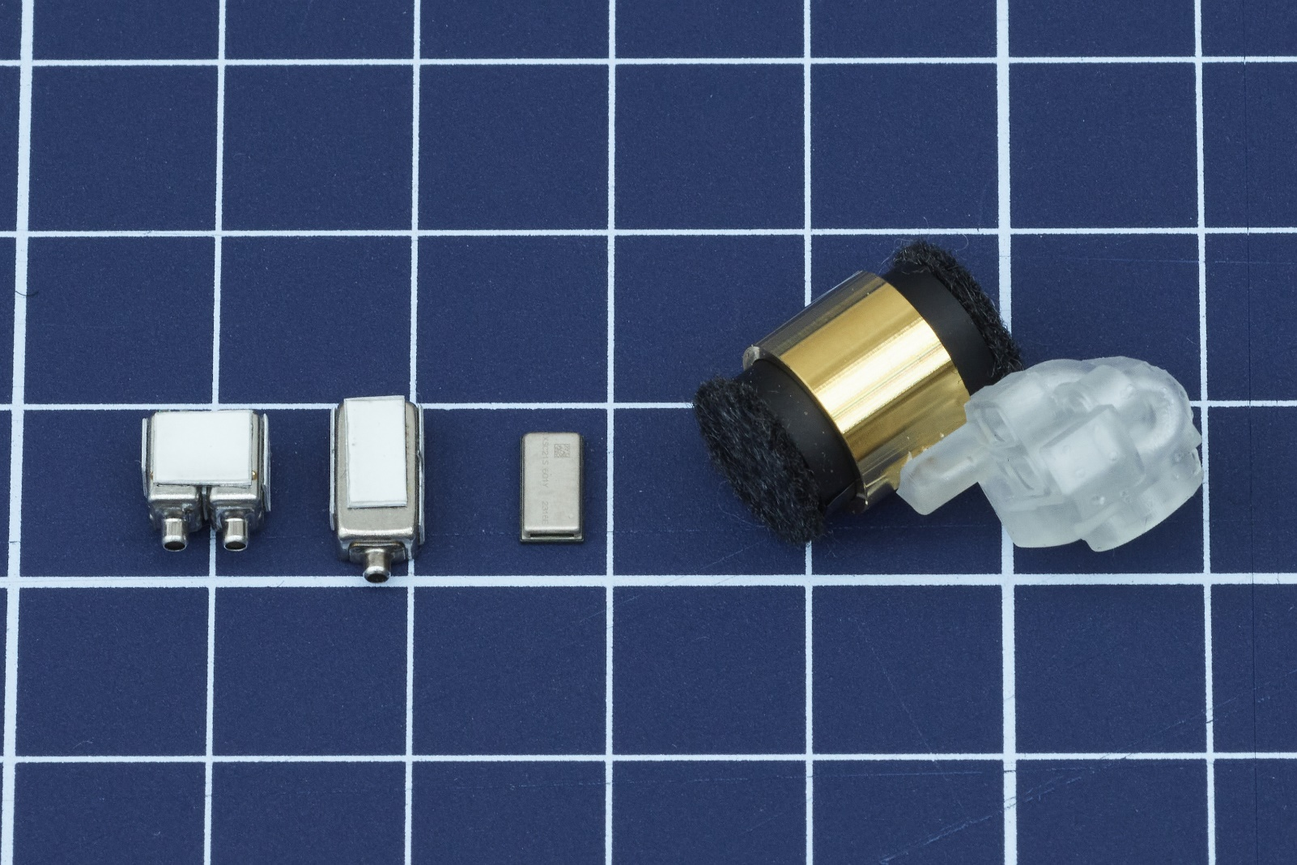
Features of Earphones
Optimal Drivers Selection for Band Splitting
By splitting into 5-band with choosing their optimal drivers
achieved harmonious and brilliant sound in whole range.
Low Range: Face-to-face arranged 2 LCP diaphragm dynamic drivers
Mid-low Range : Single BA made by Sonion
Mid Range : Dual BA by Knowles
High Range : Dual BA by Knowles
Ultra High Range : Small, wide-band, fast response MEMS
Notes:
Next, we will move on to the inside of the earphone.
Based on our experience in the development and manufacture of custom IEMs and universal IEMs, we have determined that a 5-way band division with excellent balance in terms of implementation scale and ease of creating good characteristics is optimal.
The low range uses a Φ8mm dynamic driver with an LCP (liquid crystal polymer) diaphragm.
We ordered samples from the driver vendor and compared listening tests of several types of drivers, including PET diaphragms and PEEK PU diaphragms,
we decided to use it because the sound of this driver was good.
The two dynamic drivers are fixed facing each other in an OFC ring.
By arranging them opposite each other, we were able to cancel out any unwanted vibrations caused by the diaphragm's movement, and by distributing the load between the two drivers, we were able to achieve a low-distortion, responsive, and rich bass.
In addition, the surface of this OFC ring has been gold-plated to protect it and keep it smooth.
(After trying several different types of rings, such as plastic, aluminum and titanium rings, the OFC ring was found to be the best in terms of sound quality.)
It has a single BA made by Sonion in the mid-to-low range, and a Knowles dual BA in the mid-to-high range, for a total of 5 BA drivers.
We had used these standard drivers before, but when we tried them out in this new multi-way system,
we were able to extract a sound that was even more connected and smooth than before, so we decided to use it.
For the ultra-high range, we have adopted a side-ported MEMS speaker made by xMEMS.
The high response of the piezoelectric system and its wide-band playback characteristics enhance the sense of air, subtlety and sound realism.
(This uses the inverse piezoelectric effect, in which the piezoelectric membrane deforms when voltage is applied, and the sound is produced by vibrating the piezoelectric membrane itself, which is manufactured from a silicon wafer.
Compared to DD and BA, which drive the diaphragm using electromagnetic induction from a coil,
(it is small, highly responsive, and requires no assembly of mechanical parts, so there is very little variation).

Slide 12
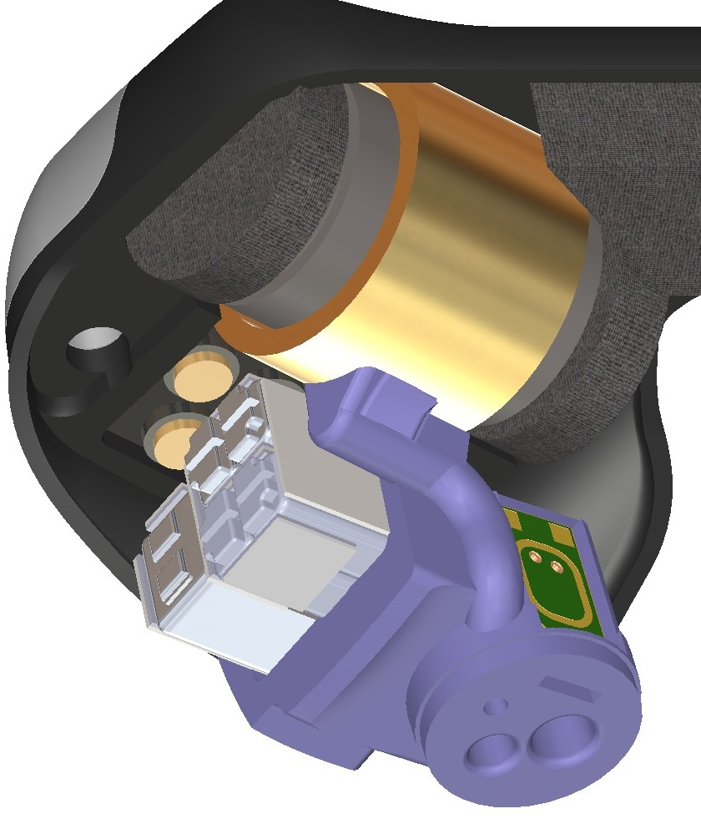
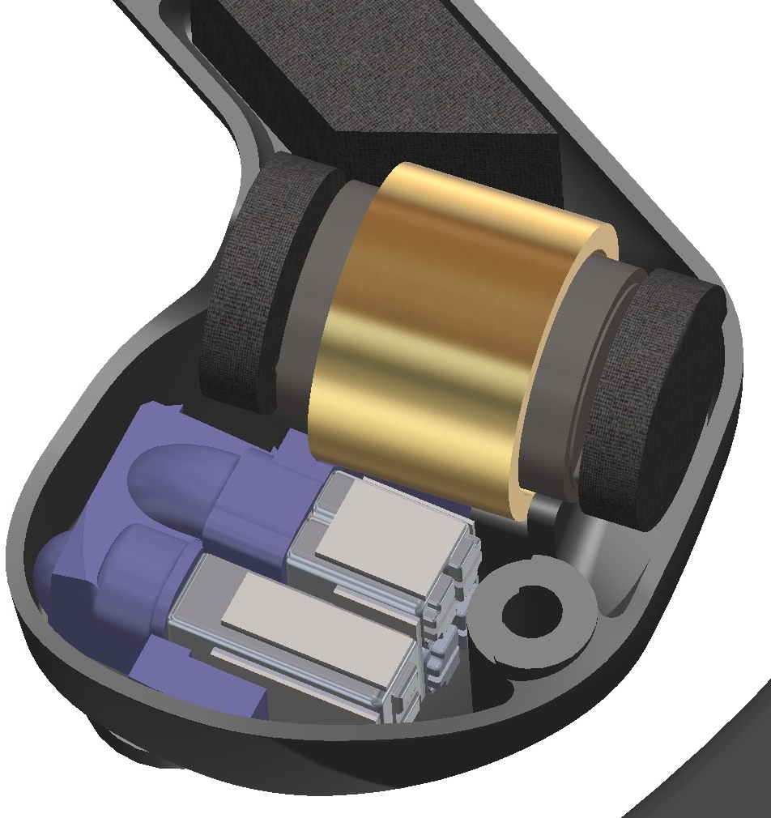
Features of Earphones
Layout for Perfect Frequency Response
OFC gold plated ring
and dynamic driver
Sound guide made by 3D printer
compacted with unit holder.
High range driver is near to the port.
2 dynamic drivers with OFC gold plated ring arranged face-to-face.
Sound emitted by dynamic driver and BA from backside are absorbed.
Absorber
Driver
Holder
MEMS
BA
Notes:
Each driver is fixed in a 3D-printed driver unit holder with an integrated sound guide, and then assembled into the casing.
This is the part that is colored purple in the diagram.
The sound that comes out of this is combined into a single sound at the stem of the titanium housing to create the final sound,
the design of this unit holder and stem section aligns the phase of each driver, resonates the sound, and adjusts the position of the peaks and dips to create the sound that forms the basis for sound creation using an active crossover.
It is one of the key components that makes FUGAKU's three-dimensional sound possible, and we went through a lot of trial and error to get it right.
Because the MEMS speaker is small and thin, it was easy to ensure that there was enough space for the sound ducts of other frequencies even when it was placed near the exit, allowing for optimal routing.
In addition, the OFC ring that holds the two dynamic drivers is also connected to the sound guide of the unit holder's fine-tube low-pass filter structure.
In addition, sound-absorbing material is placed on the back of each dynamic driver and inside the arm-like protrusion where the ear-hanger is attached.
By absorbing and damping the sound emitted from the rear ports of the dynamic drivers and the rear vents of some BA drivers, which then reverberate inside the housing,
and suppressed the impact that this sound has on the diaphragm's operation.
This improves the clarity of the low range.
This concludes the explanation of the earphone section.
I will now hand over to Kurokawa, who is in charge of the design of the portable amplifier, to explain it.

Slide 13
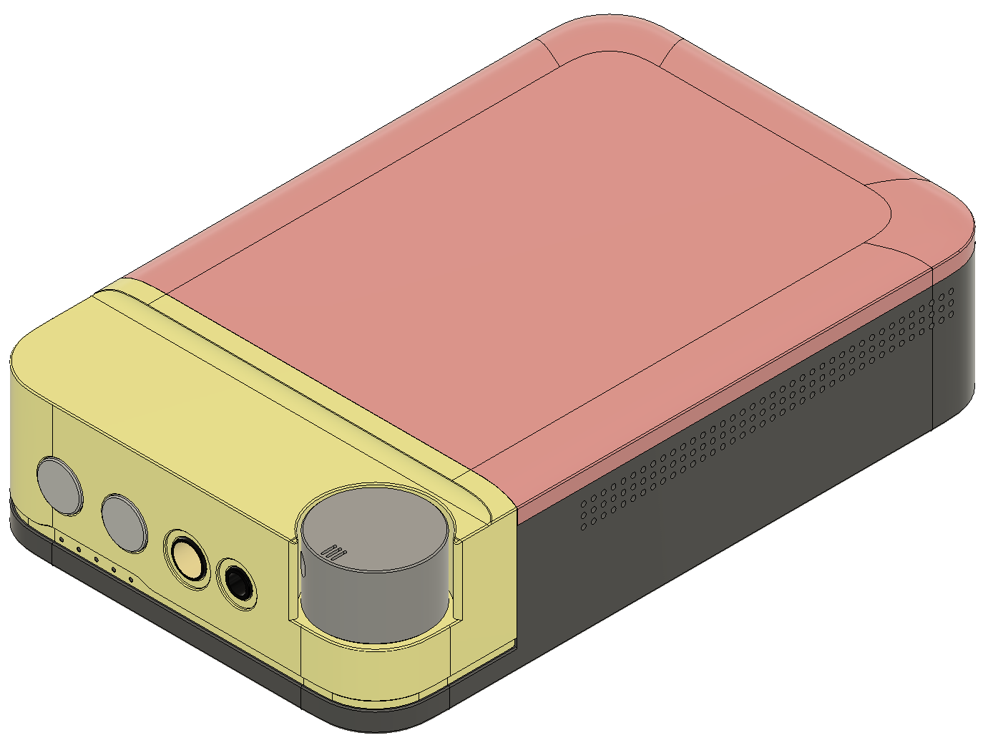
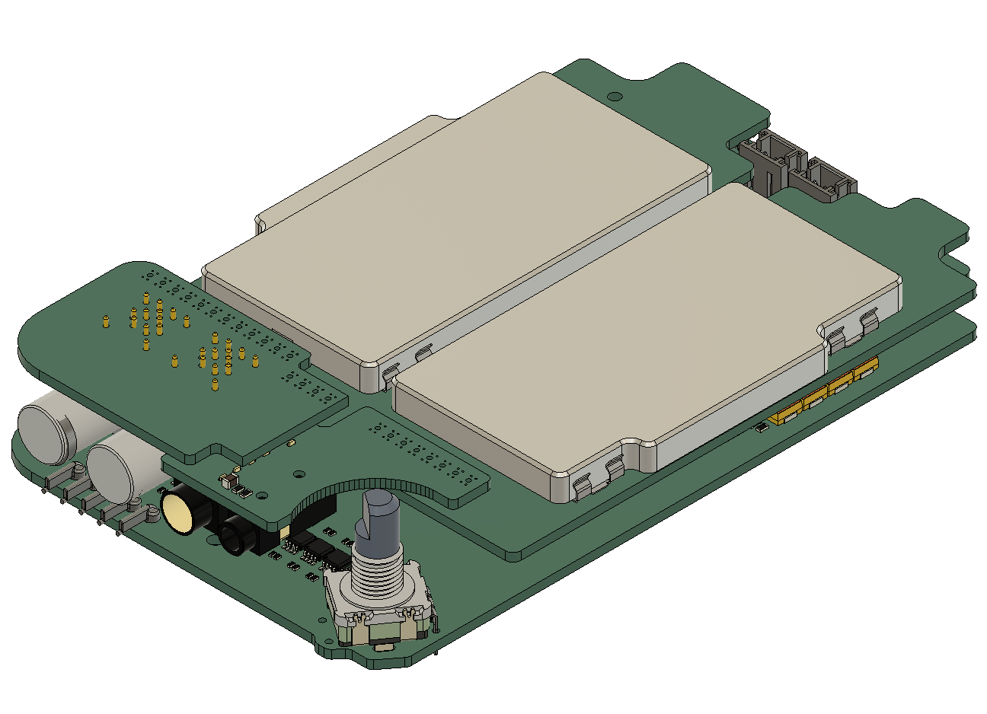
Features of Dedicated Portable Amplifier
Forged carbon and Aluminum machined top cover.
Chassis assembled by 3 parts and volume knob.
Miss-operation prevention arrangement.
Main PCB are stacked.
Terminal PCB and Main PCB connected by
pure silver cable
L/R Separated heat-sinks are also shield case.
Notes:
I will now explain the dedicated portable amplifier.
First of all, the exterior is made up of three parts and a volume knob, as shown in the diagram on the left.
The reason the casing is divided into different colors is to make it easier to understand.
The top panel is made of forged carbon with a random pattern, while the rest of the casing is made of machined aluminum.
Forged carbon is a carbon material with a pattern that differs from twill weave and plain weave, and is used in supercars and other vehicles in recent years.
We have improved the volume position, which was a problem with Tsuranagi, and by placing it on a corner, there are no protruding parts, and the knob surface is flat, making it a design that is difficult to operate by mistake.
In addition, the design ensures that the screws are not visible from any angle other than the bottom, so we have also paid attention to the appearance.
Next, the internal structure is a high-density mounting, as the goal was to fit it into the TSURANAGI size.
The main circuit board is two stories high, with the sub terminal board located on the third and fourth floors.
The second floor and the terminal board are wired together, and the same pure silver wire is used as in the dedicated cable.
The method of connecting the main board and terminal board with wiring is inherited from Tsuranagi, but the intention behind this is to prevent mechanical stress from being applied to the terminals.
If everything is fixed rigidly, stress will be applied to the soldered parts of the terminals, and cracks will form in the solder during use, causing poor contact.
In fact, there has never been a case of poor contact at the terminals in TSURANAGI.
The second-floor board has a heat sink and shield case, and the sides of the shield case are thermally bonded to the aluminum chassis with silicone rubber to effectively dissipate heat.
There is a flat area on the second-floor board where there are no components, and this is thermally coupled to the back of the shield case using silicone rubber.

Slide 14
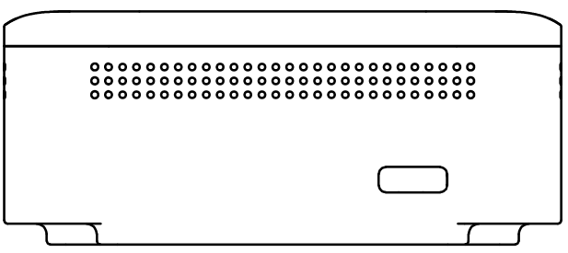
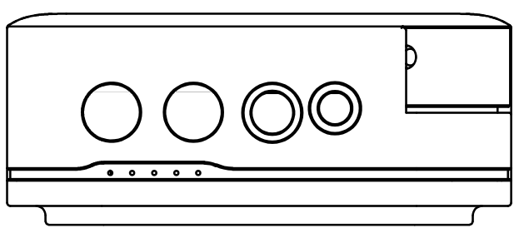
Features of Dedicated Portable Amplifier
127
33
Ultrasuede®
(Bottom Only)
Charge Connector
USB Type-C
80
Lch
Output
Rch
Output
4.4mm
Input
3.5mm
Input
Volume with Power Switch(Push-able)
Notes:
The external dimensions are as shown in the diagram on the right.
Compared to Tsuranagi, it is 3mm thicker and 5mm shorter in the length direction due to the removal of the protruding part, making it more compact in terms of circuit scale.
On the front, there is an unbalanced input 3.5mm from the right, a balanced input 4.4mm from the right, Rch output, and Lch output.
On the back, there is only a USB Type-C charging terminal.
When viewed from above, the volume is located at the corner, and the power can be turned on and off by pressing and holding the button.
Only the bottom surface is covered with Toray's Ultrasuede to prevent scratches.
There are small holes on the side, but these are for heat dissipation.

Slide 15
Features of Dedicated Portable Amplifier
Power Supply：Totally Separation for Interference Immunity
2-way
2-way
Battery
Bulk
Capacitors
Dual Supply
Bulk
Capacitors
Linear
Regulators
Bulk
Capacitors
Power Amplifier
2-way
Linear
Regulators
Bulk
Capacitors
Active Crossovers
2-way
2-way
Dual Supply
Bulk
Capacitors
Linear
Regulators
Bulk
Capacitors
Diff. Line Receiver
E-Volume Control
1-way
Linear
Regulators
MEMS
Bias Generator
7-way per channel
Notes:
From here, I will explain the internal structure of the amplifier in a little more detail.
First of all, the power supply circuit has 7 channels on each side, making a total of 14 channels.
The battery voltage is boosted and inverted by the dual power generation circuit, and a linear power supply circuit is used in the later stages to supply the amplifier with a clean power supply that has had the noise removed.
The dual power generation circuit is divided into two parts: one for low voltage and high current, and one for high voltage and low current.
This is because the electronic volume requires high voltage operation of ±10V or more, so it is set up separately.
If everything were to operate at high voltage, power consumption would be much higher, reducing the amount of time the device could be used and causing the amount of heat generated to become unrealistic, so this is the configuration we have adopted.
In addition, the linear power supply circuit uses a super high-performance linear regulator that can even eliminate high-frequency noise, which was also used in Tsuranagi.
Since a total of 14 of these are required, the cost inevitably increased...
The reason we have a linear regulator for each block of the amplifier circuit is to prevent interference between circuits and to improve the sense of separation and resolution in the sound.
Large capacitors are placed in various locations to prevent the power supply from fluctuating as it flows from upstream to downstream.
Also, because it was not possible to fit a relay into the amplifier output for protection due to space constraints, it was necessary to use a different method for protection.
In the FUGAKU amplifier, the protection circuit is a system that turns off the linear regulator and short-circuits to GND in order to discharge the charge in the large-capacity capacitor.
By shorting the power supply to GND the moment the power is turned off, the amplifier outputs a signal based on the power supply voltage, so if the power supply goes to zero, the output will also go to zero.
The protection circuit is activated when the power is turned off normally, when DC leaks from the amplifier, when the power circuit malfunctions, or when the inside of the amplifier becomes extremely hot.
This protective circuit allows protection to be achieved without the use of relays, making it possible to create a palm-sized amplifier.
In addition to this, the absence of a relay in the amplifier's output means that the output impedance is low, allowing direct drive of the earphones.

Slide 16
Features of Dedicated Portable Amplifier
Amplifier Structure：Low Noise & Distortion Fully Maintained
Trimmable
Low-pass
Filter
Diff. Line
Receiver
E-Volume
Control
Buffer Amplifier
Crossovers
Power Amplifiers
DC Bias Circuit
Differential Line Receiver New design with less distortion and residual noise 1/5 less than TSURANAGI
E-Volume Control Upgrade from MUSES72320 to MUSES72323
Buffer Amplifier To avoid E-volume driving low impedance crossovers buffer are pre-positioned.
Crossover Thin-film resistors, Film capacitor, opamp based high-order filters.
Power Amplifier(DD) Convert to differential signal. Fully differential amplifiers and current feedback amplifier (Similar to TSURANAGI with extra)
Power Amplifier(except DD) Voltage feedback amplifier (New design)
DC Bias Circuit Dedicated MEMS bias power supply using low noise linear regulation.
Notes:
Next, we will explain the amplifier section.
The bass is a development of the Tsuranagi model, with the addition of a crossover and other improvements.
The first improvement is that we have added a low-pass filter to the first stage.
In the Tsuranagi, the final stage power amplifier also acted as a low-pass filter, but by bringing it to the first stage, we were able to reduce noise overall.
In addition, the removal of the band-limiting power amplifier has also contributed to improved responsiveness when driving headphones.
The capacitor used in this low-pass filter is a special X2Y capacitor, which is a well-matched combination of two capacitors specialized for processing balanced signals.
Although I've omitted it, there is an IC that switches between unbalanced and balanced inputs in front of the low-pass filter, so that all signals are input to the low-pass filter as balanced signals.
This structure is the same as that of Tsuranagi, but instead of a toggle switch, a very low-resistance, low-distortion semiconductor switch is used, and together with the terminal insertion/removal detection function, it has a function that automatically selects the input terminal.
The differential line receiver is also a new circuit that differs from TSURANAGI, and it has been made more high-performance by splitting the single IC into two ICs.
As a result, the residual noise here is less than 1/5.
The electronic volume has also been upgraded to the MUSES72323 made by New Japan Radio. As a result, I feel that the sense of air and freshness required for high-end equipment has improved.
In addition, the volume steps have been halved from 0.5dB to 0.25dB, making it possible to make more detailed volume adjustments.
The buffer amp is an OPAMP with a JFET input, and the crossover circuit has a large capacity capacitor that drives it well, minimizing distortion by minimizing the current output by the electronic volume.
The power amplifier has a different configuration for the dynamic driver and the rest. In addition, a DC bias circuit has been added to the power amplifier that drives the MEMS driver.
First, the power amplifier that drives the dynamic driver has a circuit that combines a fully differential amplifier and a current feedback amplifier, converting it to a balanced signal while driving it, in a configuration similar to that of TSURANAGI.
What makes it more than just the sum of its parts is that we have reviewed the components used and improved the drive force by reducing the output impedance.
The power amplifier for the dynamic driver uses a completely new circuit and a voltage feedback amplifier. This is also designed to drive headphones, and it has a high performance that is more than enough for earphones.
Although it is not shown in the diagram, a DC servo amplifier is also incorporated into the power amplifier other than the MEMS in FUGAKU in order to eliminate the AC coupling capacitor.
We have reviewed the component constants of the DC servo amplifier and further simplified the feedback method to the power amplifier, and have refined it to achieve low noise with a small number of components.
We have developed a low-noise original circuit based on a linear regulator for the DC bias circuit for MEMS, as shown in the block diagram of the power supply circuit above.
The power amplifier has a trimming function, which we will explain on the next page.

Slide 17
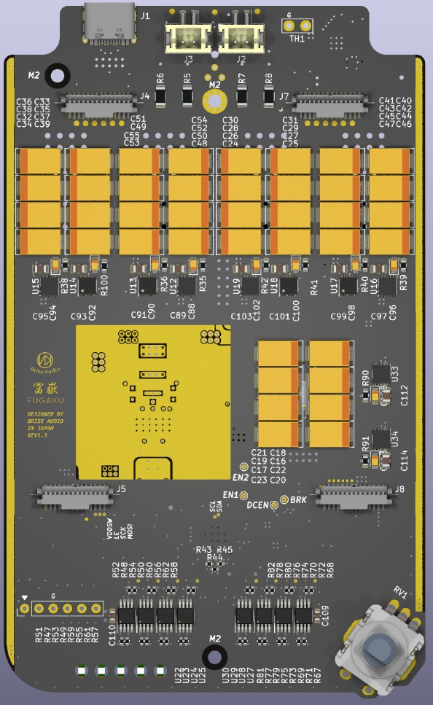
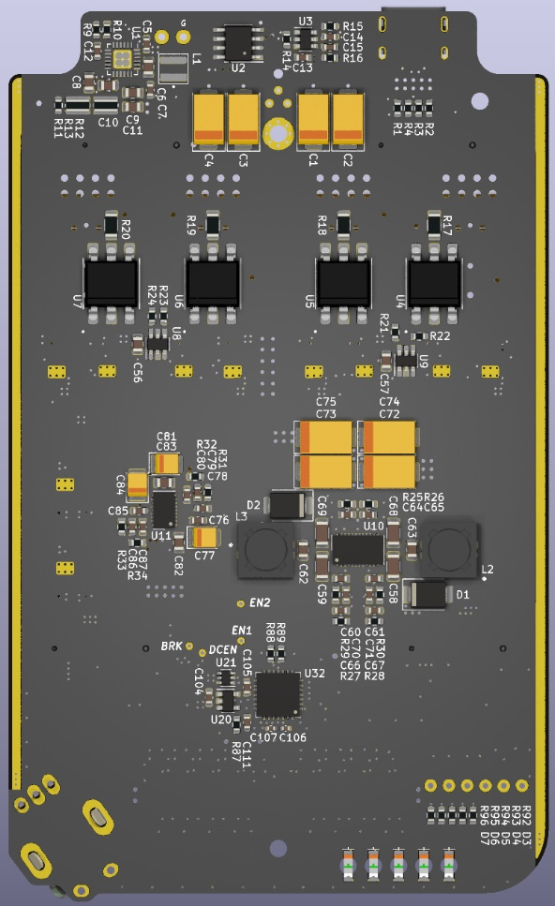
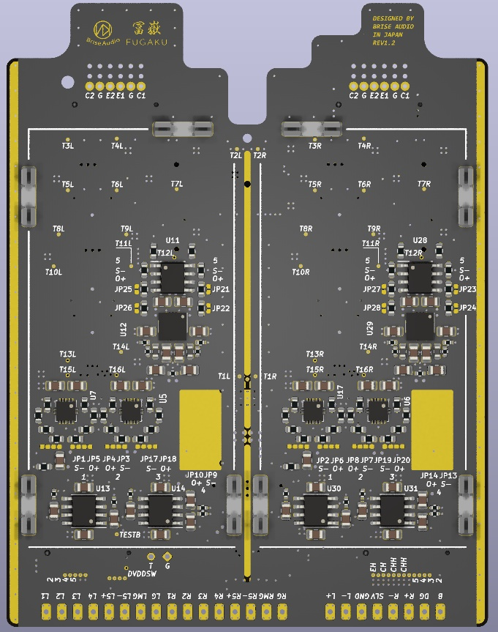
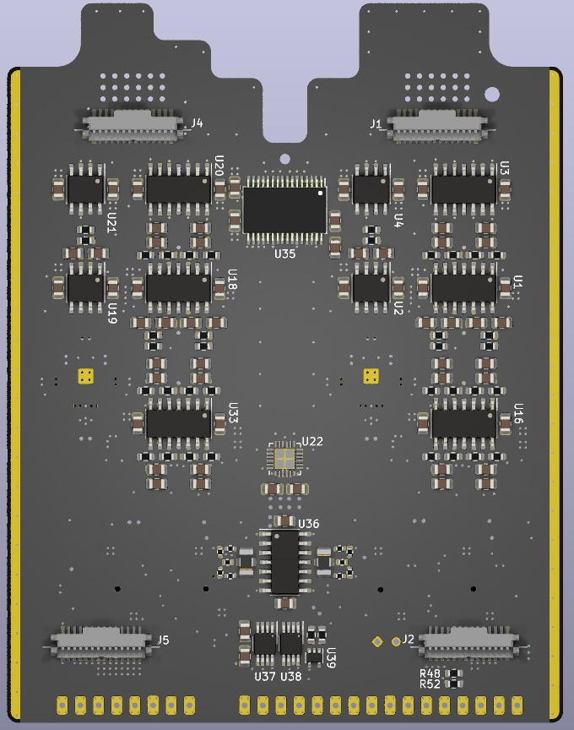
Features of Dedicated Portable Amplifier
PCB1 Top 4-layer 2oz Cu
Linear Power Supply
Volume Potentiometer
Bottom 4-layer 2oz Cu
Dual Power Supply
Battery Charger, MCU
Protection Circuit
PCB2 Top 8-layer 1oz Cu
Power Amplifiers
DC Servo
Shield Case
Bottom 8-layer 1oz Cu
Diff. Line Receiver
E-Volume Control
Crossovers
Notes:
Next, I will explain the layout of the circuit board.
As I explained earlier, the main board has a two-story structure, and the boards are connected by four terminals.
The first floor of the circuit board mainly contains the power supply circuit, charging circuit, protection circuit, and the microcontroller that controls them.
Because the power supply circuit is the main function, the copper foil is twice as thick as usual to reduce the resistance.
The power supply circuit has a total of over 3000uF of large-capacity capacitors mounted on it, and as much as possible. It is intended to have a low center of gravity for sound.
Both of the main circuit boards are double-sided, and the layout is designed so that there is no interference from noise or other sources through the airspace.
On the back of the first floor, there is a switch that short-circuits the GND of the power supply generation circuit, microcomputer, charging circuit, and protection circuit, which are sources of noise, so that noise does not get through to the amplifier circuit.
On the front of the first floor, there are a volume control, linear regulator, large-capacity capacitor, and comparator for the protection circuit, making up the analog circuit.
Similar to Tsuranagi, the AD converter and volume with a built-in microcontroller detect the position of the knob and send a control signal to the electronic volume. The sound signal does not pass through the volume that is turned by hand.
The yellow rectangular capacitor is actually not a tantalum capacitor, but a high-performance conductive polymer capacitor.
On the second floor, only the power amplifier is mounted, and a shielded case that also serves as a heat sink is mounted because the amplifier circuit generates relatively large amounts of heat.
On the back of the second floor, there is a circuit from the semiconductor switch to the crossover, so the functions are clearly divided between the front and back.
The second floor circuit board is an 8-layer board, which is the first time it has been used, and it has 4 layers allocated to different functions on the front and back, making it a structure that improves low impedance and noise resistance.
Basically, the audio signal is routed to the inner layers, and the outer layers are shielded with GND, making the wiring less susceptible to external noise.
As with the Tsuranagi, the power supply and GND are laid out so that they do not have a common impedance, and the GND is concentrated into a single point, connected to the chassis ground with gold-plated screws.

Slide 18
Features of Dedicated Portable Amplifier
Sound Pressure Trimming: L/R Matching and Target Curve
Adjustable
Resistance Ratio
Trimming
Unit Sorting
Using existing sorting that increase in cost and
have limitation in matching rate.
Power
Amplifier
Trimming
FUGAKU have dedicated amplifier,
sound pressure can be trimmed with unit.
Efficiency difference of drivers are
compensated with attenuator.
→ Attenuation ratio trimmed by
setup-kit before shipping.
Earphones and Amplifier are associated
with serial numbers.
L/R and Target Curve Mismatch
within±10%(0.83dB)
Notes:
With conventional earphones, matching of left and right and adjustment of frequency characteristics are achieved by selecting the drivers, but this still results in increased costs and limits the degree of adjustment.
FUGAKU has a trimming function that ensures mass-produced products do not deviate from the target frequency characteristics.
As a result, we have achieved a mismatch of less than ±10% and ±0.83dB between the left and right channels and the target curve.
The power amplifier is configured as an inverting amplifier, as shown in the diagram on the right, and is a circuit that allows you to set the attenuation and amplification freely.
The frequency characteristics of earphone drivers vary depending on the type, but since efficiency also differs, it is necessary to adjust the overall level in each band so that they connect smoothly when combined.
The power amplifier is responsible for this level adjustment, and there is a function that allows fine-tuning of the driver level before shipping, which is the trimming function.
Before the drivers are incorporated into the earphones, the acoustic characteristics of each driver are measured individually, and the trimming method is decided based on the degree of variation.

Slide 19
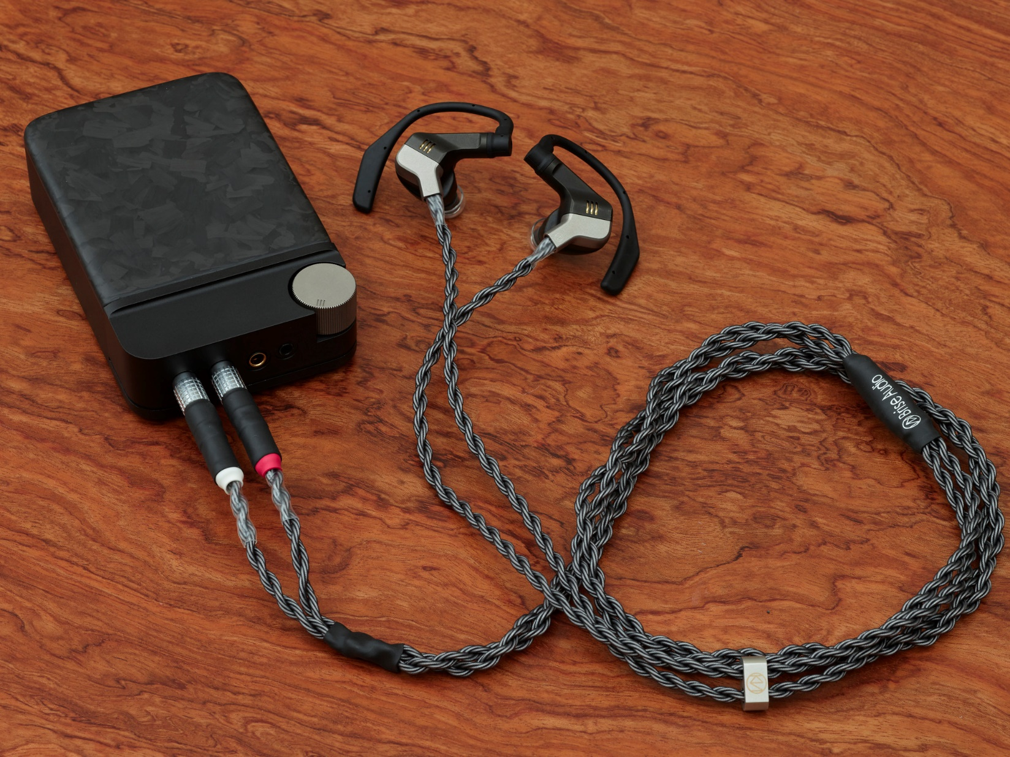
Features of Dedicated Cable
16-wire Pure Silver Cable Developed for FUGAKU
Wire Structure
8 wire per channel
DD(Hot/Cold) 2 cores
DD except Hot 4 cores
GND 2 cores
Terminal
Earphone side: Original using Pogopin & PCB
Amplifier side: 9-pin Push-Pull Connector
High Quality Production
Earphone side: Splitting Wire Ultimate Process
Amplifier side: Connector Ultimate Process
Notes:
Next, an explanation of the dedicated cable.
This cable is used to connect the amplifier to the earphones, and uses a new type of wire that differs from our SHIROGANE silver wire cable.
The material is the same, but the thickness of the wire per core has been reduced, and even when bundled into 16 cores, the cable still retains its practicality and has a sufficient total conductor capacity.
The reason why 16 cores are necessary is because it is necessary to connect the amplifier independently to the 5-way earphones,
two cores for the dynamic driver, which is balanced drive, four cores for the BA and MEMS hot, and two cores for the GND
. Although one core for GND would be fine, we decided to use 8 cores instead of 7 because it is more stable in terms of shape, and to separate the GND for the BA and MEMS to the earphone jack to prevent a muddy feeling.
In total, there are 8 cores on each side, making a total of 16 cores for the left and right.
In addition, the internal wiring of the earphones is made of pure silver litz wire. As there was no wire material that met our standards and was also easy to use as internal wiring,
we developed a new one for FUGAKU.
We created six different colors of sheathing for ease of assembly.
The amplifier side is also wired with a cable between the main board and the terminal board, but this also uses the same 16-core cable wire, and is made entirely of silver wire.
Using a large amount of silver wire was a challenge even in the development of SHIROGANE, as it not only brought out the best of silver but also its peculiar quirks,
the high-quality processing of the amplifier and the 16-core cable is of the Ultimate grade, specially tuned for FUGAKU.
I think there are some people who are not familiar with our high-quality processing, so I will explain. In cables, we place materials that absorb and shield electromagnetic waves, static electricity that is generated when the cable moves, and vibrations near the terminals and at branching points.
We have several types of materials, and the final sound adjustment is made by deciding which order to use them in and where to apply them, and this is what we call high-quality sound processing.
In amplifiers, these materials are attached to electronic components.

Slide 20
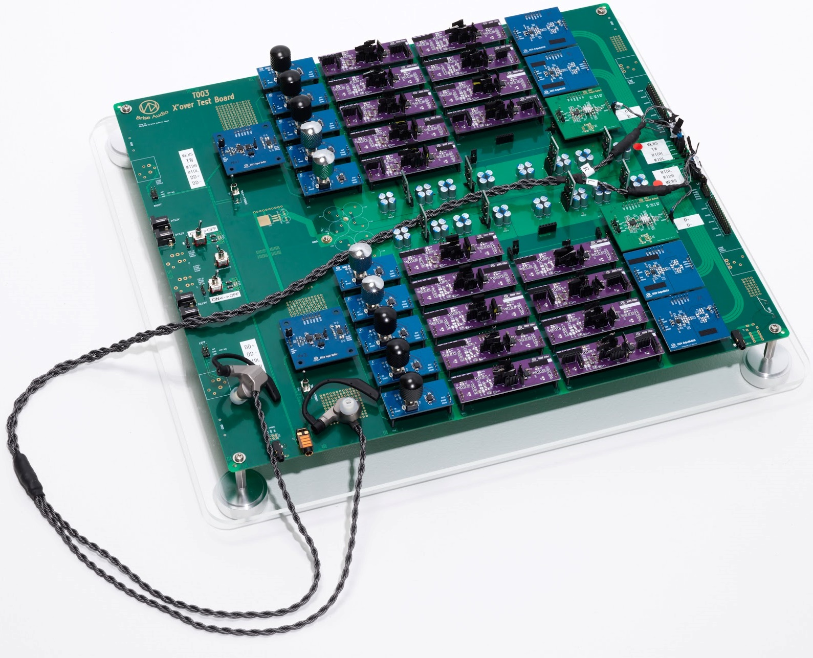
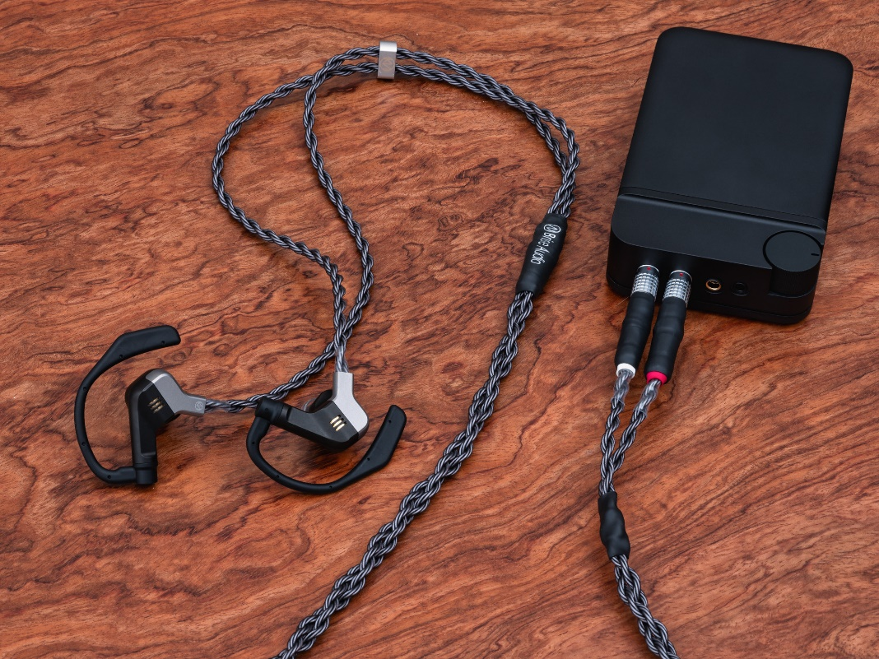
Epilogue
After
1 Year
Portability without compromising
Notes:
To conclude, FUGAKU is Bliss Audio's masterpiece, which took about a year from planning to the completion of the prototype, and then another year to complete the product.
Generally, the budget for a product is decided first, but Bliss Audio's products are developed in a special way where the product price is decided based on the cost after doing as much as possible to achieve a satisfactory quality.
The best example of this is FUGAKU, which ended up costing 2.5 million yen.
In terms of sound, even we who made them were surprised, and we believe that they have transcended the boundaries of conventional earphones, so we would like everyone to try them out.
In addition, we plan to continue to provide opportunities to try out our headphones, not just at this headphone festival, so we would be happy if you could drop by on those occasions.
This is the announcement of the new product from Bliss Audio. Thank you for listening.

