Slide 1
Quick start guide

Slide 2
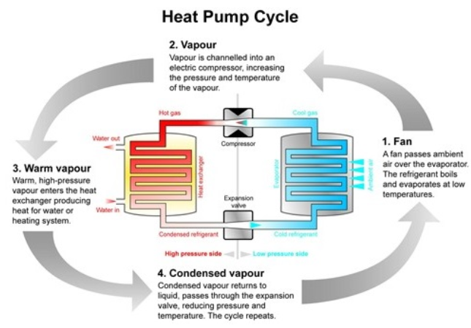
How the Heat pump works:
The Outdoor unit uses the energy from the outside ambient air and thanks to the refrigerant
process, this energy is increased at the right temperature to satisfy your heating and hot water
demands.

Slide 3
Your Heat Pump has been sized by your installer to fit your
Home. Forget how you were using your old oil/gas boiler!
The best way to use your system is to leave it on a constant
temperature and use a set back temperature of 3 degrees
maximum when you are away or at night time.
Running your heat pump longer on a lower temperature will keep
your home warm and it will save you money.

Slide 4
How to use the remote controller:
The remote controller can be installed close to the cylinder location or used as a room-stat. If a room-stat has been installed,
please refer to the manufacturer manual.
The installer must have commissioned the heat pump and “pre-set” the controller. Because each house is different, you may
need to fine tune the settings for optimum comfort and efficiency at the beginning. Once you’ve done this, you won’t have to alter any settings.

Slide 5
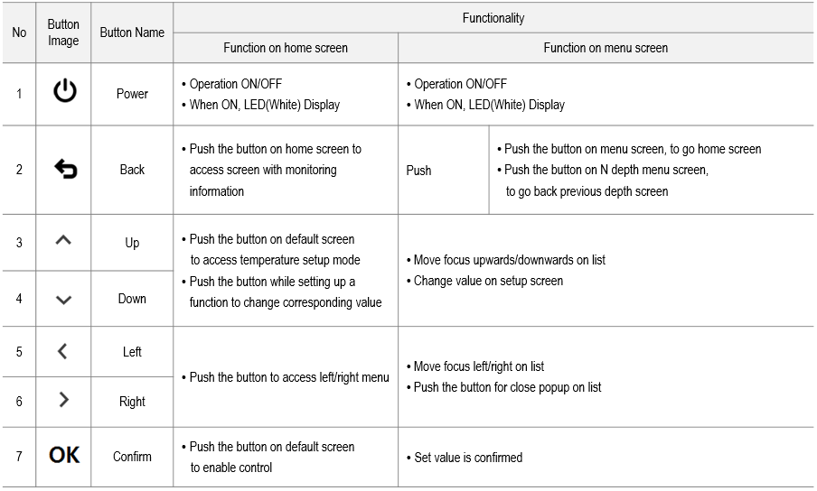
How to use the remote controller:
Display can be moved or configured with Power, Back, Direction and Confirm buttons

Slide 6
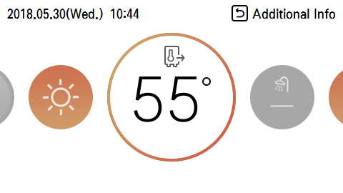
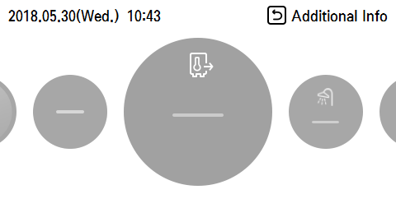
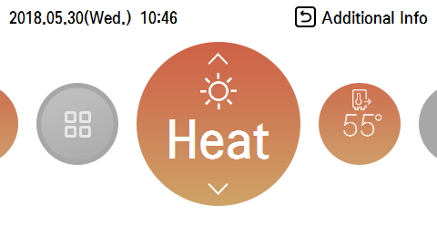
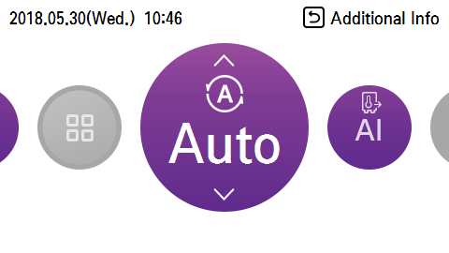
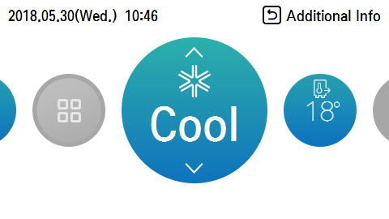
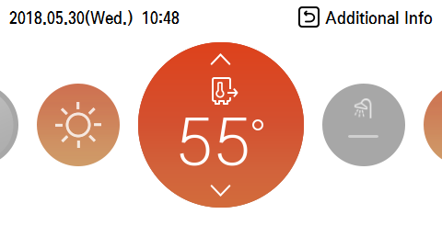
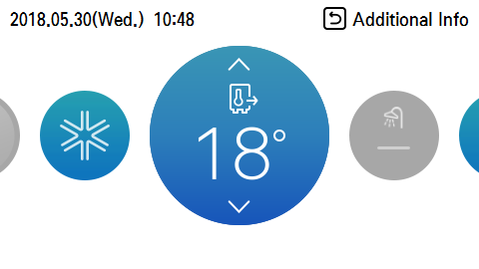
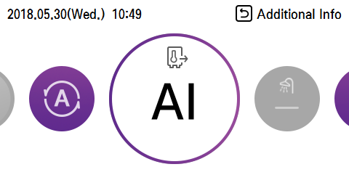
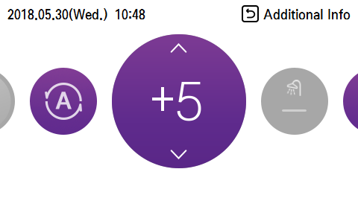
How to use the remote controller:
Heating/cooling On/Off
Select operation or stop with power button
Not available when Locked, Error and linked Thermostat
Operation Mode
Select operation mode with Heat, Auto Cool
If Heating Only is selected, Can not select Cool mode
In Operation on status, Can mode change
Not available when Locked
Target Temperature (if a room-stat has been installed, please refer to the manufacturer manual)
Setting target temperature of Heat and Cool mode
① Controlled by Leaving Water Temp.
- Monobloc R32 : Heating 15 ~ 65℃, Cooling 5 ~ 27℃
- Split 3 R410 : Heating 15 ~ 57℃, Cooling 5 ~ 25℃
② Controlled by Entering Water Temp. : Heating 15 ~ 55℃, Cooling 10 ~ 27℃
※ Supported only Monobloc R32 model
③ Controlled by Room Air Temp. : Heating 16 ~ 30℃, Cooling 16 ~ 30℃
※ Target temperature can be set up within the set range by installer setting
Auto Mode : -5 ~ 5℃

Slide 7
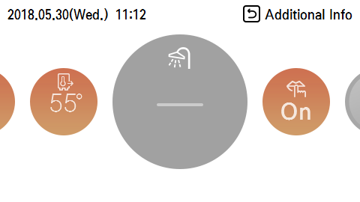
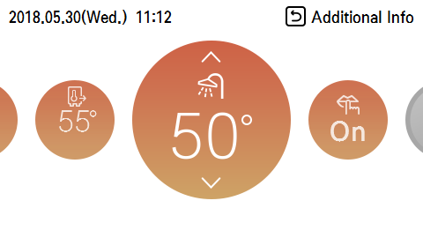
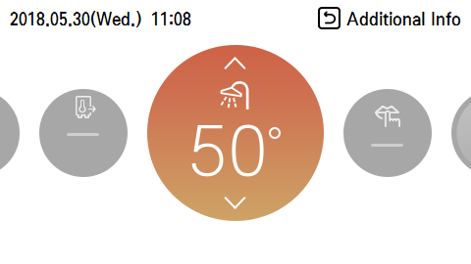
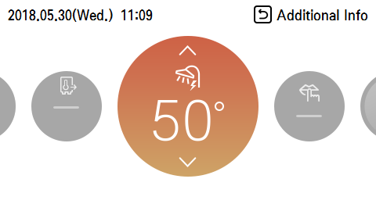
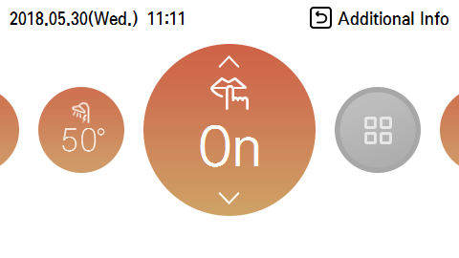
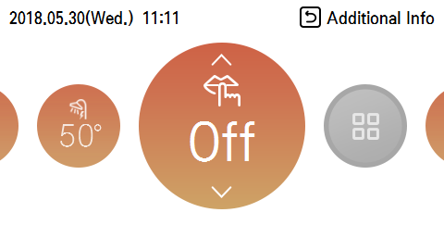
How to use the remote controller:
The recommended setting temperature for your hot water is between 48 and 52 degrees,
DHW Heating Enable/Disable
Select enable or disable by power button
※ Available only when DHW tank is installed and focus is set on DHW
Available when operation off status
Available emergency operation, When S/H-Trouble is occurred
Not available when Locked
DHW Heating Target Temperature
Controlled by Leaving Water Temp. : 30 ~ 80℃ (Not used DHW heater : 30 ~ 55℃)
Target temperature can be set When DHW is enable
(Does not matter Operation On/Off status)
Quick DHW Tank Heating On/Off
DHW heating by heat pump and DHW heater without delay time
※ Available When DHW tank and heater are installed and DHW Heating enable status
Push and hold Back button for 3 seconds with focus target temperature for DHW heating
Not available when Locked
Low Noise Mode On/Off
Select silent operation or stop
Not available when Locked and Emergency operation

Slide 8
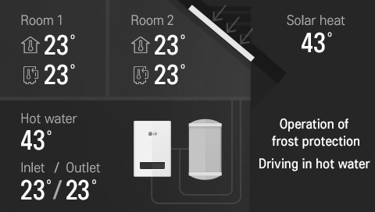
How to use the remote controller:
Information Display
Display temperature and operation status by Back button
- Temperature monitoring area
① Room Air temperature
② Inlet water temperature (Entering)
③ Outlet water temperature (Leaving)
④ Domestic how water tank temperature
⑤ Solar thermal temperature
- Operation information area
① During freeze prevention operation
② DHW heating, DHW heater operation
③ During sterilization operation
④ Low noise mode operation
⑤ SG Ready : Smart Grid Status (SGN, SG1, SG2, SG3)
⑥ Thermostat interlocking
⑦ Screed drying with remain date
⑧ Operation of the heater 1, Operation of the heater 2
⑨ Water pump in operation
⑩ Solar pump in operation
⑪ During operation of outdoor unit
Temperature monitoring area
Operation information area

Slide 9
Q and A :
- Why are my radiators not very hot?
A heat pump is a “low temperature” system. It means the radiators while never be hotter then 55 degrees C. The heat pump has been selected after evaluating the “heat loss” of your home. It means the heat pump will provide sufficient heat when the temperature is at its lowest outside, the rest of the year (i.e: in autumn and spring.) the heat pump will modulate its power and gives only the necessary heat.
Why the radiators temperature changes when the “Auto mode” is activated?
When the Heat pump is set on Auto mode, the controller monitors the outside air ambient temperature and adjusts the radiator temperature, when the weather turns cold, the radiators become warmer to keep the house at the same temperature.
Since I replaced my old oil boiler for a heat pump, my electricity bills increased?
The heat pump is using electricity, so it is important to make sure you have the best deal from your electricity supplier. Bare in mind for one kilowatt absorbed, the heat pump will produce up to 4.9 kilowatt.
When the weather is cold, I can regularly see steam out of my heat pump?
When the weather is cold, close to zero degrees, the evaporator gets very cold and the moisture in the air freezes it, so when the controller feel the needs for it, a defrost mode is engaged to melt the frost from the heat exchanger and becomes more efficient. At the end of the cycle, the fan(s) restart and blow away a plume of steam.
What can I do to keep my heat pump working efficiently?
You need to keep a good airflow around the outside unit, by keeping the area around it free from obstacles or debris which could get stuck on the evaporator.
You need to keep an eye on the heating system pressure (your installer would have showed you how to adjust the pressure)
The Heat pump doesn’t need any special care, once a year, it needs to be serviced by a specialist.

Slide 10
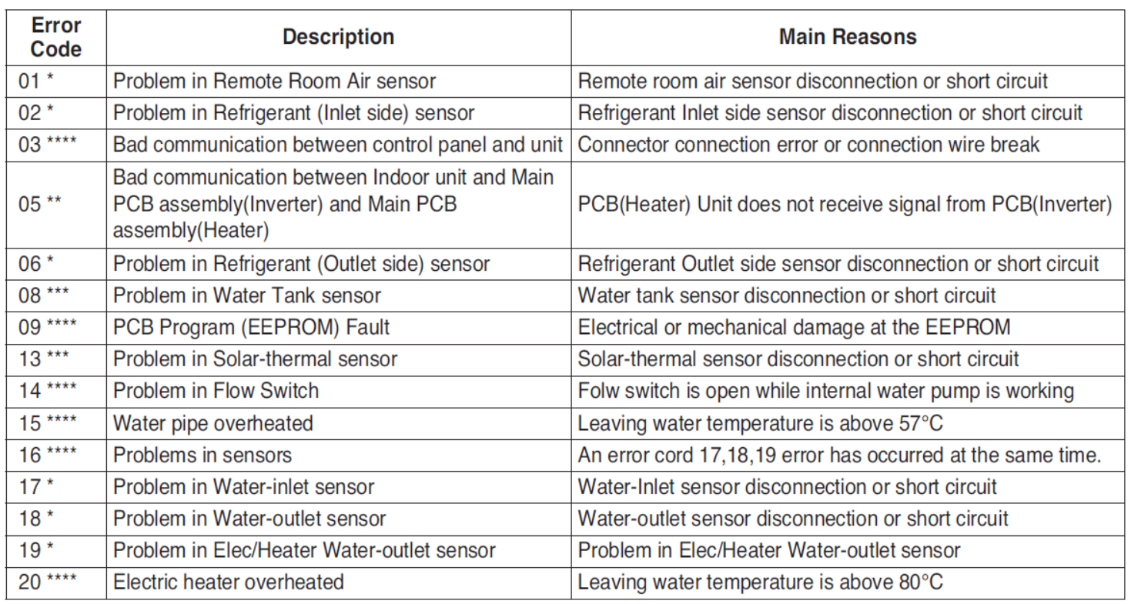
Troubleshooting :
- If an error occur, the controller will display an error code. If CH14 is displayed, please before calling your installer, check your heating system pressure.
You can also switch the power off for twenty second and power the unit back on, if the error message appears again then ring the installer or service partner
and give them the error code displayed on the controller’s screen.

