Slide 1
Data Integrity: A Global Regulatory Survey
With Emphasis on Excipients

Slide 2

Definition
Data integrity is “the extent to which all data are complete, consistent and accurate throughout the data lifecycle.”*
Applies to both electronic and paper records
*MHRA GMP Data Integrity Definitions and Guidance for Industry, March 2015

Slide 3

Importance of Data Integrity
Documentary evidence relies on data integrity
Lack of data integrity is a serious cGMP finding
Receiving increased regulatory emphasis

Slide 4
Statutory Requirements
Food, Drug, and Cosmetic Act
  Components of drugs and drug products are drugs [section 201(g)(1)(d)]
  Drugs (components and drug products) must be manufactured in conformance with current good manufacturing practice [section 501(a)(2)(B)]
  A drug whose name appears in an official compendium, must meet the standards set forth in the official compendium [section 501(b)]

Slide 5
What two classes of chemicals are used to make just about every drug?
Every drug must have an active pharmaceutical ingredient (API)
Almost every drug has one or more “inactive” ingredients called excipients that provide functionality:
  Lubricants
  Colors
  Coatings
  Capsules
  Sweeteners
  Flavors
  Glidants, etc.

Slide 6

ALCOA
Per FDA guidance, data needs to be:
  Attributable
    Identity of person
  Legible
    Including permanent
  Contemporaneous
    Recorded at time of the task or measurement
  Original
    File or format, preserving the integrity
  Accurate
    Reliable

Slide 7
Finished Drug Product
Able Labs: 2005
  Paper records differed from electronic records in the chromatography system
  Massive record falsification
Leiner Health Products: 2007
  Data manipulation
  Inadequate test procedures
Ranbaxy Labs: 2008
  Falsified quality data

Slide 8
What were the consequences to these companies?
Consent Decree

Slide 9


API Data Integrity Issues: 2015
Improper practices:
  Deletion of incomplete tests
  Disabled computer audit trail
  Discarded chromatograms
  Deleted analytical results after retest
Inadequate computer security:
  Lack of unique user names
  Shared passwords
  Improper user access levels allowed:
    Data to be altered or deleted
    All technicians to release material

Slide 10

API Data Integrity Issues: 2015
Documentation deficiencies:
  Completion of production records days after the activity
  Destruction of original data after transcription
  Destruction of original data after retest
  Incomplete test records
  Improper invalidation of data
  Unauthorized changes to paper records
  Original data in the designated waste bin

Slide 11
Regulatory Guidance
FDA: Data Integrity and Compliance with Drug CGMP, Questions and Answers, December 2018
MHRA: GxP Data Integrity Guidance and Definitions, March 2018
EMA: Data integrity, August 2016
PIC/S: Good Practices for Data Management and Integrity in Regulated GMP/GDP Environments, August 2016
WHO: TRS 996, Annex 05, Guidance on good data and record management practices, 2016

Slide 12
Common Themes
Reinforce applicability to predicate rules
  No new requirements
Applies to drug products and active pharmaceutical ingredients
  Excipients not mentioned
Applies to both paper and electronic records
Paper forms should be controlled

Slide 13
Definitions
Data governance: sum total of arrangements that provide assurance of data integrity
Data lifecycle: refers to generation, processing, reporting, checking, use for decision-making, storage and discarding at the end of the data retention period
Metadata: contextual information required to understand data, e.g. units of measure

Slide 14
Definitions
Dynamic Record: a record, usually electronic, that allows for an interactive relationship between the user and the record content.
Static Record: a record, usually in paper or PDF format that is fixed, allowing little or no interaction between the user and the record content.

Slide 15
U.S. FDA

Slide 16

General
Reference: 21 CFR Part 211 and 212 (PET)
Purpose: role of data integrity in cGMP [section 501(a)(2)(B)]
Scope: all data generated to meet cGMP requirements
Principle: create quality culture where data integrity is core value

Slide 17
Applicable Data Integrity Requirements
§ 211.68: backup data are exact and complete and secure and computer output is checked for accuracy
§§ 211.100 and 211.160: activities must be documented at performance and lab controls are scientifically sound
§ 211.180: records are retained as originals or true copies

Slide 18
Applicable Data Integrity Requirements
§§ 211.188 and 211.194: complete information and test data, and records for all tests performed
§§ 211.22, 211.192, and 211.194(a): review of production and control records, and laboratory records are reviewed for accuracy, completeness, and compliance with standards
§§ 211.182, 211.186(a), 211.188(b)(11), and 211.194(a)(8): records are checked, verified, or reviewed

Slide 19

Organization
Question and answer format

Slide 20
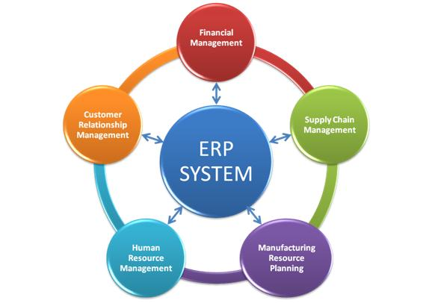
Overview
Validate computer system and each workflow
  Manufacturing Execution System (MES)
    Validate each work flow
  SAP
    Validate GMP workflows, e.g.,
      Maintenance,
      Inventory management
Restrict computer access
  Authorized individuals and their privileges are appropriate

Slide 21
Overview
Controlled issuance and reconciliation of blank forms
  Uniquely numbered forms
  Reconcile all forms; complete and incomplete
  Use bound paginated notebooks
Weight Verification: balance 3
Page 22 of 68

Slide 22

Overview
Review audit trail for changes to:
  History of test results
  Sample run sequences
  Sample identification
  Instrument critical processing parameters

Slide 23


Overview
Review audit trail of critical data
  Frequency based on criticality, control mechanisms, and product impact
Electronic copy OK when content and meaning of original are preserved
  Must include metadata
  Preserves the static or dynamic nature of original

Slide 24
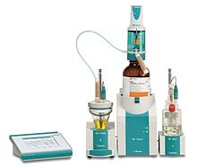
Overview
Static record: printed on paper, e.g. output from:
  Balance
  Karl Fisher
  pH meter

Slide 25
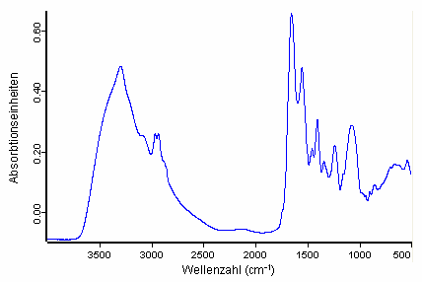
Overview
Dynamic record: retained in dynamic format
  E-File of Fourier Transform Infrared (FIR) spectra
  E-File of HPLC chromatogram

Slide 26

Overview
Retain all data; paper and electronic
  Scrap paper
  Printouts
Unacceptable to store electronic data in temporary memory
  Not covered by audit trail
Train personnel in data integrity
  Importance
  Common deficiencies

Slide 27
Medicines and Health products Regulatory Agency
MHRA: Great Britain

Slide 28
General
Reference: none
Scope: Chemical and pharmaceutical development lifecycle
Extensive glossary of terms

Slide 29
Organization
Emphasis on:
  Data criticality and inherent integrity risk
  System designed to assure data quality and integrity
Expanded definitions
  Unique to this guidance:
    Allowance for when data may be excluded
    Benefits of using a relational database
    Expectations for cloud and virtual service providers

Slide 30
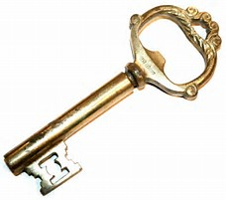
Overview
Key Principle: Effort and resources are commensurate with risk to patient or environment
  Documented system controls data integrity based upon risk
  Routinely review data
    Confirm integrity of each data set
  Periodically audit data integrity
    Schedule assessment
    Identify opportunities

Slide 31

Overview
Design systems to facilitate data integrity:
  Common clock for time at point of use
  Record data at point of use
  Control blank forms
  Reconciliation of controlled print-out
  User access control
  Scribes
Training
Retention
  Secured
  Validation of scanned documents

Slide 32

Overview
Computer system
  User access limited to functionality for job
  Single login, use:
    Third-party software, or
    Paper log for traceability
  System administrator must have no direct interest in data
  Maintain legacy software for retrieval
IT Services
  Understand the service provided

Slide 33

Overview
Audit Trail
  Software shows all changes to data, including for each data set:
    Identity of individual
    Time stamp
    Reason for the change
  User cannot switch off or alter
    Only Administrator
  Logbook for manual record
Periodic review assures integrity
  Review for each batch is not expected

Slide 34
European Medicines Agency
EMA

Slide 35
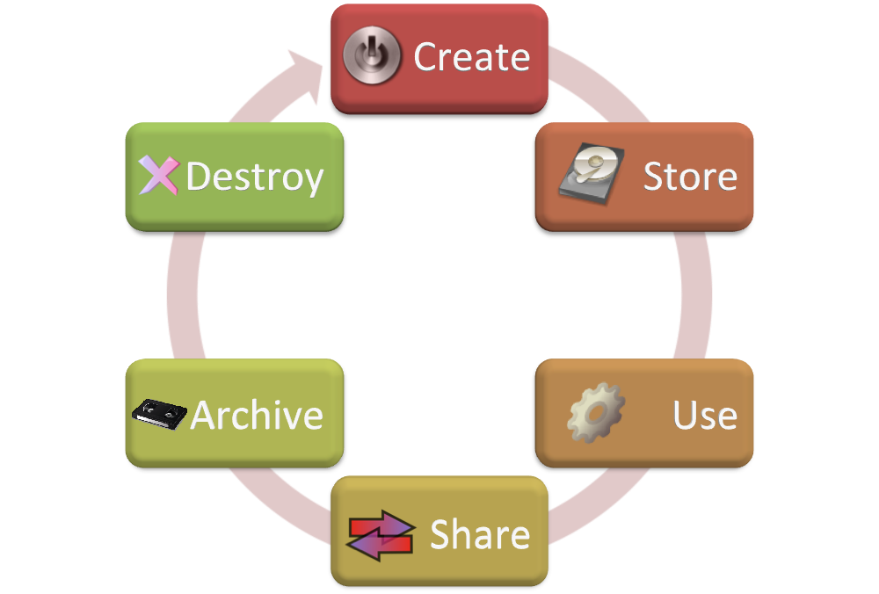
Organization
Question and answer format
Emphasis on:
  Data lifecycle issues
  Review of data
  Oversight of contract receivers
Table links ALCOA to EU Volume 4 for:
  Medicinal products
  Active substances
  Computerized systems

Slide 36
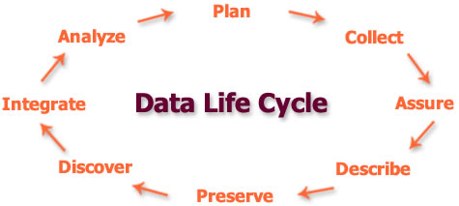
Overview
Data lifecycle
  Generation
  Processing
  Checking
  Reporting
  Use
  Storage
  Disposal

Slide 37
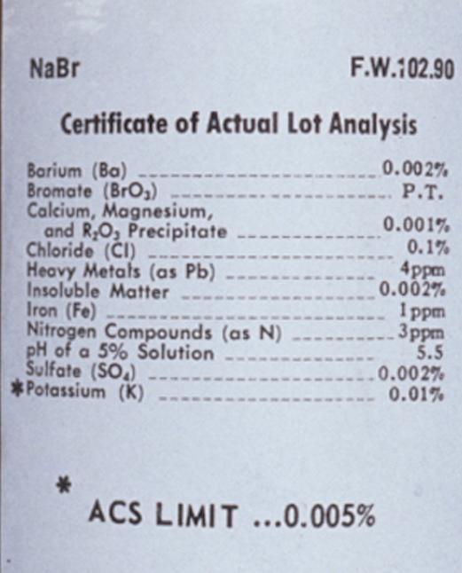
Overview
Supplier COA
  Systems and procedures
  Notification of significant change
    Assess change effectiveness
  Periodic on-site review (audit)
Calibration service provider
  Paper audit acceptable

Slide 38

Overview
Data lifecycle:
  Decision-making
    Only after data is in permanent memory
  Protected from loss or change
    Limited access
    Protection
    Backup
  Discarding
    Established retention period

Slide 39
Pharmaceutical Inspection Cooperation Scheme (PIC/S)
association of regulatory authorities

Slide 40
General
Reference: PIC/S GMP and GDP
Scope: Manufacturers and distributors of API & drug products, but “many principles regarding good data management practices…have applications for other areas of the regulated pharmaceutical and healthcare industry.”

Slide 41
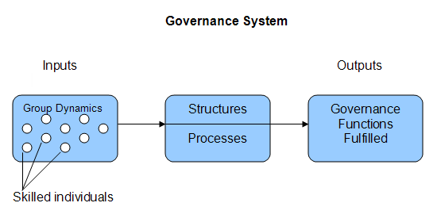
Overview
Major topics addressed:
  The data governance system requires ownership throughout data lifecycle and includes:
    SOPs
    Training
    Verification
    Risk management
    System review
  Computer system control
  Personnel empowerment

Slide 42
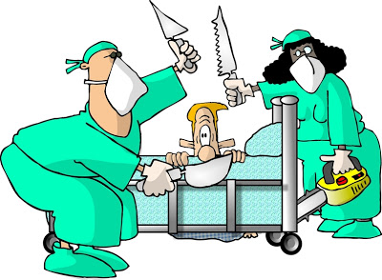
Overview
Data governance
  Efforts to minimize risk commensurate with the impact to product quality
    Data criticality
    Decision making
    Product quality impact
  Risk to data integrity

Slide 43

Overview
Major topics addressed:
  Organizational influences
    Open company culture
    Code of Conduct emphasizes honesty
    Quality culture; lead by example
    Periodic review of quality metrics
    Provide adequate resources
    Investigate data integrity issues
Principles and enablers
  Use science and risk-based approach
  Good documentation practices

Slide 44
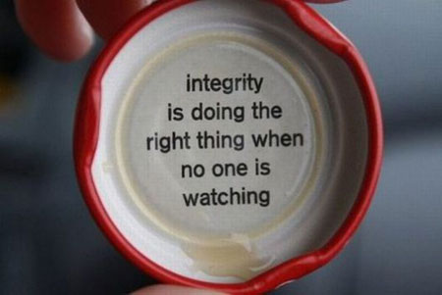
Organization
Major topics addressed:
  Paper systems
    Quality Management System structure
    Blank forms, templates and records

Slide 45

Organization
Major topics addressed:
  Data Integrity for outsourced activities
    Supply chain
    Document verification
  Regulatory actions
    ALCOA aligned to PIC/S GMP guide
    Classification of deficiencies
  Remediation of failures
    Responding
    Indicators of improvement
  Computer systems

Slide 46
Overview
Introduces ALCOA+
  Attributable
  Legible
  Contemporaneous
  Original
  Accurate
Plus
  Complete
    Record includes metadata
  Consistent
    Good Documentation Practices
  Enduring
    Protected and accessible
  Available
    Provided for review in readable format

Slide 47
World Health Organization
WHO

Slide 48

General
Reference list:
  WHO GMP-related publications
  FDA, MHRA, EMA, PIC/s and GAMP
Scope: Pharmaceutical quality systems for organizations performing work subject to GXP
  Expectations of Quality Management System to provide Quality risk management that ensures good data management

Slide 49

Overview
Introduction
  Key elements of responsibility:
    Realistic and achievable goals
    Monitor processes
    Allocate resources
    Quality culture fosters transparency
    Train personnel
    Designate responsible quality manager

Slide 50
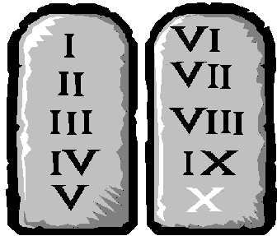
Organization
Major Topics
  Aims and Objectives
  Glossary
  Principles
    Good Document and Record Management Practices (GDRP)

Slide 51
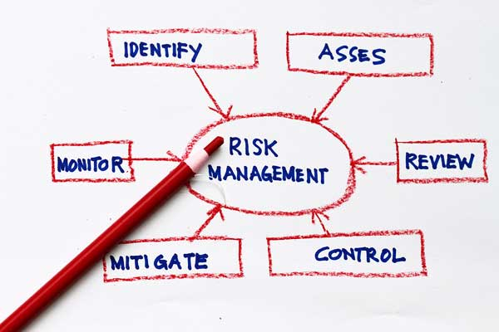
Organization
Quality risk management to ensure good data management
  Infrastructure
  Organization
  Policies and procedures
  Process and systems
  Prevention and detection

Slide 52

Organization
Appendix: Risk management for ALCOA in:
  Paper-based system
  Electronic system
    Example: paper original ➔ true copy
      SOP
      Training
      Review
      Audit
    and for the electronic copy:
      Equipment
      Verification against the original
      Protection

Slide 53



Summary
FDA
  Establishes expectations
  Computer system implications
MHRA
  Provides illustrations on meeting data integrity
EMA
  Emphasizes addressing elements of data lifecycle

Slide 54

Summary
PIC/S
  Interprets GMP requirements
  Offers risk-based control strategies using current industry practices
  Provides a basic overview
  Applies data integrity to paper records
  Provides suggestions for regulatory audit

Slide 55

Summary
WHO
  Comprehensive list of definitions
  Personnel to be trained and content of training
  Elements of the data lifecycle
  Establishes expectations for investigation
  Tabulates requirements for paper and electronic records
  List of additional regulatory references

Slide 56
Final Thought
Protect raw data in the format the data was originally developed:
  E.g., printout from electronic record is not the raw data, the electronic file is the raw data

Slide 57
Conclusion
Regulators are increasingly concerned that serious violations of data integrity impact verification of compliance to GMP
Operational and procedural control should be assured through:
  Audit
  Employee training
  Work simplification
  Company culture

Slide 58
Illustrations of Issues

Slide 59
Illustration 1
The batch record required 4 pages of the same form, each numbered. The form was printed from the ERP system as sequentially number pages.
Page 1 of
Page 3 of
Page 4 of
Page 5 of

Slide 60
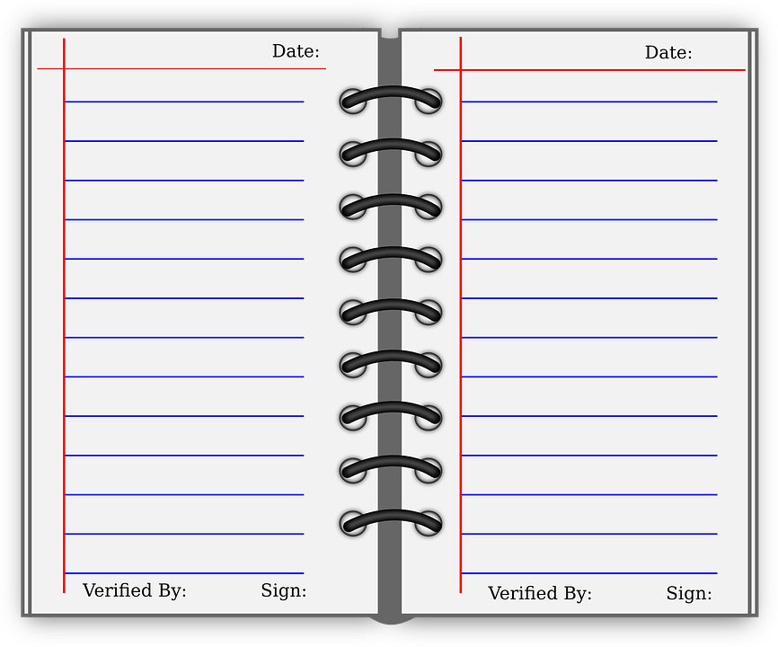
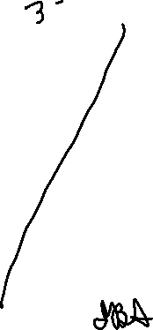
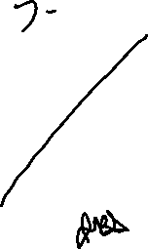
Illustration 2
These are the first two pages of a log.
Page 4 of 50
Page 5 of 50

Slide 61


Illustration 3
Employee training sign-in sheets for read and understand SOPs 10, 13, and 14
SOP 10 Date: 11/20/18
SOP 13 Date: 11/20/18
SOP 14 Date: 11/20/18
Printed name | Initials
Irwin Silverstein
John Doe
Tom Jones
Jay Patel
Printed name | Initials
Irwin Silverstein
John Doe
Tom Jones
Jay Patel
Printed name | Initials
Irwin Silverstein
John Doe
Tom Jones
Jay Patel

Slide 62
Illustration 4
The auditor noticed an obsolete form was being used in receiving. The corrective action was to issue blank forms from Document Control.
Receiving was instructed to get the form from Document Control.

Slide 63

Illustration 5: What is wrong with this form?
SOP 123 Receiving log Form 123-01
Date | Time | PO | Clean | Spillage | Odor | Infested | By
11/20/18 | 08:15 | 231098 | Y | N | N | N | BDS
11/20/18 | 10:15 | 232000 | Y | N | N | N | HTS

Slide 64
Thank you for your attention
Irwin Silverstein
IBS Consulting in Quality LLC
(732) 319-6481
Irwin.sil@aol.com

