Slide 1

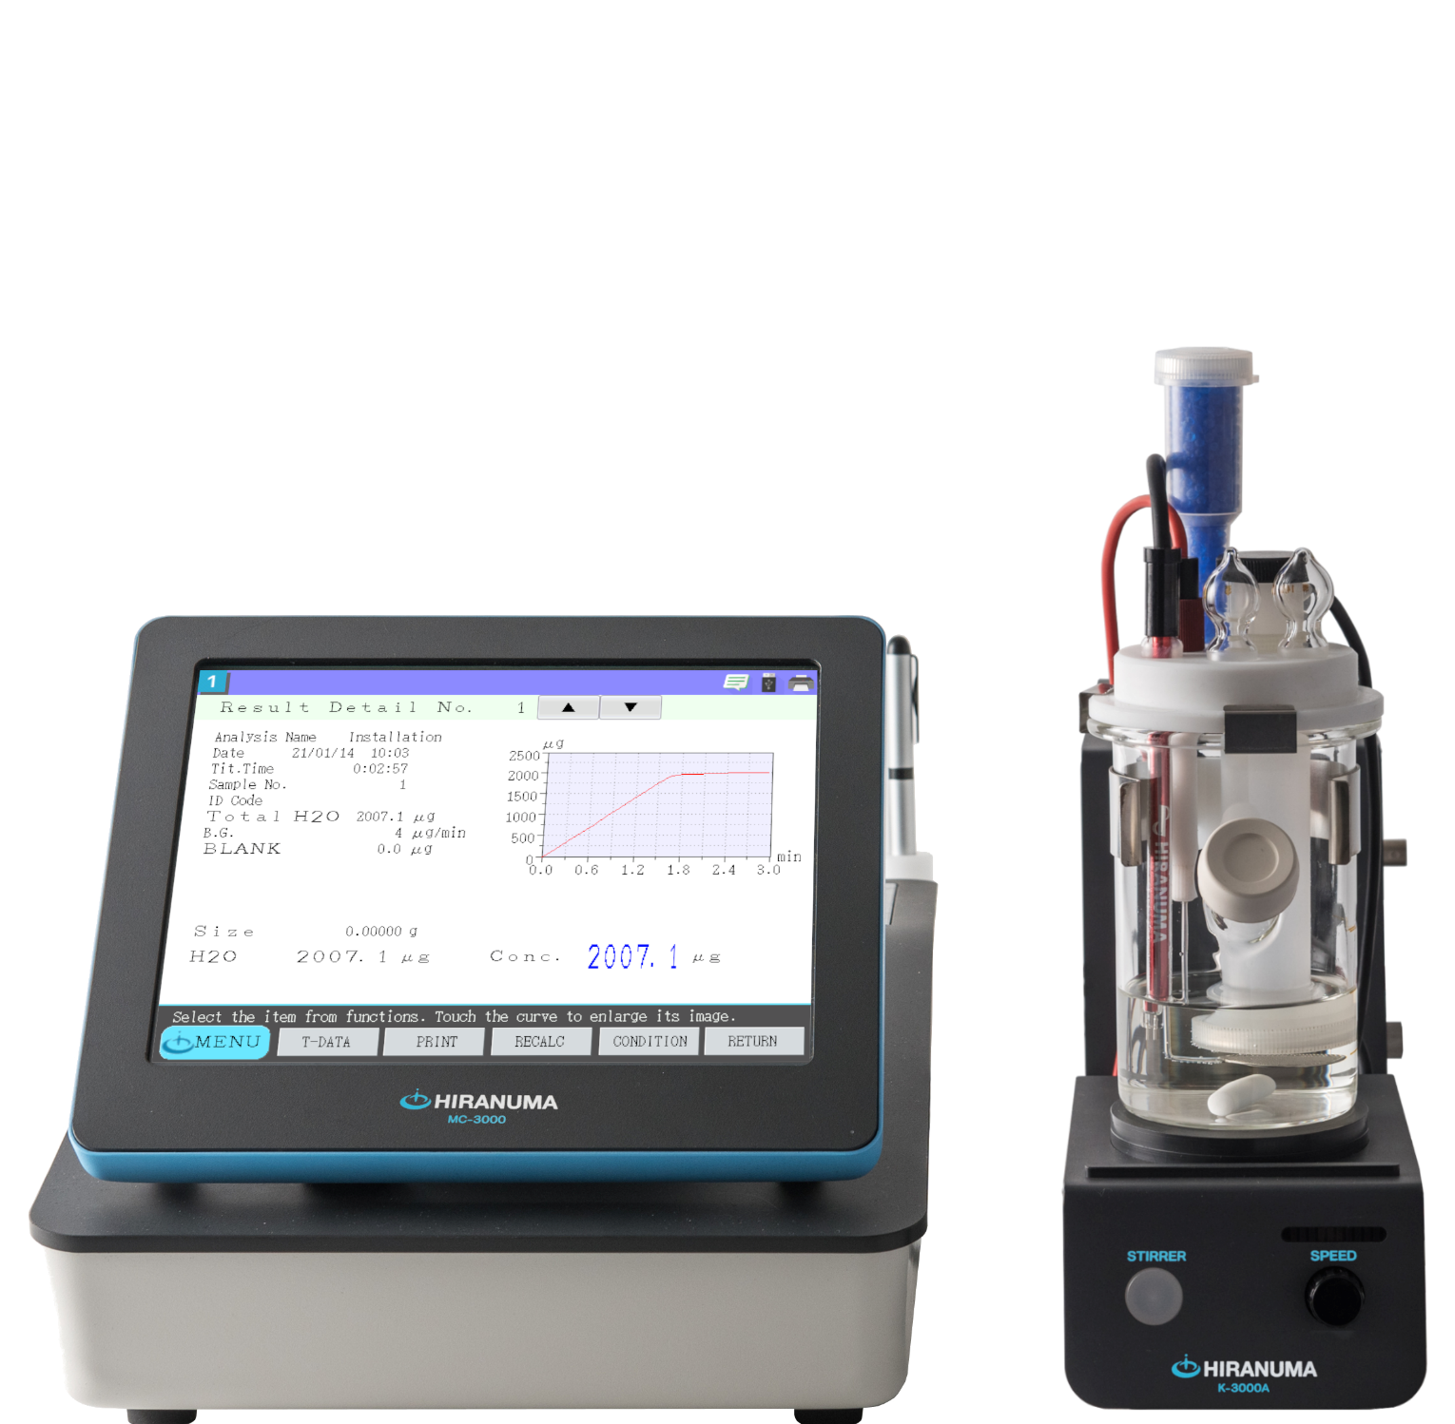

Reference material
■ Standard Specifications
MOICO-A19 Coulometric Karl Fischer Titrator
Item | Description
Measurement method | Karl Fischer coulometric titration method
Titration control system | Constant-current electrolysis, and non-constant electrolysis at around end points only.
End point detection modes | Alternating current polarization potential difference detection
Measurement range | 5μgH₂O～300mgH₂O
Display resolution | 0.1μg
Background compensation | Automatic compensation (Can be set with or without compensation.)
Measurement accuracy | Within CV 0.3% (When measuring approx. 1g of 1mgH₂O/mL water-methanol for 10 times)
Duration of measurement | FAST： 1.8mgH₂O/min (30μgH₂O/sec) MEDIUM： 1.2mgH₂O/min (20μgH₂O/sec) SLOW： 0.6mgH₂O/min (10μgH₂O/sec)
Titration cell | Double chamber electrolysis cell 150mL (Minimum anolyte volume: Approx. 100mL)
Electrolytic diaphragm | Ion exchange membrane
Display | 8.4" color LCD touch panel
Settings input method | Key touch input (English guide displayed)
Display unit | μgH₂O、ppm、%
Calculation function | Concentration calculation, re-calculation, statistic calculation
File function | Measurement condition files (measurement condition files appropriate for the sample): 51 Sample files (reservation setting files for sample volumes): 99
Number of data storage (per titration station) | Built-in memory: 100 data per channel*1 USB memory (256MB or larger): Maximum capacity of about 9,900 results
GLP-compliant functions | (1) Electrode management i) Total electrolysis volume of the anolyte, replacement date and replacement alarm ii) Total electrolysis volume of the catholyte, replacement date and replacement alarm iii) Date of the ion exchange membrane replacement iv) Date of indicator electrode replacement (2) Measurement accuracy test (3) User management
Printer | Built-in thermal printer (Paper roll width: 58 mm) Optional external printer: Dot impact printer PR-302B can be connected.
External input/output | RS-232C: 1 port (to be connected to the balance or computer) LAN: 1 port USB: 1 port (for USB memory only)
Power supply | MC-3000: AC100-240V±10％ 50/60Hz 60VA TQ-3000: AC100-240V±10％ 50/60Hz 50VA No power supply cable provided.
Dimensions/weight | MC-3000: 235W × 400D × 250H (mm) Approx. 5.0kg TQ-3000: 10W × 250D × 160H (mm) Approx. 2.5kg
Coulometric Karl Fischer Titrator
MOICO-A19
＊1 Depending on the volume of the results (for example when there are more pieces of data per hour created).
K-3000A Stirrer
Item | Description
Stirring system | Magnetic stirrer
Stirring bar | PTFE (φ8 x 30 mm): 1
Power supply | DC12V (supplied by titration station)
Dimensions/weight | 100W x 165D x 345H (mm) Approx. 1.5 kg
■ Operating Requirements for Equipment
・ Temperature: 5–35 °C
・ Humidity: 45–85% with no condensation
・ Atmosphere: No presence of acid, alkali, organic solvent gas, or rare gas
・ Other: No inordinately high amount of dust or particles.
No equipment nearby that generates strong lines of magnetic force.
Note: The color of the actual product may differ from what you see here due to printing-related issues.
Note: The appearance, specifications, and accessories may be changed without prior notice for the purpose of making improvements.
Caution regarding safety: Be sure to read the instructions before use, and use the equipment as intended.
Manufacture
Distributed by:
JM Science Inc.,
2408 Bedell Rd/PO Box 250
Grand Island, NY 14072
www.jmscience.com
HIRANUMA Co., Ltd.
https://hiranuma.com/
1739 Motoyoshida, Mito, Ibaraki, 310-0836, JAPAN

Slide 2
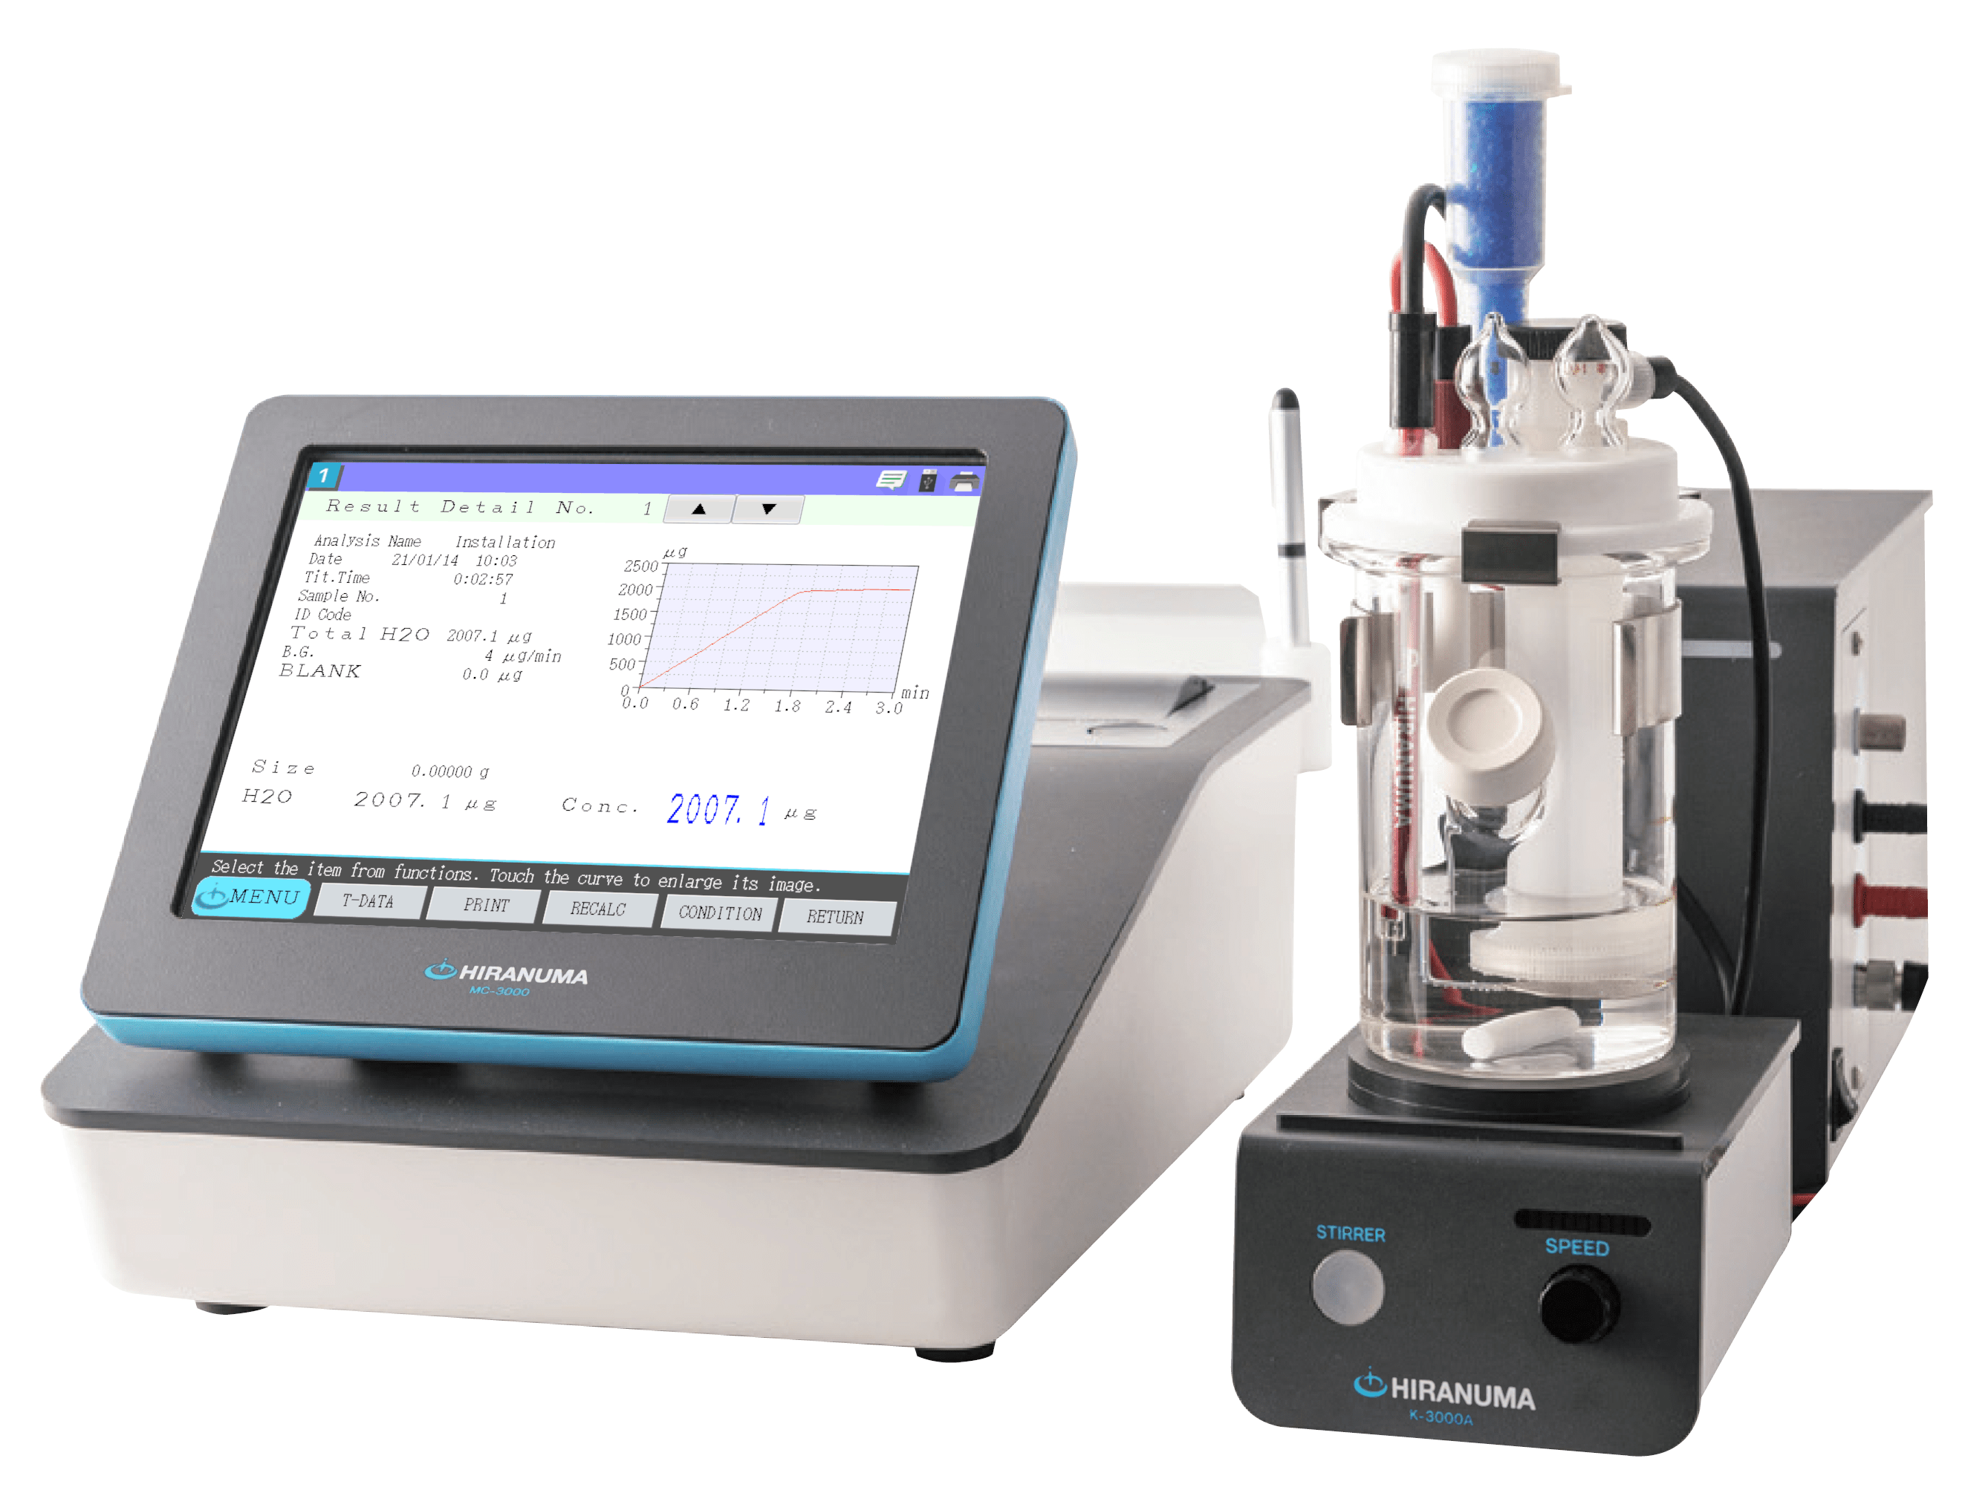
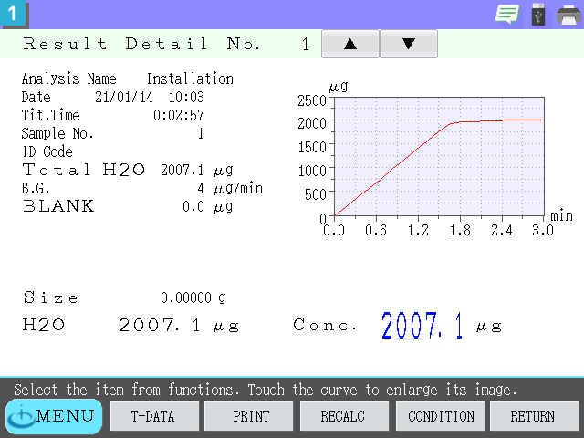
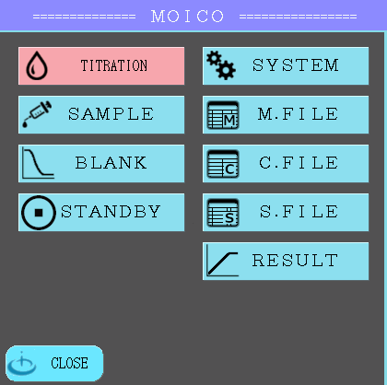
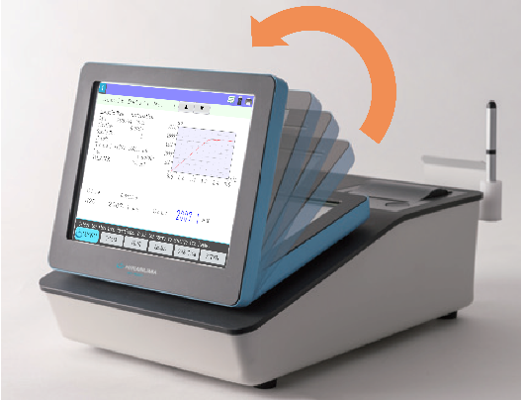
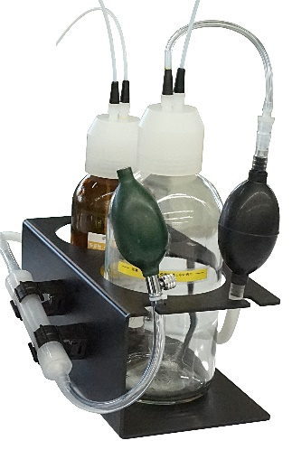
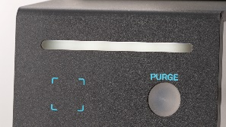
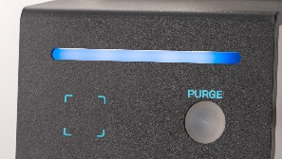
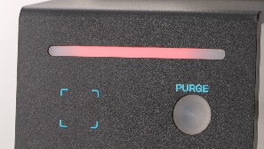
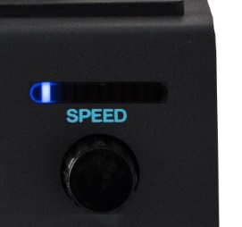
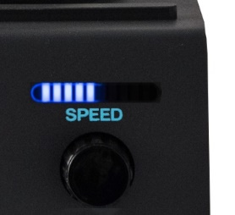
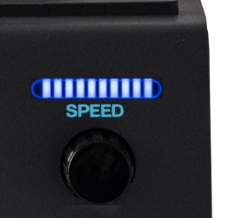
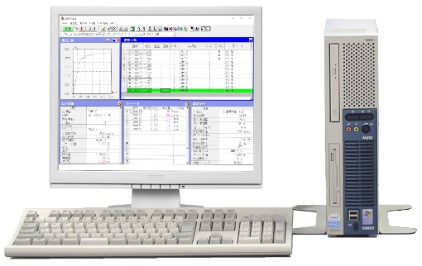
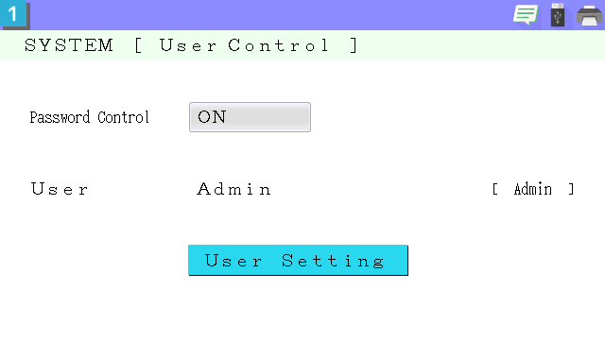
Karl Fischer Titrator with Flexibility
For How You Need To Use It
Multi-Control Unit MC-3000
Coulometric Titration Station
TQ-3000
Large Color LCD Touch Panel
A large 8.4" touch panel screen makes text input easy. Selecting functions from the menu is intuitive. The protective film can be replaced to protect from scratches and wear over the long term.
LCD Display Adjustable in 16 Positions
Stirrer
K-3000A
Each user can adjust the angle to their liking. The position can be locked so that it will not move when the screen is pressed
Manual Supply/Discharge Unit
Status Indicator with 3 LED Colors
The manual pump supplies or discharges reagents.
Ready
Titration in progress
Error!
Colored lights allow you to confirm the status of operation from a distance. You will also be alerted to unexpected problems right away.
Built-in Thermal Printer
Forty Rotation Speeds Can Be Set
Has a built-in thermal printer with a paper roll 58-mm wide.
Simply insert the roll and close the cover to set it up.
Rotation can be adjusted manually in fine increments shown by LED bars—it is easy to see and understand. (Four increments per bar)
USB/LAN Port
User Authentication Settings
Approximately 9,900 results can be stored on a USB memory stick. With optional software, you can view the data on a PC or use a recalculation function. With a LAN connection, you can also view the data on a Web browser.
User restrictions can be imposed for improved security as well as the prevention of inadvertent changes to, for example, measurement conditions.

