Slide 1
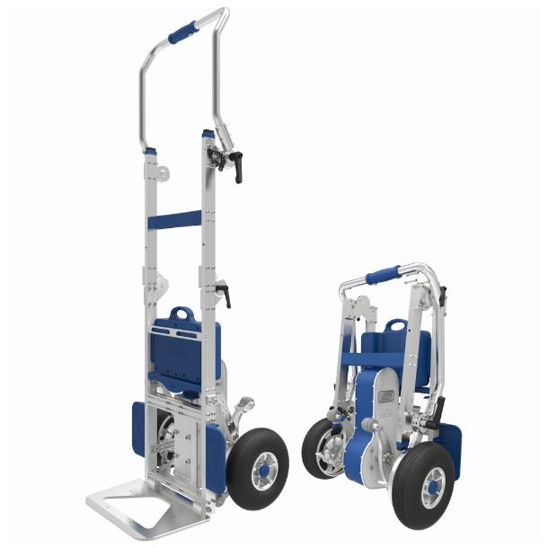
XS Range Electric Stair Climbing Sack Trucks
HI-XS2-170GF
HI-XS2-200G

Slide 2
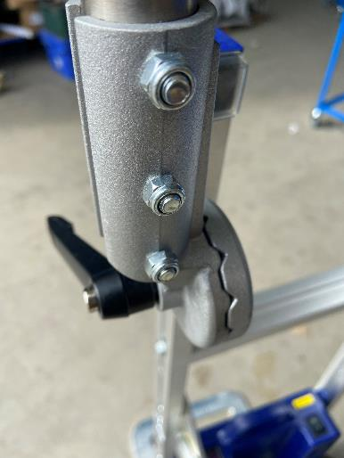
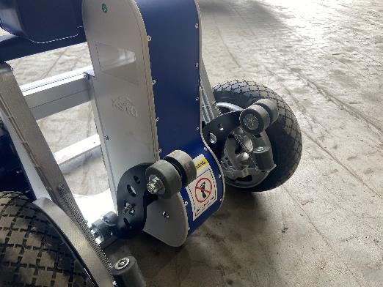
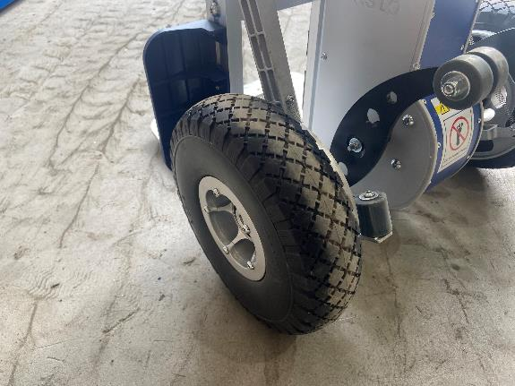
EQUIPMENT
Inspect Stair Climber:
All bolts and fixtures are tight.
Pivot arms are not visibly damaged.
Do not use the HI-XS2-170GF / 200G if the pivot arms are damaged.
Are the wheels in good condition with no visible damage.
Check that the auto edge brake system is working.

Slide 3
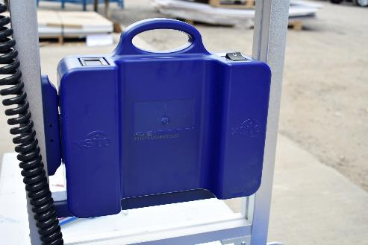
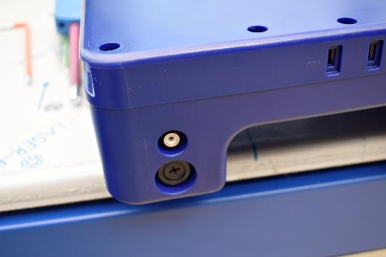
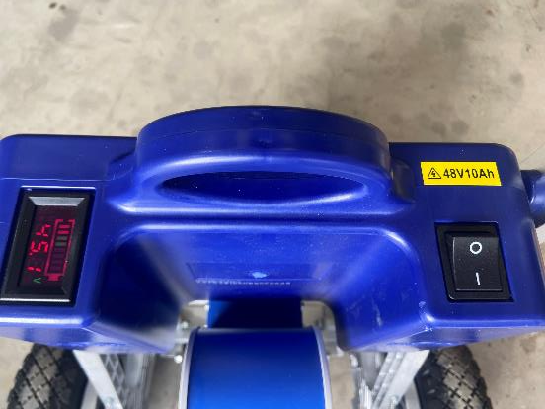
Battery:
There is no visible damage to the battery case.
The battery has sufficient charge for the task.
Ensure that the fuse is correctly in place.
Is a spare battery available.
Battery charging procedure is understood.
Are operators aware of the difference between 24V & 48V batteries as these are NOT interchangeable.

Slide 4
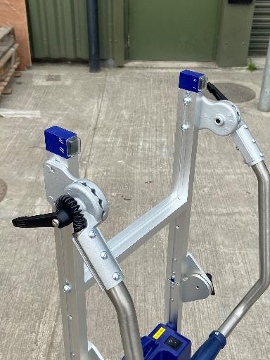
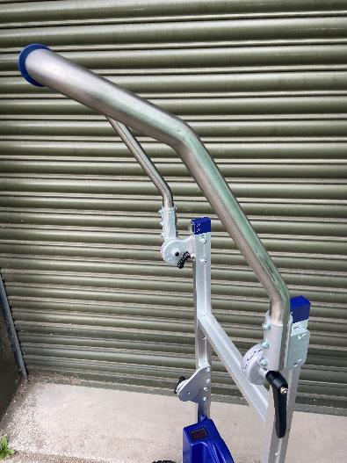
Handle:
Has the handle been suitably tightened.
Has the handle been adjusted to suit the operators height.
Has the handle been fully assembled (Folding handle versions only).
Capacity:
Is the load suitable for the SWL of the
unit (170KG / 200KG).

Slide 5
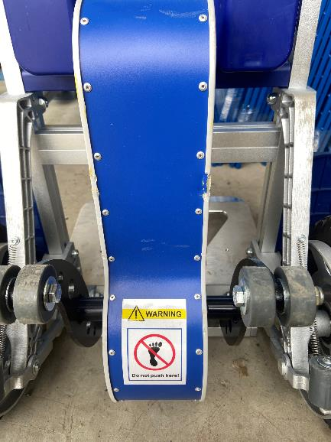
The Person
Physical Capability:
Does the operator have the required upper body strength to ‘break the back of the load’. (Do NOT stand on the motor shell to do this)
Does the operator have the stamina to complete the task.
User Training:
It is highly recommended that the operators practices using the stair-climber without a load until competent and confident.
Has the operator undertaken this training course in full and understood the requirements for safe use.
When climbing upstairs, the operator will feel an initial force. Adjust the angle of the machine keeping the balance of gravity to counteract the force.
Do not allow other people to stand behind the machine during operation.
Always keep the machine balanced.
Turn of the power after each use.

Slide 6
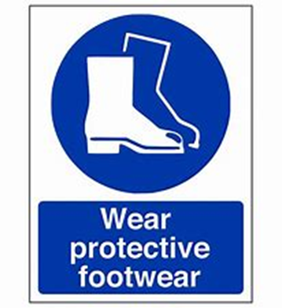
PPE
PPE:
Is appropriate safety footwear being worn.
Is the operator wearing a High Visibility Vest.
The operator doesn’t have any loose clothing that could be snagged during the operation.

Slide 7
The Environment
Staircase Size:
Is the staircase wide enough to allow for free movement and safe operation.
Are landings large enough to allow the stair climber to be safely turned.
Are the stairs and landings capable to take the combined weight of the load, the user and the stair climber.
Are bannisters / hand rails in place.

Slide 8
The Environment
Staircase / General Conditions:
All floor surfaces are dry and free from any loose material.
Is the lighting adequate for the task.
Nose of the stairs are clearly identified and of solid construction.
Do not use in wet, rainy, snowy or icy conditions.
Other People / Traffic:
If the route forms part of a designated fire escape / emergency route, have all the necessary people been notified of the task.
Have the stairs and landings been closed for the duration of the task and is suitable warning signage in place.

Slide 9
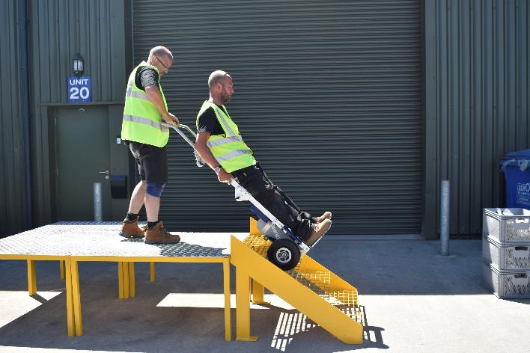
The Load
Load:
Does the load have a stable centre of gravity.
Is the load suitable for the size of the load bed. Ensure the load does not exceed the front of the load bed.
If moving hazardous chemicals, have they been appropriately and safely secured.
Is the load strong enough to support it’s own weight.
Has the load been securely strapped to the stair climber, using the safe belt provided.
Ensure that the load isn’t interfering with the wheels or tracks of the stair climber.
Only use for the movement of cargo, NOT for people.
The load should be no wider than 3 times the width of the load bed.

Slide 10
HOW TO ASCEND/DESCEND

Slide 11
Specification
Model | HI-XS2-170GF | HI-XS2-200G
Item Weight | 26.4KG | 29KG
Maximum Loading Capacity | 170KG | 200KG
Battery Capacity | 1224 – 2448 Steps | 930 – 1870 Steps
Climbing Speed | 24 steps / min (Slow) 34 steps / min (Fast)
Charging Time | 2.5 Hours
Battery Type | Lithium -ion
Operational Noise Level | <70dB
Protection Grade | IP54
Staircase Requirement | Height <21cm

Slide 12
Knowledge Test
Person: Company: Date:
No |  | True | False
1 | Bolts and fixing do not always need to be checked prior to use.
2 | It is acceptable to use the HI-XS2-170GF / HI-XS2-200G if there are visible signs of damage to the pivot arms.
3 | The HI-XS2-170GF / HI-XS2-200G must not be used if the wheels are damaged.
4 | There is a visible crack in the battery case but it is still OK to operate the HI-XS2-170GF / HI-XS2-200G .
5 | The battery display is indicating 2% charge but it will be OK to use the HI-XS2-170GF / HI-XS2-200G to climb 5 flights of stairs.
6 | Only a 24V battery is available but it is OK to continue to use the HI-XS2-170GF / HI-XS2-200G.
7 | The handle needs to be tight and in the correct position prior to use.
8 | The maximum load that the HI-XS2-170GF / HI-XS2-200G can carry is 400kg.
9 | Safety footwear should always be worn when operating the HI-XS2-170GF / HI-XS2-200G.
10 | The HI-XS2-170GF / HI-XS2-200G can be used without any prior training and demonstration of competency.
11 | The staircase to be navigated must be wide enough to ensure safe operation.
12 | The operator should stand on the motor shell to break the back of the load.

Slide 13
Knowledge Test
No | Question | True | False
13 | It is acceptable to transport a load up and down stairs on the HI-XS2-170GF / HI-XS2-200G in poorly lit conditions.
14 | The HI-XS2-170GF / HI-XS2-200G should not be used if the floor surface is wet
15 | The HI-XS2-170GF / HI-XS2-200G can be used outside if it is raining
16 | Other people are permitted to use the same stairs when the HI-XS2-170GF / HI-XS2-200G is being used
17 | Warning signs must always be displayed whilst the HI-XS2-170GF / HI-XS2-200G is in operation
18 | The load must always be of a suitable size to suit the load bed
19 | The load should be no wider than 3 times the width of the load bed
20 | The load must always be securely strapped to the HI-XS2-170GF / HI-XS2-200G using the strapping bar
21 | Other employees can be safely moved around whilst stood on the toe plate.

Slide 14
KNOWLEDGE TEST
Congratulations you have completed this part of the course.
Send the KNOWLEDGE TEST to info@handle-it.com for marking and the issue of your certificate.
We STRONGLY ADVISE that you practice using the stair climber unloaded and build confidence and skill.

