Slide 1
Content Creation & Distribution Made Easy

Slide 2
Remember these 3 words:
TELL THE STORY

Slide 3
Let’s start by creating content….

Slide 4
Pictures
Create Posts, Flyers, & More
Canva.com

Slide 5
Video
Live
Quick Tips
Fully Edited

Slide 6
Words
Written- Articles/blog (LinkedIn)
Audio- Start a podcast Anchor.fm

Slide 7
Don’t want to create? Then share instead
Find contextual content and share
Or use a service like
meteorgo.com

Slide 8
Now we have to share our content with the world...
Facebook, IG, LinkedIn, Twitter, GMB, TikTok, & More

Slide 9
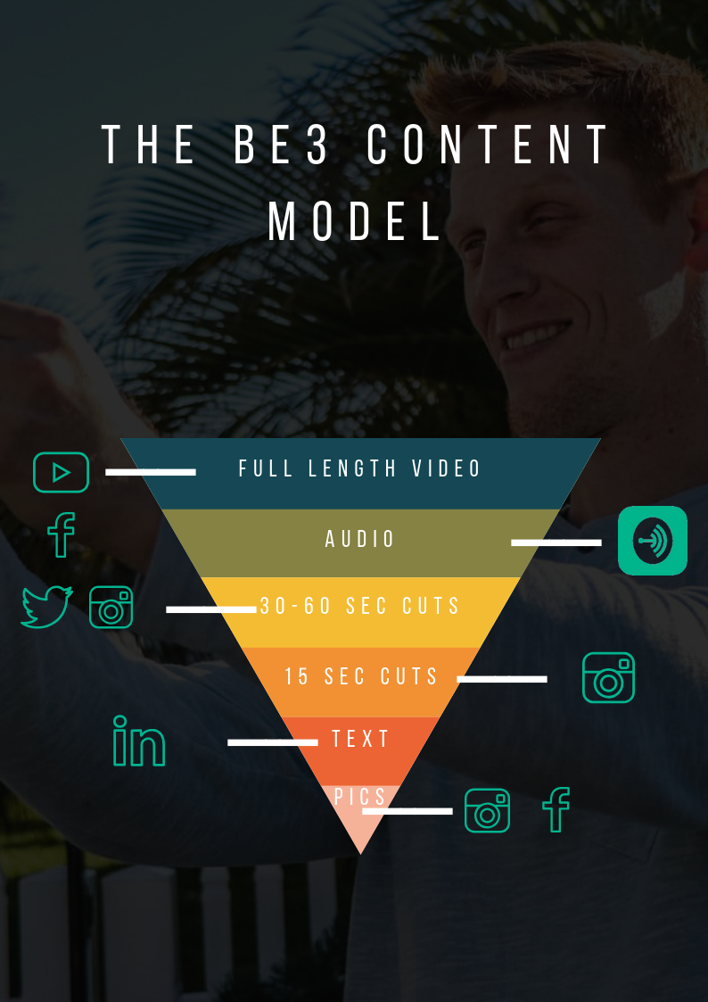

Slide 10
How to distribute:
-Understand how the algorithms work
-Leverage all of the platforms
-Understand and leverage hashtags
-Respect the audience and how they like to consume
-Create a framework that you can replicate

Slide 11
Some things to avoid:
Be careful auto posting between platforms
Understand the power of your content
Posting for likes
Overthinking

Slide 12
Q&A

