Slide 1
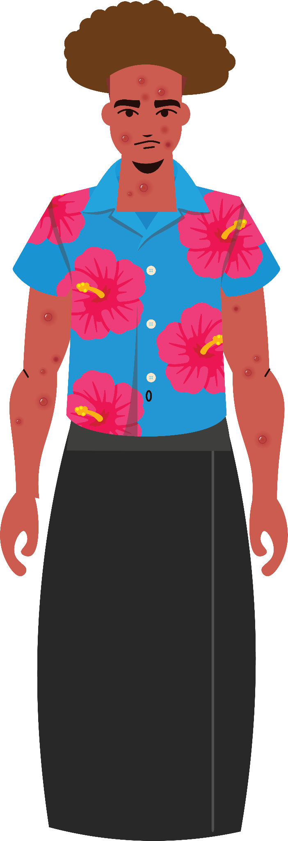
Mpox – Ko hono fakatupulekina ho‛o ‘ilo fekau‛aki pea mo e mpox.
Tonga (Tisema 2022)

Slide 2
Nofo malu, fētokoni‛aki pea tauhi ho kāinga kenau mo‛ui lelei

Slide 3
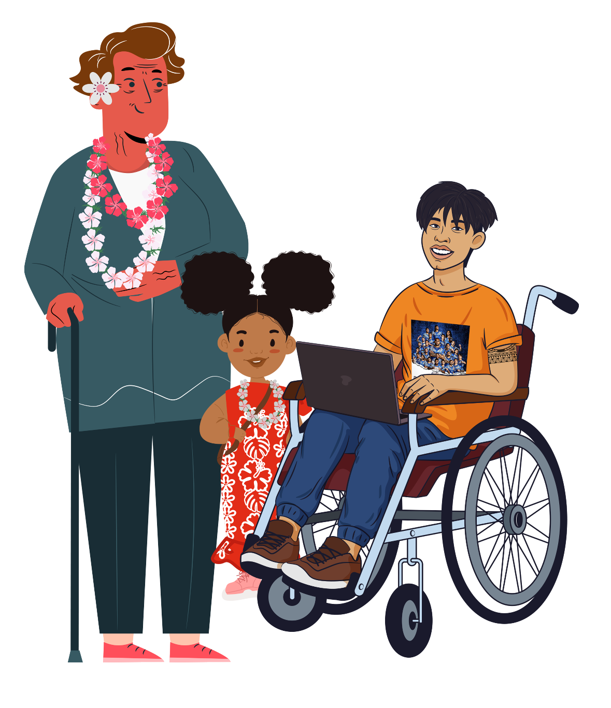
Nofo malu, fētokoni‛aki pea tauhi ho kāinga kenau mo‛ui lelei /1
Ko e Mpox (monkeypox) ko e mahaki fakamamani lahi pea ‘oku hoko ‘ene mafola ‘i he feohi vāofi pe ko e nonofo fe‛auaki.
Ka ‘oku ‘ikai ke vave ‘ene pipihi pea ‘oku kei ‘i he tu‛unga ma‛ulalo ‘a e fakatu‛utamaki ‘a e vailasi ko ‘eni.
‘Oku malava pe ke ma‛u ‘e ha taha ‘a e Mpox. ‘I he lolotonga ni, ko kinautolu pe ‘oku lahi nonofo fe‛auaki tautau tefito ki he kakai tangata ‘oku fe‛auaki mo e kakai tangata pe, pe ko e kakai ‘oku nau nonofo fe‛auaki.

Slide 4
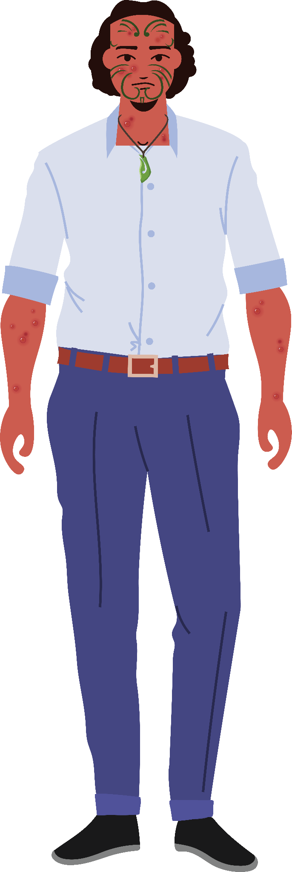
Nofo malu, fētokoni‛aki pea tauhi ho kāinga kenau mo‛ui lelei /2
Ko e ngaahi faka‛ilonga mahino ‘oku ‘asi ‘i ha taha ‘oku ma‛u ‘e he mpox ‘oku kau ai e petepete pe ko e ngaahi liliu ‘i he kili hangē ko e velia- fufula pe pupula ‘o hangē ha fuofua, fā pe ko e pala.
Kakai ‘e ni‛ihi ‘oku nau fakamokosia hangē ‘oku nau puke he mofi, pea fēfulofulai pe fēlangaaki honau sino.
‘Oku ‘ikai ke totongi ke ke ‘alu ‘o talatala mo sivi pe ‘oku ke puke ‘i he mpox ‘okapau ‘oku ke ma‛u ‘a e ngaahi faka‛ilonga ko ‘eni pe ko hono fekau atu ke ke sivi mpox.

Slide 5
Tauhi ke malu pea mo fakaongo- faka‛ilonga mo e nanunga ‘o e mpox

Slide 6
Tauhi ke malu pea mo fakaongo- faka‛ilonga mo e nanunga ‘o e mpox /1
Tokanga ke ke fakapapau‛i ‘a e ngaahi faka‛ilonga ‘o e mpox (monkeypox).
Ko e tokolahi ‘oku kamata ‘i he petepete mo e ngaahi liliu ‘i honau kili ‘o koviange ‘a ‘ene velia –hange ko e fufula pe pupula ‘o hangē ha fuofua, fā pe ko e pala.
‘Oku ‘i ai mo e ngaahi faka‛ilonga hangē ko ‘enau fakamokosia hange ‘oku nau puke he mofi, pea fēfulofulai pe fēlangaaki honau sino.

Slide 7
Tauhi ke malu pea mo fakaongo- faka‛ilonga mo e nanunga ‘o e mpox /2
Ko e petepete ‘oku fekau‛aki pea mo e mpox, ‘oku fakalūkufua pe ‘oku fakafeitu‛u.
Ko e veli ko ‘eni ‘e liliu ia ‘o mongumangu pea ‘e pakupaku ‘o momoa pea ngangana.
Ko e ngaahi faka‛ilonga ‘o e mpox ‘e saipe ‘iate ia pe, ‘i loto ‘i he uike ‘e ua ki he fā.

Slide 8
Fakamu‛omu‛a ma‛u pē ho‛o mo‛ui- faka‛ehi‛ehi ‘a hono fakamāfola ‘o e mpox

Slide 9
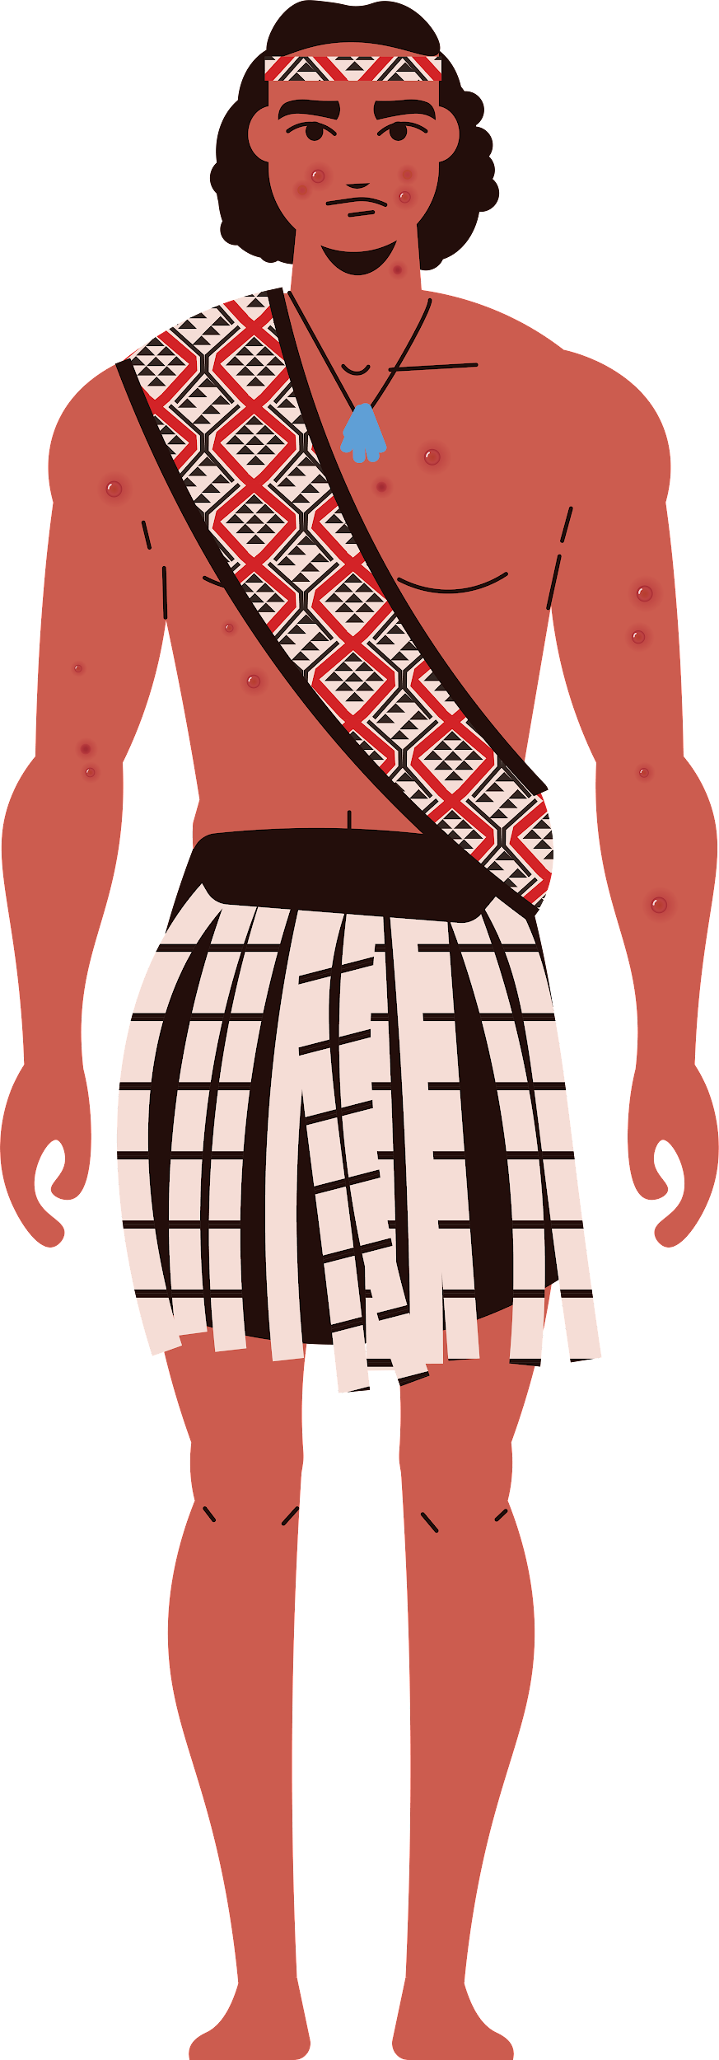
Fakamu‛omu‛a ma‛u pē ho‛o mo‛ui- faka‛ehi‛ehi ‘a hono fakamāfola ‘o e mpox /1
Faka‛ehi‛ehi mei he feohi vāofi pe nonofo fe‛auaki mo ha taha ‘oku ne ma‛u ‘a e mpox pe ko e faka‛ilonga ‘o e petepete, velia, mongumangu pe ko e pupuha ‘o ha taha ‘oku puke ‘i he mpox.
Faka‛ehi‛ehi mei hono tui hono vala, ngāue‛aki ‘a e taueli mo e naunau mohenga ‘o e tokotaha koia ‘oku puke ‘i he mpox.

Slide 10
Fakamu‛omu‛a ma‛u pē ho‛o mo‛ui- faka‛ehi‛ehi ‘a hono fakamāfola ‘o e mpox /2
Fakapapau‛i ‘oku ke mo‛ui lelei pea ‘oku ‘ikai ke ke ma‛u ‘a e ngaahi faka‛ilonga ‘o e mpox pea ke toki nonofo fe‛auaki moha taha.
Fiema‛u ke ke ‘ilo‛i ‘a e ngaahi fika fetu‛utaki ‘o e kakai ‘oku ke nonofo fe‛auaki mo ia, ke ke fetu‛utaki kiate kinautolu kapau te ke ma‛u ‘a e ngaahi faka‛ilonga ‘o e mpox.
Tonga

Slide 11
Toutou Fakafehu‛i mo mo‛ui fifili

Slide 12
Ko hai ‘oku ‘i he tu‛unga fakatu‛utamaki ki hono ma‛u ‘o e vailasi mpox (monkeypox)?
‘Oku malava pe ke ma‛u ‘e he mpox ha taha, ka ko e mafola fakamamani lahi ‘o e mahaki ‘oku hoko lahi ia ki he kakai tangata ‘oku nonofo fe‛auaki pe mo e kakai tangata pe ko e kakai ‘oku nau nonofό. ‘Oku kau atu ki heni mo kinautolu ‘i ha fa‛ahinga pe ‘o e tangta- tangata pe ko e fefine.
Tonga

Slide 13
‘Oku fakatu‛utamaki ‘aupito ‘a e mpox?
‘I he sio fakalukufua, ‘oku ‘ikai ke fakatu‛utamaki ‘aupito ‘a e mpox.
Tonga

Slide 14
‘E malava ke ma‛u ‘o lahi hake ‘i he tu‛o taha ‘a e kakai?
‘Oku ‘ikai.
Tonga

Slide 15
Ko e hā hono lōlōa ‘o e taimi ‘oku puke ai ha taha?
Fakafuofua ki he uike ‘e 2-4
Ko kinautolu ‘oku ma‛u ‘e he mpox ‘o kamata mei he ‘uluaki velia (fufula pe pupula ‘o liliu ‘o hoko ko e fuofua, fā pe ko e pala) ‘o ‘alu aipe ke sai ‘a e velia ‘o e kili.
Tonga

Slide 16
Kapau ‘e sivi ‘oku ke ma‛u ‘a e mpox, ‘e kei fakapulipuli pe ho‛o ngaahi fika fetu‛utaki?
‘Io, ko e mpox ko e me‛a fakafo‛ituitui peia
Pea ko e mpox ‘oku fiema‛u ke ‘ilo ‘a e mahaki ko ‘eni pea ‘e ‘i ai ‘a e taimi ‘e fiema‛u ke fakahā ‘e he tokotaha fale‛i ki he mo‛ui ki he ngaahi kupu fekau‛aki mo feohi vāofi.
Tonga

Slide 17
‘E malava ke ta‘etotongi e sivi mpox kiate kinautolu ‘oku nau ‘a‘ahi mai, pe ‘oku ‘i ai ha‘anau visa kenau nofo ‘i Nu‘usila ni ‘i he taimi nounou?
‘Io, kapau te nau ma‛u kotoa ‘a e ngaahi fiema‛u.
Ko e sivi ‘oku fakahoko ia ha fa‛ahinga kiliniki pe, pe ko e kiliniki ki he nonofo fe‛auaki pe ko e ngaahi kiliniki ‘oku ava houa ‘e uafā ki he ngaahi fiema‛u fakavavevave.
Ko kinautolu ‘oku ‘ikai kenau nofo fonua (kau atu ki ai ‘a e fanau áko mei muli, kau ngāue fakato‛u kai (toil) mo e kau visa ‘eve‛eva) ‘e malava kenau kau atu he sivi mpox mo e talatala ta‛etotongi.
Tonga

Slide 18
‘Oku uesia ‘e he mpox ‘a e fakahuhu ‘o e longa‛ifanau?
‘I he sio fakalukufua, kapau ‘oku ke ma‛u ‘a e mpox, ‘oku ‘oatu ‘a e fale‛i ke faka‛auha kotoa ‘a e ngaahi naunau na‛a ke ngāue‛aki ki he fakahuhu pea ta‛ofi mo e fakahuhu kae ‘oleva kuo ke sai ‘aupito.
Tonga

Slide 19
‘O kapau ‘oku ‘i ai ha ki’i leka ‘i ha ‘api pe ko ha taha na‛e nonofo fe‛auaki mo ha taha ‘oku puke ‘i he mpox, ‘oku saipe ke kei ‘alu ki he ááko, pe ko e áko ki he fanau valevale pe áko tokamu‛a? /1
‘Ikai pea kapau ‘oku ‘i ai ha taha ‘oku ‘ilo pe feohi vāofi mo ha taha ‘oku ne puke ‘i he mpox, ‘oku ‘ikai ke fiema‛u ia ke nofo mavahe
Tonga

Slide 20
‘O kapau ‘oku ‘i ai ha ki’i leka ‘i ha ‘api pe ko ha taha na‛e nonofo fe‛auaki mo ha taha ‘oku puke ‘i he mpox, ‘oku saipe ke kei ‘alu ki he ááko, pe ko e áko ki he fanau valevale pe áko tokamu‛a? /2
Ko ha taha pe na‛e feohi vāofi pea kamata ke ne ma‛u ‘a e ngaahi faka‛ilonga ‘o e mpx, ‘e fiema‛u ke ne nofo mavahe
Pea ke ne fetu‛utaki leva ki he potungāue mo‛ui ki ha tokoni.
Tonga

Slide 21
‘E anga fēfē leva hono tauhi ‘o e vala (tānaki ‘o e vala ‘uli & fō) ‘i he taimi ‘oku puke ai ha taha ‘o he mpox ‘i ha ‘api? /1
Ke fakamavahe‛i pe ‘a e vala mo e fō ‘o e tokotaha koia.
‘I he taimi ‘oku tānaki ai ‘a e taueli, vala, mo e me‛a mohenga ‘a e tokotaha ‘oku puke, ke tokonga‛i ‘oua ‘e toe tupe‛i holo na‛a to e mafola ai ‘a e mahaki ‘i he ‘ea.
Tonga

Slide 22
‘E anga fēfē leva hono tauhi ‘o e vala (tānaki ‘o e vala ‘uli & fō) ‘i he taimi ‘oku puke ai ha taha ‘o he mpox ‘i ha ‘api? /2
Fō ‘a e ngaahi naunau kotoa koia ‘aki ha me‛afō pea ngāue‛aki ‘a e māfana ma‛olunga taha ‘oku fiema‛u. Faka‛ehi‛ehi mo hono ngāue‛aki ‘a e saikolo vave taha ‘o e misini fō.
Fakamōmōa pe ‘a e fō ‘i he founga angamaheni.
Tonga

Slide 23
‘E malava ke mafola ‘a e mpox ki he pe mei he fanga ki‛i monumanu ‘oku ke tauhi ‘i ‘api?
‘Io, ka ‘oku tātāaitaha ‘ene hoko.
Ko e fakatokanga pe ki ha taha ‘oku ne ongo‛i pe ‘oku puke ‘i he mpox ke faka‛ehi‛ehi mei hono ngaahi ‘o e fanga monumanu.
‘Oku mahu‛inga ke fakapapau‛i ko e veve mo e naunau kotoa pe ‘oku ngāue‛aki ‘e ha taha ‘oku puke ‘i he mpox ke ‘oua ‘e tuku ‘i he feitu‛u ‘e malava ke a’u ki ai ha fa‛ahinga monumanu pea ke fakapapau‛i ‘oku malu ‘i he taimi ‘oku laku ai ki he veve.
Tonga

Slide 24
‘E anga fēfē hono tokanga‛i ‘a e fanga ki‛i monumanu ‘oku te tokonga‛i kapau ‘oku nau ma‛u ‘a e vailasi mpox?
Talanoa ki he toketā ki he monumanu.
Tonga

Slide 25
Ki ha ngaahi fakamatala makehe
Fetu‛utaki ki he Kiliniki fale‛i ki he fakakaukau‛i ‘o e nonofo fe‛auaki pe ko ho‛o toketā fakafāmili pe ko e va‛a ki he mo‛ui lelei ‘i he 0800 611 116 – ‘oku ‘i ai foki pea mo e fakatonu lea.
www.health.govt.nz/our-work/diseases-and-conditions/mpox-monkeypox

