Slide 1
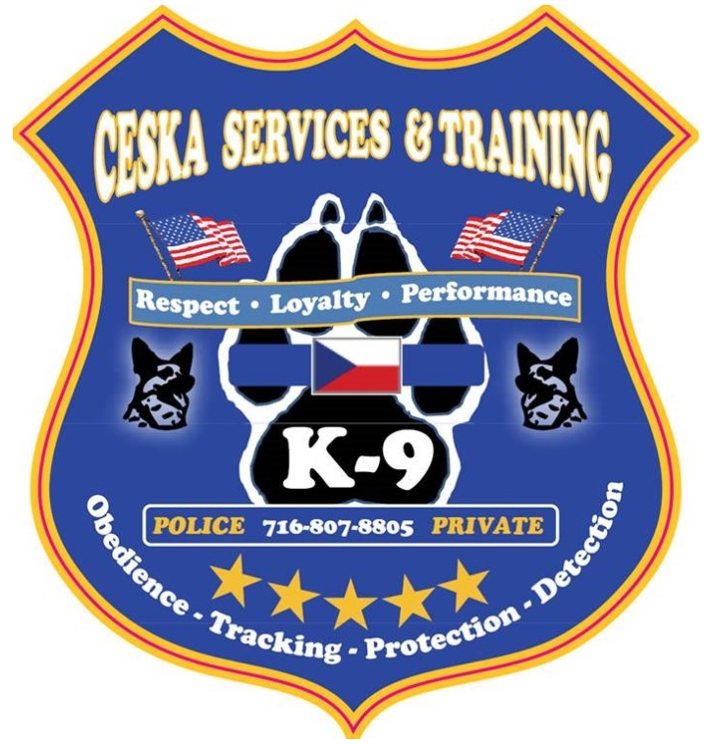
CESKA POLICE SERVICES
Supporting The
Thin Blue Line
Providing Quality Service And Results to the W.N.Y. Region
Dog – Education - Training – Apprehension – Detection - Tracking

Slide 2
Police Services
We have been Training Handlers and there dogs for over 47 years both in Private & Law Enforcement
We are a professional Dog Training & K9 Service Business who supports the common need for different professional Services & Training related to Canine use.
We Provide The Following in Services : Purchase & Selection of K9,Training in Control , Detection, Obedience, Tracking, Search, for Enforcement Canines and there applicable use in the Law Enforcement Environment.
A full package of the right stuff for your K9 team. Some Training Segments Are As Follows:
Handler Training Course to meet standards of certification multiple week course.
Dog(s) for Acquisition (Importing of actual Dog for Department from (Czech Republic)
Dog or Dogs with quality selection process for the specific need
Detection (Narcotics Elements , Weapons / Nitrate detection, etc.
Obedience (Entry Level Beginner & Advanced Skills) On and Off Lead Control
POLICE Criminal Apprehension , Patrol functions of Police K-9 units Handler Protection
Tracking a.k.a. Manhunting.
Search Area, Grid, Scent Discrimination
Many of these Functions can be tied into one dog & handler Team, ask for information to be specific to your need.

Slide 3
Contact Us For More Information

