Slide 2
Colored Boomwhacker Notation
KidsNotes
Regular Notation
Chords

Slide 3
PowerPoint Samples
Rhythm Challenge 1
Rhythm Game
Introducing the Staff and Letter Names
Liza Jane (Colored Boomwhacker Notation)
Liza Jane (KidsNotes)
Liza Jane (Regular Notation)
Liza Jane (Chords)

Slide 4
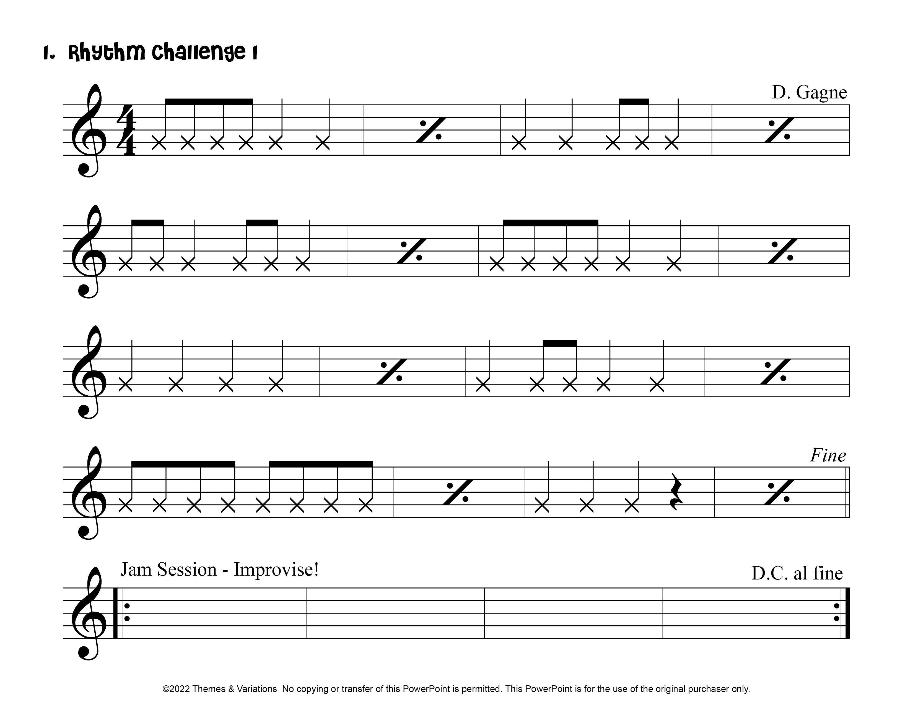
Index

Slide 5
Index

Slide 6
Index

Slide 7
Index

Slide 8
Index

Slide 9
Index

Slide 10
Index

Slide 11
Index

Slide 12
Index

Slide 13
Index

Slide 14
Index

