Slide 1


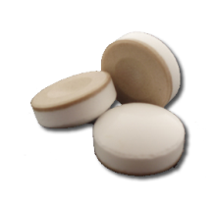
ORAHEALTH
132434 SE 27th Pl
Bellevue WA
425-451-9876
Placing XyliMelts discs in the mouth
Relief that Sticks™

Slide 2

XyliMelts Disc
Tan side is adhesive side
White side contains Xylitol and oral lubricant

Slide 3
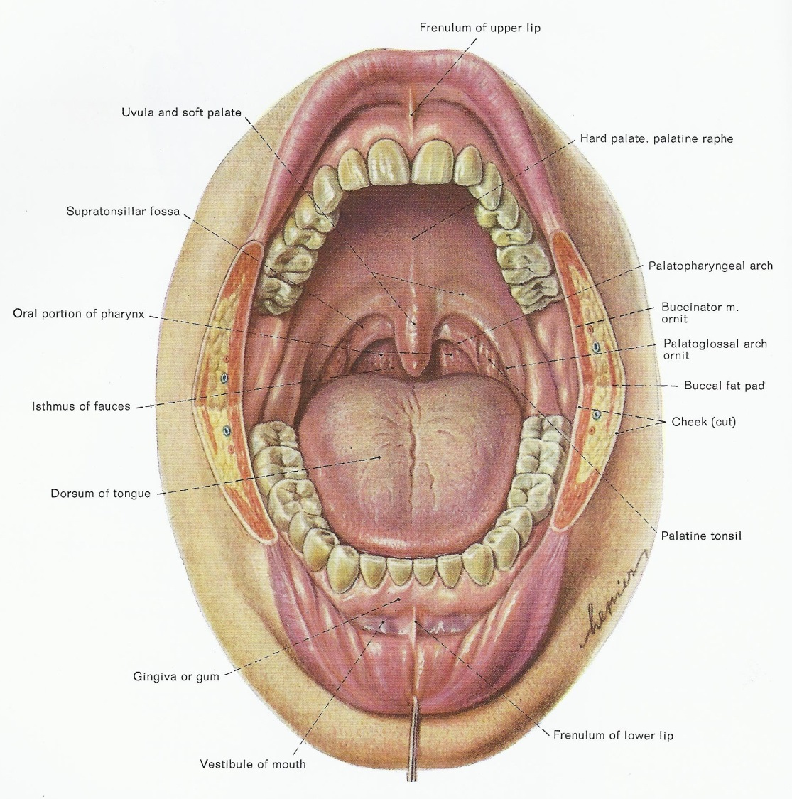
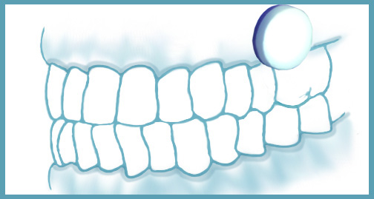

How to place XyliMelts disc in mouth
Place a disc on the gums (gingiva) adjoining a molar, upper or lower, with white side touching your check and the tan (adhesive side) against your gums. Do not move for 10 seconds.

